Slide 1
CBDC Engagement Forum
18 September 2023

Slide 2
Agenda
Economic Secretary to the Treasury Remarks and Roundtable Discussion
Engagement Forum refresh and working groups
Project Rosalind
CBDC Design Phase Objectives
Next Steps and AOB

Slide 3
Item 3: Engagement Forum refresh and working groups

Slide 4
Current Engagement Forum membership
Adam Jackson
Innovate Finance
Charlotte Hogg
Visa Europe
Hannah Regan
British Retail Consortium
Mick McAteer
Financial Inclusion Centre
Ruth Wandhöfer
PSR Panel
Andrew Murphy
John Lewis Partnership
Chris Rhodes
Nationwide Building Society
Harry Newman
Swift
Nabil Manji
Worldpay
Simon Coles
PayPoint
Anne Boden
Starling Bank
Jana Mackintosh
UK Finance
Natasha de Terán
Financial Services Consumer Panel
Simon Gleeson
Clifford Chance
Colin Bell
HSBC
Arvin Abraham
Goodwin Procter
Diana Layfield
Google
Jorn Lambert
Mastercard
Simon Gayford
Frontier Economics
Neha Narula
MIT
Arunan Tharmarajah
Wise
David Grunwald
NatWest Group
Kate Frankish
PayUK
Tracy McDermott
Standard Chartered Bank
Paul Bances
PayPal
Etay Katz
Ashurst
Martin McTague
Federation of Small Businesses
Bryan Zhang
Cambridge Centre for Alternative Finance
William Chalmers
Lloyds Banking Group
Reema Patel
Ipsos UK
Fran Boait
Positive Money

Slide 5
Working group 1: offline payments
Working group 2: retailer needs
Considerations for the working group:
What are the use cases for offline payments and how would that influence design of the digital pound?
What constitutes an offline payment and is it feasible to implement offline payments in CBDC?
Consideration for the working group:
What would merchants need from a digital pound design?
What are the range of factors that would influence whether merchants accept digital pound payments alongside other payment methods?
The working groups will present their findings to the Engagement Forum

Slide 6


Item 4: Project Rosalind
An API Prototype for retail CBDC ecosystem innovation

Slide 7
We had clear aims for Project Rosalind
Innovation platform - using public infrastructure to support private innovation.
Harness the creativity of innovators and entrepreneurs - encouraging the private sector to experiment and create use cases.
Reusable resource – creating a reusable and adaptable technology asset which can be reused for further experimentation, and to generate further innovation.
Distinctive project– deliberately different to other central bank experiments by focusing on the API layer, and producing a resource that is agnostic to specific payments use cases.

Slide 8
Why we experiment
Gain applied understanding of technologies relevant to the design of the digital pound; and assess through practical work their suitability for deployment in a digital pound blueprint.
Gather evidence to support the decision on whether or not to build a digital pound, specifically with regard to technology feasibility, suitability, risk and cost.
Enrich policy and design work with insights and real world perspectives.
Enhance the Bank’s capabilities and skills across a range of cutting edge digital currency technologies, that might be suitable in varied deployments (e.g. CBDC, tokenised deposits, real time payments etc).
Support capacity building and generate spill-over benefits across the UK digital currency technology community through knowledge sharing and collaboration.

Slide 9
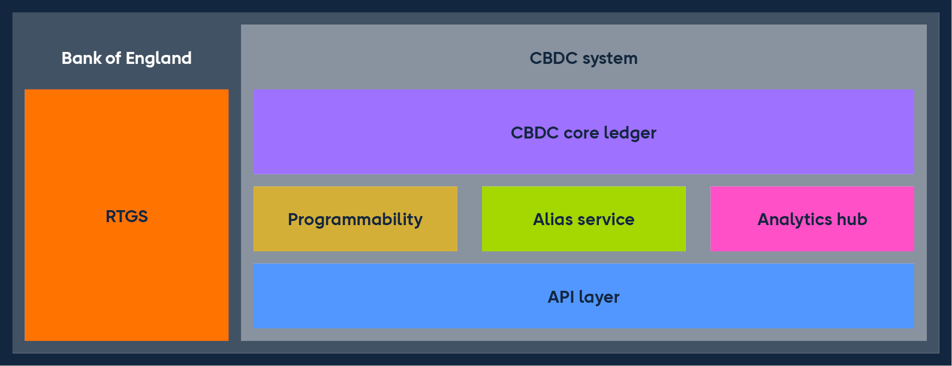
APIs are fundamental to how the digital world works
APIs allow applications and systems to communicate with each other.
They enable interoperability between different systems and provide access to functionality.
They allow developers to develop the use cases that we employ in our everyday lives.
Common examples include TfL journey planner.

Slide 10
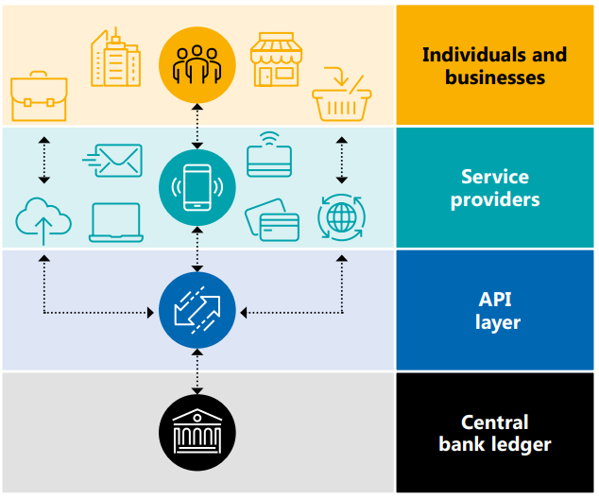
Project Rosalind is…
Build API prototypes to explore how an application-agnostic API layer could enable retail payments while support innovation.
Support the exploration of the platform model.
Public-private collaboration. Public sector to provide basic infrastructure – API layer. Private sector service providers to provide user-facing applications.

Slide 11
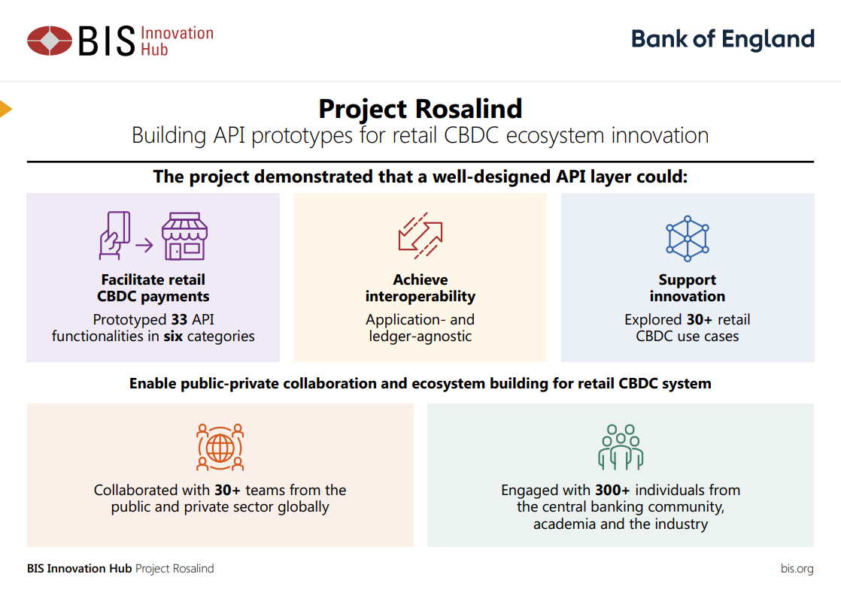




The project delivered…
Rosalind APIs
Rosalind Sandbox
30+ use cases
Project report

Slide 12



The private sector developed a broad range of innovative use cases
Payments
PoS
QR
Smart Cards
Offline Payments
e-Sim Payments
E-commerce
One-click checkouts
Conditional Payments
Cash on delivery
Pocket money
Gig economy workers
Trade Finance
Electronic receipts
Micropayments
Split payments
Integrations
Smart assistants
Web-3
NFTs
Card schemes
Decentralised ID

Slide 13
What’s next?
Reusing the APIs for existing and future experiments during the design phase.

Slide 14

Item 5: Digital Pound:
Design Phase objectives

Slide 15



Digital Pound Design Phase: where we are now?
Phase 1: Research and explore 2018-2022
Phase 2: Design 2023 – 2025/26
Phase 3: Build & Test: only if a decision is taken to proceed
  Research and exploration of digital currency questions
  Development of the model set out in the 2023 Consultation
  Technical development work and proof of concepts
  Developing architecture and digital pound platform technical design
  Decision on whether to proceed
  Dependent on decision to proceed
  Large scale prototypes & live pilots
Actions
After close of consultation on 30 June:
Review 50k+ responses
Respond formally later this year
Iterate further over design phase

Slide 16







Seven aims for the design phase
Cut lead-times on development; gain knowledge and capabilities; stand ready to move into a ‘build’ phase, subject to decision.
Determine the technological feasibility and investment needed to build a digital pound.
Articulate, in detail, what the technology and operational architecture for a digital pound would look like.
Assess and evaluate benefits and costs of the digital pound architecture.
Deepen the Bank’s knowledge of CBDC technology and private sector understanding of our technology approach.
Support the development of the broader UK digital currency technology industry through experimentation and proofs of concept.
Provide the basis for a future decision on whether to introduce a digital pound and move to a ‘build’ phase.
By the end of the design phase, we will have:
Evaluated the technological feasibility of the digital pound
Determined the optimal design and technology architecture
Supported business model innovation through knowledge sharing and private-public collaboration.

Slide 17
Design Phase: building our work on four pillars
Assessment
  Build evaluation framework for assessment of proposition
  Assess feasibility and viability of digital pound proposition
Technical Experiments
National Conversation
  Explore different technology solutions and experiments
  Develop use cases
  Support industry
  “Open, national conversation” about the future of our money
  Explain and build trust in our work on digital pound
Digital Pound Blueprint
  Determine what the digital pound will look like
  Set out product proposition
  Establish build requirements

Slide 18
Role of the Engagement Forum in the Design Phase
The design phase will require deeper expert input and problem-solving. The Forum refresh and the launch of working groups reflect this, alongside:
    Refreshed Technology Forum
    New Academic Advisory Group
The Forum will support work across the design phase:
  Strategic advice and input on digital pound work and wider industry and society context
  Forum and working groups to support development of the Blueprint
  Forum members to shape development of National Conversation as work progresses
The Forum will be pivotal in ensuring the design phase is taken forward with input from private sector and civil society.

