Slide 1

Central Bank Independence:
Mirage and Mythos
E6XYB6412478
Presentation given at the Bank of England Independence:
20 Years’ On’ Conference
29 September 2017**
Willem Buiter^{AC}
Global Chief Economist
willem.buiter@citi.com
+1 212-816-2363
See Appendix A-1 for Analyst Certification, Important Disclosures and non-US research analyst disclosures
Citi Research is a division of Citigroup Global Markets Inc. (the "Firm"), which does and seeks to do business with companies covered in its research reports. As a result, investors should be aware that the Firm may have a conflict of interest that could affect the objectivity of this report.. Investors should consider this report as only a single factor in making their investment decision. Certain products (not inconsistent with the author's published research) are available only on Citi's portals.
This presentation was approved for distribution on September 25, 2017; the disclosures in Appendix A1 are current as of the same date.

Slide 2
Central Bank Independence
Introduction
Brief history of central bank independence
Rationale(s) for central bank independence
Two frequent correlates of central bank independence
Since GFC: growing scope and scale of central bank activities, powers and responsibilities
  Stabilisation policy
  Financial stability
    Bagehot’s revenge: central bank operational independence & inflation targeting not the defining mission of central banks
    Central banks and liquidity
    Central banks and solvency
  Enhanced financial stability, supervisory and regulatory responsibilities of central banks
  The fiscal and quasi-fiscal roles of the central bank
  Central banks not ‘sticking to their knitting’
Legitimacy and accountability of central bank power
  Input & output legitimacy
  Formal and substantive accountability
Recommendations and conclusion
  The likely end of central bank independence, even where it makes sense
  Ways to prevent the end of central bank independence

Slide 3
Brief history of central bank independence
Bundesbank
Bundesbank created in 1957 as successor of Bank deutscher Länder (BdL) (created March 1, 1948), which introduced Deutsche Mark with currency reform of 20 June 1948, as part of a wider (West) German default on its domestic sovereign debt that year. Formal default on and restructuring of the external debt occurred in 1953.
BdL was creation of Western Allies; formally independent of German political bodies and institutions from the start, but not independent of Western Allies. Federal Republic of West Germany was founded in May 1949, but the BdL remained subject to the control of the three Western Allied powers until 1951. Occupation of West Germany formally ended on May 5, 1955.
Creation of operationally independent central bank for West Germany by Western Allies in 1948 part of deliberate policy of Allies to prevent high degree of concentration of political power in post-war (West) Germany. None of Allies had operationally independent central bank. Predecessor of the BdL had not been operationally independent
First central bank of unified Germany, Reichsbank (Deutsche Reichsbank from 1939), created in 1876; lasted till 1945. Started as privately owned Prussian central bank, closely controlled by the government of Reich and always remained under government control, even post-hyperinflation & pre-Nazi era.
Source: Citi Research

Slide 4
Brief history of central bank independence
Federal Reserve
Since Treasury-Federal Reserve Accord of March 4, 1951, Federal Reserve has enjoyed a degree of operational independence that, until independent central bank wave that started in 1989, was rivalled by few others, except for the Bundesbank. Federal Reserve Act of 1913 insulated Fed from obligation to fund federal government. This, however, went out of the window during World War I and again during World War II. In April 1942 Federal Reserve surrendered its independence and formally committed to maintaining an interest-rate peg of 3/8 percent on short-term Treasury bills. There also was an implicit commitment to cap the rate on long-term Treasury bonds at 2.5 percent
Fed both independent agency of federal government and “creature of Congress”. Since its inception in 1913, Federal Reserve Act has been amended some 200 times by laws of Congress.
Dodd-Frank Act of 2010 restricted LLR powers of Fed (see Section 13(3) of Federal Reserve Act; mandatory Community Banker on Fed Board.
Threats of further restrictions:
  “Audit the Fed”
  Proposals supported by House Financial Services Committee Chairman Jeb Hensarling to require approval of three-quarters of Fed regional presidents to activate Section 13(3) of Federal Reserve Act, tighten definition of solvency, restrict borrowers to financial firms, and provide formula for setting interest rate above market rates.
  Proposals to make FOMC follow (Taylor) rule.
Source: Citi Research

Slide 5
Brief history of central bank independence
Reserve Bank of New Zealand
Adoption of Reserve Bank of New Zealand Act 1989, followed in 1990 by adoption by Reserve Bank of New Zealand of inflation-targeting monetary policy framework through Policy Targets Agreement (PTA) with New Zealand Treasury. This opened the floodgates.
Source: Citi Research

Slide 6
Rationale(s) for central bank independence
In what follows, independence = operational independence, including ‘operational target independence’ (as in ECB and Fed numerical definition of price stability).
Independence fully consistent with coordination of monetary and fiscal policy, cooperation between monetary and fiscal authorities and between monetary authority and financial regulators/supervisors. Independence – right of central bank to say ‘no’ to requests from political authorities, not the obligation to say ‘no’.
Solving commitment problem – time inconsistency of optimal plans (dual-mandate-targeting monetary policy maker faced with expectations-augmented Phillips curve)
  Why would operationally independent central bank not have the same problem?
  How can politicians commit to appoint only “conservative” central bankers (the Rogoff solution)?
  Do politicians/societies have occasional eruptions of credible precommitment capacity which they use to create institutions capable of precommitment?
Politicians’ time horizons too short
  Why then would they create an institution/appoint central bankers with longer time horizons?
  Do politicians/societies have occasional eruptions of farsightedness that they use to create farsighted institutions?
Central banking too complex/technical. Only experts need apply …
  Really? Then why … (see slide 10).
Political/popular response to two decades of high inflation without any noticeable benefits for unemployment (US addressed this in early 1980s under Volcker).
Source: Citi Research

Slide 7
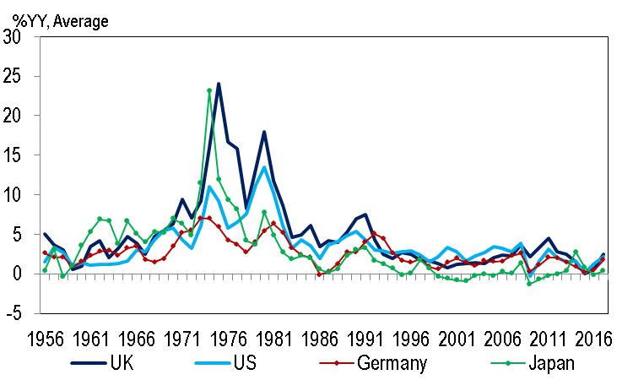
Inflation in four countries since 1956
Source: Citi Research

Slide 8
Two frequent correlates of central bank independence
As central banks were made operationally independent, they were often stripped of regulatory and supervisory powers:
  BoE lost all regulatory/supervisory powers in 1997 when it gained operational independence
  ECB dominates European Systemic Risk Board but only reference to financial stability in the Legal Framework of the Eurosystem and the European System of Central banks, ECB, July 2014. p. 63 is “Such [statistical, WHB]information is also necessary so that the ESCB can contribute to the smooth conduct of policies pursued by the competent authorities relating to the prudential supervision of credit institutions and the stability of the financial system.”
  Consolidated version of the Treaty on European Union Protocol 4 ON THE STATUTE OF THE EUROPEAN SYSTEM OF CENTRAL BANKS AND OF THE EUROPEAN CENTRAL BANK, Article 3.3: “In accordance with Article 127(5) of the Treaty on the Functioning of the European Union, the ESCB shall contribute to the smooth conduct of policies pursued by the competent authorities relating to the prudential supervision of credit institutions and the stability of the financial system.”
  Not true for BoJ: Bank of Japan Act Article 1: (1) The purpose of the Bank of Japan, or the central bank of Japan, is to issue banknotes and to carry out currency and monetary control. (2) In addition to what is prescribed in the preceding paragraph, the Bank of Japan's purpose is to ensure smooth settlement of funds among banks and other financial institutions, thereby contributing to the maintenance of stability of the financial system.
  Federal Reserve Act deals at length with financial stability issues, including LLR actions (e.g. Section 10A and Section 13)
Financial instability (need for LLR & MMLR) often treated as a historical curiosity: light-touch regulation, self-regulation and the ability to hedge and trade all risks – the ‘Greenspan delusion’ – would prevent a financial crisis.
Source: Citi Research

Slide 9
Growing scope and scale of central bank activities, powers and responsibilities
Triggered by GFC, frequent fiscal paralysis & (re)discovery of need for LLR and MMLR
Stabilisation policy: monetary policy often only game in town …
… and the only game in town often wasn’t very good:
  Monetary policy was difficult:
    Interest rates at ELB
    Large-scale asset purchases, Quantitative and Qualitative Easing, Credit easing etc. involving liquid assets in orderly market have little effect on aggregate demand
    Limited effectiveness of monetary policy to stimulate aggregate demand
      Horizontal LM?
      Vertical IS?
        Income effect of interest rate changes neutralizes substitution effect (‘target saver’)
        Highly indebted economies & Minsky neutrality: consumption constrained by a binding ‘consumption floor’
  Unwillingness or inability to engage in ‘helicopter money’
    EA: Dogma & Treaty; cooperation between and coordination of monetary and fiscal policy incompatible with central bank independence
    US: Congressional paralysis
    Japan: MoF opposition
    UK: Potentially possible, should there be a clear case for it. BoE does not believe central bank independence means not answering the telephone when the Chancellor calls.
Source: Citi Research

Slide 10
Growing scope and scale of central bank activities, powers and responsibilities
  Monetary policy ‘technical’ competence was mixed
    Central banks’ obsession with setting both price and quantity and either failing or creating inefficient rationing equilibria
      ECB attempting to set (1) the usual set of short-term rates; (2) a quantity (APP purchase volume) and (3) a floor on the rates of the assets they purchase …
    Fed setting interest rate floor (IOER) at the upper end of the Target Range for the federal funds rate and creating a ‘leaky double floor system’ instead of a ‘corridor system’.
    Occasional reappearance of “constructive ambiguity” – crossover from non-cooperative game theory that has no place in design and implementation of monetary policy
    Forward (mis)guidance & ‘communication by committee’ mostly confused markets –Fed, ECB, BoE, BoJ, SNB etc.
    Excessive fear of surprising the markets & excessive sensitivity to high-frequency asset price movements (especially the Fed)
Source: Citi Research

Slide 11
Growing scope and scale of central bank activities, powers and responsibilities
Financial stability: its rediscovery as the primary responsibility of central banks: (flexible) inflation targeting by an operationally independent central bank is not the only or even the main function of central banks.
  Bagehot’s revenge: the return of the lender of last resort and market maker of last resort
  Central banks and liquidity
    Funding liquidity (LLR)
    Market liquidity (MMLR)
    Directly through outright purchases
    Indirectly through enlargement of the set of (tradable) assets acceptable as collateral
  Central banks and financial institutions’ solvency
    Quasi-fiscal transfers to counterparties through the price, terms and conditions on which LOLR and MMLR support was made available
    Utter lack of transparency
      Fed had to be forced in 2010 by Bloomberg (through the Freedom of Information Act) to provide information about its bailout of AIG in 2008
      ECB has never provided information on the price and other terms French and German banks (which held €65bn, respectively €40bn of Greek sovereign debt end--2011) received from the Banque de France, respectively the Buba, for the sovereign debt they sold to these NCBs.
Source: Citi Research

Slide 12
Growing scope and scale of central bank activities, powers and responsibilities
  Enhanced financial stability, supervisory and regulatory responsibilities of central banks
    “Did not see it coming” not a problem: failure to anticipate & prevent not just a central bank issue
    Crisis fighting record mixed, but on balance quite good, except for transparency
    Explosion of regulatory and supervisory powers, especially in the UK
      Financial Policy Committee,
      Prudential Regulation Authority,
      Bank resolution authority,
        Financial Market Infrastructure Supervision
          Recognised payment systems
          Securities settlement systems
          Central Counterparties (CCP)
        Financial Sector Continuity
        CBEST – cybersecurity
      Of key supervisory/regulatory entities only Financial Conduct Authority and Financial Services Compensation Scheme outside BoE.
      Many of these powers could be exercised by independent entities, if necessary with a credit line to the BoE, guaranteed by the Treasury.
    Central planning fallacy: when things are a mess, centralize …
Source: Citi Research

Slide 13
Growing scope and scale of central bank activities, powers and responsibilities
  Fiscal and Quasi-fiscal roles of central banks
    Treasury is beneficial owner of the central bank – not well understood
    Redistribution of wealth and income through implicit subsidies – opaque, non-transparent and often unaccountable
Source: Citi Research

Slide 14
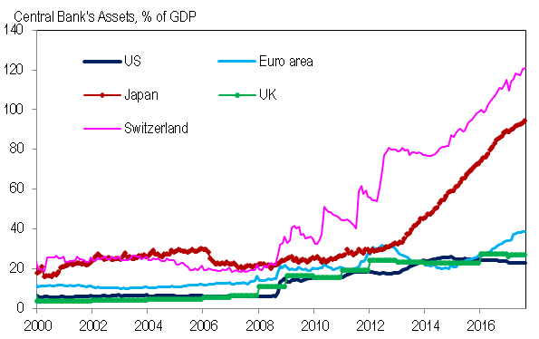
The changing size of the balance sheet of the leading advanced-economy central banks
Note: Figure shows total assets as a percentage of GDP, where GDP is measured as a four-quarter moving sum.
Source: National Central Banks, National Statistical Offices and Citi Research

Slide 15
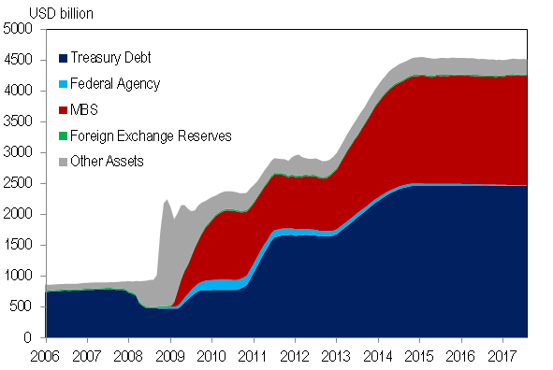
US Federal Reserve Assets
Source: Federal Reserve and Citi Research

Slide 16
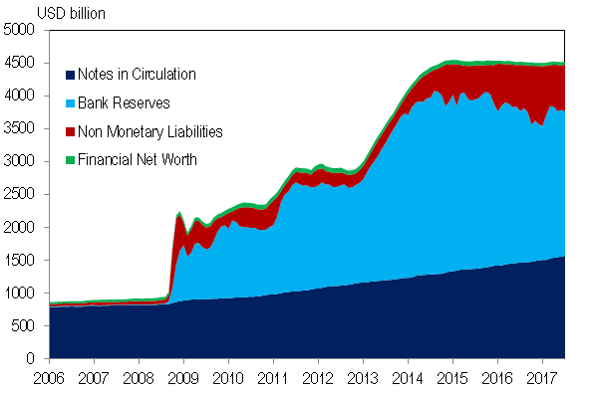
US Federal Reserve Liabilities
Source: Federal Reserve and Citi Research

Slide 17
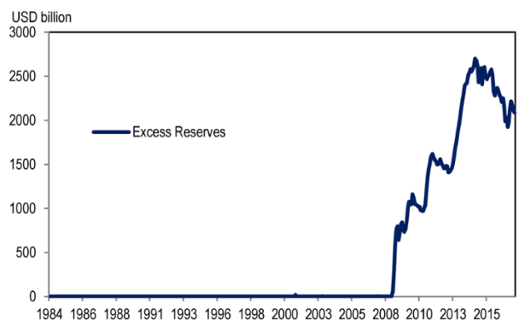
How excessive are the excess reserves?
Following Basel 3, banks are constrained by liquidity coverage ratio (LCR) and net stable funding ratio (NSFR) to hold high-grade liquid assets well in excess of traditional required reserves.
Paying 1.25% IOER is also likely to make it an attractive investment for banks (with Reverse Repo Target Rate at 1.00%).
Source: Citi Research

Slide 18
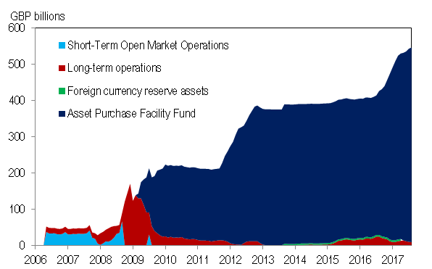
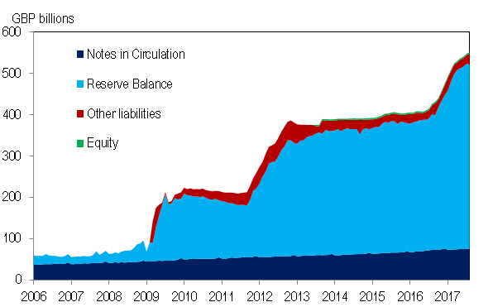
UK BoE Assets and Liabilities
Assets
Liabilities
Source: Bank of England and Citi Research

Slide 19
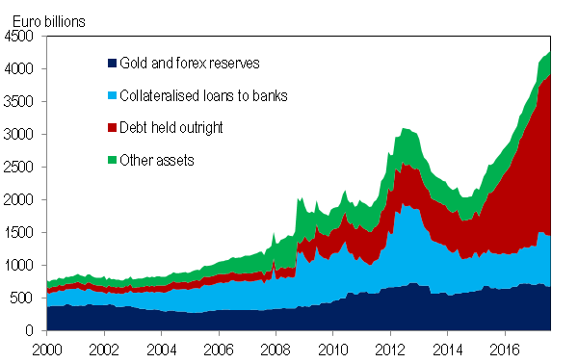
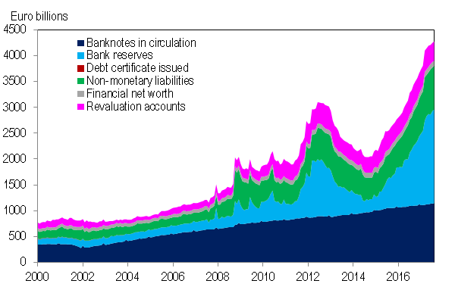
Eurosystem Assets and Liabilities
Assets
Liabilities
Source: European Central Bank and Citi Research

Slide 20
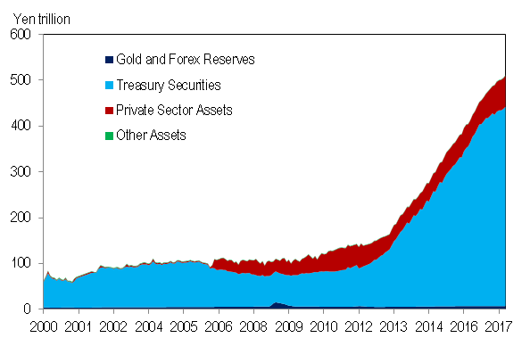
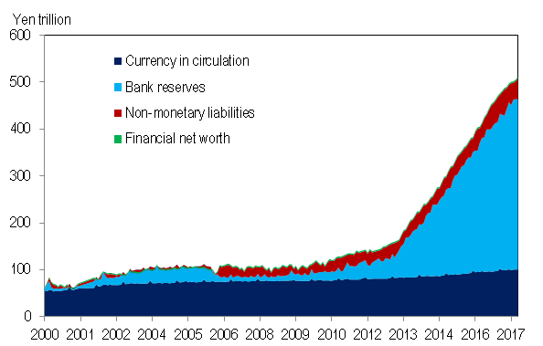
Japan BoJ Assets and Liabilities
Assets
Liabilities
Source: Bank of Japan and Citi Research

Slide 21
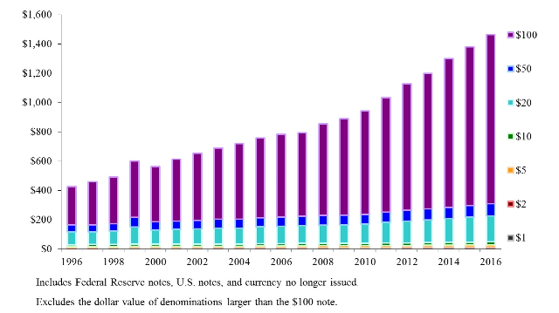
Time to stop de-facto subsidization of crime, by eliminating high-denomination notes and moving to central bank E-currency?
US: Value of Currency in Circulation
(Billions of dollars as of December 31 of each year)
2016: 79% in $100 notes (by value). 2016 US population: 324 million. Per capita currency holdings: $4,516.
Currency is probably the oldest fiat cryptocurrency – the bitcoin/etherium of the Tang and Song dynasties 7th century.
Source: Citi Research

Slide 22
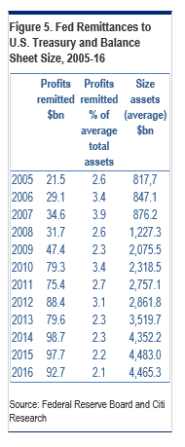
Time to stop de-facto subsidization of crime, by eliminating high-denomination notes and moving to central bank E-currency?
Fed Remittances to US Treasury and Balance Sheet Size
Congress also raided the reserves (capital surplus accounts) of the Regional Federal Reserve Banks for an additional $19.3bn in 2015 to help fund federal infrastructure projects.
Source: Citi Research

Slide 23
How deep are the pockets of the central bank?
From conventional balance sheet to comprehensive balance sheet – the intertemporal budget constraints of the central bank and the Treasury
Stylized central bank conventional balance sheet
Assets |  | Liabilities
R | Gold and foreign exchange holdings | Base money | M
_{B}cb | Treasury debt held by central bank | Non-monetary liabilities | N
L | Private sector debt and loans to the private sector held by central bank | Central bank conventional net Worth | _{W} cb
Source: Citi Research

Slide 24
From conventional balance sheet to comprehensive balance sheet – the intertemporal budget constraints of the central bank and the Treasury
Stylized Treasury comprehensive balance sheet
Assets |  | Liabilities
K | Value of real assets, equity in public enterprises and other financial assets owned by the Treasury | Marketable and non- marketable Treasury debt | _{B}p _{+ B}cb
 |  | Treasury conventional net worth | W
K | Value of real assets, equity in public enterprises and other financial assets owned by the Treasury | Marketable and non-marketable Treasury debt | _{B}p _{+ B}cb
Source: Citi Research

Slide 25
How deep are the pockets of the central bank?
From conventional balance sheet to comprehensive balance sheet – the intertemporal budget constraints of the central bank and the Treasury
Stylized central bank comprehensive balance sheet
Assets |  | Liabilities
R | Gold and foreign exchange holdings and other investments | Base money | M
_{B}cb | Treasury debt | Non-monetary liabilities | N
L | Private sector debt and loans to the private sector | PDV of current primary expenditure by central bank | V ({G^{cb}})
V({(i-i^{M})M}) | PDV of interest saved by central bank through issuance of base money | PDV of payments made by central bank to Treasury | V ({T ^{cb}})
V (M ∞ ) | PDV of terminal base money stock | PDV of transfer payments by Central Bank to private sector (helicopter money) | V ({H})
 |  | PDV of implicit net subsidies paid by central bank | V ({S^{cb}})
 |  | Central bank comprehensive net worth | _{W}ˆ cb
Source: Citi Research

Slide 26
From conventional balance sheet to comprehensive balance sheet – the intertemporal budget constraints of the central bank and the Treasury
Stylized Treasury comprehensive balance sheet
Assets |  | Liabilities
K | Fair value of real assets, equity in public enterprises and other financial assets | Marketable and non- marketable Treasury debt | _{B}p _{+ B}cb
V ({T ^{p} }) | PDV of taxes, levies and social security contributions net of transfers and cash benefits and entitlements | PDV of Treasury primary exhaustive current expenditure | V ({G})
V ({T^{cb}}) | PDV of payments made by central bank to Treasury | Comprehensive Treasury net worth | _{W}ˆ
 |  | Central bank comprehensive net worth | _{W}ˆ cb
Source: Citi Research

Slide 27
From conventional balance sheet to comprehensive balance sheet – the intertemporal budget constraints of the central bank and the Treasury
Conventional balance sheet of consolidated Treasury and central bank
Assets |  | Liabilities
K +R+L | Market value of real assets, equity in public enterprises and other financial assets, forex reserves and central bank loans to the private sector | Base money | M
 |  | Non-monetary liabilities of the Central Bank | N
 |  | Marketable and non- marketable Treasury debt held by public | _{B}p
 |  | Consolidated Treasury and Central Bank conventional or financial net worth | W = W + W ^{cb}
Source: Citi Research

Slide 28
From conventional balance sheet to comprehensive balance sheet – the intertemporal budget constraints of the central bank and the Treasury
Comprehensive balance sheet of consolidated Treasury& Central Bank (State)
Assets |  | Liabilities
K+ R +L | Fair value of real assets, equity in public enterprises and other financial assets, forex reserves and central bank loans to the private sector | Base money | M
V ({T ^{p} }) | PDV of net taxes, levies and social security contributions | Non-monetary liabilities of the Central Bank | N
V({(i-i^{M})M}) | PDV of future interest saved through the issuance of base money | Marketable and non-marketable general government debt held by the public | _{B}p
V (M ∞ ) | PDV of terminal base money stock | PDV of State primary current exhaustive expenditure | V ({G})
 |  | PDV of transfer payments by Central Bank to private sector (helicopter money) | V ({H})
 |  | PDV of implicit subsidies paid by Central Bank | V ({S^{cb}})
 |  | Comprehensive State net worth | W^{ˆ} = W^{ˆ} + W^{ˆ cb}
Source: Citi Research

Slide 29
For those who like this kind of thing:
i is the interest rate on the central bank’s assets
i^{M} is the interest rate on central bank money.
Source: Citi Research

Slide 30
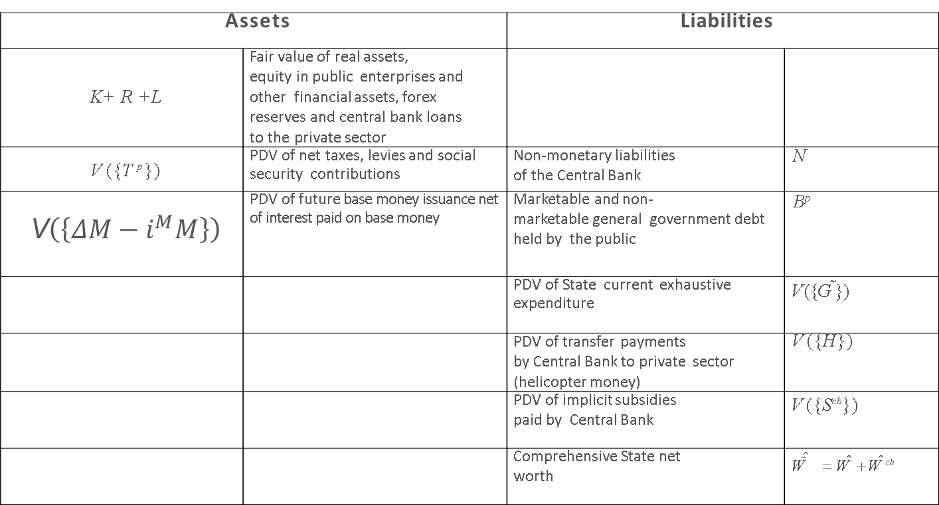
From conventional balance sheet to comprehensive balance sheet – the intertemporal budget constraints of the central bank and the Treasury
Comprehensive balance sheet of consolidated Treasury& Central Bank (State)
Assets |  | Liabilities
K+ R +L | Fair value of real assets, equity in public enterprises and other financial assets, forex reserves and central bank loans to the private sector
V ({T ^{p} }) | PDV of net taxes, levies and social security contributions | Non-monetary liabilities of the Central Bank | N
 | PDV of future base money issuance net of interest paid on base money | Marketable and non- marketable general government debt held by the public | _{B}p
 |  | PDV of State current exhaustive expenditure | V ({G})
 |  | PDV of transfer payments by Central Bank to private sector (helicopter money) | V ({H})
 |  | PDV of implicit subsidies paid by Central Bank | V ({S^{cb}})
 |  | Comprehensive State net worth | W^{ˆ} = W^{ˆ} + W^{ˆ cb}
Source: Citi Research

Slide 31

What’s your NILAC? The non-inflationary loss absorption capacity of the central bank
PDV of future seigniorage
Narrow definition (currency only)
Source: Citi Research

Slide 32
What’s your NILAC? The non-inflationary loss absorption capacity of the central bank
Source: Citi Research

Slide 33
What’s your NILAC? The non-inflationary loss absorption capacity of the central bank
Present Discounted Value of future seigniorage in Japan(α= 0.7; β=12.1)
Yen (trn) | Interest/ Discount Rate (i)
Real Growth Rate (γ) | 3.5% | 4.0% | 4.5% | 5.0% | 5.5%
0.5% | ¥136 | ¥90 | ¥65 | ¥50 | ¥40
1.0% | ¥225 | ¥131 | ¥89 | ¥66 | ¥51
1.5% | ¥457 | ¥203 | ¥125 | ¥88 | ¥66
2.0% | ¥2,438 | ¥360 | ¥185 | ¥120 | ¥86
Note: α represents the long run income elasticity of the money demand function, and β the corresponding interest rate semi-elasticity
Source: Citi Research

Slide 34
Central banks not ‘sticking to their knitting’
Interventions in bank recapitalizations or resolutions.
  ECB in November 2010: Exchange of letters between Trichet & Lenihan on bank recapitalization.
  Revaluation of its equity by Banca d’Italia late 2013-early 2014 (original equity value set by the 1936 Law at €156,000 (300 million lire at the time)) to €7.5 bn and buyback of excess shares by Banca d’Italia from Italian banks.
Interventions in debate on fiscal policy
  ECB (Draghi, August 2014)
  ECB (Weidmann, October 2014)
  Fed (Bernanke, January 2008)
Interventions in debate on structural reforms
  ECB (Draghi, August 2014)
Interventions in debate on inequality
  Fed (Yellen, October 2014)
Active participation in constitutional debates
  BoE (Carney) and Scottish referendum;
  BoE (Carney) and Brexit referendum;
  Bank of Spain (Luis Maria Linde) and Catalan independence, September 2017)
Active role in turnover of elected political leaders
  Trichet and Draghi’s role in the fall of Berlusconi, September 2011.

Slide 35
Legitimacy and accountability of central banks
Central banks have some output legitimacy
  Overstating the powers of central banks does not help
Central banks have little input (process or procedural) legitimacy,
Need to strengthen input legitimacy through greater accountability
  Formal accountability – reporting duties, transparency; ECB improving but still poor.
    Vote on monetary policy decisions!
    Publish individual votes – improper influence and ability to violate mandate more likely behind the wall of anonymity.
  Substantive accountability; payoff-relevant consequences from formal accountability (pay and/or security of tenure depend on individual performance). This conflicts with independence
  Greater transparency (formal accountability) may strengthen substantive accountability.
  Voting for every decision with every individual vote in the public domain essential; permits outside world to assess individual performance. Relevant to post-MPC career, honors etc.
  A single, non-renewable term for all monetary policy makers
  Operational independence makes sense only for Central Bank as minimalist monetary authority, LLR and MMLR. Other supervisory, regulatory, recovery, recap and resolution functions too openly political to be entrusted to operationally independent central bank

Slide 36
Reasons for likely loss of central bank independence
The modern central bank has control over too large a volume of quasi-fiscal resources to be allowed to operate independently.
Central banks/bankers have intruded in policy areas beyond their mandates and competence
We have had 25 years of low inflation in most AEs. Politicians and the public now take this for granted
The conduct of monetary policy has been at best moderately competent. Communication has been a disaster
Populism means distrust of experts, establishment, elite. Central banks seen as experts, establishment, elite
(1) to (5) mean that both input and output legitimacy have been undermined

Slide 37
Recommendations
To have any chance of surviving as operationally independent entities, the following has to happen.
Central bank should be narrow monetary authority, LLR and MMLR
Any credit risk taken on by central bank should have a full sovereign guarantee (in EA: sovereign guarantee according to capital key)
Central bank should not be the leading macro-prudential or micro-prudential supervisor or regulator; should not play a leading role in deposit insurance and SIFI recapitalization
Reinvigorated Tripartite arrangement (FSOC with teeth, European Systemic Risk Board with strong fiscal representation) should coordinate preventive and corrective financial stability policies of all agencies, including central bank. It should be headed by the Treasury (for the Eurozone, the closest thing to a Treasury).
Accounting: central bank should be part of the general government sector. Its accounts should be consolidated with those of the central government.

Slide 38
Recommendations
With a suitable time lag to allow for commercial secrecy and market sensitivity (never more than 6 months) the following information should be in the public domain (for both on- and off-balance sheet transactions):
  For each outright purchase or sale of a financial instrument
    A complete characterization of the financial instrument that is bought or sold
    Name(s) of the counterparty/counterparties and their beneficial owner(s)
    Price and all other relevant terms and conditions of the transaction
For each loan, repo or reverse repo
  Name(s) of the counterparty/counterparties and their beneficial owner(s)
  Full characterization of the price, terms and conditions of the loan, repo or reverse repo, including the duration, payment schedules for interest and repayment of principal, nature of the collateral offered, haircut etc. etc.
For each guarantee or other financial comfort provided by the central bank
  A complete characterization of the guarantee or other financial comfort
  The names of the beneficiaries and their beneficial owners
  A well-motivated, independently replicable estimate of the fair value of the guarantee or financial comfort

Slide 39
Conclusion
Central bank independence, even for a narrow, open and accountable monetary authority, is unlikely to survive much longer
  (1) Milch cow irresistible, both through explicit transfers to Treasury and through quasi-fiscal subsidies and taxes
  (2) 25 years of low and stable inflation has dulled the memories of the bad old days of high and highly variable inflation. Low inflation is taken for granted; the belief than an operationally independent central bank is necessary for this is waning.
  (3) Populism (people’s QE) is on the rise.
  (4) Helicopter money only consistent with central bank operational independence if the central bank can say ‘no’, if it considers helicopter money to be in conflict with its mandate
  (5) Even if central banks can veto helicopter money under these conditions, the government can always change the mandate…
  (6) When there is a stand-off between a single national Treasury and the Central Bank, fiscal dominance is overwhelmingly likely to prevail –except in Eurozone

Slide 40
Conclusion
Eurosystem is the only possible exception to fiscal dominance (19 national Treasuries vs. one central bank). Result is likely to be not the survival of an operationally independent ECB but a break-up of the Eurosystem, unless urgent and overdue reforms are implemented.
Create EMF (SDRM plus enhanced European Stability Mechanism with significant credit line to ECB, guaranteed by national governments according to capital key, up to a limit decided by the European Council)
Take ECB out of banking supervision and regulation (transfer powers to EBA (Eurozone Banking Authority)).
Turn NCBs into branches of the ECB
End to all own-risk activities of NCBs (ANFA, resurrected Tier 2 collateral, ELA, PSPP). All profits and losses are shared according to the capital key.
All assets on balance sheet of Eurosystem either triple-A rated (backed by triple-A rated collateral) or guaranteed by the national governments according to capital key.

Slide 41
Conclusion
Eurosystem assets requiring a sovereign guarantee can only be acquired by the Eurosystem with the permission of either a qualified majority of the national Ministers of Finance/Treasuries or the permission of a newly created Eurozone Treasury/MoF.
Create limited Eurozone Ministry of Finance/Treasury. EMF could be part of this MoF. Strictly limited taxation, public spending and borrowing capacity.
Exposure limits of banks to all sovereigns (including their own)
Risk-weighting of sovereign debt held by banks
Change the Treaty
Recognize financial stability as the primary responsibility of the ECB/Eurosystem
Eliminate the prohibition on direct monetary financing

Slide 42
References
Buiter, Willem H. and Ebrahim Rahbari (2012), "The ECB as Lender of Last Resort for Sovereigns in the Euro Area", with Ebrahim Rahbari, CEPR Discussion Paper No. 8974, May 2012, Journal of Common Market Studies, Special Issue: The JCMS Annual Review of the European Union in 2011, September 2012, Volume 50, Issue Supplement s2, pp. 6-35.
Buiter, Willem H. (2014), "Central Banks: Powerful, Political and Unaccountable?", British Academy Keynes Lecture, given on 18 September 2014, published in the Journal of the British Academy. A working paper version (longer than the published version) can be found here.
Buiter, Willem H. (2015), "Inflation in the Eurozone: why has demand management failed so badly?", Willem H. Buiter. Remarks made at the panel "Current perspectives on unemployment and inflation in the euro area and advanced economies", held on 22 May 2015, at the second ECB Forum on Central Banking, Sintra, Portugal, 21-23 May 2015.
Buiter, Willem H. (2016). "Dysfunctional Central Banking; The End of Independent Central Banks or a Return to ‘Narrow Central Banking’ – or Both?”, Willem H. Buiter, Citi Research, Multi-Asset, Global, Global Economics View, 21 Dec 2016.

