Slide 1
In the Fray, Not Above It Observations on the Global History of Central Bank Independence
Adam S. Posen
Bank of England Conference
Independence 20 Years On
September 29, 2017

Slide 2
Observations on the History of Central Bank Independence
Haldane Questions
What is experience with different CBI models?
What are the merits of different CBI political-legal arrangements?
How does CBI align with economic changes since spreading in 1990s?
How does CBI experience inform decisions about CB control of financial stability decisions?

Slide 3
Observations on the History of Central Bank Independence
Haldane Questions
What is experience with different CBI models?
What are the merits of different CBI political-legal arrangements?
How does CBI align with economic changes since spreading in 1990s?
How does CBI experience inform decisions about CB control of financial stability decisions?
Evidence/Experience
CBI impact on economic outcomes overrated
Differences in legal structures have little consistent impact
Independence matters as insulation, not as counter-inflationary conservatism
Central bank will be held responsible. Time-inconsistency argument for rules better for financial stability than price stability

Slide 4
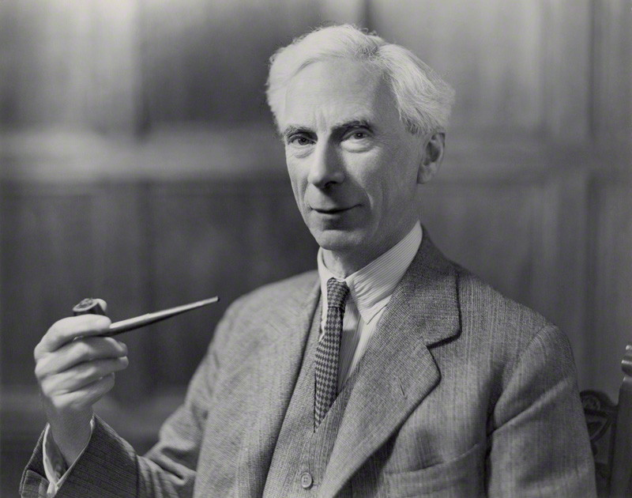
“It is easy in the world to live after the world's opinion; it is easy in solitude to live after your own; but the great man is he who in the midst of the crowd keeps with perfect sweetness the independence of solitude.” ― Bertrand Russell

Slide 5
Experience with CBI models
Initial promise of political economy of CBI
Impose it anywhere, and it will work to π
False premise led to varied results
Generally adopted after disinflation successful
Cross-national variation in CBI explains little of overall decline in inflation rates globally
Division between rule of law (respecting governors’ autonomy/tenure) vs not is key to effectiveness
Even experiments with reduced CBI (e.g. BOJ) have not had impact on inflation expectations

Slide 6
Experience with CBI models
Every CB takes into account its political environment and risks to independence
Even the most independent central bank legally (ECB) has had to adjust its policies
Backlash against QE in the US led to curtailed capabilities of the FRB
Lohmann (1992) fixed cost of changing view combined with ongoing negotiations and coalitions
Thus there are no wider knock-on effects of CBI
Not on wage-bargaining, fiscal discipline, structural reform, price flexibility…

Slide 7
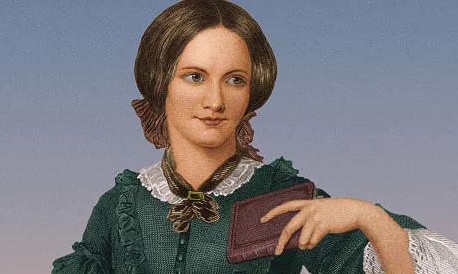
“I do not think, sir, you have any right to command me, merely because you are older than I, or because you have seen more of the world than I have; your claim to superiority depends on the use you have made of your time and experience.”
― Charlotte Brontë, Jane Eyre

Slide 8
Merits of different CBI political-legal arrangements
What is the real meaning of CB independence?
Conservatism against inflation
Expertise and near-objectivity
Depoliticization of decisions
Seal of approval for markets and governments
Legitimacy of the institution to decide
In each country, adoption of CBI and its specific form is context specific and requires support
Even at height of technocratic spread via EMU
A lesser version of ‘constitutional moments’
Tension of need to change with coalitions and times

Slide 9
Merits of different CBI political-legal arrangements
Instrument v Goal independence – blurry but useful
But even on this a wide variety of goal setting processes
Aspects that should matter a lot do not seem to matter
Mandates are all over the place in focus and definition
Committee structure, relative power of monetary policy voters and degree of explicit voting do not change outcomes
Perhaps matter more for political legitimacy, less for economic
Importance of context can be seen in what allowed to buy under duress
FRB could only buy public obligations, violation to buy private
ECB would prefer to buy private debt, violation to support public
Smaller central banks buy foreign assets not domestic

Slide 10
Merits of different CBI political-legal arrangements
Fiscal indemnity or not was fundamental
BOE had it for QE under successive governments
ECB and BOJ publicly fretted about vulnerability if CB ‘capital’ were eroded
FRB under attack by Congress for ‘spending our money’
Not foreseen as an issue in CBI
Fiscal cooperation or criticism without rules
Often (in EM) seen as virtue of independence, if not duty, to critique government fiscal policy
Usually (in G20) CB criticism is an intrusion
Ability to willingly cooperate gets stigmatized, though evidence is that only involuntary primary debt purchases do harm (to inflation or expectations)

Slide 11
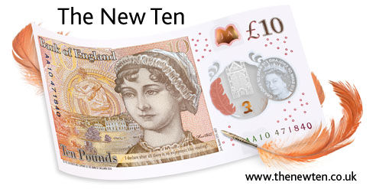
“What! Would I be turned back from doing a thing that I had determined to do, and that I knew to be right, by the airs and interference of such a person, or any person I may say? No, I have no idea of being so easily persuaded. When I have made up my mind, I have made it.”
― Jane Austen, Persuasion

Slide 12
CBI alignment with economic changes since 1990
Lots of reasons to doubt simple inflation bias story
Including the ease of shedding it once done
And the stickiness of inflation expectations
And the flattening of the Philips Curve
Ended up with asymmetric models of CBI in a world of asymmetry in the other direction (incl. ZLB)
Low inflation as part of a syndrome, not neutrality
Global trends and convergence beyond CBI
Seeming evidence for real (wage) driven inflation
Difficulty of using currency depreciation economically and politically to reflate
Link of capital inflows and financial instability

Slide 13
CBI alignment with economic changes since 1990
From money illusion to distribution illusion?
People cannot only notice distributional consequences of MP when in crisis or when using quantitative measures
Information overflow reduces transparency
Argument for return to ‘firefighting’ model for CBs
CB have broadening responsibilities/demands
No longer blinded by happy coincidence of one goal/one instrument/good outcome
Need for ongoing engagement in macroprudential
Independence defined only in terms of inflation or even of monetary policy is no longer viable
At least the case for independence in other areas has to be fought separately

Slide 14
“Unheard-of combinations of circumstances demand unheard-of rules.”
― Charlotte Brontë, Jane Eyre

Slide 15
CBI and the control of financial stability decisions
As with CBI in practice, very wide range of institutional models, little difference in outcomes
Some of this due to international common trends, as with declining inflation
But placing supervision in or out of CB, shared or separate from other regulators, does not seem to matter to crisis incidence or financial stability
Again, shifts in reg/sup regime reflect perceptions and interest group of the time, not some inherent logic
But an added layer of distrust regarding the intent and will of reg/sup, seemingly justified
In contrast to the higher trust in price stability for CBI

Slide 16
CBI and the control of financial stability decisions
Central bank control of financial stability seems to pursue goal independence
We know from CBI that this is a mistake
Too much discretion over too many instruments leads to distrust about motives
Not clear what interest is being insulated or which expectations are being anchored
Strong case for unified regulator/supervisor is not necessarily a case it should be the CB
If CBI was an intermediate point on rules vs discretion for inflation, probably should be closer to end point for rules for financial stability

Slide 17
Suggestions for the Future of Central Bank Independence
Evidence/Experience
CBI impact on economic outcomes overrated
Differences in legal structures have little consistent impact
Independence matters as insulation, not as counter-inflationary conservatism
Central bank will be held responsible. Time-inconsistency argument for rules better for financial stability than price stability
A Way Forward
Replace false precision and credibility talk
Give MP voters autonomy, and the rest will follow – if CB has outside support
Make common cause with judiciary, military, climate technocrats for expertise
Reduce discretion by central banks in macro-pru and complexity in financial oversight. Shift accountability to results.

Slide 18
“It isn't what we say or think that defines us, but what we do.”
― Jane Austen, Sense and Sensibility

