Slide 1
Bank of England Independence: 20 Years On
Panel discussion:
"Does the model remain fit for purpose? Financial stability considerations"
Adair Turner
28 September, 2017

Slide 2
Private domestic credit as a % of GDP:
Advanced economies 1950 – 2011
Source: Financial and Sovereign Debt Crises: Some Lessons Learned and Those Forgotten, C. Reinhart & K. Rogoff, 2013

Slide 3
US debt as a % of GDP by borrower type
300%
250%
200%
150%
Corporate
100%
Household
50%
Financial
10%
1953
1929
1935
1941
1947
1959
1965
1971
1977
1983
1990
1996
2002
2007
Source: Oliver Wyman

Slide 4


Estimates of cost of public rescue
% of GDP
 | IMF Global Financial Stability Review April 2009 | IMF Fiscal Monitor October 2014⁽*⁾ | UK Office of Budget Responsibility April 2017
 | 12.7% | -0.5%
 | 9.1% | 8.0% | 1.2%
 | ⁽*⁾ US estimate at 4.5% gross; 4.9% recoveries to date. UK estimate at 10.5% gross; 2.6% recoveries to date
~

Slide 5

Advanced economy growth per capita 1997-2016
% per annum

Slide 6



Credit supply or demand?
Abundant credit available at very low interest rates, but minimal demand in a balance sheet recession
Japan 1990s:
Largest falls in consumption in countries with most overleveraged households
… with consequent falls in business investment and borrowing (Mian and Sufi, 2014)
US 2009 – 10:
Tripartite discussions with banks abut why not lending
… but low utilisation of committed overdraft facilities
… and Bank Credit Conditions Survey shows low demand for business output far more important than links to credit supply
UK 2009 – 12:
Targeted LTRO offers €400bn four year money at 0.1%
- banks borrow €80bn
Eurozone Sep 2014:

Slide 7
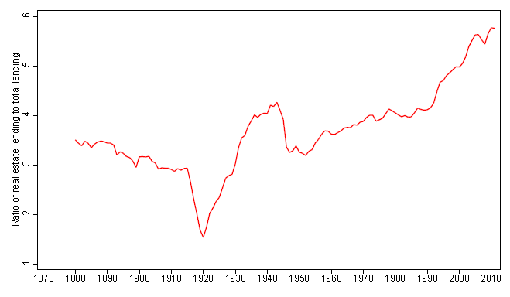
Share of real estate lending in total bank lending
60%
50%
40%
Percentage
30%
20%
10%
Source: “The Great Mortgaging”, Oscar Jordá, Moritz Schularick and Alan Taylor, 2014)

Slide 8
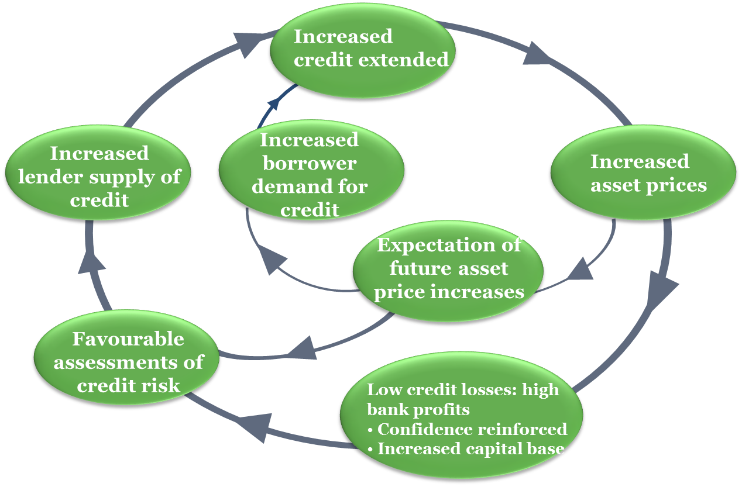
Credit and asset price cycles: upswing

Slide 9
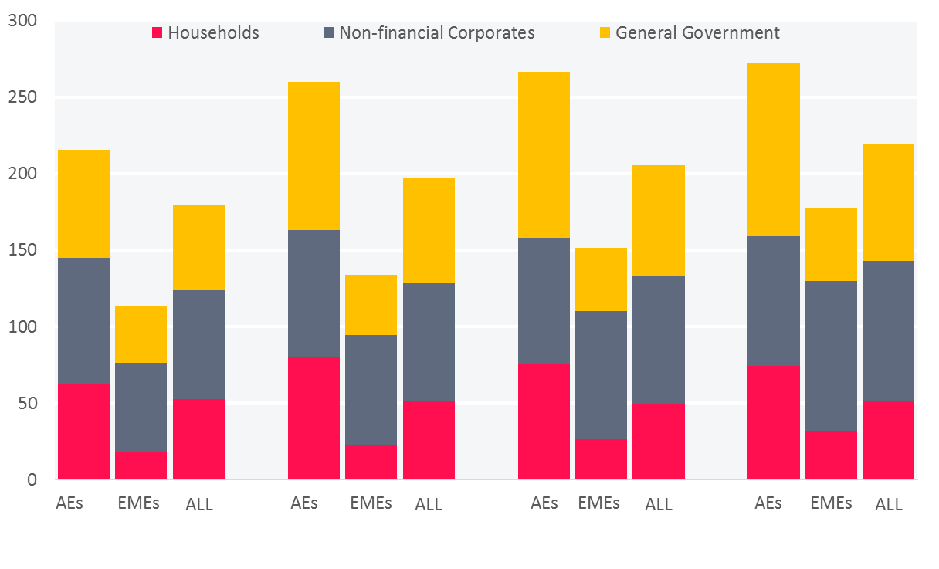
Global debt continues to rise
Debt as % of GDP
End-2007
End-2010
End-2013
End-2016
Source: Bank for International Settlements 87th Annual Report, 2017

Slide 10
More radical use of macro-prudential levers
Bank capital ratios significantly higher than Basel III requirements and focussed Not just on financial system resilience But also on constraining total real economy leverage
Countercyclical capital requirements applied Not just to prevent credit growth ‘above trend’ But to constrain leverage level above optimal
Higher risk weights for real estate lending Set by macro-prudential regulator to prevent macro-economic risks Not by internal models to reflect probability of default

Slide 11




Differentiated central bank funding schemes
Funding for lending scheme (FLS) with ‘incentives’ for lending skewed towards SMEs”
Targeted LTRO: for non-mortgage bank lending

