Slide 1
Publishing while female:
Are women held to higher standards? Evidence from peer review.
By Erin Hengel
Discussion by Anne Boring
May 14th, 2018

Slide 2
Research on the underrepresentation of women
What do we know?
  To what extent are women and minorities underrepresented?
  To what extent do implicit attitudes and institutional practices exist?
Does it matter?
  Does more diversity lead to better research?
  Does more diversity reduce biases?
What can we do?
Notes:
generates a broader range of perspectives and experiences, leading to an improvement of economic analyses
will provide role models, which will reduce biases and motivate more diverse students and faculty to enter the field
E.g. Bayer and Rouse (JEP, 2016):
“This underrepresentation within the field of economics is present at the undergraduate level, continues into the ranks of the academy, and is barely improving over time. It likely hampers the discipline, constraining the range of issues addressed and limiting our collective ability to understand familiar issues from new and innovative perspectives. (…)
We argue that implicit attitudes and institutional practices may be contributing to the underrepresentation of women and minorities at all stages of the pipeline.”

Slide 3
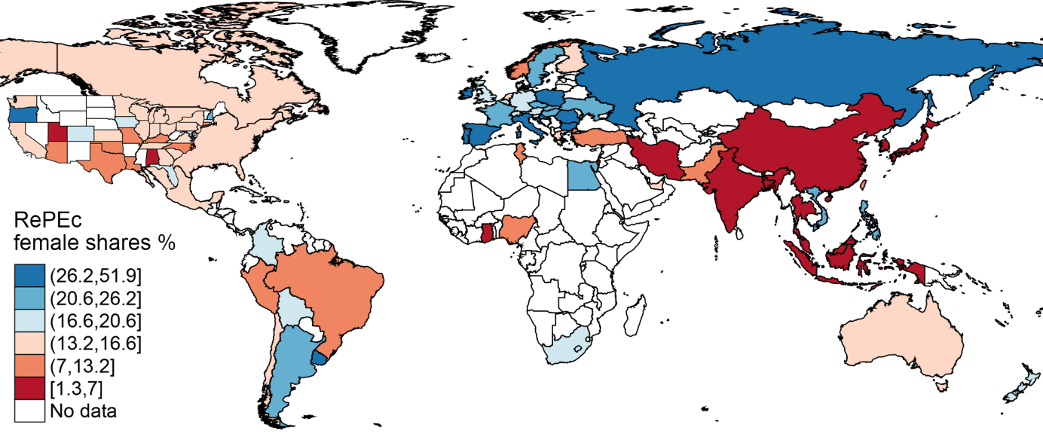
Proportion of female economists by country
Source: Female representation in Economics, RePEc, January 2018
See: Economics: where are the women? Boring & Zignago (2018)

Slide 4
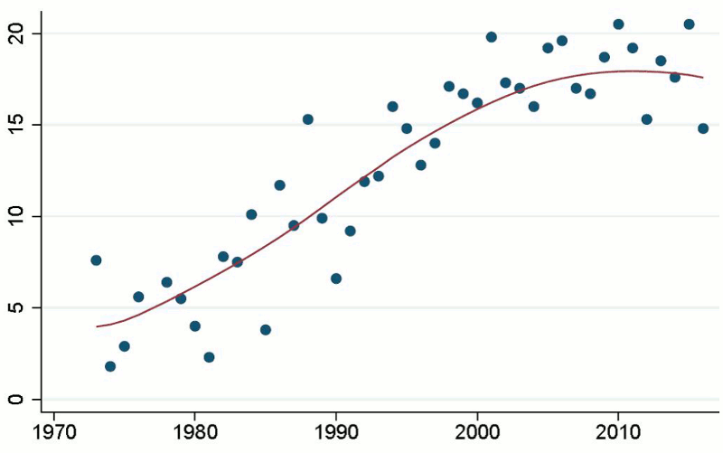
Shares of women in RePEc, by PhD cohorts
Source: Female representation in Economics, RePEc, January 2018
See: Economics: where are the women? Boring & Zignago (2018)
Notes:
https://www.linkedin.com/pulse/women-economics-new-repec-data-soledad-zignago/

Slide 5
Research: publications in Top Five
Boring & Périvier (2018) reanalysis of Card & DellaVigna (2014) research on publications in Top Five journals from 1970 to 2012:
Of all the names attached to papers (N=21,171): 6.9% are female
Only 5.9% of single-authored articles have been written by a woman

Slide 6
Number of articles with at least two authors published in top five journals

Slide 7
Women as single authors tend to be cited less often
Ann Krueger “The Political Economy of the Rent-Seeking Society” (AER, 1974)

Slide 8
Is research by women held to higher standards?
Hengel (WP, 2017) uses readability scores to test for quality of paper:
Female-authored papers are better written than equivalent papers by men
Gap higher for published articles
Female-authored papers take half a year longer in peer review (Econometrica)
Do these results provide evidence of tougher editorial standards and/or biased referee assignment?

