Slide 1
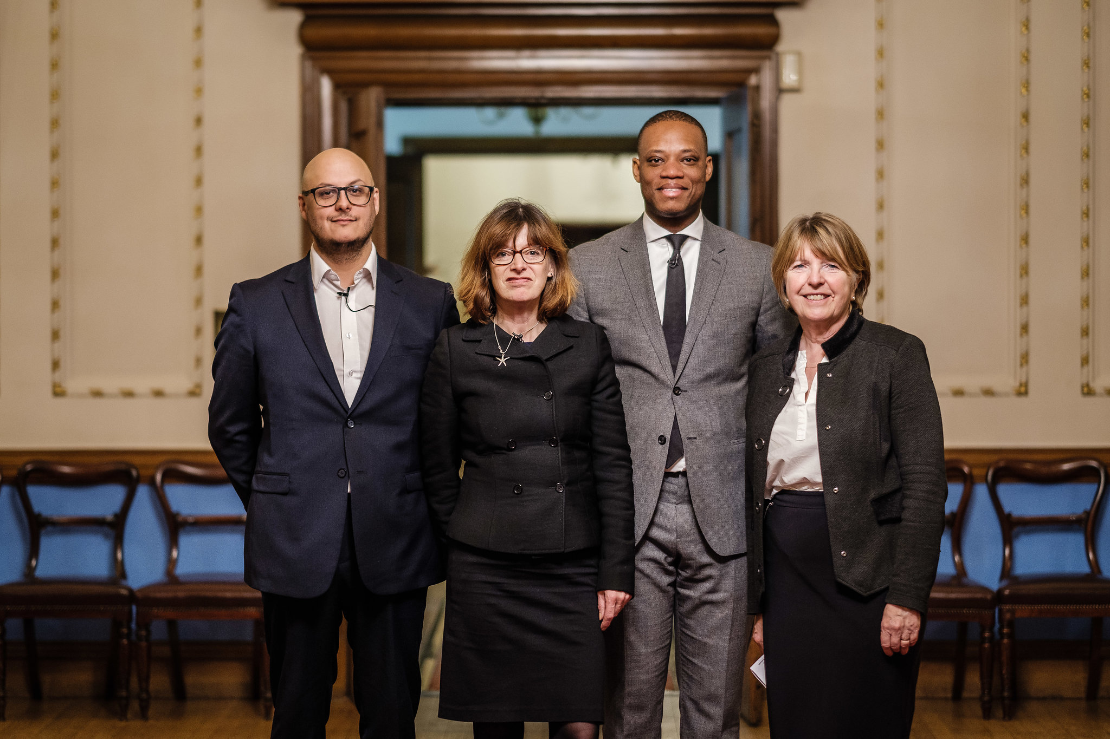
Collaborating with Men To Build Inclusive Workplace Cultures Dame Barbara Stocking and Dr Jill Armstrong Gender and Career Progression Conference Bank of England. May 2018.

Slide 2
Scope of presentation
1
Why achieving gender balance in positions of power means changing workplace culture
2
How men can work with women to build gender inclusive workplace cultures

Slide 3
Men as workplace culture change-makers
1
Workplace culture continues to advantage men
2
Men and women need to work together to create a gender inclusive environment
3
Change needs to come from the bottom up, as well as the top down

Slide 4
Workplace culture perceived barrier to career progress
38%
factors attributed to workplace culture
22%
Factors attributed to balancing work and family life
2014 Murray Edwards College survey of almost 1,000 alumnae

Slide 5
Six examples of workplace culture problems
Informal networks that are vital to accessing opportunities tend to be male-dominated
When male and female managers behave in the same way women are often more negatively judged
Benevolent Sexism
Well motivated men can ‘kill careers with kindness’
Double standards in the way potential and performance is assessed
Women are interrupted in meetings and presentations far more than men – which means women are less likely to be credited for the contribution they make
Women have less access than men to powerful sponsors of career opportunity

Slide 6
Double standards: Women are judged more negatively when they behave in the same way as men
40%
of women feel they are judged unfairly
81%
of men
think this rarely happens to women
Aggregated data from 4 science institutes – 337 men and 445 women

Slide 7
Informal networks influence opportunities but tend to be male dominated
57%
of women report that informal networks in their organisation are male-dominated
56%
of men report that informal networks in their organisation are male-dominated
Aggregated data from 4 science institutes – 337 men and 445 women

Slide 8
In a more gender balanced organisation, men don’t appreciate that women find this a problem
75%
of senior women report that informal networks in their organisation are male-dominated
81%
of men
reported they had not noticed the issue
Data from 300 respondents in a public sector organisation

Slide 9
Women report they are interrupted and talked over by men in meetings
100%
of women report they are occasionally (86%) or often (14%) interrupted by men
33%
of men
think this occasionally happens to women
53%
of men say they are occasionally interrupted in meetings
STEM company – survey response rate more than 70% of team

Slide 10
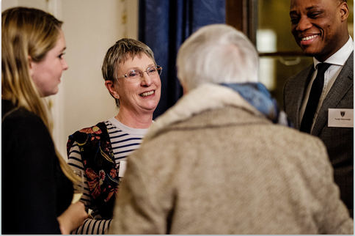
Ideas about how to tackle barriers to progression by merit
1
See More, Hear More: Building Understanding
2
Reverse mentoring
3
MEC Survey and Workshop

Slide 11
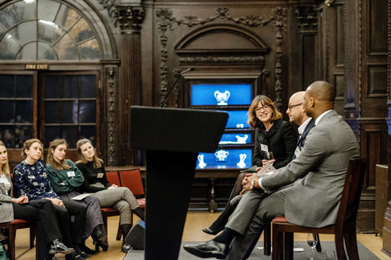
More inclusive meetings
1
Pair up to deal with interruptions
2
Amplification - giving credit
where it’s due
3
Advice on running inclusive meetings (CONVENE)

Slide 12
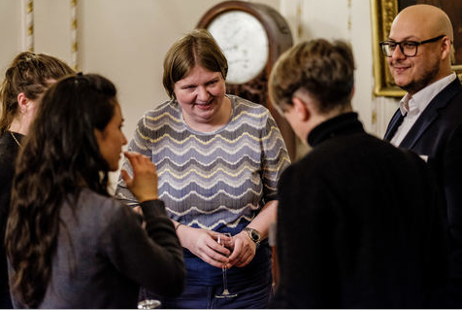
Mix it Up: Informal Gender Mixed Networking Tips
1
Men mentor women
2
Fun social events that are inclusive
3
New joiners: coffee with 10 people in their first 3 months
4
Rules about eating only in social spaces
5
Pair up – ‘Take 2’; attend formal networking events together

Slide 13
Challenging Double Standards
1
Ask a man to do the people management & good citizenship
2
No all male panels
Question what ‘promotion by merit’ means and how this aligns with inclusivity
3
4
Safe space for women to share experience of double standards

Slide 14
“I think the awareness building of men to other men is quite important. If a man is noticing it and you don’t, you probably wonder why. Whereas a woman noticing it isn’t surprising”. “We need to dispel the myth that gender issues are ‘done’. Moving the conversation to evidence based facts is key. Men leading those conversations as well as hearing the messages is as important”.
Men Challenging Double Standards

Slide 15
Actions for leaders
Frame gender diversity as a business issue
Make the business case
Evidence the problem
Set clear targets – with consequences for achievement or not
Purpose:
Why is gender inclusion important?
Measure the change
Role model the change
Treat parents equally

Slide 16
Collaborating with Men To Build Inclusive Workplace Cultures Dame Barbara Stocking and Dr Jill Armstrong THANK YOU

