Slide 1
August 2020
Monetary Policy Report & Financial Stability Report
Andrew Bailey Alex Brazier
Ben Broadbent Dave Ramsden Becky Maule
Friday 7 August 2020

Slide 2
Plan for the session
Andrew will introduce the event
Ben will give you an overview of the Monetary Policy Report
Alex will give you an overview of the Financial Stability Report
Q&A session with Andrew, Ben, Dave and Alex
Please submit questions as we go and we’ll put some to them – anonymously
We’re also running a couple of polls to get your input on the economic outlook – please do take part if you feel comfortable

Slide 3
Poll Question 1
How do you expect demand to change from current levels over the next twelve months?
Options are:
Rise strongly, rise modestly, remain unchanged, reduce slightly, reduce sharply (defined as >10% higher, 1-10% higher, unchanged, 1-10% lower, >10% lower)

Slide 4
AUGUST 2020
Monetary Policy Report
Ben Broadbent
Friday 7 August 2020

Slide 5
Conditioning assumptions
Back to doing a forecast (albeit a very uncertain one).
Direct impact of COVID-19 on economy assumed to fade away gradually over forecast.
Encouraging signs of a return of activity post full national lockdown
But MPC hasn’t taken much signal from this about medium term
Great deal of uncertainty (our “fan charts” are much wider than usual). Key risks involve the pandemic: how it evolves, the reaction of households, businesses and governments to the economic and health risks; the prospects for improving medical technologies.
Orderly Brexit.

Slide 6
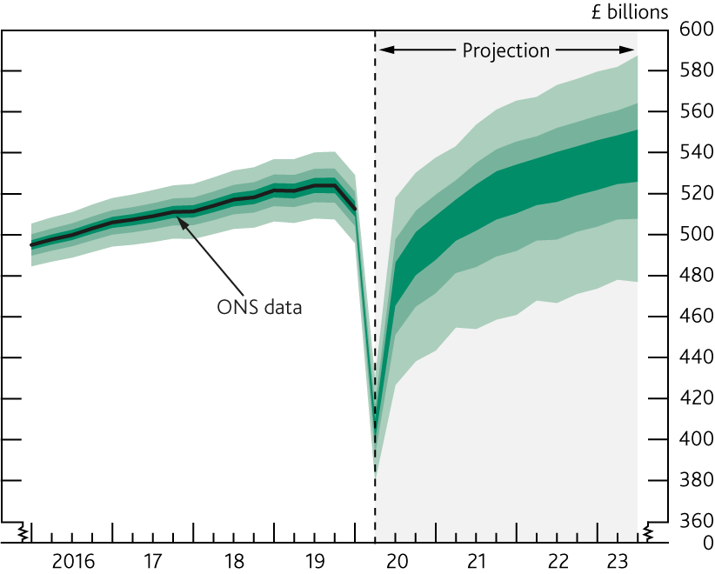
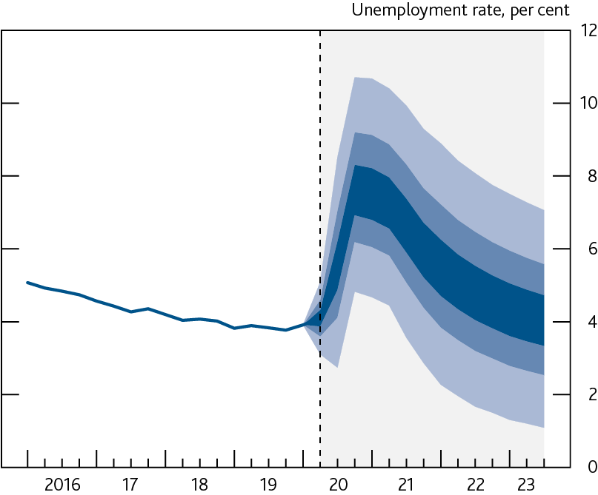
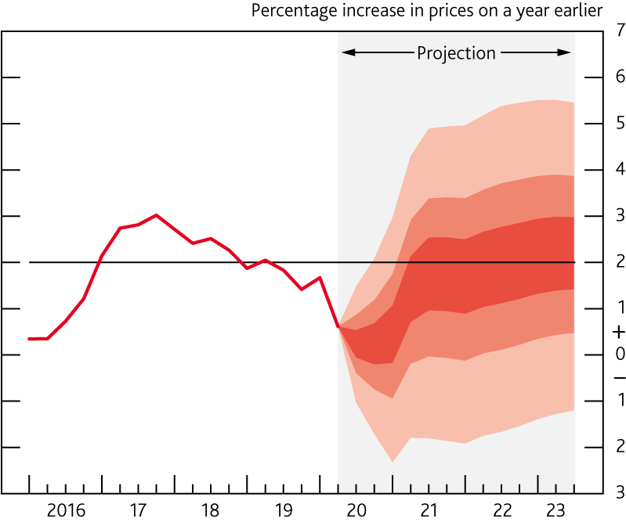
Projections
GDP
Unemployment
CPI

Slide 7
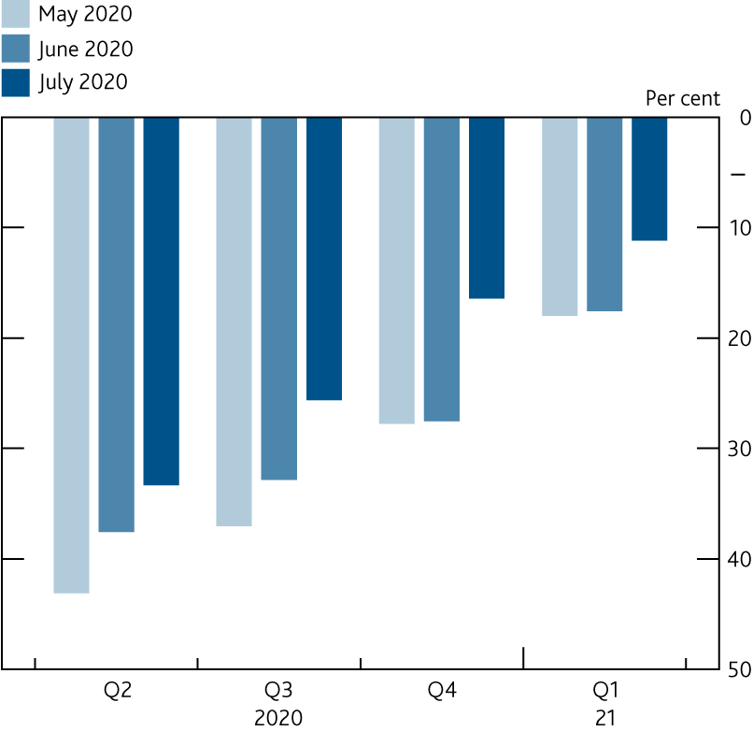
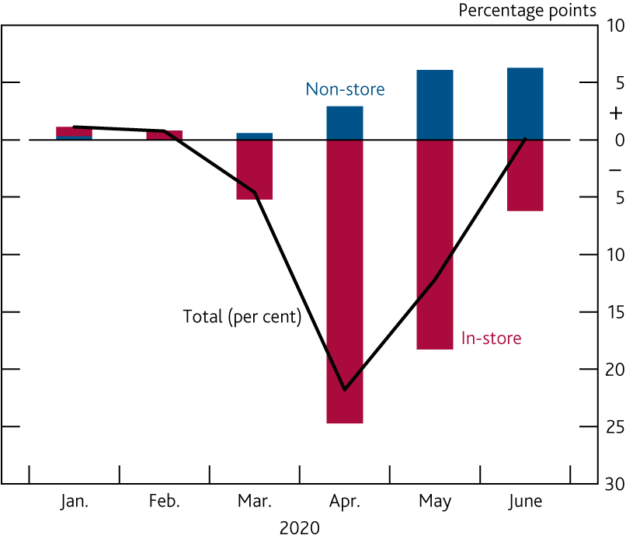
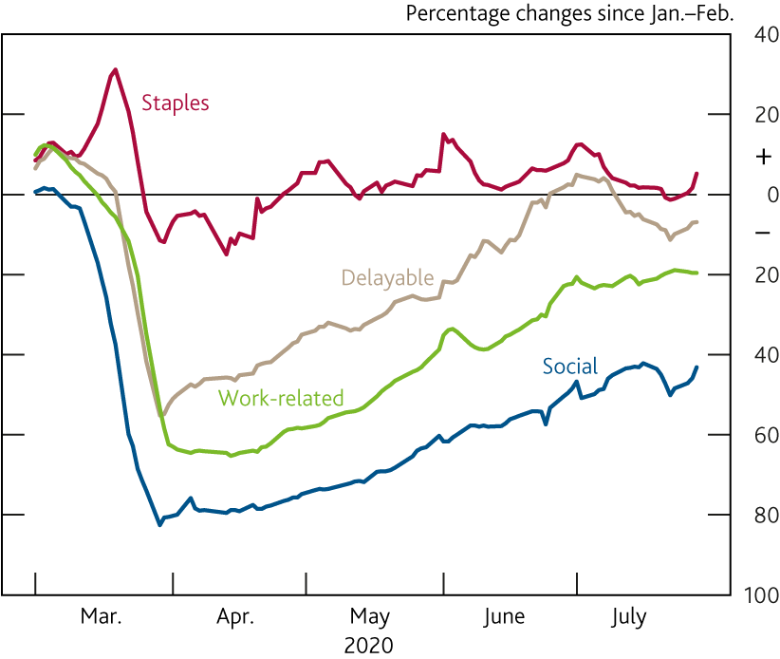
Near-term: output
Retail sales
CHAPS spending
DMP investment

Slide 8
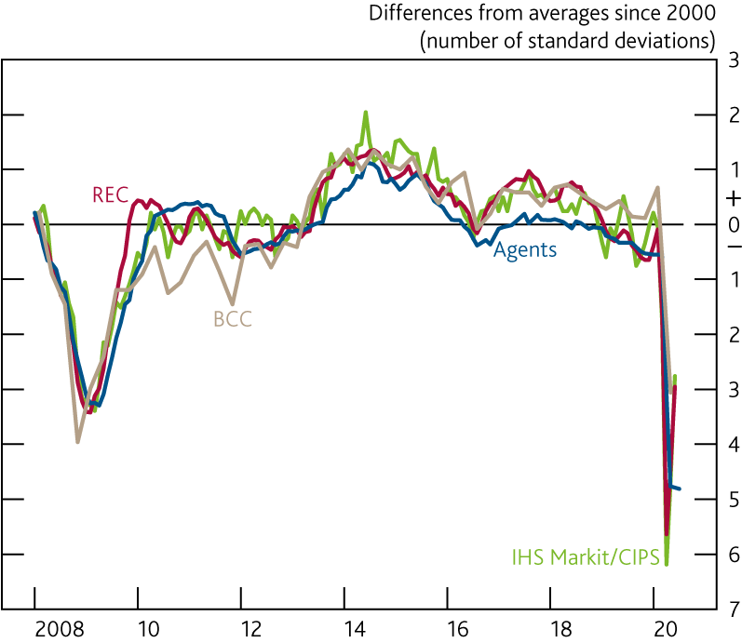
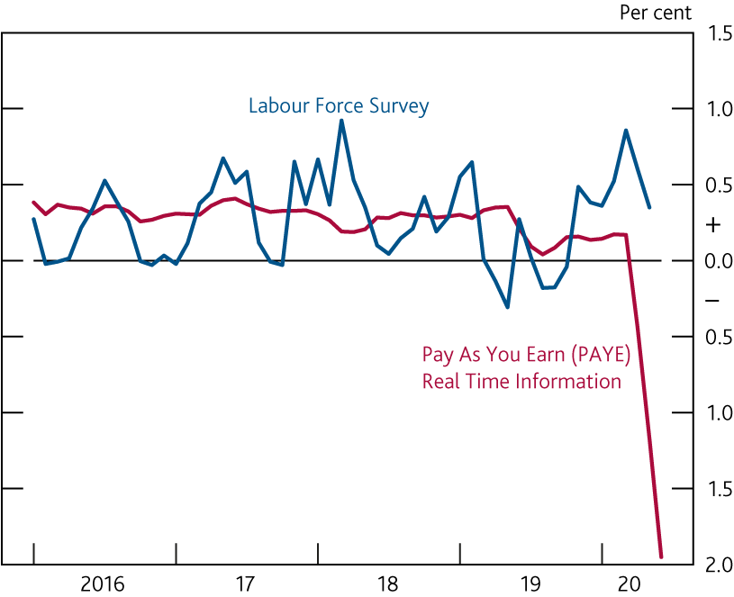
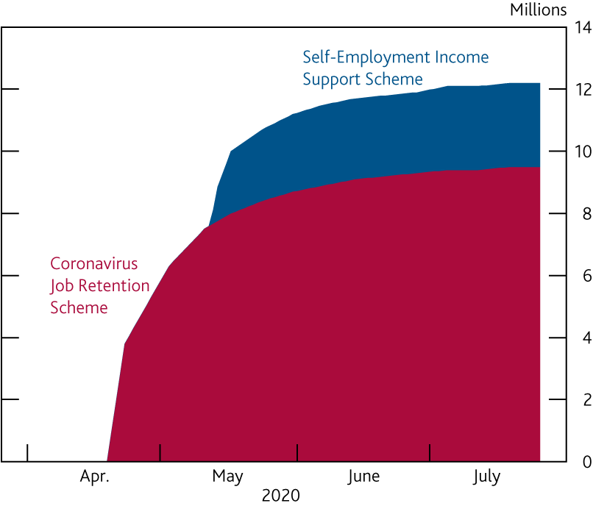
Near-term: labour market
Change in number of employees
Total claims under government schemes
Employment intentions

Slide 9
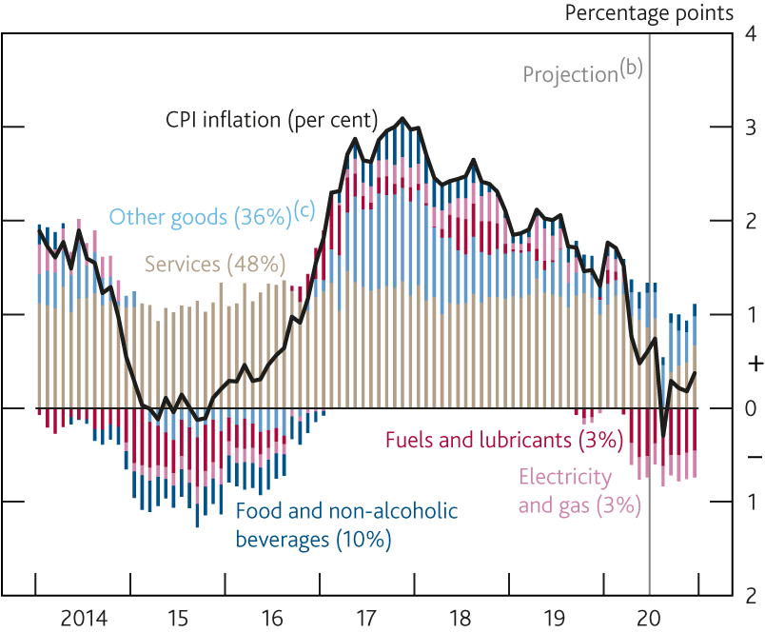
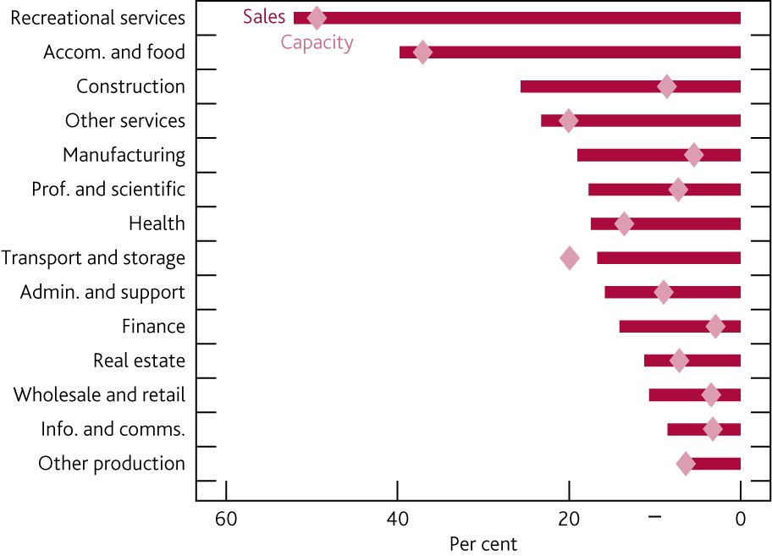
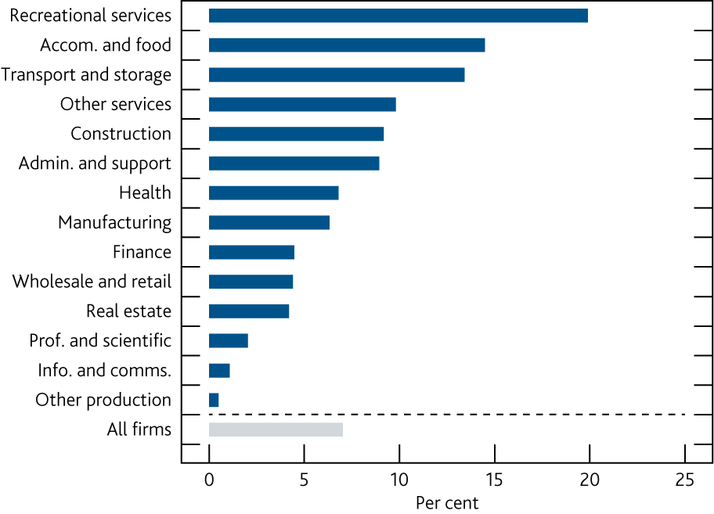
Near-term: inflation
Contributions to CPI inflation
Sales & spare capacity
Unit costs

Slide 10
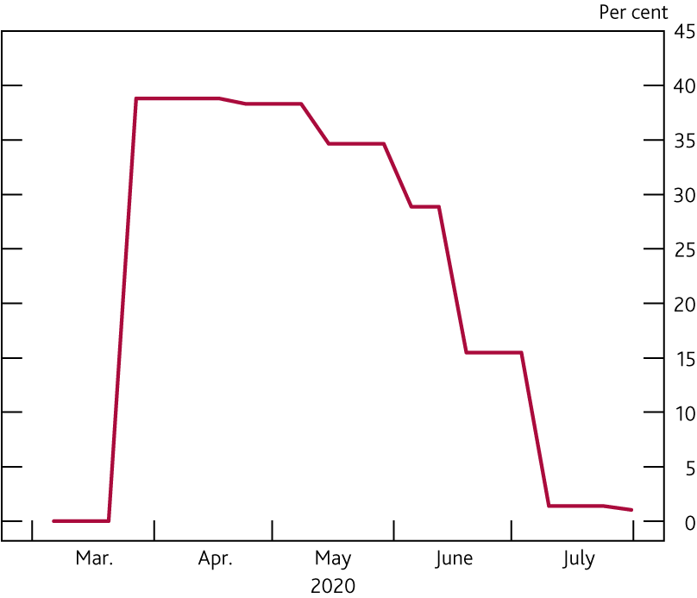
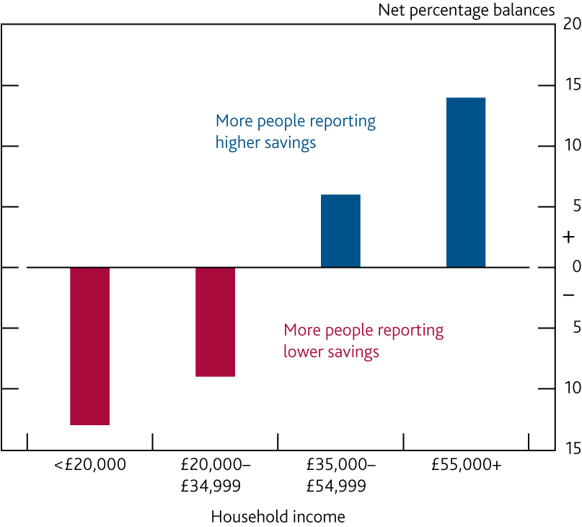
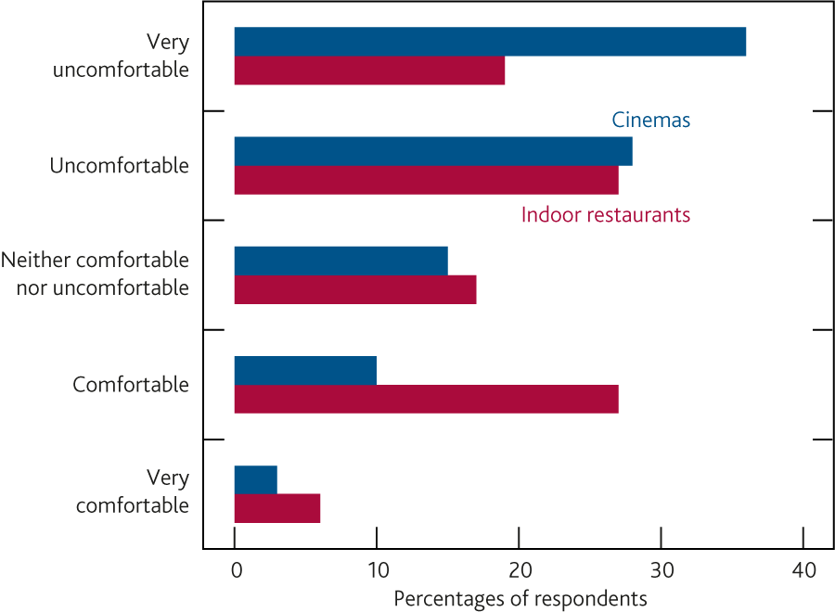
Medium term: consumer spending
Estimated share of restricted weekly consumption
Confidence around social consumption
Household savings by income group

Slide 11
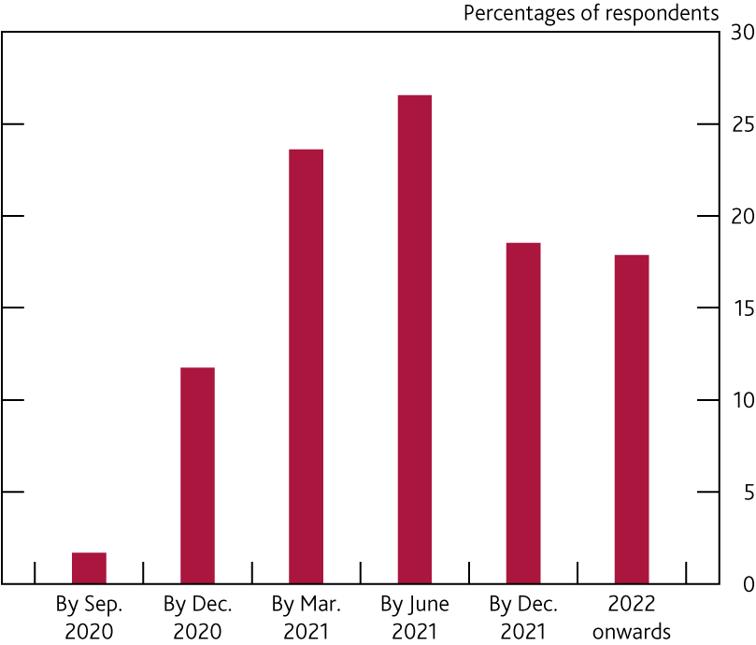
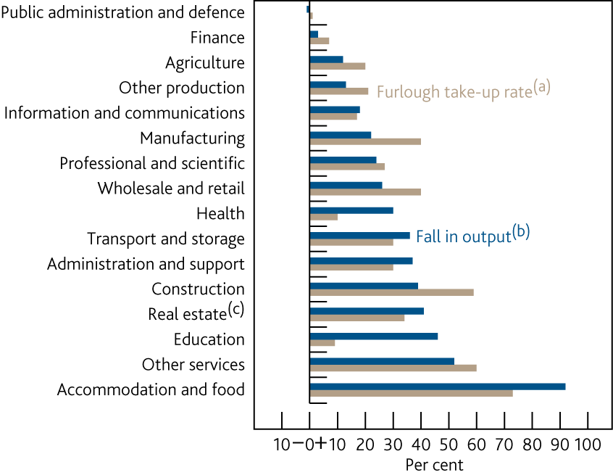
Medium term: labour market
Firms’ uncertainty surrounding Coronavirus
Furlough & output

Slide 12
Projections
GDP
Unemployment
CPI

Slide 13
MPC perspective and policy
MPR includes a box on issues involved in a negative Bank Rate. Effects may depend on nature and state of financial system.
Given the uncertainties involved, MPC has said it will base policy on economy as it evolves, more than on medium-term forecasts at any particular point, and that it will not withdraw accommodation until confident of a significant degree of progress to its objectives.

Slide 14
Poll Question 2
How do you expect the size of your workforce to change over the next twelve months compared to pre-COVID levels?
Options are:
Rise strongly, rise modestly, remain unchanged, reduce slightly, reduce sharply (defined as >10% higher, 1-10% higher, unchanged, 1-10% lower, >10% lower)

Slide 15
Update signpost
August 2020 FSR
Alex Brazier
Friday 7 August 2020
Agency contacts briefing

Slide 16
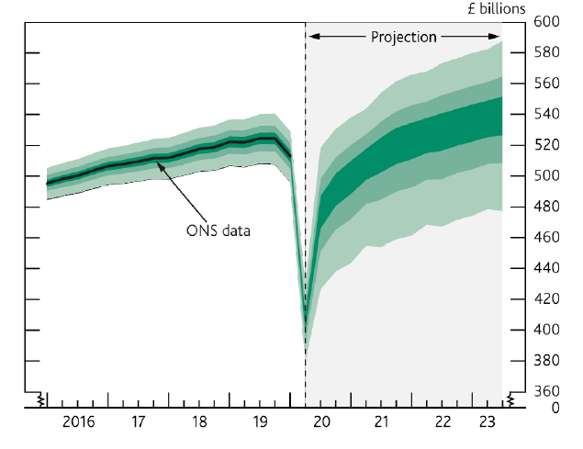
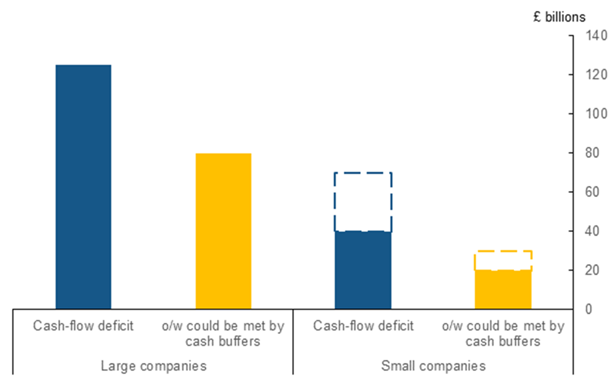
Severe economic disruption resulting in cash-flow deficits for many companies
GDP projection in the Monetary Policy Report
Company Cash-flow deficits could sum up to £200bn
Under the MPR central projection, companies could face a cash-flow deficit of up to around £200bn.

Slide 17
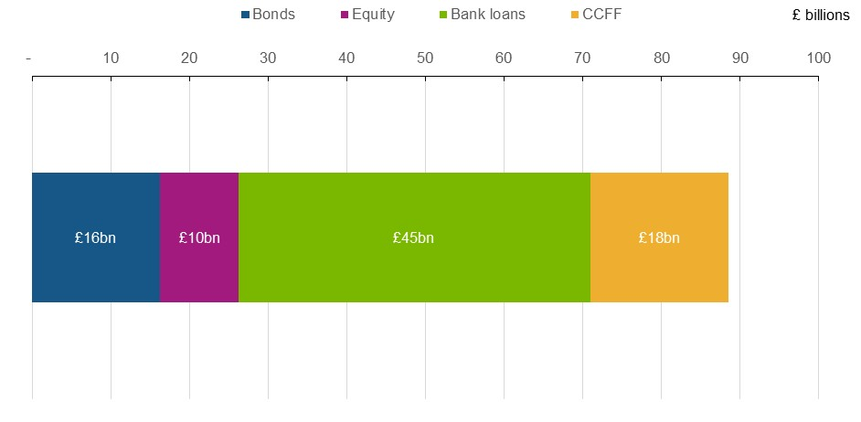
Supported by government-backed loan guarantee schemes, the financial system has met the initial surge in credit demand
Finance raised by businesses in the period March-June

Slide 18
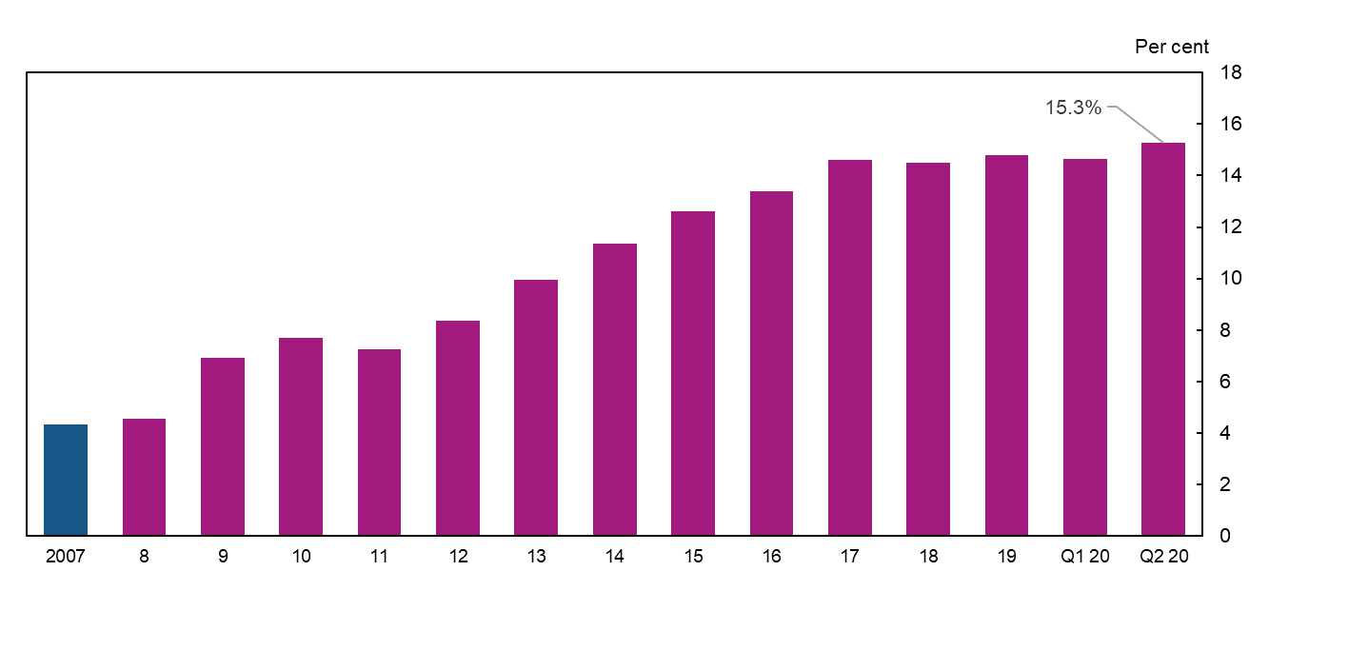
Banks are more than 3x stronger than in 2008…
Banks loss absorbing capital (as % of assets)

Slide 19
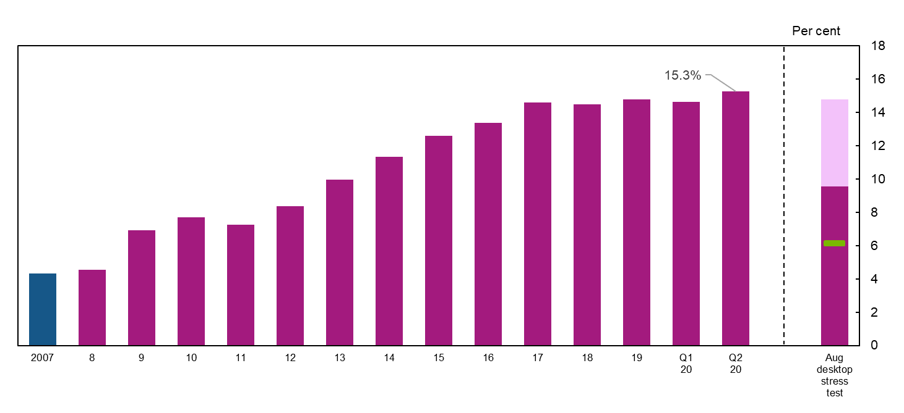
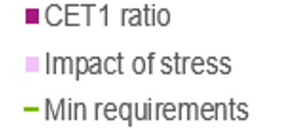
How bad does the economy need to be to jeopardise bank lending?
Banks loss absorbing capital (as % of assets)

Slide 20
How bad does the economy need to be to jeopardise bank lending?
Banks loss absorbing capital (as % of assets)
Equivalent to £120bn of credit losses

Slide 21
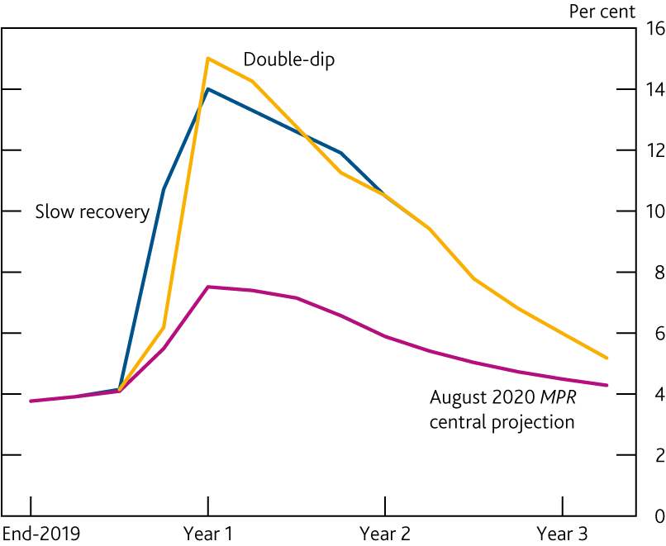
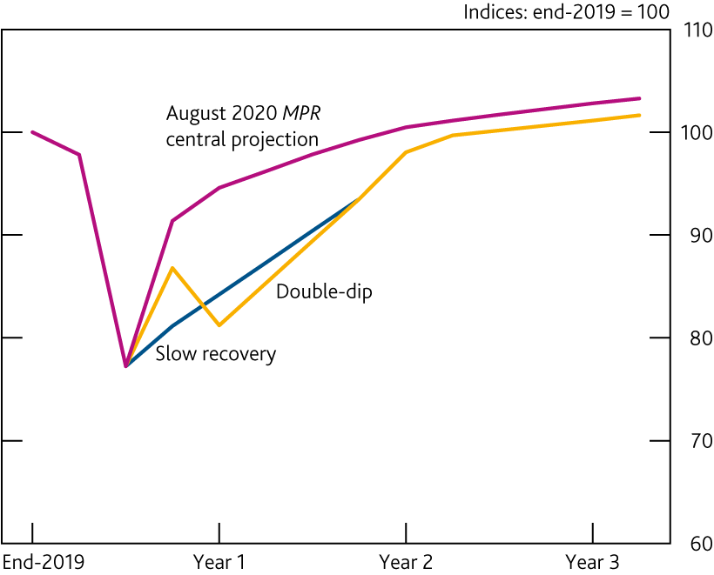
A: Twice as bad as the central outlook.
UK real GDP needed to jeopardise bank lending
Unemployment needed to jeopardise bank lending

Slide 22
Leading us to conclude…
Banks have got the buffers of capital to take the losses even in a very bad scenario. Cutting back lending isn’t necessary to protect them.
With businesses needing finance to bridge, cutting lending would be very costly for economy. (And hence also for the banks)
So despite the wide range of uncertainty, banks can keep lending.

Slide 23
Bond and equity markets
Finance raised by businesses in the period March-June

Slide 24
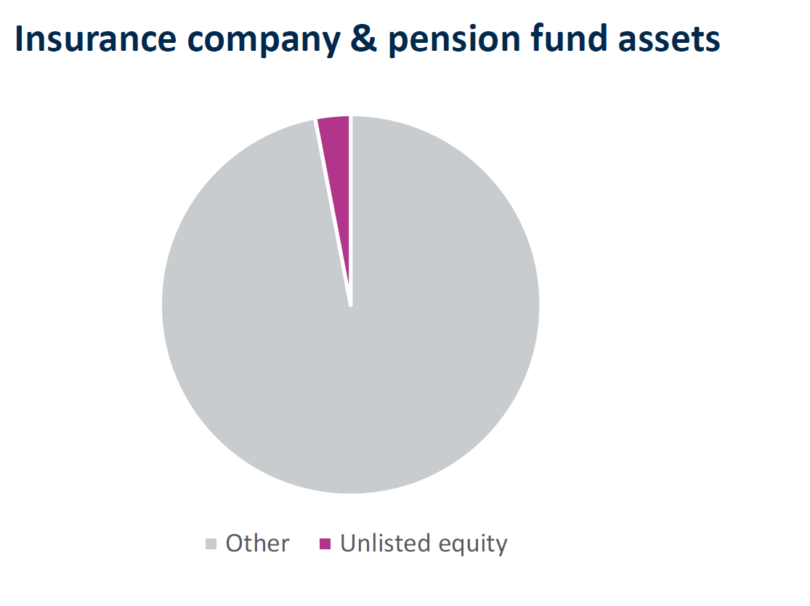
A need for more equity finance in the recovery
Non-listed companies may benefit from greater access to equity finance:
As finance for already highly levered companies
To help repair balance sheets
To support new entrants and growth of incumbents
The FPC will examine distortions to supply of illiquid long term/equity-like investments and any regulatory obstacles

Slide 25
Important: dealing with contracts that use the LIBOR benchmark
Lots of financial products still use the LIBOR benchmark interest rate. But that rate isn’t based on very many actual transactions. It isn’t robust.
It could suddenly cease to exist after end 2021. Most larger borrowers will be affected in some way. You could be exposed to a sudden change in the terms of a contract.
It’s best to change any contracts before then so they refer instead to the SONIA interest rate.
Lenders should work with you to make the necessary changes. They should stop offering Libor-linked loans by early next year. Further information and support is available from the UK’s industry working group.
2022

Slide 26
Questions

