Slide 1
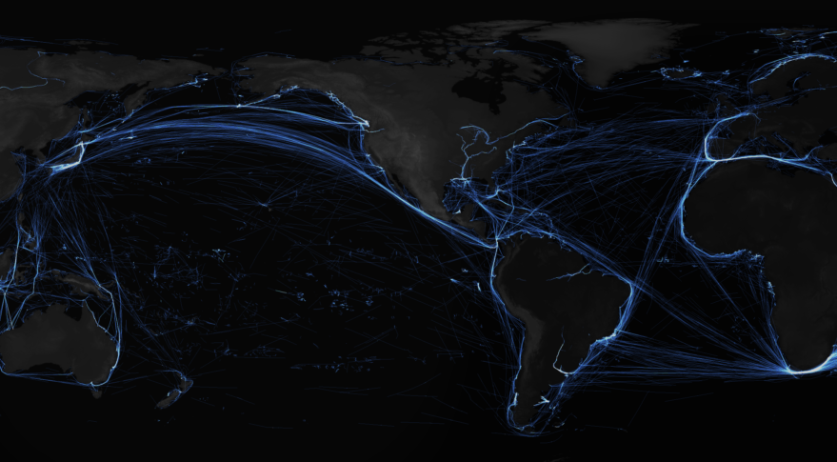
World Seaborne Trade in Real Time
Diego Cerdeiro, Andras Komaromi,
Yang Liu, Mamoon Saeed
Modelling with Big Data & Machine Learning:
Measuring Economic Instability
Bank of England | Federal Reserve Board | King's College
November 6th, 2020
The views expressed here are those of the author(s) and do not necessarily represent the views of the IMF, its Executive Board, or IMF management.
Notes:
I would like to thank the organizers for inviting us to present our work on World Seaborne Trade in Real Time.
This is joint work with Diego Cerdeiro, Yang Liu and Mamoon Saeed.
The four of us is at the IMF, but the usual disclaimer applies: nothing I say represents the official views of our institution.

Slide 2
ROADMAP
Motivation: Real-time trade monitoring
AIS data
Algorithms
Benchmarking results
Applications
  Tracking trade during the pandemic
  Lockdown-induced supply disruptions in trade
Notes:
This is the roadmap for the presentation:
First, I will briefly describe the problem that motivated our research, and the big data source that we use to address the problem.
Then, I will discuss in some detail the algorithms that we designed to extract useful information from the data and show you some backtesting results.
Finally, I will talk about two recent applications of the constructed indicators. The first and more straightforward is high-frequency trade monitoring during the COVID crisis. The second application will show how this new data can help answer research questions that are hard to tackle using traditional data sources.

Slide 3


PROBLEM
3 months
Lag of main trade volume indicator
< 15%
Trade covered by trade finance
(and not volumes)
Data lags
Coverage
t-3
t-1
t
t+1
t-2
Notes:
When we started this project, before the pandemic, people perhaps needed more convincing than now about the usefulness of timely activity indicators. In the case of trade, giving an up-to-date weekly assessment of activity is challenging. [click]
For example, the “gold standard” volume indicator of global trade – based on customs reports – has an effective lag of about three months. [click]
At the IMF, we also follow the trade finance messages between banks in the SWIFT network, but they cover less than 15% of the value of international trade, and do not directly measure trade volume.

Slide 4


DATA: Automatic Identification System (AIS)
2 to 10 seconds
OUR DATABASE:
>2 billion messages (hourly downsampling)
~90,000 cargo ships
2015-today (updates in weekly batches)
Frequency of radio messages sent by ships
Satellite
Message combined with vessel information (e.g. container ship, 15 meters into the water, speed and position)
Terrestrial
receiver
Notes:
At the same time, we know that more than 80% of merchandise trade by volume and 70% by value is carried by cargo vessels.
For navigational safety purposes, all these ships carry a device (called AIS, for Automatic Identification System) that periodically emits a signal. These radio messages can be picked up by satellites and terrestrial stations, and some companies offer them as structured data feeds, mostly as business intelligence for port operators and fleet managers.
We hypothesized that using the same data feed and powerful algorithms, we could aggregate information and literally see international trade happening in front of us. [click]
The results I will present are based on a database that currently contains well over two billion messages emitted by about 90,000 ships from January 1st 2015.

Slide 5
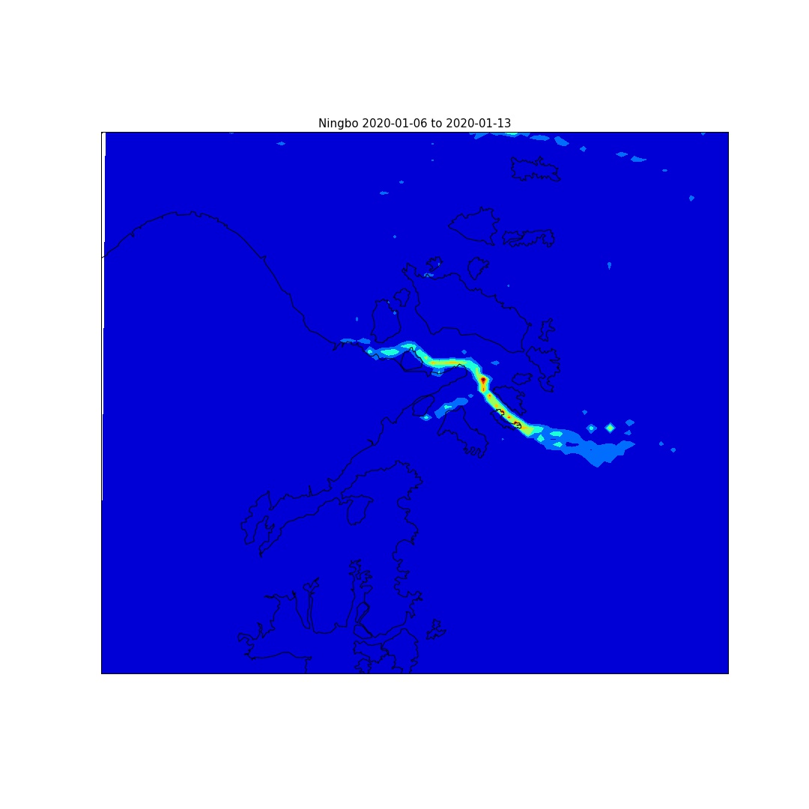
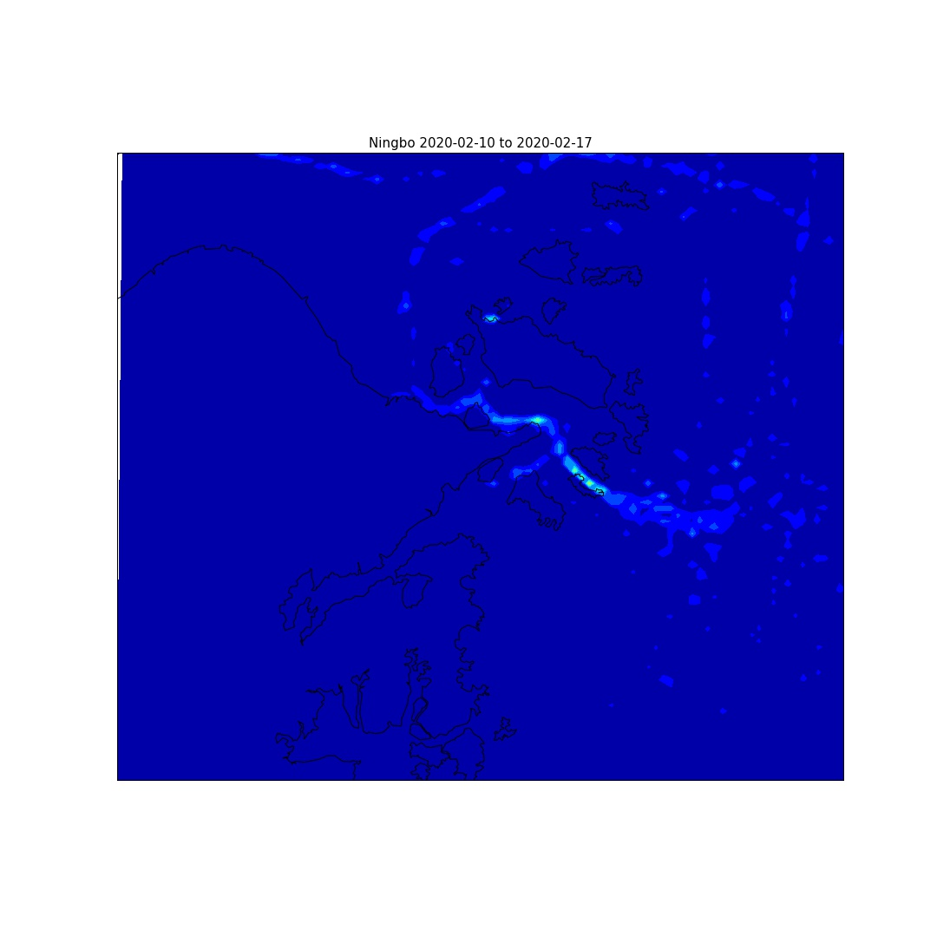
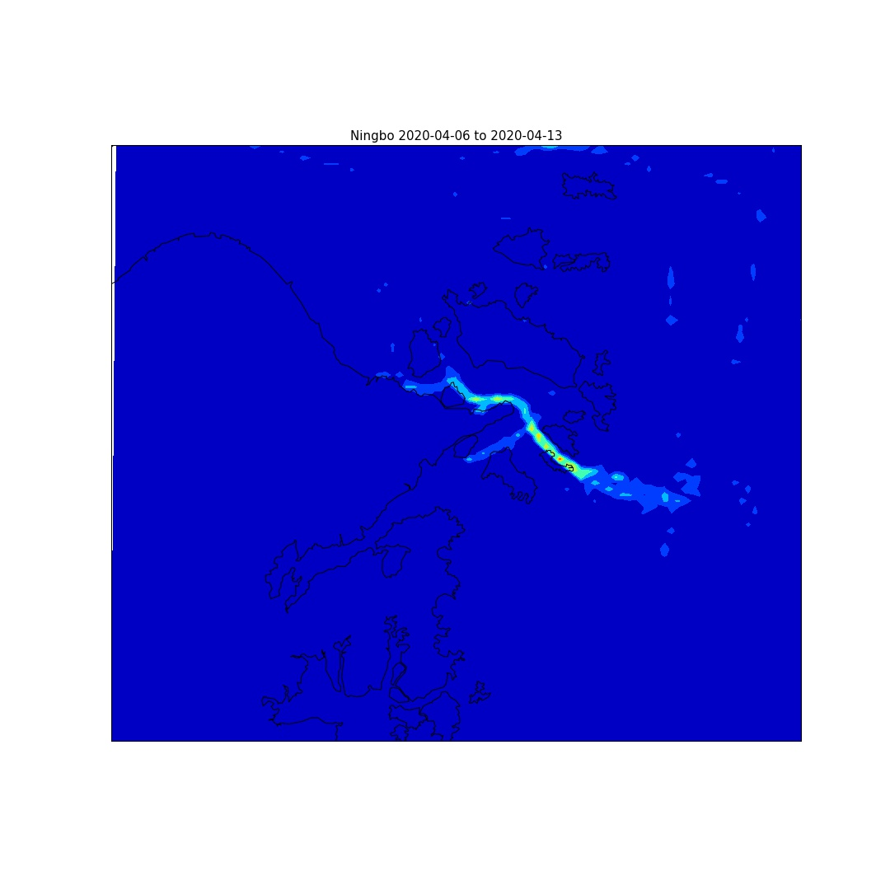
DATA: Visual representation
Port of Ningbo-Zhoushan, China
Jan 6 to Jan 13
Feb 10 to Feb 17
Apr 6 to Apr 13
Notes:
Here is an example of how one could represent the data on a map.
The port of Ningbo is one of the busiest ports in China, and here you see a heatmap of cargo ships over three different weeks in 2020.
The panel on the left corresponds to the first week of this year, where you can see the port seemingly teeming with activity.
The panel in the middle shows a week in the middle of February, during the strictest lockdown measures. The picture shows that things went pretty much dark.
The right panel shows the second week of April. Lights are up again, but maybe not as bright as pre-crisis.
Heatmaps are nice, but we need more work to convert these visuals into economically-meaningful, policy-relevant indicators. We want to answer simple questions like: How big is the drop in trade? Or, was it mostly exports or imports that dropped?

Slide 6
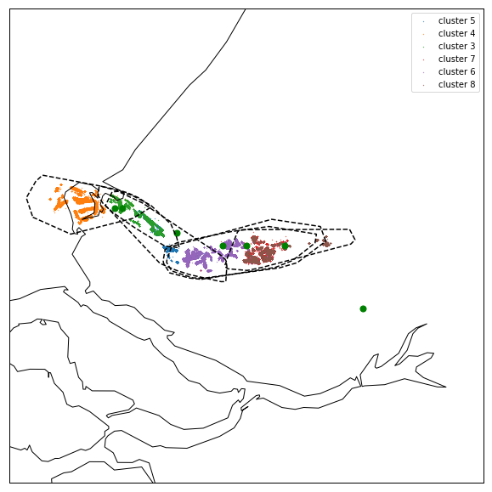


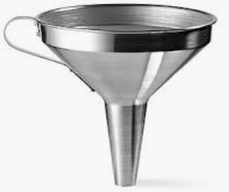

ALGORITHMS: Overview
Transforming raw messages into policy-relevant indicators
Spot the port
Trader or passerby?
Volume? Import/Export?
Benchmarking
Rotterdam
Length of stay
Average speed
How deep is the ship into the water?
etc.
Classifier trained with U.S. data
Trader
Passerby
Notes:
This is the big picture overview of the algorithms we designed:
First, we detected areas that are presumed to be ports, and we assigned these areas to known ports and countries. [click]
Second, we trained a classifier to tell us whether a ship stepping on these port areas is engaged in trade or is simply passing by. [click]
Third, we estimate trade volumes based on the draught of the ship. [click]
Finally, we compare our trade volume indicators with official statistics.
Now let me provide more details about each of the above steps.

Slide 7
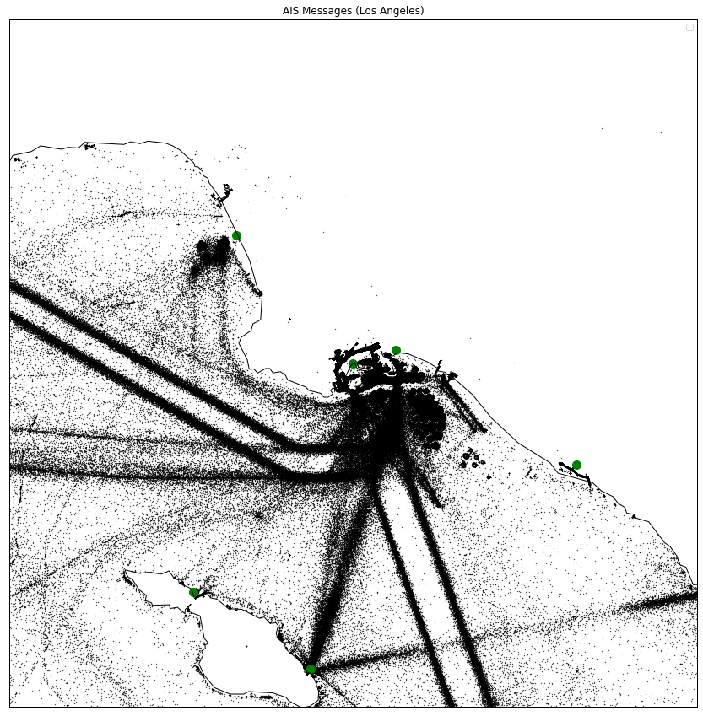
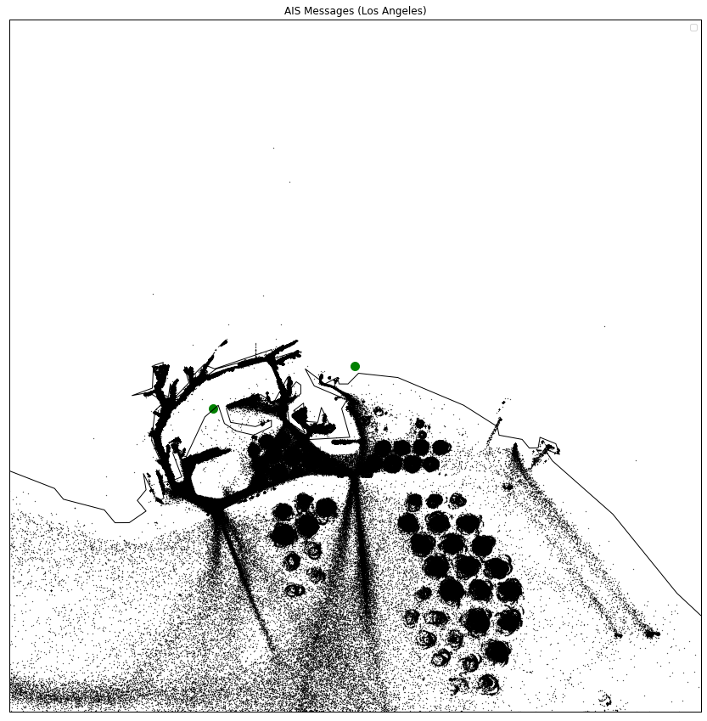
PORT AREAS: Start from reported positions
El Segundo
Los Angeles
Los Angeles
Long Beach
Long Beach
Newport Beach
Isthmus Cove
Avalon
Notes:
As an example of finding port areas, let’s look at all the reported ship positions around the Los Angeles metro area. There are 6 ports in this region.
We can see higher density along the shipping lanes, at anchorages and berth areas. If we zoom in on the Los Angeles and Long Beach ports [click], it shows up even more clearly where ships congregate. The little circles are designated anchorage areas.
As a first step, we filter out messages that are likely sent by calling cargo ships. [click]
********************
Non-cargo/tanker vessels: sailing vessels, yachts, fishing, tugs, dredging, passenger vessels (e.g. ferries),
ISTHMUS COVE (very small) - no cargo/tanker
AVALON (very small) - no cargo/tanker
NEWPORT BEACH (very small) - no cargo/tanker
LONG BEACH (medium) - 38% cargo/tanker
LOS ANGELES (large) - 40% cargo/tanker
EL SEGUNDO (very small) - 25% tanker (Chevron off-shore oil terminal)
Information on port calls by ship type is from fleetmon.com.

Slide 8
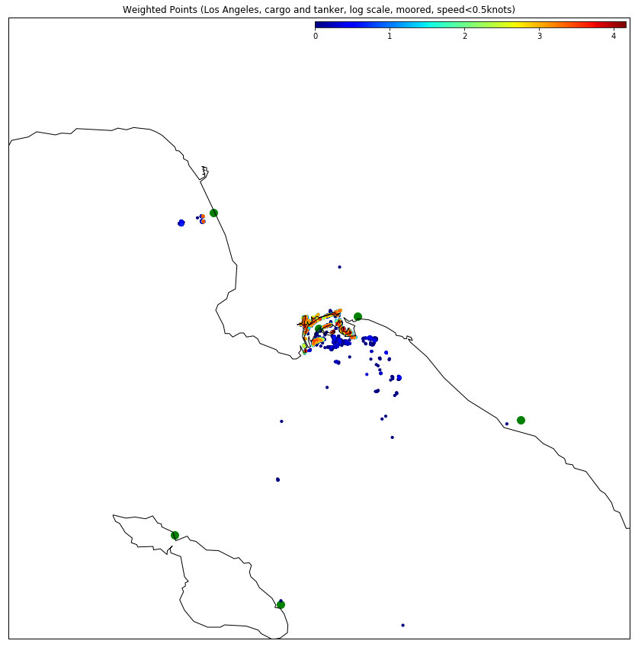
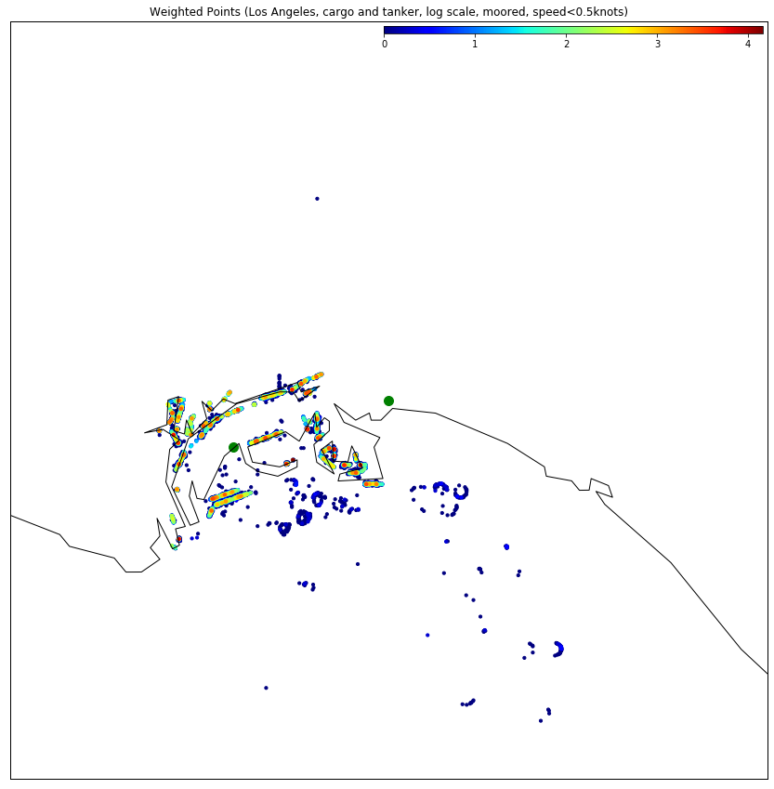
PORT AREAS: Filter relevant messages
El Segundo
Los Angeles
Los Angeles
Long Beach
Long Beach
Newport Beach
Isthmus Cove
Avalon
Notes:
This means filtering on ship type – getting rid of yachts, fishing vessels and the sort, filtering on speed – keeping only stationary ships, and keeping only positions with navigational status “moored”.
On the slide you can see a heatmap of the remaining points. We can make three important observations:
The high-density – reddish, yellowish – areas clearly outline the berths where ships moor.
Some ports end up with no or very few ships around them. These are small ports that don’t participate in trade and will be irrelevant for us.
There are some clearly erroneous messages on open sea or on land.
These errors are well-known features of AIS data, and they mean that we cannot simply draw a polygon around these positions to designate port areas. We need a spatial clustering algorithm that can separate high-density areas from noise. [click]

Slide 9
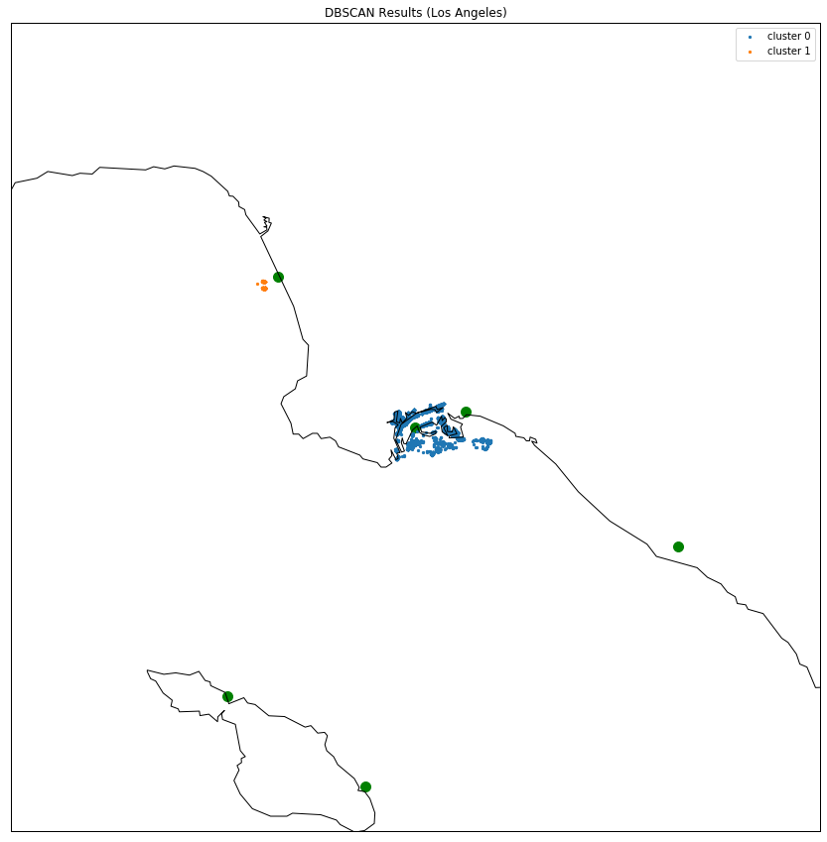
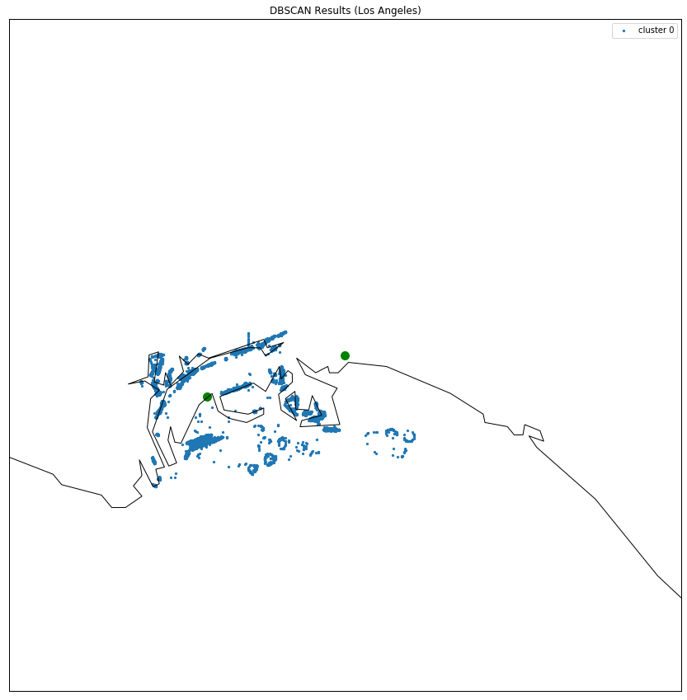
PORT AREAS: Spatial clustering, noise-reduction
El Segundo
Los Angeles
Los Angeles
Long Beach
Long Beach
Newport Beach
Isthmus Cove
Avalon
Notes:
We use a popular spatial clustering algorithm called DBSCAN.
You can see that after running DBSCAN on this area, only three ports retain any ship positions: El Segundo, which is actually an offshore oil terminal for a Chevron refinery, Los Angeles and Long Beach.
The Los Angeles and Long Beach ports are located so close that the algorithm assigns only one cluster to them, and we merge them into one port. We make sure that such merge never happens with ports in different countries.
The last step is to translate the clusters into port polygons. [click]

Slide 10
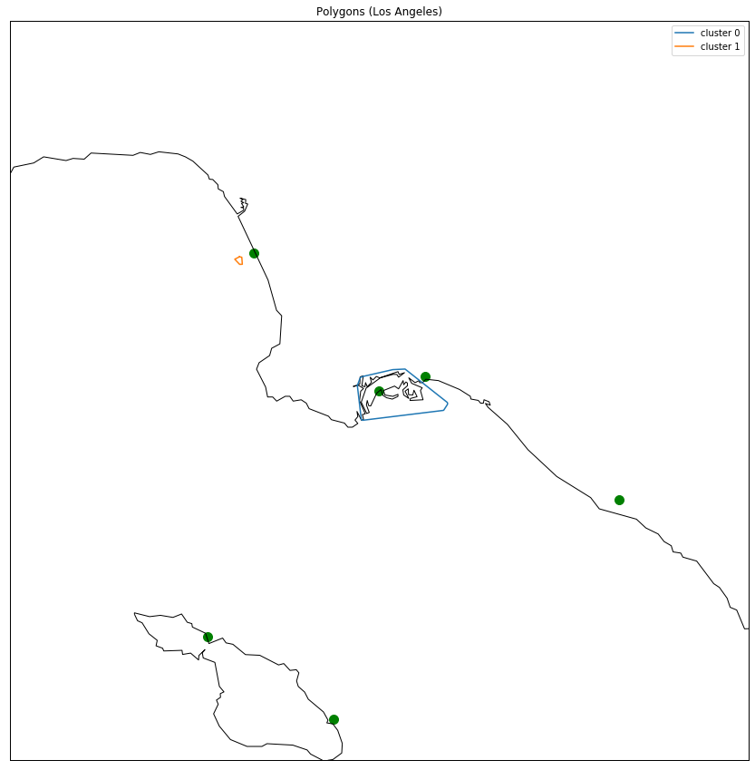
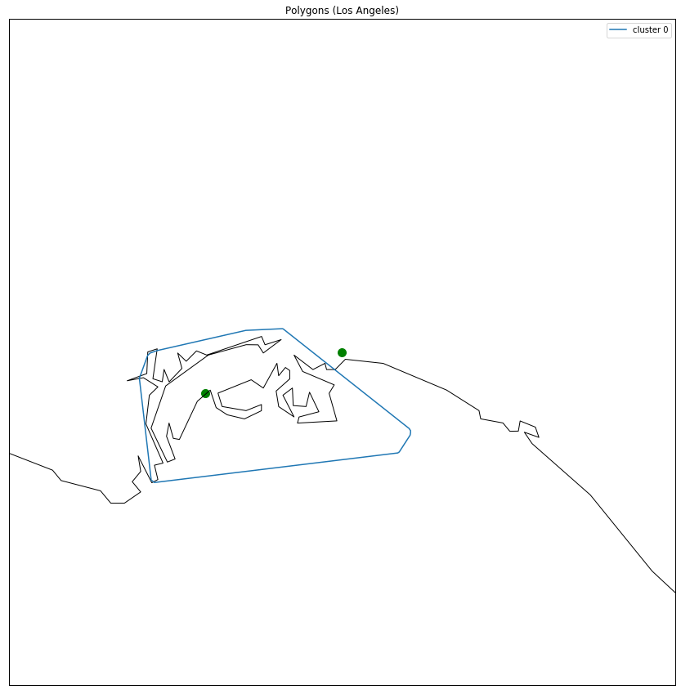
PORT AREAS: Convex hull for port polygon
El Segundo
Los Angeles
Los Angeles
Long Beach
Long Beach
Newport Beach
Isthmus Cove
Avalon
Notes:
We do this by taking the convex hull of the points in the clusters.
In this example, we end with one small polygon for the El Segundo offshore oil terminal and one bigger polygon for the merged Los Angeles-Long Beach port.
For the Los Angeles area, it is easy to validate our results based on public information. Notice, however, that the algorithm didn’t know any of this information.
All that go into the procedure is the AIS-reported ship positions and the location of known ports.
The World Port Index lists about 3700 ports worldwide, so doing this procedure manually would have been impossible.

Slide 11
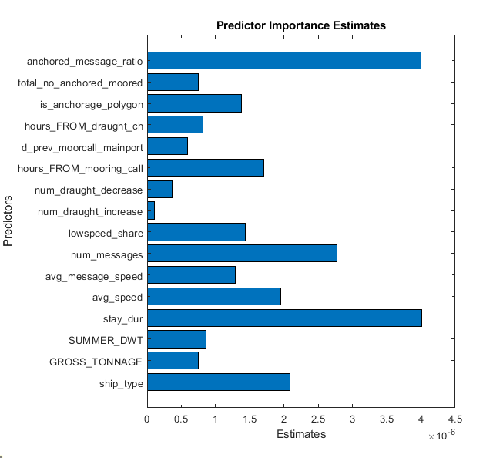
PORT CALLS: Validation and training on US data
Searching official US port calls in polygons
Feature selection (visual analysis + domain knowledge)
↓
Train and compare standard classification models
↓
Random Forest unambiguously best (ROC)
Notes:
We can treat ships entering our port polygons as candidate port calls. To validate the algorithm, we used 4 years of official port call statistics from the US that exactly identifies the vessel and time of entry.
We were able to find most official US port calls in our polygons. [click] In fact, we only miss 5.7% of port calls. This is great news, but there is a caveat. [click]
We find that a lot of times ships enter our polygons without filing an entrance report with the customs agency. We can call these polygon visits fake port calls generated by the algorithm. [click]
Fortunately, we found that there are some features of the polygon visits that help distinguish true port calls from the fake port calls. Hence, we decided to train a model that classifies polygon visits as either genuine port calls or just ships passing by a port.
We needed a flexible model that captures non-linearities. For example, from simple plots it was clear the duration of stay within the polygon is important, but it interacts with other variables. This makes sense because a small container ship can unload much faster than a large iron ore carrier.
We experimented with different classifiers, but a simple random forest unambiguously dominated based on the ROC curve. [click]
The feature importance chart on the right-hand side confirms that the most important variables to identify true port calls are related to the ship type, the length of the polygon visits and whether the ship moved around within the polygon.

Slide 12


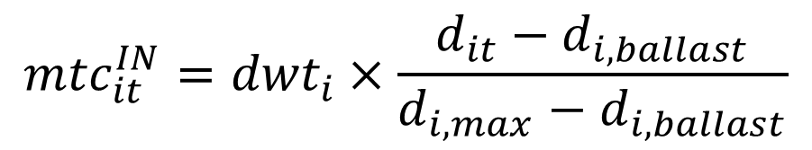
TRADE VOLUME
Estimated cargo weight = capacity × utilization rate
Port calls classified as export/import/internal trade based on:
  sign of ${mtc}_{it}^{IN}−{mtc}_{it}^{OUT}$ (net trade)
  country of previous port
deadweight tonnage
current draught
inbound metric tons of cargo
$${mtc}_{it}^{IN}={dwt}_{i}×\frac{d_{it}−d_{i,ballast}}{d_{i,max}−d_{i,ballast}}$$
draught of empty ship
draught of full ship
outbound metric tons of cargo
$${mtc}_{it}^{OUT}={mtc}_{i,t+1}^{IN}$$
Notes:
Once we identified port calls, we can construct port-to-port voyages. The only remaining piece is to estimate the loaded or offloaded cargo, and construct import and export indices.
To estimate cargo weight, we multiply the ship’s capacity – also known as deadweight tonnage – by a utilization rate. The utilization rate is calculated from the reported draught, taking into account the ship’s minimum or ballast draught and the maximum or design draught.
The change in the cargo weight gives us an indication how much cargo was loaded to or unloaded from the ship. Based on the country of the previous and next port, we classify these loading events as imports, export or internal trade.
This concludes the process of going from raw AIS messages to estimated trade flows for any voyage of any ship. The only remaining step is aggregation across the desired geographical region, vessel types and time periods.

Slide 13
BENCHMARKING RESULTS
NOTE:
We compare our seaborne trade indicators to official trade statistics that include all modes of transportation
Unfair, but realistic
Macroeconomic nowcasting
Sectoral analyses
Notes:
In our benchmarking exercise we use two different aggregations.
First, we use total country-level export and import volumes at the monthly frequency. We call this macroeconomic nowcasting.
Second, we use monthly country-level import and export of crude oil, which we call sectoral analysis.
I note that we compare our seaborne trade estimates to official data that includes all modes of transportation.
From a practical point of view, trade volume by mode of transportation is rarely available, so we don’t really have any other choice.
But it is also how policy-makers want to use any trade nowcast. Generally, they are not interested in how much trade grew via land, air or sea – they want to know how much trade grew, period.

Slide 14
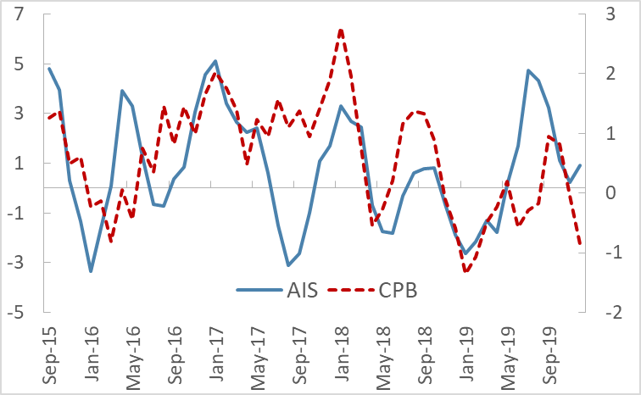
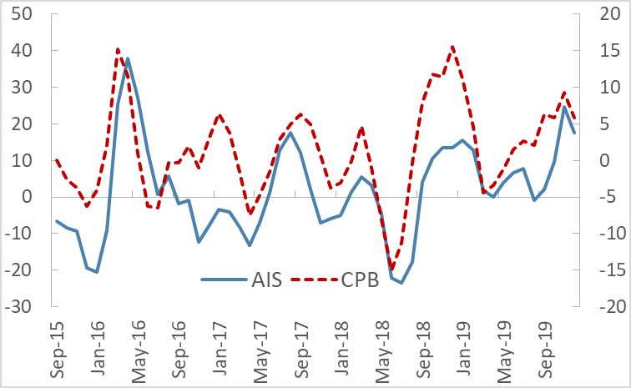
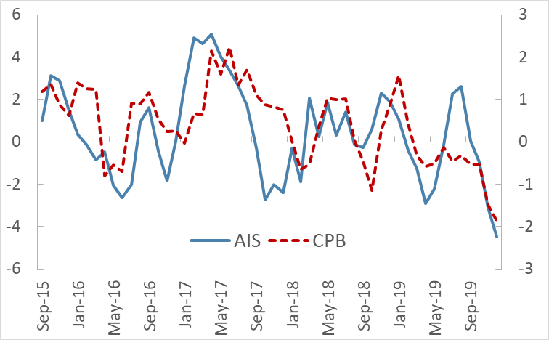
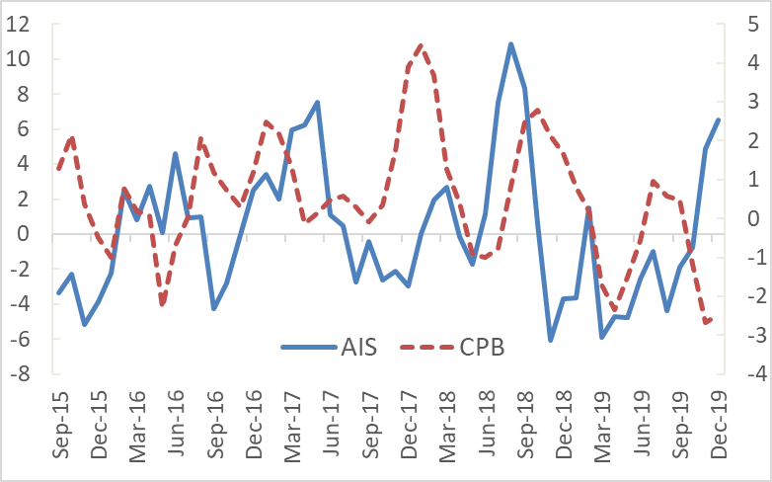
RESULTS: Benchmarking trade nowcasts
Backtesting with official customs data (3m/3m % growth, seasonally adjusted)
Promising results for regional aggregates…
World imports: r = 0.40
Euro Area imports: r= 0.54
…and several country cases:
Argentina exports: r = 0.71
Turkey imports: r = 0.68
Mixed results for some countries:
US imports: r = 0.12
Not always explained by other modes of transportation:
US vs Korea
Homogeneity of product mix?
World imports
Argentina exports
Euro Area imports
US imports
Notes:
We do this benchmarking for more than 40 countries and several regional aggregates. We find good fit for regional aggregates, such as the Euro Area or the whole world, [click] and for many country cases. The correlation coefficients on the slide are from growth rates of seasonally adjusted series.
Not all cases work so well currently, though. [click] For some countries, our estimates don’t track well official customs data. The example I put on the slide is US imports.
It is reasonable that countries with higher share of land and air in their trade would perform worse. For example, maritime transport makes up less than half of US trade value – due to sizable trade with its neighbors via land. However, seaborne trade dominates in Korea, but it still performs relatively poorly in the benchmarking.
Another factor that might be important is how diversified the country’s imports or exports are. The volume of more homogenous trade may be captured better by our methodology – a feature that I will return to in a few slides.
But before that, let’s look at some sectoral results. [click]

Slide 15
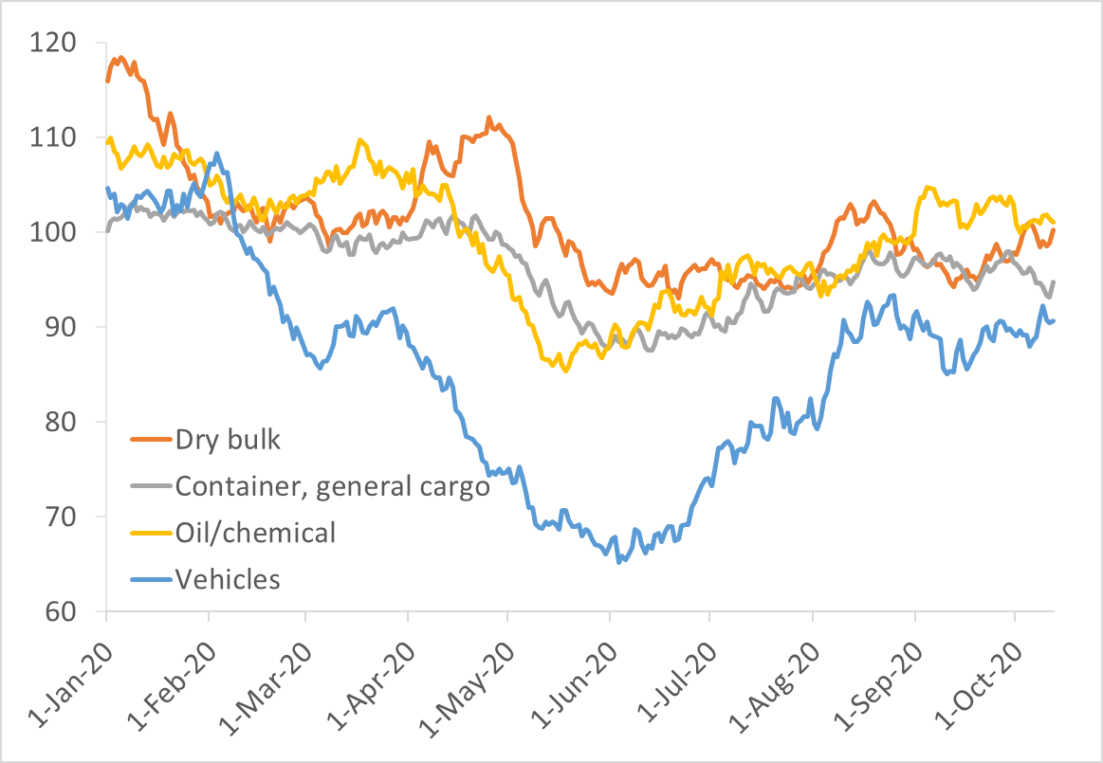
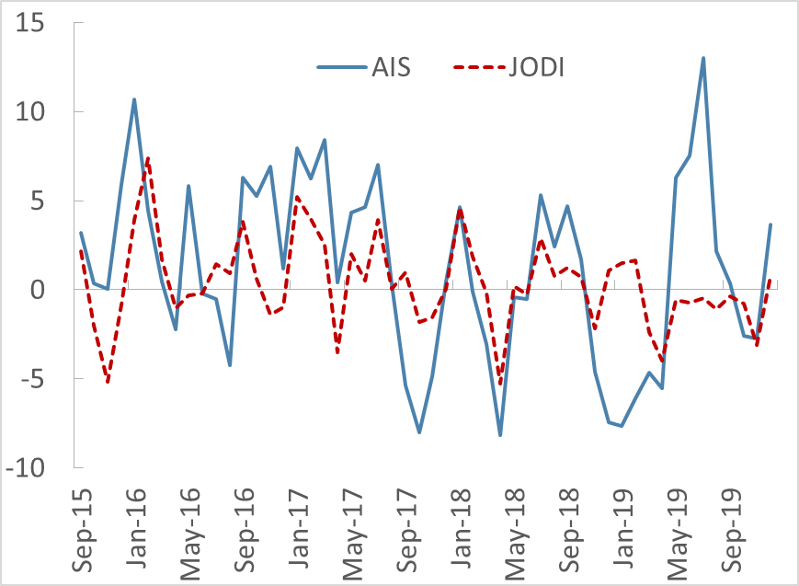
RESULTS: Sectoral analysis
Daily world imports by ship type, 2020
(2019 same day = 100, 30-day moving average)
World crude oil import
(3m/3m growth rates, seasonally adjusted)
AIS: No information on cargo
Tankers/Ro-Ro: more homogenous commodities
Container/dry bulk: vast variety of products
Crude oil imports:
World (0.47), EA (0.60)
mixed country-level results
Crude oil exports:
World (0.11)
generally poor country-level results (reporting issues!)
Notes:
First of all, I want to clarify that the AIS data has no information on the type of cargo. Certain commodities require specialized vessels – such as oil tankers and roll-on/roll-off vessels for vehicles. Other ship types, like container ships or bulk carriers, can accommodate a vast variety of products.
We chose crude oil trade as a testing ground because you need very specific ships to carry crude. On the other hand, unfortunately for us, oil is also transported in large quantities via pipelines. [click]
Broadly speaking, we find that we can track imports much better than exports, and again, regional aggregates often work better than individual country cases. We hypothesize that the poorer tracking of exports may have to do with well-known reporting issues of some major exporters. One telltale sign of these problems is that reported imports of crude oil far exceed reported exports. Considering this, our index may actually be useful in some cases as a source of independent information on oil exports.
To sum up our benchmarking results, I would say that at high level of aggregation our index tracks official monthly statistics very well, but it is available at daily frequency in near-real time.
The timeliness of the indicator allows us to provide a very quick reading of trade when big shocks hit the world economy, like the COVID shock. [click]

Slide 16
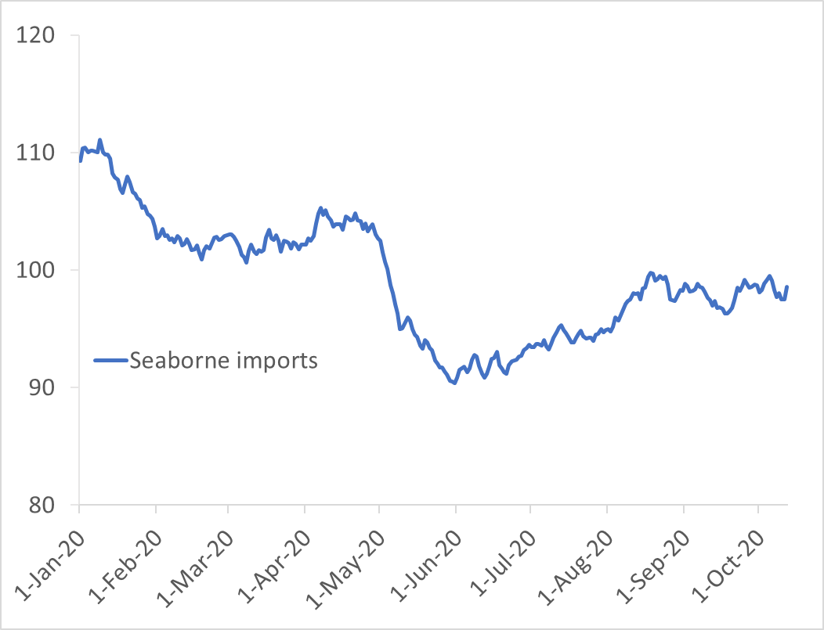
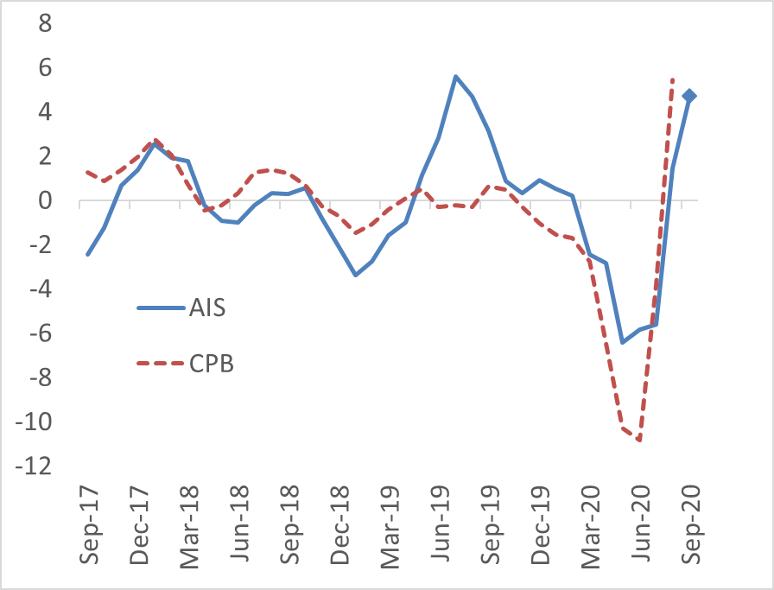
APPLICATION 1: The COVID shock
World seaborne imports, daily
(2019 same day = 100, 30-day moving average)
World seaborne imports and customs data, monthly
(3m/3m growth rates, seasonally adjusted)
Notes:
This leads me to the first application of our methodology and data. In early 2020, as the COVID crisis unfolded, policymakers in international organizations wondered about the impact on the global economy. Since available official statistics were all from the previous year, people turned to new high-frequency indicators – like ours.
As soon as China introduced the lockdowns in January – or even a little bit before – we saw world seaborne trade starting to fall significantly. However, we also saw a flattening out by late February and a modest recovery in April. When China published its March and April trade reports, financial markets were surprised on the upside, even though the data releases were consistent with our internal high-frequency readings. At the same time, the data also showed a steep decline starting early May as major economies grappled with the health crisis. [click]
Today, 6 months later, we have some official trade data for comparison, and this is shown on the right-hand side chart. [click] There is an interesting feature I would like to point out. In historical data, our world trade index exhibits about 2% change for any 1% change in official CPB numbers. But in this episode, it seems that both the drop and the uptick of total trade is larger than what we measure in seaborne trade. What could explain the discrepancy?

Slide 17
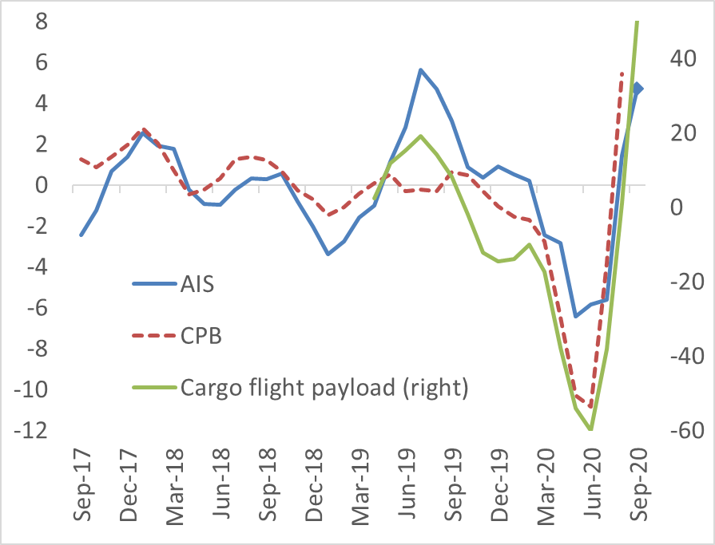
APPLICATION 1: The COVID shock
World seaborne imports, daily
(2019 same day = 100, 30-day moving average)
World seaborne imports and customs data, monthly
(3m/3m growth rates, seasonally adjusted)
Notes:
One explanation specific to this crisis is the complete collapse of air traffic due to containment measures. At the IMF there has been some effort to monitor international air cargo based on real-time flight data. Although it’s hard to separate passenger and cargo flights and we don’t have a utilization measure like the draught for ships, the green line shows the spectacular drop of estimated capacity in operation. If simply there are no flights, we don’t really need to correct for the utilization rate.
Notice that I put air cargo on a different axis for visibility. This is how it would look on the same scale. [click]

Slide 18
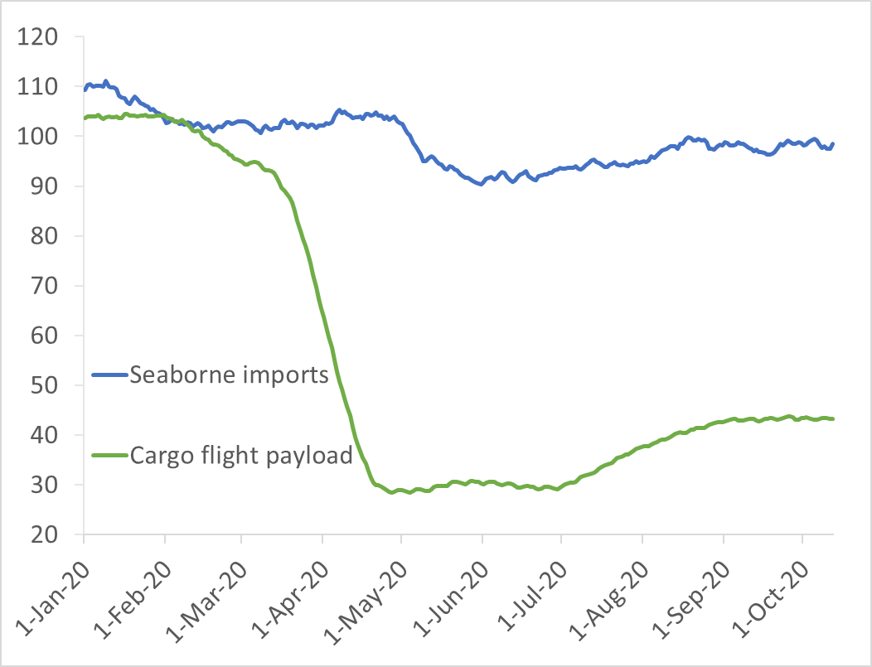
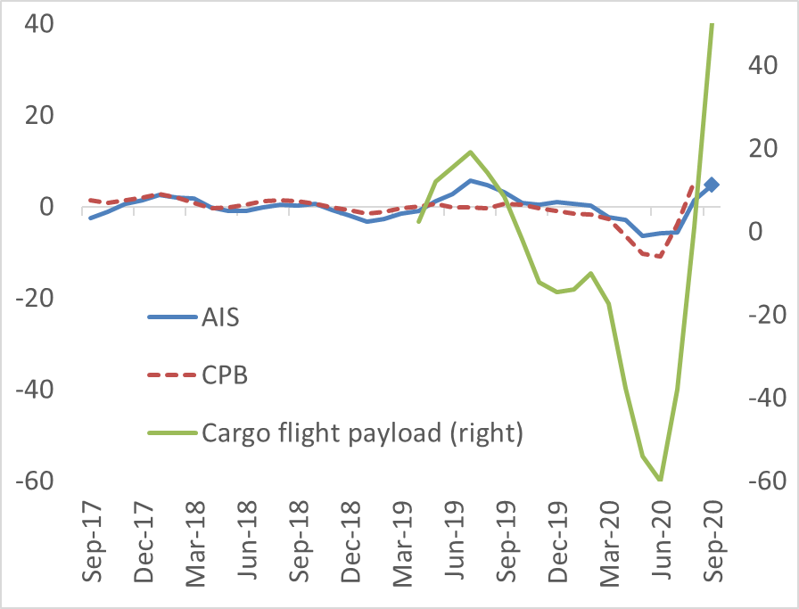
APPLICATION 1: The COVID shock
World seaborne imports, daily
(2019 same day = 100, 30-day moving average)
World seaborne imports and customs data, monthly
(3m/3m growth rates, seasonally adjusted)
Notes:
Similarly, on the left side, you can see the divergence between sea and air transport at the daily frequency.
Even though air cargo is a significantly smaller share of world trade than maritime cargo, such dramatic fall leaves a mark on aggregate growth rates and explains part of the difference between our index and official customs data.
But there is another factor that contributes to this difference. [click]

Slide 19
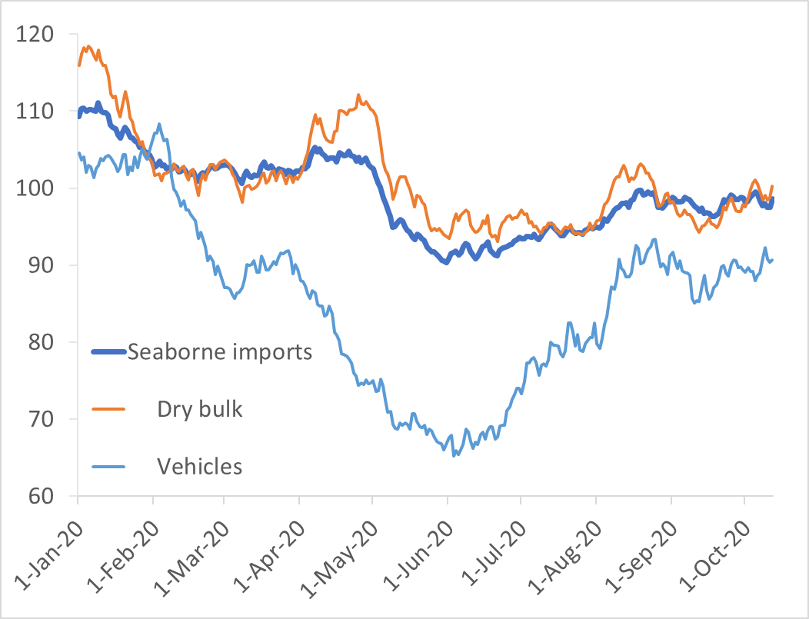
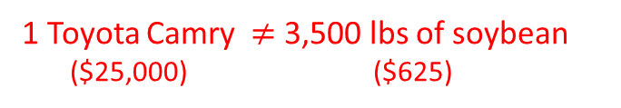
APPLICATION 1: The COVID shock
World seaborne imports, daily
(2019 same day = 100, 30-day moving average)
World seaborne imports and customs data, monthly
(3m/3m growth rates, seasonally adjusted)
1 Toyota Camry $≠$ 3,500 lbs of soybean
($25,000) ($625)
Notes:
On the left-hand side, the thick blue line is the same seaborne import index as before, but I also show the index for two broad subcategories: dry bulk carriers and vehicle carriers. It is evident that vehicle trade was hit much more, due to supply chain disruptions and because households postponed purchases of durable goods.
In our current methodology, we just add up the weight of all cargo. [click] But in a proper volume index, 3500 pounds of soybean on a bulk carrier should not count as much as a Toyota Camry on a vehicle carrier, even if they have the same weight. In the paper, we map ship types to broad HS product categories and construct value-weighted volume indices. However, the results are quite mixed, so we decided to use the simpler unweighted index as our main indicator.

Slide 20
APPLICATION 2: Supply spillovers due to lockdowns
Research questions:
Role of supply and demand factors in trade collapse?
Impact of lockdown-induced supply disruptions on trade?
Method: shift-share design on daily bilateral seaborne trade data
We construct time-varying import lockdown exposure, using:
pre-COVID trade weights
lockdown stringency of partners
historical delivery lags
Notes:
Now let me turn to the second application which is less about high-frequency monitoring and more about testing economic hypothesis.
In the early phases of the pandemic, policymakers wondered ‘How much of the trade decline was caused by disruptions in supply chains versus a reduction in demand?’ For example, government-imposed lockdowns were often linked to disruptions in trade activity.
In ongoing very preliminary work, we attempt to separate the supply and demand channels by constructing a measure of lockdown exposure to trace the effects of these supply-side disruptions.
The logic can be illustrated through the example of Korea and the US West Coast, two areas that import a lot from China. From our AIS data we know that most cargo ships take 1 to 3 days to travel from China to Korea – as shown in the top left chart. [click] This means that a lockdown in China increases Korea’s lockdown exposure very quickly and Korean imports should fall within a few days. This is exactly what we see on the bottom left chart.
In contrast, most cargo ships from China to US West Coast ports travel for 2 weeks or more. [click] As a result, the US West Coast’s lockdown exposure spiked up and import started to fall only about two weeks after China had imposed strict lockdowns.
We use this intuition in a shift-share research design, …[click]

Slide 21
APPLICATION 2: Supply spillovers due to lockdowns
Lockdown Spillovers – Effect on Import Growth
Contribution of Lockdowns to Containerized Trade
Notes:
…and find that lockdown-induced supply spillovers significantly contributed to the contraction of trade, at least in the early phases of the crisis. [click] Our preliminary estimates suggests that containerized trade – the backbone of international supply chains – would have been 10-15% percent higher in February-March without lockdowns.

Slide 22
CONCLUDING REMARKS
AIS data can be used to track trade in real time
  transparent methodology: public data and off-the-shelf ML
New data can help answer interesting research questions
There is room for improvement:
  tighten polygons and increase coverage
  better aggregation across product groups
  integrating other modes of transportation (flights)
Notes:
Let me conclude the presentation. I hope we convinced you that AIS data is useful to track trade in real time. We tried to make our methodology as transparent as possible in the paper, and we share our estimates publicly. [click]
We believe that granular high-frequency trade data also opens the floor for empirical research questions that are hard to address with traditional trade statistics. The lockdown spillover application I discussed is one step in that direction. [click]
However, we think of our methodology as a proof of concept, and there are several avenues for improvement. The automatic detection of port areas does not handle all cases equally well. It should be possible to have a more precise guess of the carried cargo than what we can do now, which would allow for better aggregation across different commodities. Finally, as I demonstrated, it seems possible to integrate other modes of transportation into the system, such as flights, trucks and oil pipelines.

Slide 23
ESTIMATES AVAILABLE ONLINE
Visualize metric tons estimates:
https://comtrade.un.org/data/monitor
Query interface for metric tons estimates:
https://comtrade.un.org/data/ais
Further estimates in .zip file posted here
https://www.imf.org/en/Publications/WP/Issues/2020/05/14/World-Seaborne-Trade-in-Real-Time-A-Proof-of-Concept-for-Building-AIS-based-Nowcasts-from-49393
Notes:
Finally, I just want to flag that links to our data are included in the presentation that will be posted on the conference website. Thank you. [click]

Slide 24
Thank you

