Slide 1

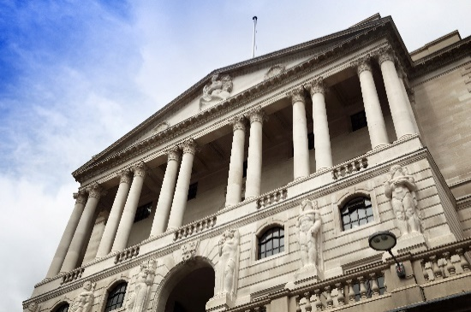

July 2021 FSR
  Lee Foulger
  Sarah Breeden
  Geoff Coppins (Chair)
Wednesday 14th July 2021

Slide 2
Main messages
The UK banking system is strong enough to provide the support households and businesses need as the economy recovers.
There is evidence of increased risk taking in financial markets and some asset prices look stretched.
We are working to strengthen financial markets so they can support the economy in bad times as well as good.

Slide 3
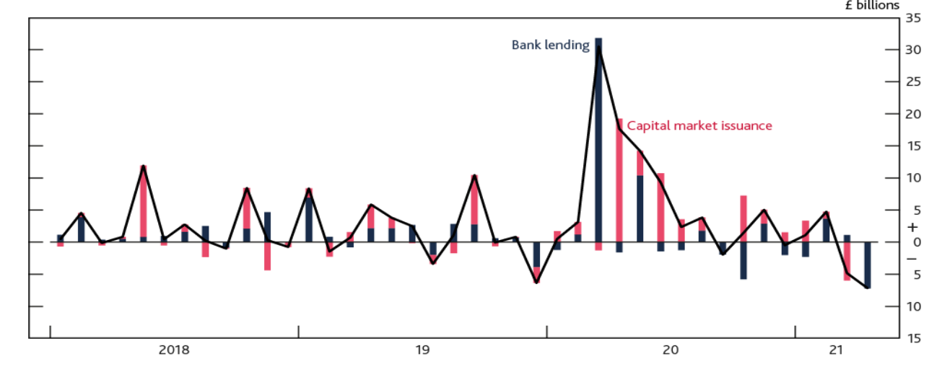
The UK financial system has provided support to the economy during the pandemic
Net finance raised by UK PNFCs per month

Slide 4
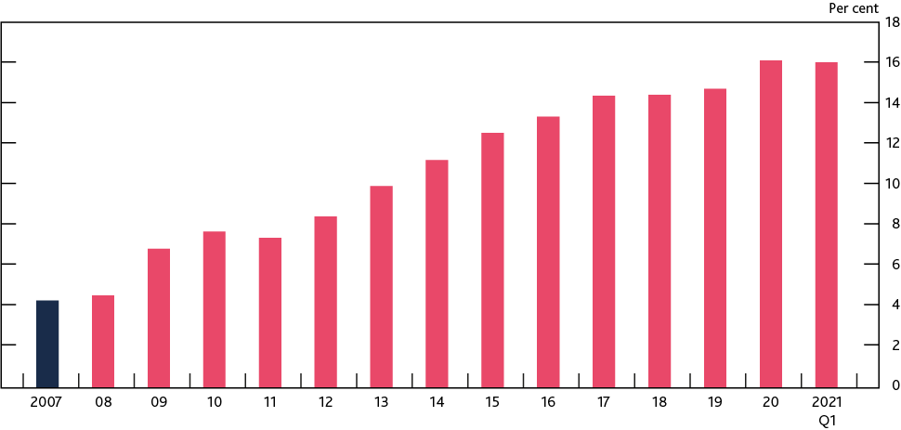
The UK banking system is strong enough to provide the support households and businesses need as the economy recovers.
Aggregate CET1 capital ratio of major UK banks
Stress test scenario variables
Cumulative GDP loss of 37% of 2019 UK GDP
Residential property prices fall by 33%
UK unemployment peaks at just under 12%

Slide 5
The UK banking system is strong enough to provide the support households and businesses need as the economy recovers.
Aggregate CET1 capital ratio of major UK banks
Stress test interim results
>£70bn of credit impairments over 2021/22
Low-point CET1 capital ratio of 10.4%
<60% of banks’ aggregate capital buffers used up

Slide 6
Summary
The financial system has provided support to households and businesses
Households and businesses are likely to need continuing support from the financial system as the economy recovers
The banking sector remains resilient and has the capacity to provide that support

Slide 7
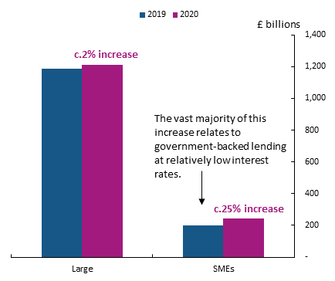
Corporate sector aggregate debt vulnerabilities have increased modestly
Stock of UK corporate debt, split by size, end-2019 and end-2020

Slide 8
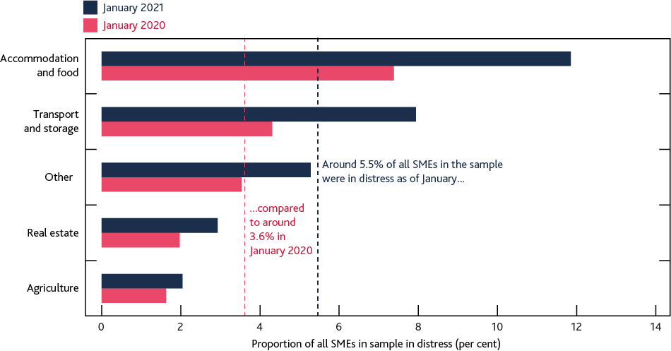
SMEs in some sectors are more likely to be facing additional cash flow needs
Proportion of SMEs in distress (either arrears or default on pre-existing loans) split by sector

Slide 9
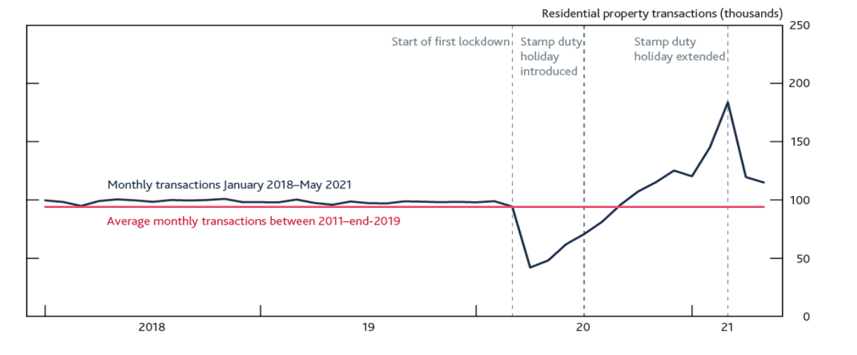
Housing activity is strong
Monthly residential property transactions from January 2018 to May 2021

Slide 10
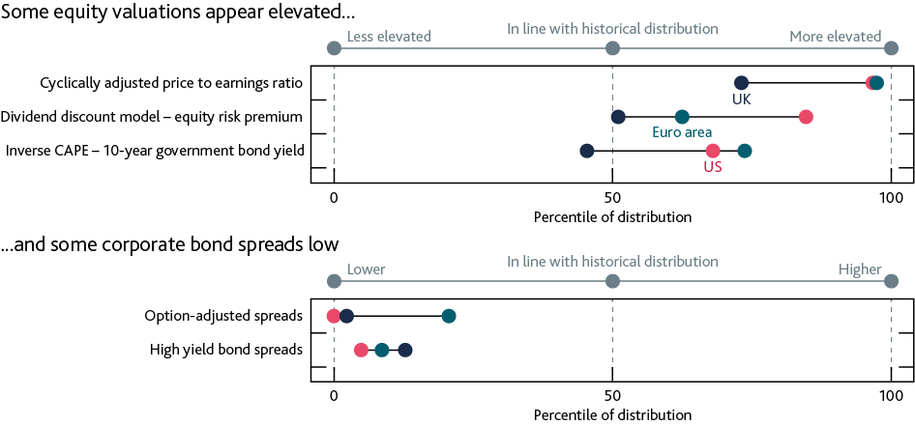
There is evidence of increased risk taking in financial markets and some asset prices look stretched.
Current level of selected asset valuation metrics as a percentile of historical values

Slide 11
Building resilience of the financial system for the future
The resilience of market based finance

Slide 12
Building resilience of the financial system for the future
The resilience of market based finance
The transition to robust alternative benchmarks to Libor
Systemic risks posed by cloud service providers

Slide 13
Main messages
The UK banking system is strong enough to provide the support households and businesses need as the economy recovers.
There is evidence of increased risk taking in financial markets and some asset prices look stretched.
We are working to strengthen financial markets so they can support the economy in bad times as well as good.

