Slide 1
May 2021
Monetary Policy Report
Ben Broadbent
Andy Haldane
Becky Maule
Friday 7 May 2021

Slide 2
Plan of the session
Andy will give you an overview of the Monetary Policy Report
Then we’ll have Q&A session with Ben and Andy
Please submit questions in the chat box as we go and I’ll put some to them

Slide 3
Quick tour of the Report

Slide 4
What’s changed since February?
Economy has weathered the winter a bit better than expected
Restrictions easing a little faster
Furlough scheme extended to the Autumn
Investment and job prospects looking more positive
Evidence consumers willing to spend a little more of their savings
Further fiscal stimulus here and abroad – but some payback further out
Commodity prices and other input costs have risen
Yields and sterling a little higher

Slide 5
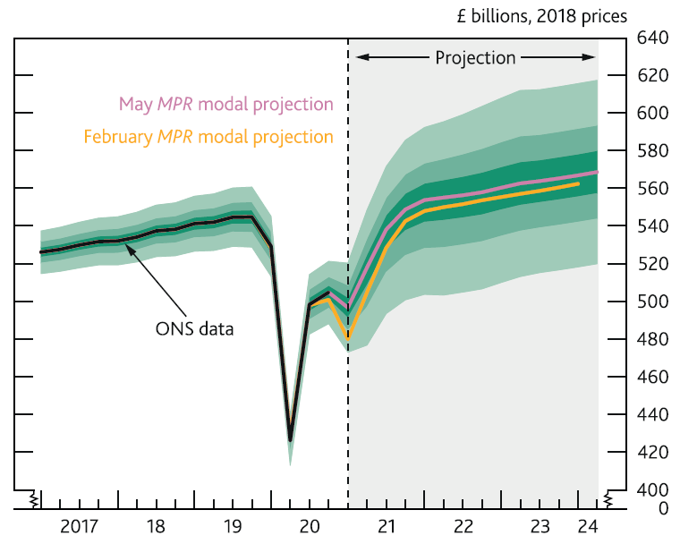
Output profile
Output higher at every point
But two-paced recovery – fast then slow

Slide 6
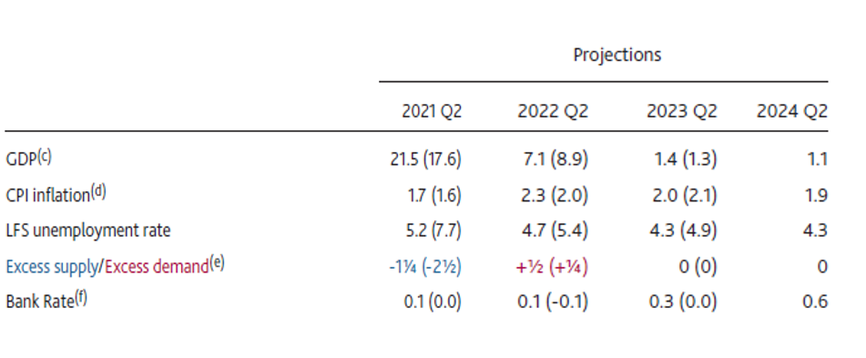
Forecast summary

Slide 7
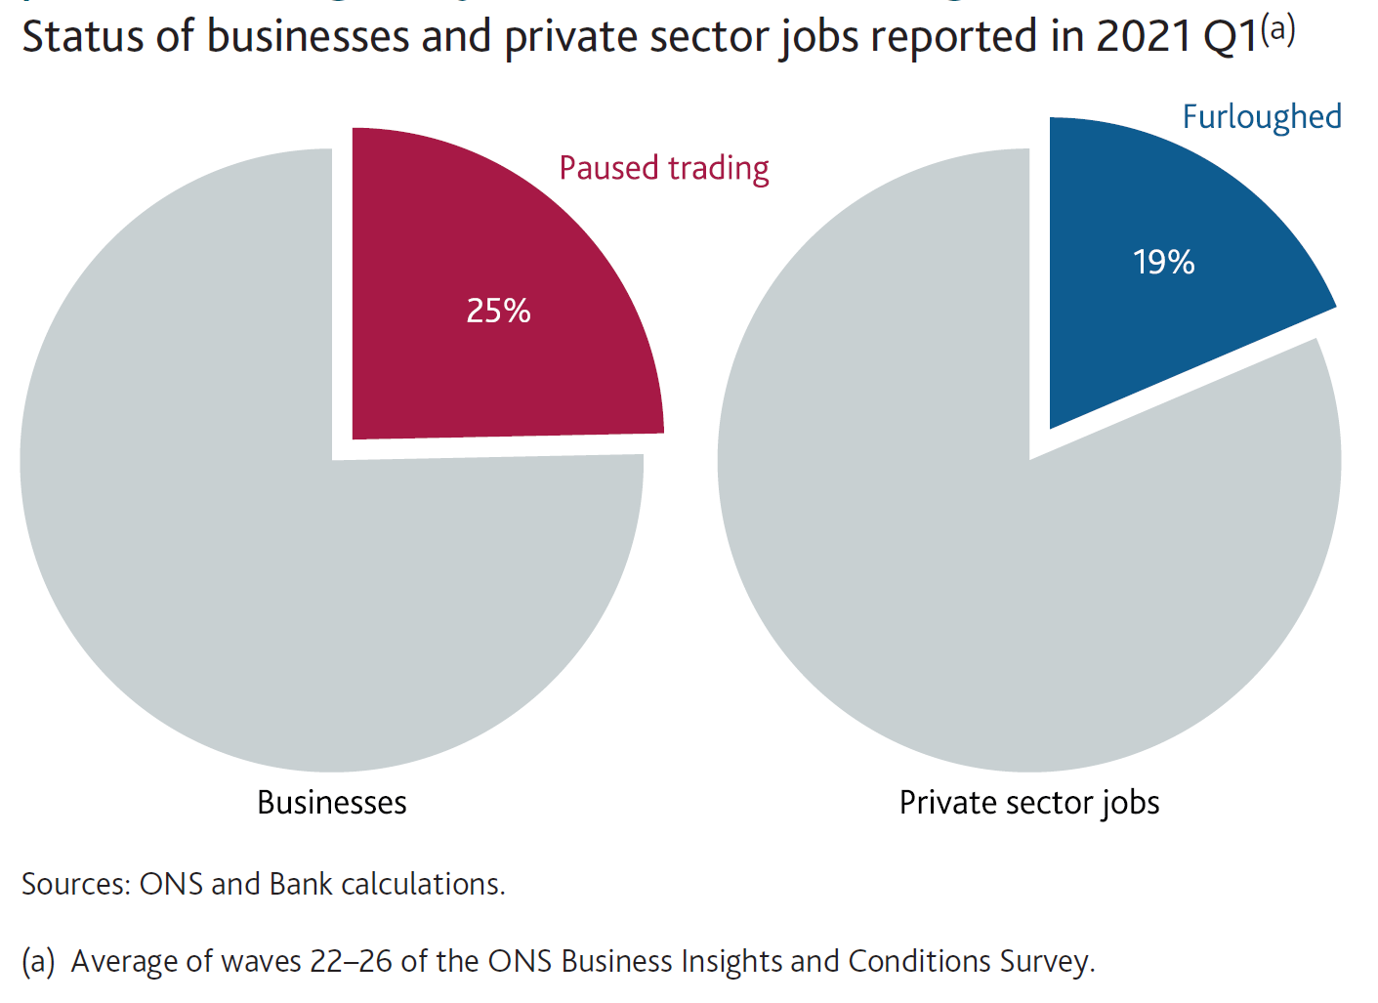
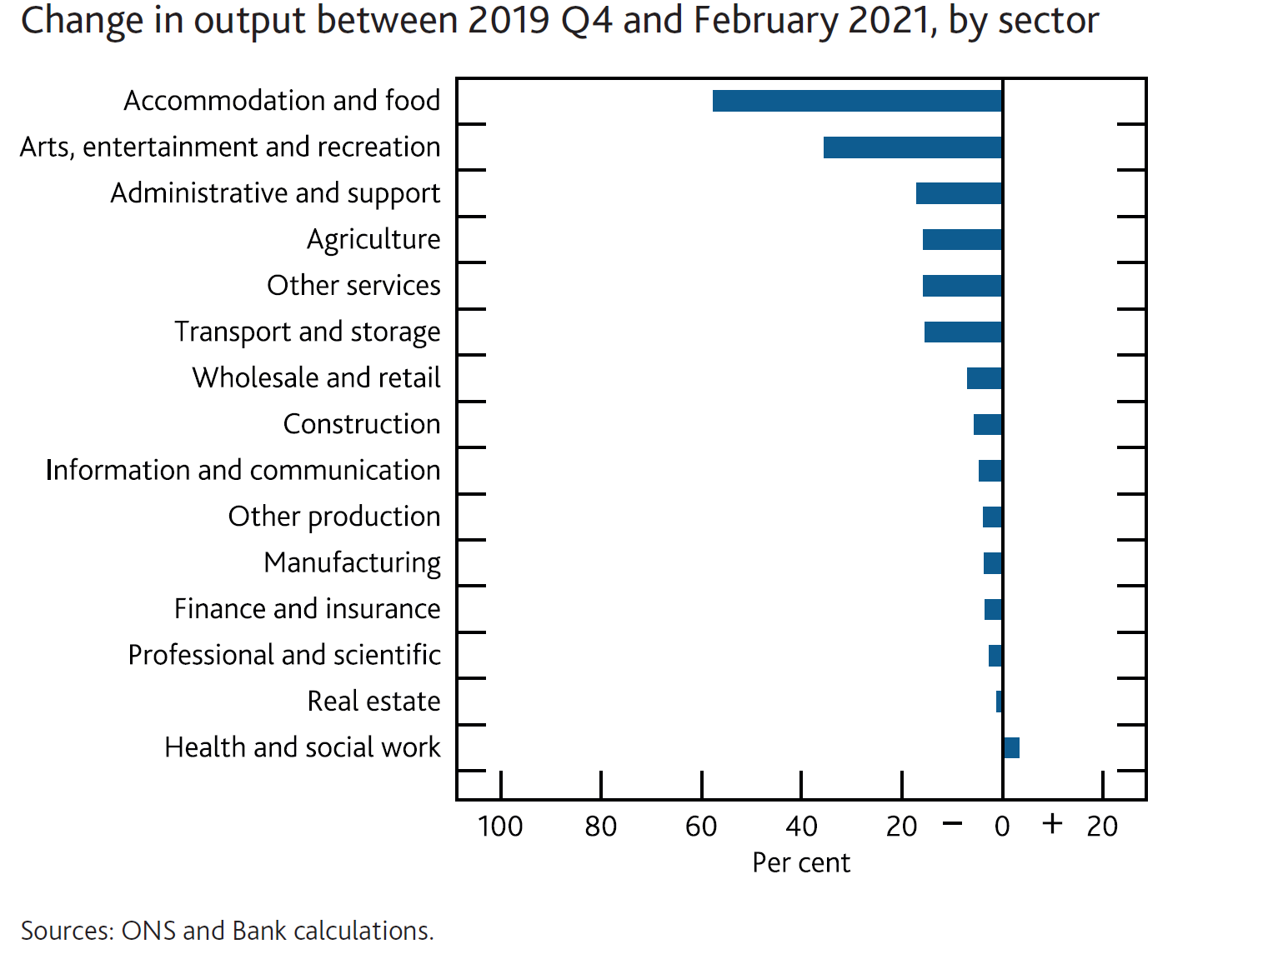
First phase – fast recovery

Slide 8
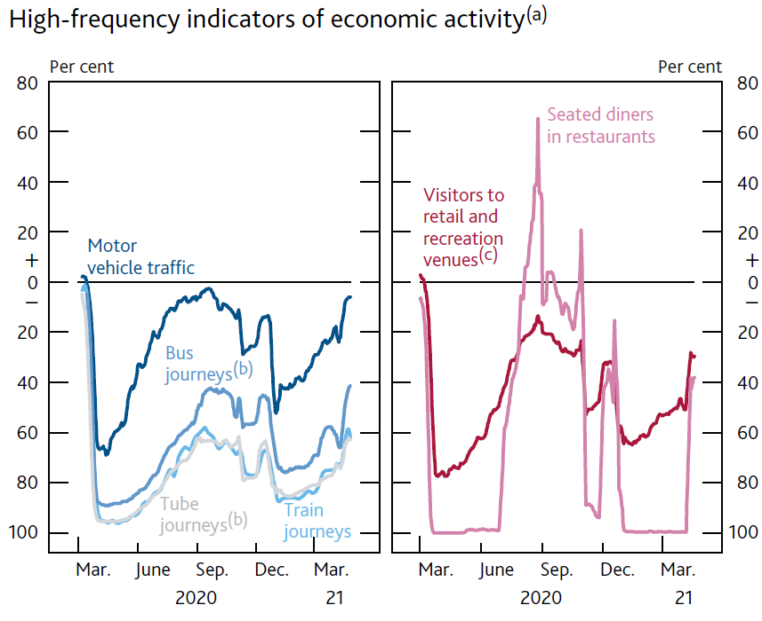
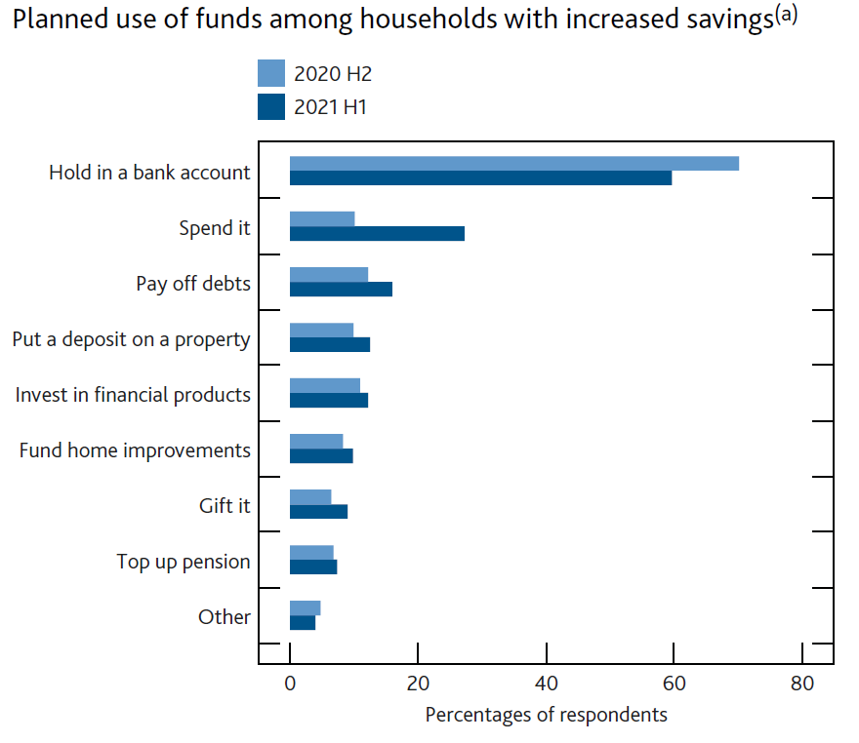
Economy re-opens, households’ spending picks up

Slide 9
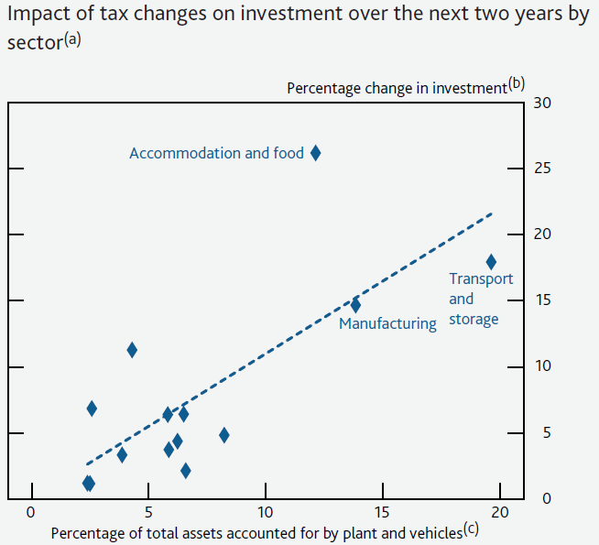
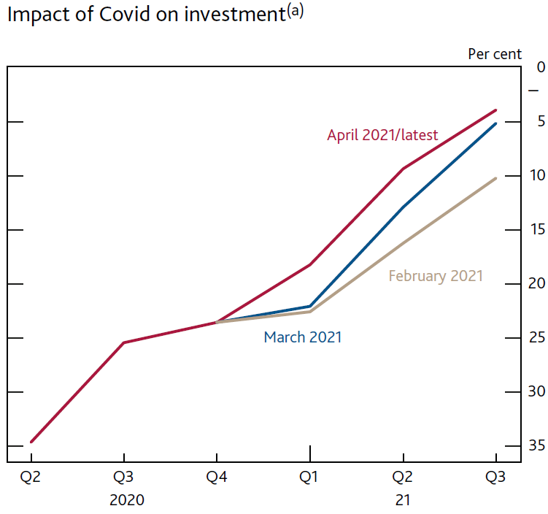
Investment also picking up, supported by super-deduction

Slide 10
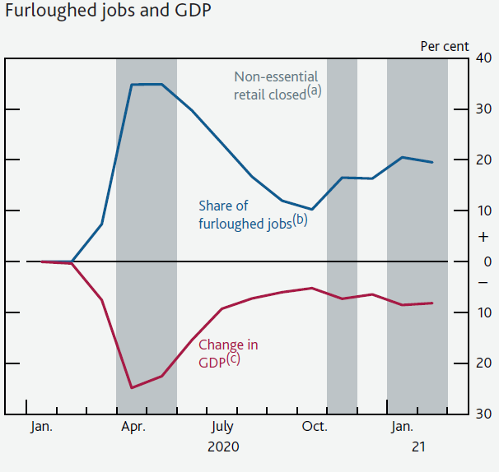
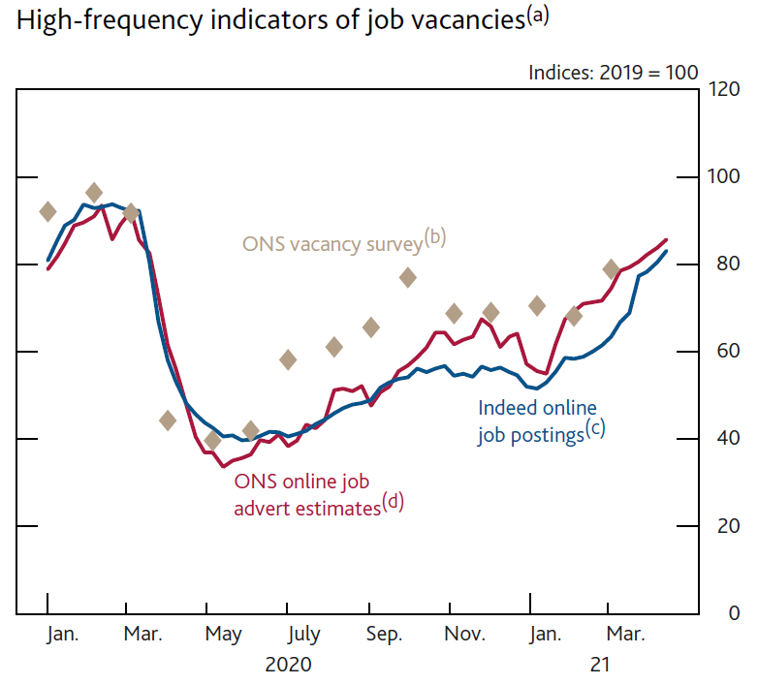
Furlough scheme insulates the labour market and vacancies rise

Slide 11
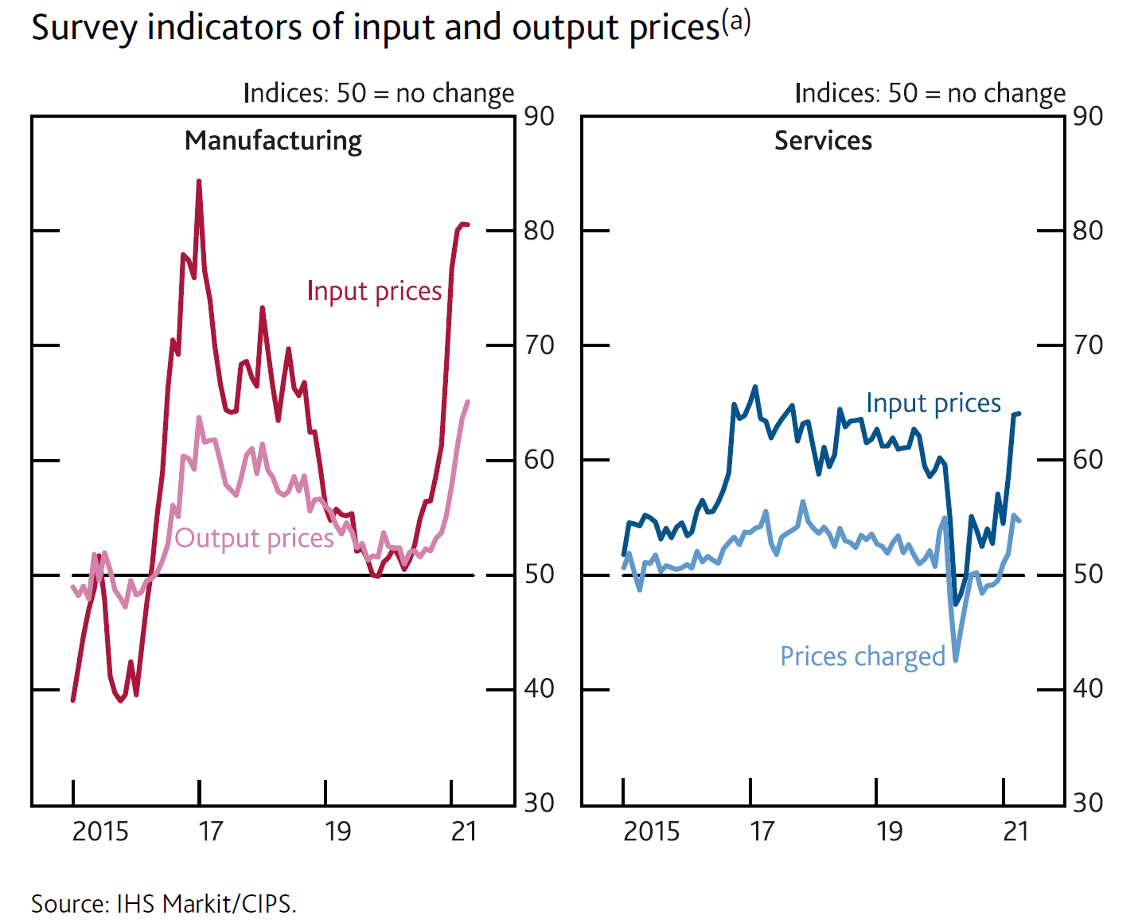
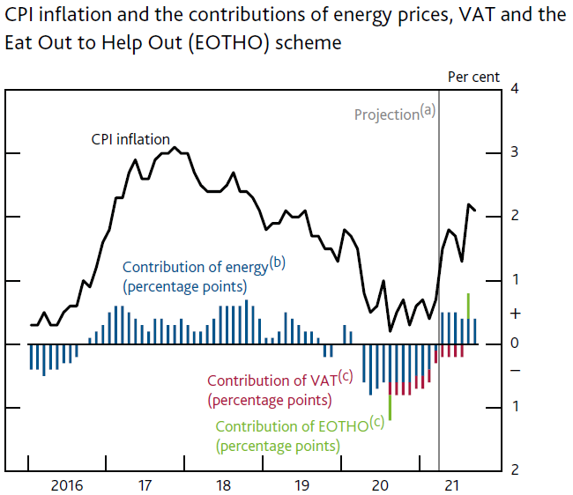
Higher input costs starting to feed through, contributing to return of inflation to target

Slide 12
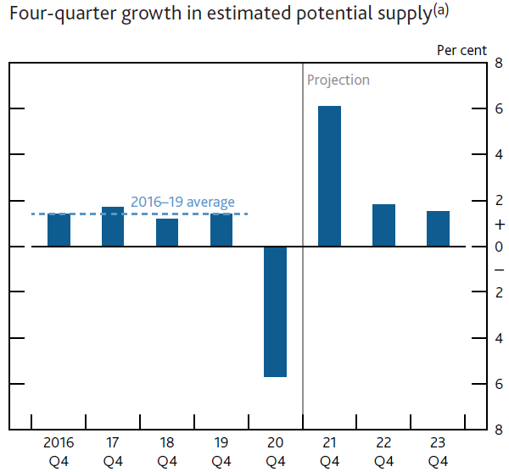
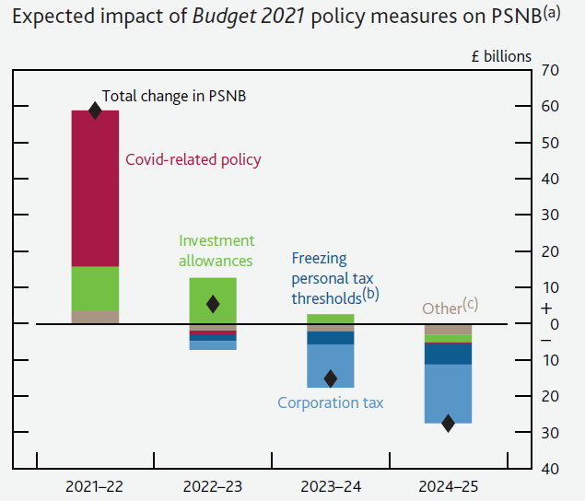
Second phase – slow recovery

Slide 13
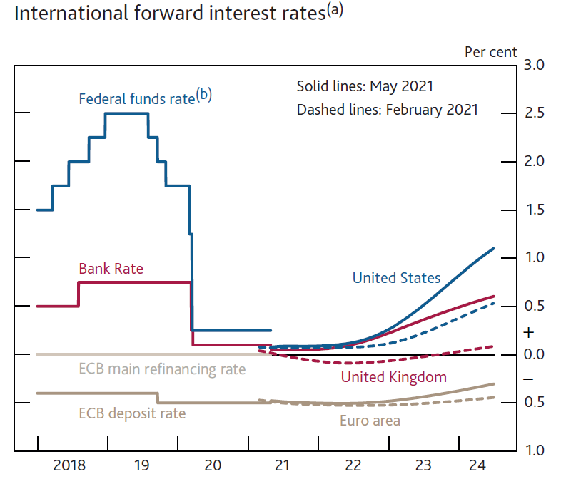
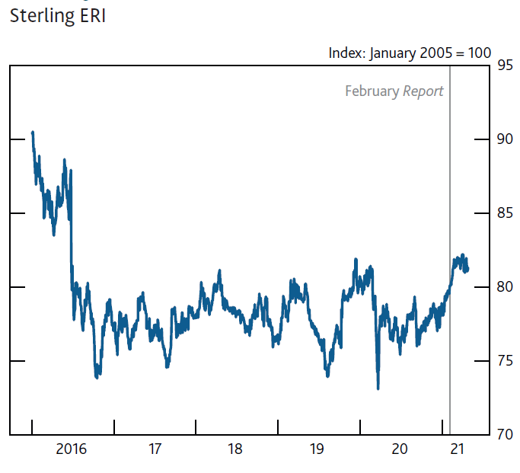
Interest rates and sterling have risen since February

Slide 14
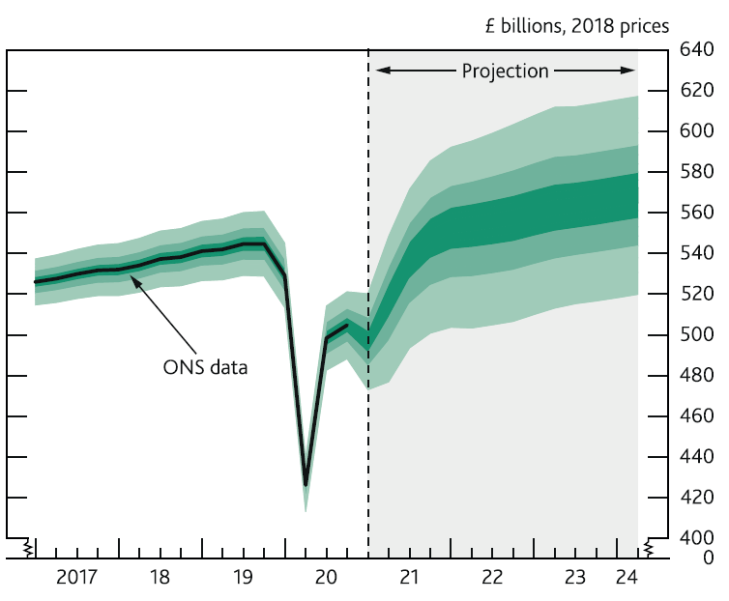
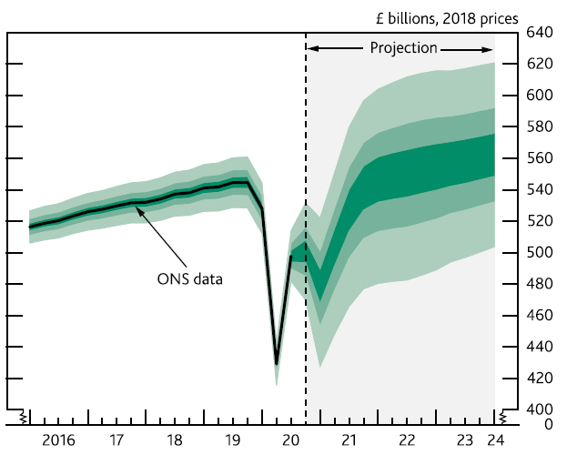
Output
May
February

Slide 15
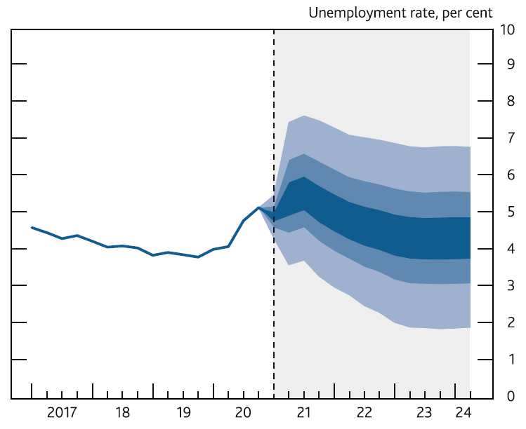
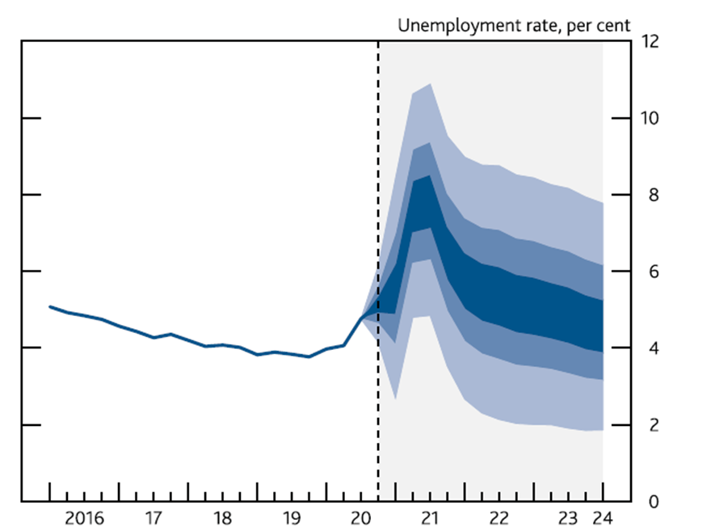
Unemployment
May
February

Slide 16
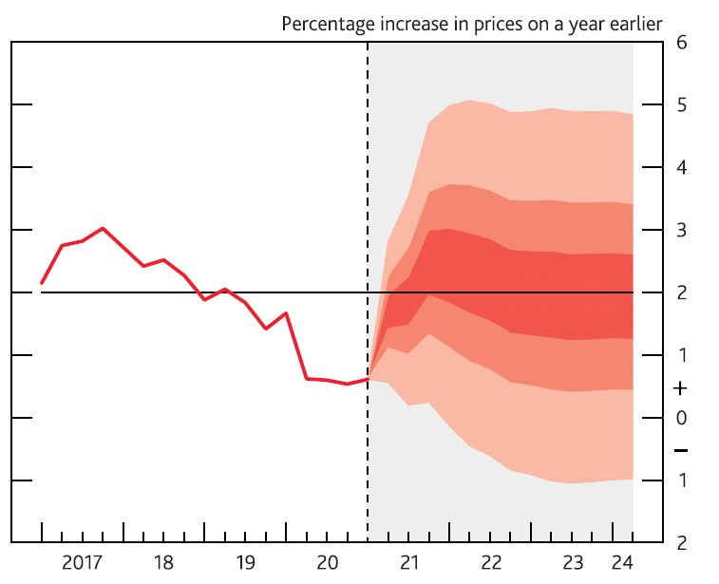
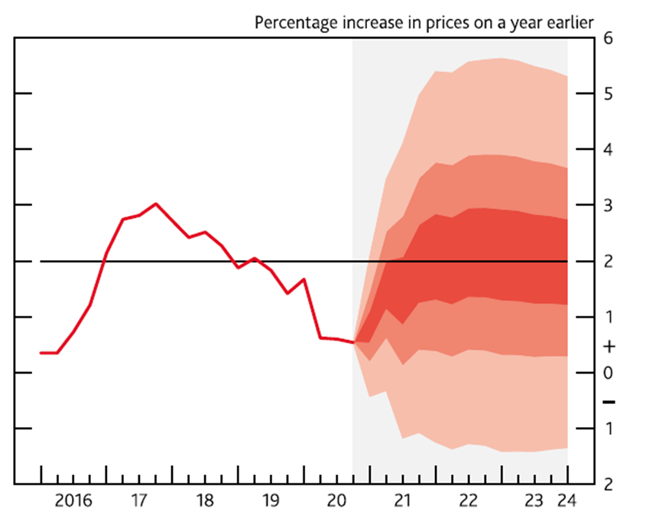
CPI inflation
May
February

Slide 17
Monetary policy
Unchanged at the meeting – Bank Rate of 0.1%, target stock of QE of £895bn.
MPC guidance also (largely) unchanged:
“The MPC will continue to monitor the situation closely and will take whatever action is necessary to achieve its remit. The Committee does not intend to tighten monetary policy at least until there is clear evidence that significant progress is being made in eliminating spare capacity and achieving the 2% inflation target sustainably.”

Slide 18
Q&A

