Slide 1
Climate and Capital Conference
19 and 20 October

Slide 2
Understanding the conceptual route from climate change to capital for banks and insurers
Chair: Professor Lord Nicholas Stern, Chair of the Grantham Research Institute
Presenters:
Kevin Stiroh, Senior Advisor in the Division of Supervision and Regulation at the Board of Governors of the Federal Reserve System
Vicky Saporta, Executive Director, Prudential Policy, Bank of England and Chair of the Executive Committee of the International Association of Insurance Supervisors

Slide 3
Climate Change and the Role of Regulatory Capital:
A Stylized Framework for Policy Assessment
Michael Holscher, David Ignell, Morgan Lewis, and Kevin Stiroh*
October, 2022
*The views expressed here are the authors’ only and do not necessarily reflect those of the Federal Reserve Board or the Federal Reserve Bank of New York.

Slide 4
Goals
Identify potential interactions between climate change and regulatory capital
  How could climate change impact the capital framework?
  What assumptions and beliefs would be needed to support alternative policy conclusions?
Systematic and neutral assessment of the bank regulatory capital framework
  Loss-generating process
  Components of capital framework
Identify research topics to advance the discussion

Slide 5
Views of Capital
Resilience - capital to absorb unexpected losses
  Traditional purpose
    BCBS (2010): “the regulatory minimum requirement is the amount of capital needed for a bank to be regarded as a viable going concern by creditors and counterparties”
    FRB (2022): “The primary function of capital is to support the bank's operations, act as a cushion to absorb unanticipated losses and declines in asset values that could otherwise cause a bank to fail, and provide protection to uninsured depositors and debt holders in the event of liquidation”
    Bank of England (2021): capital framework should address consequences of climate change, not the causes
    EBA (2022): risk-based approach to ensure prudential requirements reflect underlying risks
  Focus of this paper
Incentives - capital to promote transition to low carbon economy
  Modify risk-weights to change marginal cost and provide incentives for certain activities
    Green-supporting factors – lower risk weights for low-carbon activities
    Brown-penalizing factor – higher risk weights for high-carbon activities
  Proposals from academics, advocacy groups, and some central banks
  Depends on supervisory mandate

Slide 6
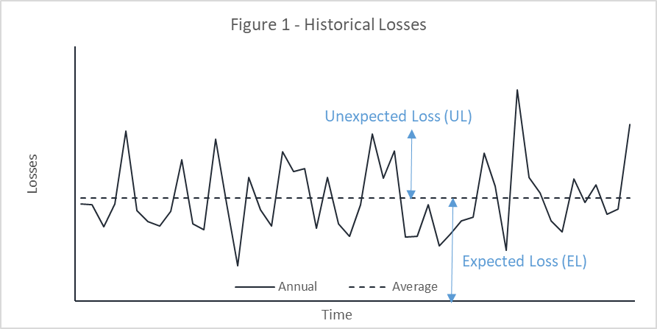
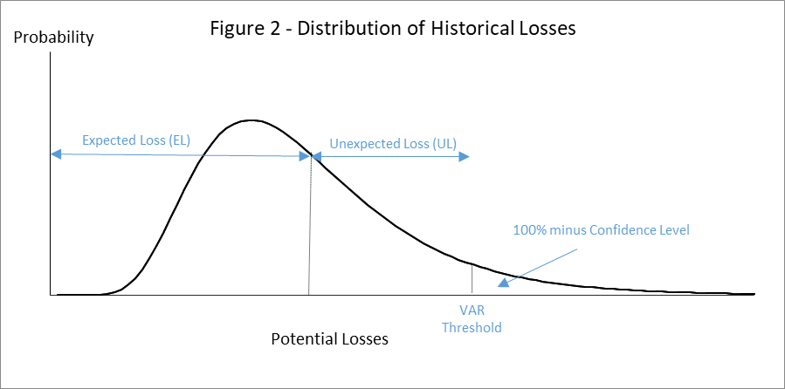
Traditional Purpose of Regulatory Capital for Resiliency
  Capital absorbs “unexpected losses” so a bank can continue to operate under a wide range of conditions, while reserves and risk-based pricing absorb “expected losses”
  Level of capital determined to maintain solvency with a certain level of confidence based on the “loss-generating process” that determines distribution of potential losses
$$Total Losses=Expected Losses \left(EL\right)+Unexpected Losses \left(UL\right)$$
$$Capital=VAR Threshold−EL=UL$$

Slide 7
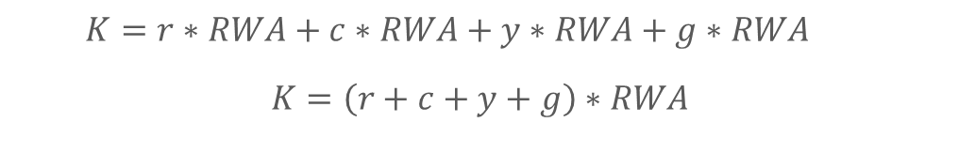
Components of a Stylized Capital Framework
$$Required Capital=Minimum+Conservation Buffer+Countercyclial Buffer+GSIB Buffer$$
$$K=r∗RWA+c∗RWA+y∗RWA+g∗RWA$$
$$K=\left(r+c+y+g\right)∗RWA$$
Variable | Policy Objective | Calibration
Minimum (r) | Ensure firm remains viable, with certain level of confidence | Historical loss data, BCBS (2010)
Conservation Buffer (c) | Cover stress losses to reduce probability that firm breaches the minimum | Historical stressed loss data, BCBS (2010)
Countercyclical Buffer (y) | Protect against cyclical changes when risks are elevated, e.g., macro or credit cycle | Jurisdiction-specific
GSIB Buffer (g) | Lower the probability of default (PD) to offset higher loss given default (LGD) for systemically-important firms | Indicators-based approach, BCBS (2013, 2021)
Risk-Weighted Assets (RWA) | Reflect relative risk across asset classes | Complex machinery across asset classes and approaches, BCBS (2022)
Notes:
Minimum requirement
Amount of capital needed to absorb unexpected losses so bank remains viable with a pre-determined level of confidence
Linked to distribution of historical losses, BCBS (2010)
Capital conservation buffer
Additional capital so firms avoid breaching the minimum and keeps and creditors/counterparties continue to do business
Linked to historical stress losses, BCBS (2010)
Countercyclical capital buffer
Additional capital to protect against cyclical changes when aggregate risks are elevated
Tied to macro and credit cycles – jurisdiction-specific approaches
GSIB capital buffer
Additional capital to offset systemic externalities associated with failure or distress
Lower probability of default to offset systemic externalities of distress or failure, BCBS (2013, 2021)
Risk-weighted assets (RWA)
Adjustments of bank assets to reflect relative risks across institutions and assets, BCBS (2022)

Slide 8
Approach
Assess links between climate change and regulatory capital
  Step 1 - loss-generating process
    Physical or transition risks could generate higher or more variable losses
  Step 2 - components of capital framework
    Examine impact on each component relative to policy objectives
Challenges
  Unclear how the loss-generating process for banks might change, if at all
  Multiple policy objectives and mandates
  Complexity of regulatory capital regime
  Automatic updating of some framework parameters

Slide 9
Step 1 - Loss-Generating Process
Key question: Does climate change increase mean or variance of potential losses?
  Increase in mean → higher expected losses (EL) → higher loan loss reserves and risk-based pricing
  Increase in variance → higher unexpected losses (UL) → higher capital
Climate-related hypothesis: variance of losses increases
  Uncertain links between climate and the economy, uncertain policy/technological changes, financial amplifiers/mitigants, tipping points, and feedback loops
  Climate impact is uncorrelated or positively correlated with business cycle
But, unclear how the loss-generating process will change, if at all
  Ultimately, an empirical question that will be answered over time
  Examples of offsetting factors
    Change brings risks and opportunities
    Banks and real economy will adapt
    Heterogeneous impacts

Slide 10
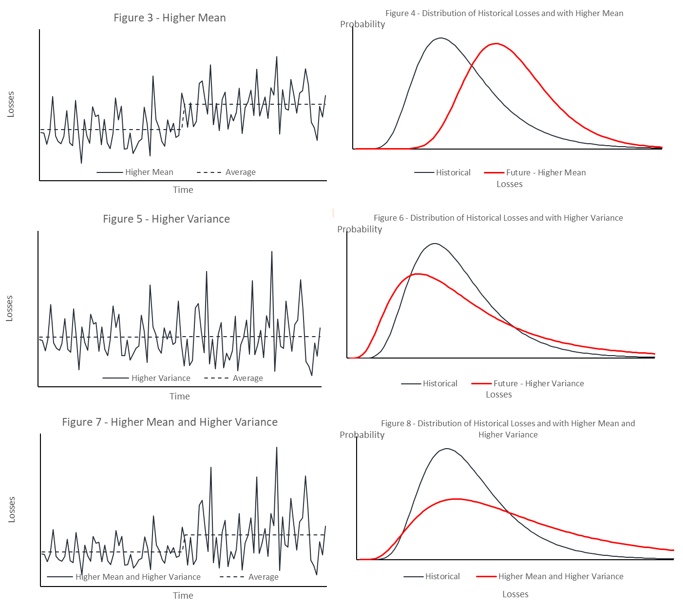
Illustrative Cases
Case 1 – Higher Mean
  ↑ EL, so ↑ reserves
  No change in UL, so no change capital
Case 2 – Higher Variance
  No change in EL, so no change reserves
  ↑ UL, so ↑ capital
Case 3 – Higher Mean and Variance
  ↑ EL, so ↑ reserves
  ↑ UL, so ↑ capital

Slide 11
Step 2 - Components of Capital Framework
$$Required Capital=Minimum+Conservation Buffer+Countercyclial Buffer+GSIB Buffer$$
$$K=\left(r+c+y+g\right)∗RWA$$
Variable | Assumption Needed for a Climate Impact | Examples
Minimum (r) | Higher variance of losses across asset classes | Climate-related uncertainties (climate sensitivity, policy, technology, sentiment), amplifiers, tipping points, or feedback loops
Conservation Buffer (c) | Increased stress losses for the bank as a whole | Interaction between business cycle or climate shocks amplify losses
Countercyclical Buffer (y) | Elevated macro risks or cyclical properties | Stranded assets or bubbles, transition-focused firms become less resilient, or evolving business cycle dynamics
GSIB Buffer (g) | Higher LGD for GSIBs | More difficult to reallocate credit during transition
Risk-Weighted Assets (RWA) | Change in relative riskiness of assets | Climate change has a heterogenous impact across assets, regions, or sectors

Slide 12
Discussion Questions
Uncertainty
  How will we know if the loss-generating process has changed? When will we know it?
  What would an “epistemological break” with less reliance on historical evidence look like?
Forward-looking
  How does one incorporate more forward-looking loss estimates? Will some risk and RWA parameters update automatically?
  Will market prices and accounting treatment reflect emerging risks? Is that enough?
  How can scenario analysis help?
Time horizon
  Does climate change require a shift in the one-year capital horizon?
  If so, how do we determine the appropriate horizon?
Capital minimum vs. RWA
  How to disentangle impact on required level of capital (ratios) from relative riskiness (RWA)?
  Is there a different burden of proof for each?
Sustained v. temporary risks
  Could climate change increase risks and uncertainties primarily during the transition?

Slide 13
Conclusions
Paper tries to provide an objective, conceptual framework to assess potential links between climate change and regulatory capital
Primary conclusion is that climate change could impact the regulatory capital regime, but impact depends on:
  Assumptions and beliefs about changes to the loss-generating process
  Policy objective and link to a specific component of the framework
Key challenges
  Uncertainty about how and when climate change might impact potential bank losses
  Complexity of capital regime, particularly RWA machinery

Slide 14
The conceptual links between climate change and the prudential frameworks, parallels to and differences for insurance
Vicky Saporta, Executive Director, Prudential Policy, Bank of England and Chair of the Executive Committee of the International Association of Insurance Supervisors
19 October 2022

Slide 15
Setting the scene… Our work at the IAIS
The IAIS has been progressing thinking on climate risk insurance supervisory standards:
May 2021: Application Paper on the Supervision of Climate-related Risks in the Insurance Sector
September 2021: Global Insurance Market Report (GIMAR) special topic edition on climate change
2022:
Delivered workshops to over 200 insurance supervisors globally on climate scenario analysis drawing from the experience across our membership
Notes:
This analysis does also not cover any impact on the PRA’s existing insurance-specific primary objective.

Slide 16
Setting the scene: climate risk on the balance sheet
Banks
Insurers
Similarities
Climate-related risks are a new driver of the existing financial risks that firms both insurers and banks face. Both are similarly affected by climate risk on the asset side
Differences
Climate change affects liabilities for example, physical risks will impact liabilities of general insurers
Bank deposits are not a function of climate risk
Valuation is determined mainly by accounting
The valuation of climate-liabilities is influenced by regulators
Practical considerations for the insurance industry
Notes:
This analysis does also not cover any impact on the PRA’s existing insurance-specific primary objective.

Slide 17
Expected and Unexpected Losses
Assets
Liabilities
Concept of expected and unexpected losses familiar in insurance.
Risk selection, pricing and underwriting, diversification and reinsurance manages expected loss though reinsurance sometimes covers unexpected.
Capital covers remaining unexpected losses.
But there are material differences in how the balance sheet is affected by climate risk.
Excess of Assets Over Liabilities
Assets at market value
Other Liabilities
Risk margin
Best estimate liabilities (BEL)
Technical Provisions
*Based on a Solvency II balance sheet

Slide 18
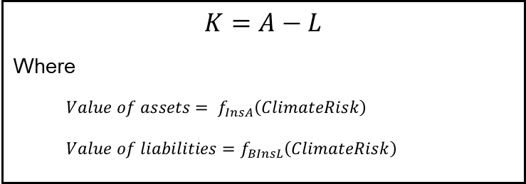
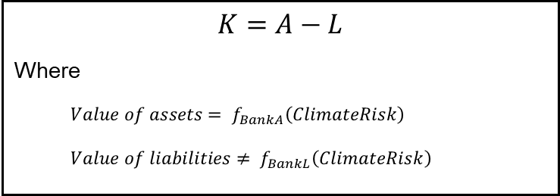
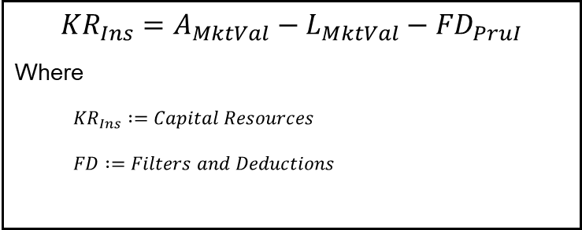
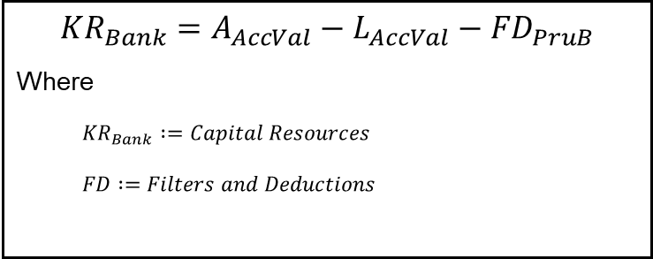
Expected and Unexpected Losses
Banks
Insurers
$$K=A−L$$
Where
$$Value of assets= f_{BankA}\left(ClimateRisk\right)$$
$$Value of liabilities≠ f_{BankL}\left(ClimateRisk\right)$$
$$K=A−L$$
Where
$$Value of assets= f_{InsA}\left(ClimateRisk\right)$$
$$Value of liabilities=f_{BInsL}\left(ClimateRisk\right)$$
Capital
$${KR}_{Bank}=A_{AccVal}−L_{AccVal}−{FD}_{PruB}$$
Where
$${KR}_{Bank}∶=Capital Resources$$
$$FD∶=Filters and Deductions$$
$${KR}_{Ins}=A_{MktVal}−L_{MktVal}−{FD}_{PruI}$$
Where
$${KR}_{Ins}∶=Capital Resources$$
$$FD∶=Filters and Deductions$$
Capital resources

Slide 19
Capital stacks: buffers
Another difference between the banking and insurance frameworks is that there is no explicit role for buffers within insurance frameworks.
Banks
Insurers
PRA buffer
Countercyclical capital buffer
Capital conservation buffer
Systemic buffers
Pillar 2A
Pillar 1
Solvency capital requirement (SCR)
Minimum capital requirement (MCR)
*Based on a Solvency 2 balance sheet

Slide 20
What’s Next?
More work is required to enhance our understanding of how the risks of climate change will drive financial risks that impact both insurers and banks.
Is there a place to reflect the risks from climate change within the existing regulatory framework?
Two broad questions are being explored as part of the conference that are particularly relevant to insurance:
  What is the appropriate time horizon to reflect climate risks into the regulatory framework?
  How should we understand and manage uncertainty over that time horizon?

Slide 21
Bank of England
Understand how and whether to reflect climate-related financial risk into the banking microprudential and macroprudential frameworks
Chair: Alison Scott, Director, Supervisory Risk Specialist, Prudential Regulation Authority
Presenters:
Benjamin Guin, Senior Economist, Prudential Policy, Bank of England
Zsolt Jaczko, Head of Retail IRB Modelling, Nationwide Building Society
Paul Hiebert, Head of Systemic Risk and Financial Institutions Division, ECB
Pierre Monnin, Senior Fellow, Council on Economic Policies
David Aikman, Professor of Finance and Director of the Qatar Centre for Global Banking and Finance, King’s Business School
Jeremy McDaniels, Senior Advisor, Institute of International Finance
Katie Rismanchi, Senior Policy Advisor, Institute of International Finance
Simon Hills, Director, Prudential Policy, UK Finance

Slide 22
Risk Differentials between Green and Brown Assets
Ben Guin, Senior Economist, Prudential Policy, Bank of England
19 October 2022

Slide 23
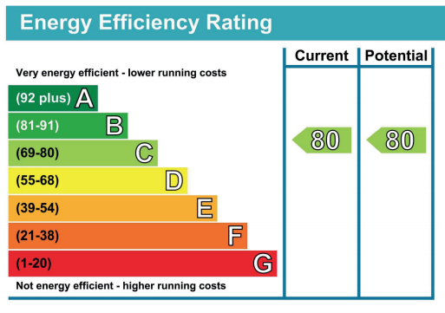
There are differences in energy costs across energy efficiency ratings
Energy Efficiency |  | High | Medium | Low
Rating |  | A to C | D | E to G
2-bedroom flat |  | £417 | £676 | £1,023
3-bedroom house |  | £578 | £891 | £1,340
4-bedroom house |  | £695 | £1,130 | £1,775
* Historical costs based on EPC ratings
Energy efficient properties can protect households from unexpected decreases in income or increases in expenses.
Are mortgages against energy-efficient properties less “credit-risky”?

Slide 24
Evidence on risk differential depending on energy efficiency of properties
Energy Efficiency |  | High | Medium | Low |  | Difference
Rating |  | A to C | D | E to G
 |  | (1) | (2) | (3) |  | (1)-(3)
Arrears (in %) |  | 0.94 | 1.00 | 1.14 |  | -0.21***
 |  | (N=412,704) | (N=893,913) | (N=527,026) |  | (N=939,730)
The share of mortgages in payment arrears is 0.21 percentage points, or about 18%, lower among mortgages against energy-efficient properties.
This result is robust to controlling for a rich set of other risk drivers.

Slide 25
Conclusions and future work
Conclusions:
  Novel evidence on existence of a risk differential between green and brown assets.
  Energy efficiency could become a relevant risk driver in credit risk models estimating defaults.
Future work to inform capital debate:
  Firm-specific concentration: are energy-inefficient properties concentrated in certain lenders’ portfolio?
  Geographic concentration: are energy-inefficient properties concentrated in certain regions?

Slide 26
Reflecting climate-related financial risks in capital requirements
Zsolt Jaczko, Head of Retail IRB Modelling, Nationwide Building Society
19 October 2022

Slide 27
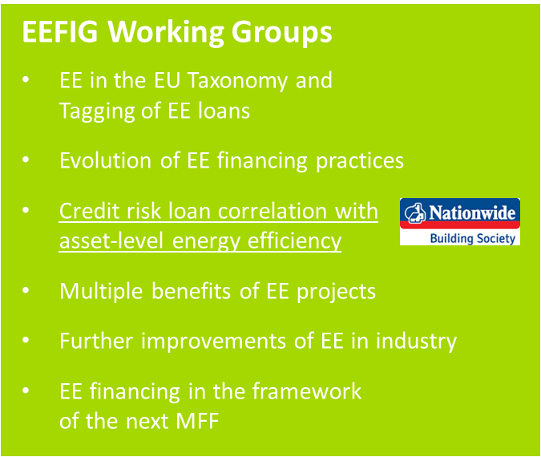

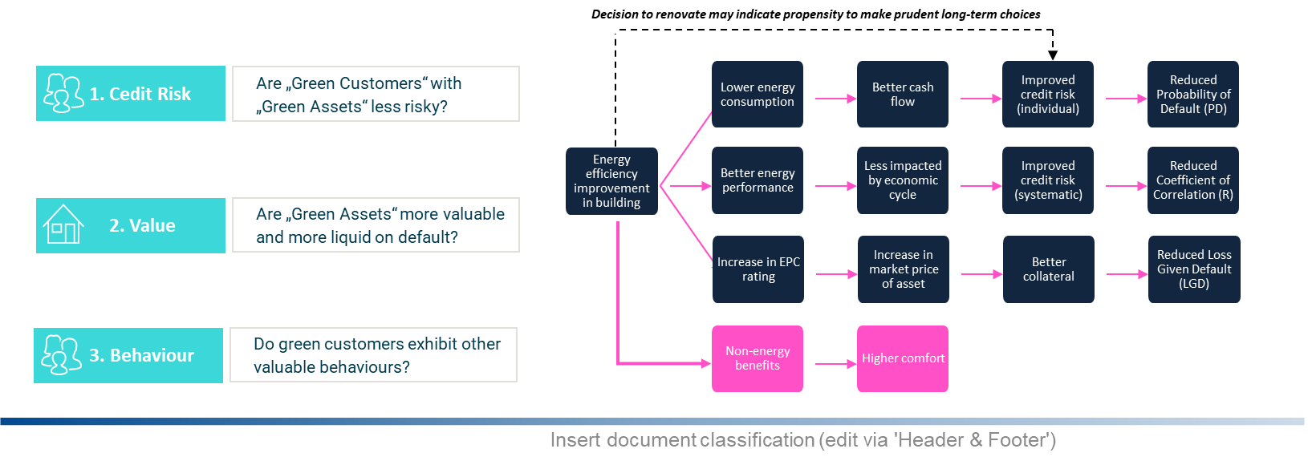
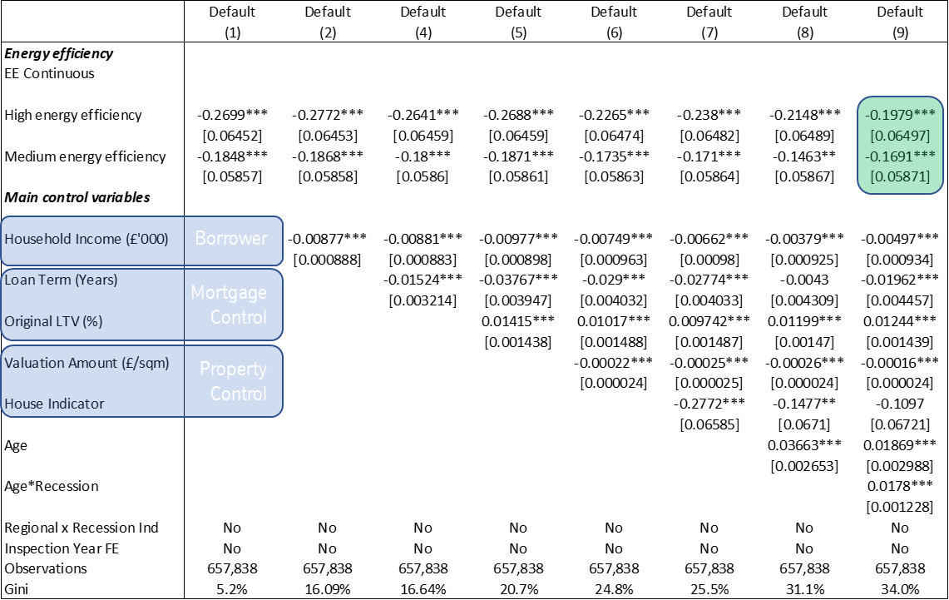
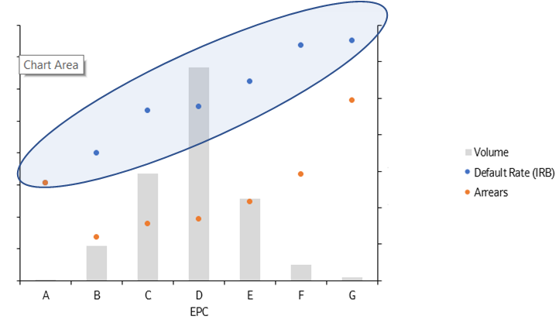
Energy Efficiency and Mortgage Default Rate
Relationship exist, but causality is not proven yet
the assumptions
the relationship (EPC vs. Default Rate)
the model adjustment
Results
High/Medium vs. Low: High and medium energy efficient properties seem to be less likely to default than low energy efficient properties.
Intuitive relationship is kept even after introducing the control variables (improvement from previous results)
Controlling for borrower characteristics such as household income does not jeopardize this relationship

Slide 28
The macroprudential challenge of climate change
Paul Hiebert, Head of Systemic Risk and Financial Institutions Division, ECB
19 October 2022

Slide 29

The macroprudential challenge of climate change
[Please select]
[Please select]
Bank of England Capital and Climate Conference
19 October 2022
Paul Hiebert (European Central Bank)

Slide 30
Summary takeaways
Build on growing body of empirical evidence, addressing analytical gaps (scope, scale and horizon of climate risk)…
Measurement
  Combining climate and financial risk metrics suggests pockets of vulnerabilities
  These could be amplified by correlated shocks and overlapping portfolios
Modelling
  Systemic risk will be aggravated by system-wide dynamics along the transition
  Impacts on financial system likely to begin with market risk which extends to credit losses
… to support a reflection on macroprudential policy options
Macroprudential policy, to…
  … complement and mutually reinforce microprudential efforts
  … address risks that cut across sectors & countries and to limit arbitrage
  ... depend on, and interact with, a broader set of policies aimed at adapting to climate change and limiting its impacts
Source: ECB/ESRB (2022)
The macroprudential challenge of climate change

Slide 31
Climate-related systemic risks and macroprudential policy
Pierre Monnin, Senior Fellow, Council on Economic Policies
19 October 2022

Slide 32
Climate systemic risks and macroprudential policy
Climate risks are a potential systemic risk for the financial sector
Some macroprudential tools currently used by financial supervisors can be explored to address climate systemic risk
However, existing tools may require some adaptation to address the unique features of climate risks

Slide 33
Adapting the current macroprudential framework to address climate systemic risk
Policy decision framework must adapt to uncertainty and lack of data
Early action is warranted
A holistic approach is necessary

Slide 34
Climate and Capital: Views from the Institute of International Finance
Jeremy McDaniels, Senior Advisor, Institute of International Finance
Katie Rismanchi, Senior Policy Advisor, Institute of International Finance
19 October 2022

Slide 35
Climate and Capital: Views from the Institute of International Finance (IIF)
Sizing the risks: Supervisory scenario exercises do not indicate solvency concerns over short to medium term, but potential for significant long-term risks
  Use of multiple scenarios and approaches yielding early insights, but challenges of data paucity, uncertainty and complexity impede conclusiveness
Time Horizons: Prudential tools should be matched to risk timeframes for which best suited
  ‘Front-loading’ climate risks into solvency assessment brings challenges
Avoiding policy paralysis: Supervisors should monitor risks, oversee firms’ risk management & have regard to NZ alignment → reducing FS risks while supporting transition
  Costs & challenges of using the capital framework to address climate risks currently outweigh the benefits; other tools effective & available
 | Policy option | Future Outlook
Pillar 1 | Amendments to Overarching Design of P1 Measures | Should not be used
 | Adjustment to Risk Weights | Should not be used
Pillar 2 | Concentration Limits, adjustments to (P1) Large Exposure Limits | Could be used in the Medium to Long Term
 | Enhanced Supervision | Can be useful in the Short Term
 | Capital add-ons (based on qualitative judgement) | Should be avoided in the Short Term
 | Capital add-ons (based on scenario analysis/stress testing) | Currently premature, but could be used in Medium to Long Term
Macropru Buffer | Climate Systemic Buffer (based on bank’s climate-related risk level) | Unlikely to be usable in the Short to Medium Term
 | System-wide Buffer (extension of capital buffer requirement by a fixed amount) | Should not be used
Time horizons are relative and indicative only, but can be considered in relation to the business planning and supervisory time horizons.

Slide 36
Prudential authorities should take a nimble and dynamic approach to supervision & regulation of climate risks, reflecting evolving science, policy and market conditions
Figure 1: Elements of a nimble approach to data-driven & risk-based supervision & regulation of climate-related risks
Prudential Mandate & Objectives
Importance of a clear mandate basis
Microprudential & macroprudential to be considered holistically
Context-specific
Cost-Benefit Analysis
Data & Evidence Basis
Broader govt./climate policy/macro context
Impact on credit provision/transition finance
Scope of application
Cross-jurisdictional consistency
Measure risks, inform policy choices, calibrate tools, evaluate effectiveness
Forward-looking lens on climate risks; use of climate scenario analysis/stress testing
Other recommendations for prudential authorities:
Ongoing assessment of vulnerabilities; greater standardization of scenario analysis results
Cross-jurisdictional collaboration on policy approaches to avoid fragmentation
Transparent criteria for any future Pillar 2 policy interventions
Capital and other prudential tools calibrated on an empirical risk basis

