Slide 1
Climate and Capital Conference
19-20 October

Slide 2
Climate and Capital Conference
Managing Physical Climate Risks
Dr Nicola Ranger
Director, Climate and Environmental Analytics, UK Centre for Greening Finance and Investment
& University of Oxford
With thanks to co-authors at EDHEC, IMF and World Bank

Slide 3
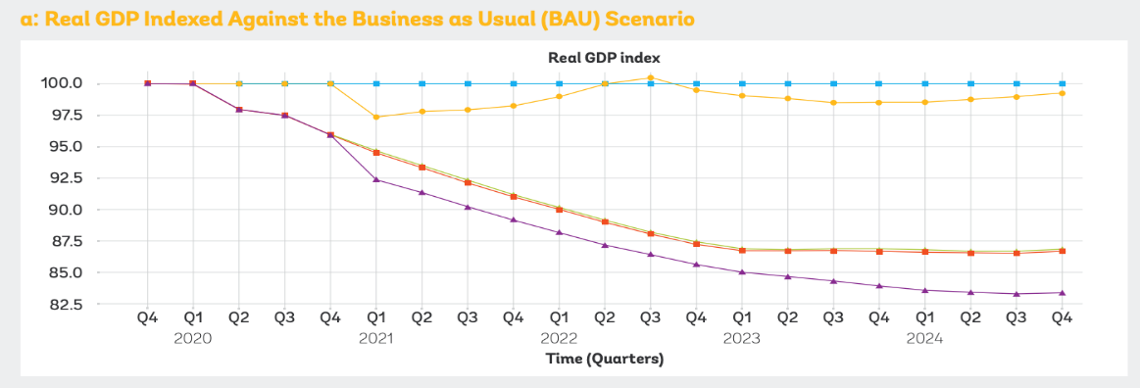
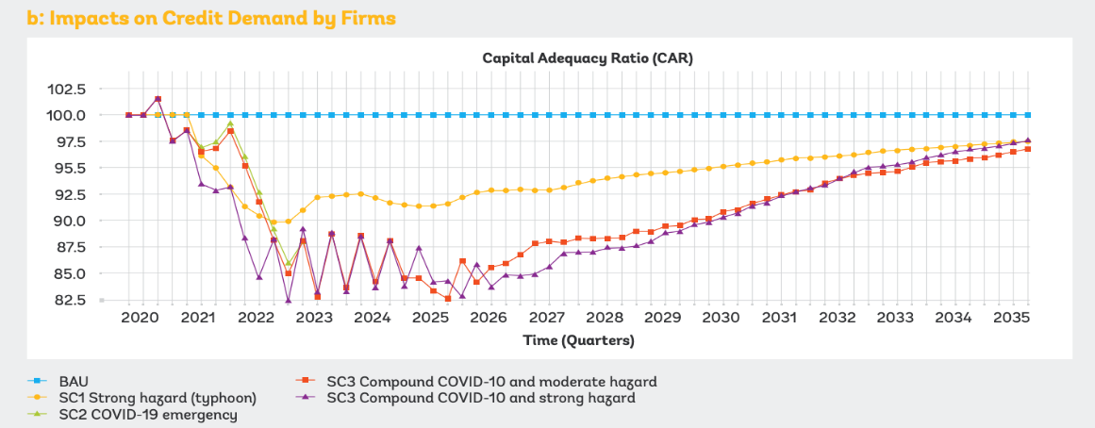
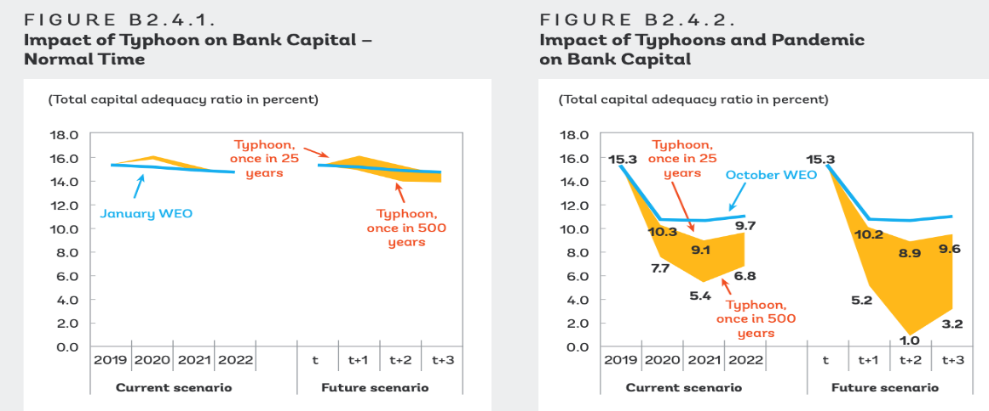
Challenges in managing physical climate risks
Example: Philippines Typhoon Risk
Evidence that physical climate risk is underpriced into the market today
Current approaches to risk assessment/ calibration based on historical volatility do not capture current or future physical risks
Information asymmetries on vulnerability to climate risks and adaptation plans
Capability in the market to assess risk has increased but more to be done (see CGFI survey)
Current scenarios and models used by the market do not fully capture the risks
Policy driven uncertainty
Situation of ‘deep uncertainty’ (e.g. cannot define what is a 99.9% confidence interval)
Tragedy of the horizons – lock-in of physical risk
Source: Ranger et al. 2022: Assessing Financial Risks from Physical Climate Shocks: A Framework for Scenario Generation (with colleagues at EDHEC, World Bank, IMF)

Slide 4
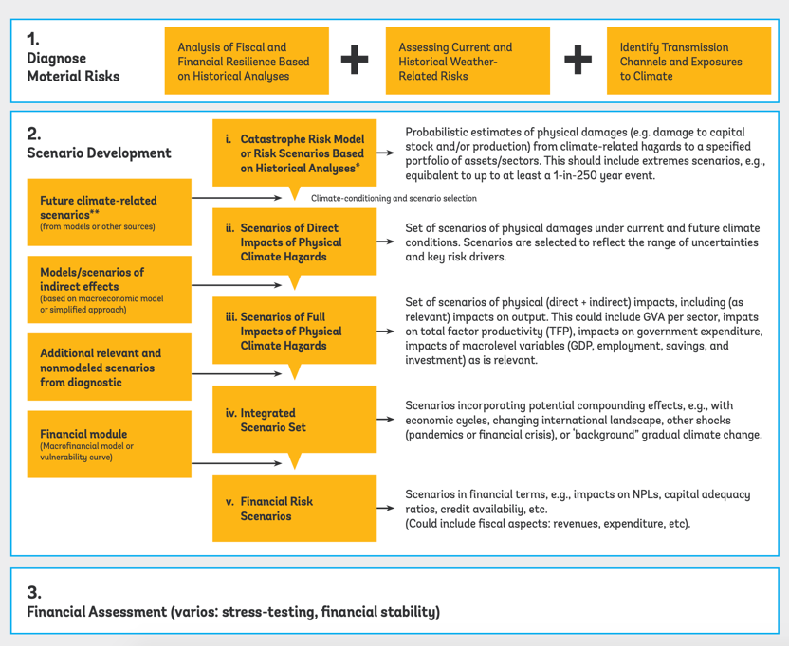
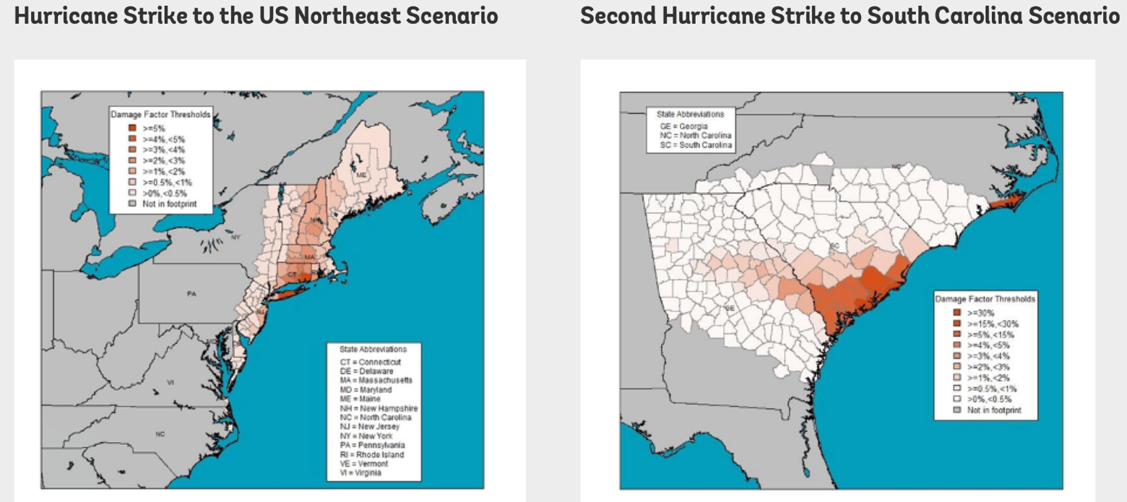
Potential Solutions and Next Steps
Strengthening risk assessment capability
Reduce information asymmetries, e.g. invest in data; disclosure of adaptation plans
Develop approaches to scenarios and models
Explore standardised methods to incorporate forward scenarios within risk assessment for capital –co-develop and test with the market
Governments: clarity on adaptation plans
Source: Ranger et al. 2022: Assessing Financial Risks from Physical Climate Shocks: A Framework for Scenario Generation, and Lloyds of London (2021)

Slide 5
Dealing with uncertainty
A novel approach to exploring industry implications of physical climate risk on General Insurers
Josie Lau, Ryan Li, Stefan Claus, David Humphry
Bank of England
The views and opinions expressed within this presentation do not in any way represent the official views or policies of the Bank of England or the Prudential Regulation Authority

Slide 6
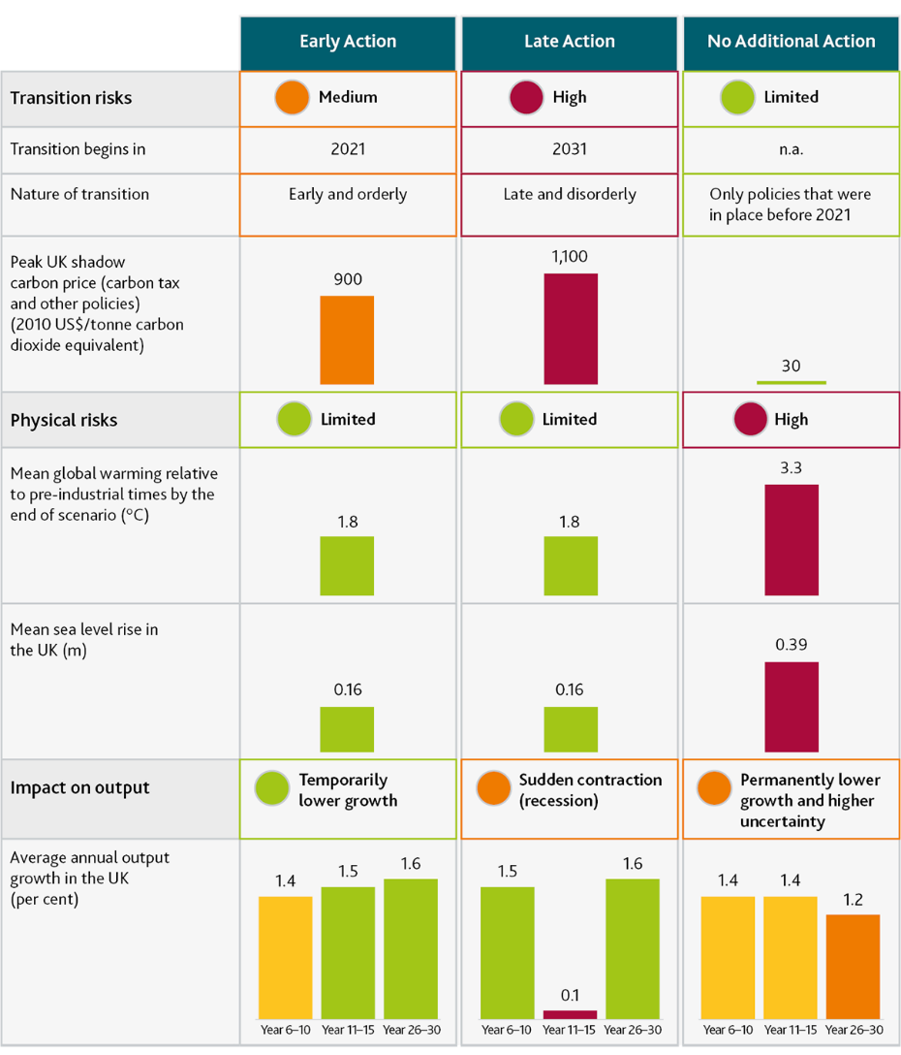
Exploring uncertainty around physical climate risk implications on the General Insurance industry
Modelling physical risk implications
Available data
Weather-related natural cat
Other natural and man-made cat
Non cat losses and reserve risks
Other risks (market, credit, etc.)
Correlation & dependencies
Total risk & capital requirement
Internal model output
2021
Scenario 1
CBES
2021
Latest research on peril correlation
Scenario 2
Increase in tail risk
Main outputs
Change in Average Annual Loss
Change in reinsurance recovery
Change in cat risk capital
Change in total risk capital
Required increase in premium
Notes:
Climate risk creates uncertainty in estimating insurance liabilities and the required capital requirement. Our research introduces a new approach to gauge the potential impact of a ‘no additional action path’ under the Bank of England’s CBES exercise conducted in 2022 and identify important dependencies for future industry outcomes, such as underwriting, reinsurance and capital.
Scenario 1 + 2
We constructed two scenarios to explore potential implications:
Scenario 1 is based on the unadjusted CBES dataset, and assuming no or low correlations across perils, which is a common assumption within firms’ internal models.
Scenario 2 is designed to address two potential shortcomings of Scenario 1 – specifically i) the lack of correlation between perils and ii) the CBES implied reductions in volatility.
In the No Additional Action scenario, the absence of new climate policies means emissions fall only modestly. As a result global temperature levels continue to increase. This leads to increased likelihood and severity of physical perils.
The latest academic research has concluded that UK wind and flood are correlated and 40% is not an overestimation. There is also evidence that such correlation exists in EU countries as well.
Using statistical methods, we applied the CBES physical risk and the additional correlation suggested by academic research to our IMO based model . This had enabled us to approximate the implications to market capacity and the potential premium increase that firms would require in order to maintain profitability. These are shown in the next slide.
For people not familiar with the IMO, it stands for internal model output and is reported by insurance firms with an approved internal model for the calculation of their capital requirement. It contains various statistical data including catastrophe losses at key return periods.

Slide 7
Provided capacity is able to expand…
…increases in average cost of insurance appear manageable
Notes:
Scenario 2
As we can see from the left-hand graph, the market catastrophe capacity has to increase by 34% to absorb the increased physical risk under CBES no action scenario, and a further 17% to account for the 40% correlation between climate exposed perils.
For most perils CBES implies a bigger impact on AAL than on 1/100 AEP, statistically indicating the losses would become bigger but less volatile as a result of climate change. This feels somewhat counterintuitive. As a what-if scenario, we further increased the volatility of each climate exposed perils by 30%. This would lead to a 63% further increase in market capacity.
Overall, we would need market capacity to more than double, and this is assuming other non weather related risks such as earthquakes remain unchanged.
What would be the impact on policyholders?
Well, first of all, the expected loss from climate exposed perils would increase significantly. After cross subsidy with non cat risks, the premium would have to increase by 13% on average.
Then the insurers and reinsurers have to increase their capital to support greater capacity. They would need to pass on the required return on capital to policyholders. Assuming firms require a 10% return on capital, this would push up premium by another 7% and 5%.
Overall the increase of 25% in the average cost of property insurance appears manageable – but, as this year’s CBES results highlighted, there is significant variation depending on the location of the property, such that some policyholders will see the cost of their insurance more than double.
It should also be noted that the 25% increase shown here is on top of any inflationary impacts.
For firms, the ability to remain competitive and viable will – as we illustrate on the next slide – depend on their ability to cross-subsidise with other insurance products, and the extent to which they can rely on reinsurance

Slide 8
But some insurers’ business models will be challenged…
Scenario 1:
Calibrated to align to our CBES 2021 exercise
Scenario 2:
Scenario 1 + Increase in peril correlation + Increase in tail risk
Without adapting their business model, these firms may become less competitive.
Capital and premium differences are more pronounced. Additional firms will face challenges.
… & this differentiation increases if physical risks are higher
Notes:
The left-hand graph shows the required increase in capital requirement against premium for a typical sample of firms under the CBES no additional action scenario, but without the lift of additional correlation and volatility. On the y-axis we show the extent to which the capital would need to increase. On the x-axis we show the increase in premium individual firms would require in order to maintain profitability.
Firms which have to increase capital and premium much higher than market average will have difficulties maintaining their business model. In other words, these firms have to adapt in order to remain competitive.
The right-hand graph shows the same firms, but with the additional effect of higher correlation between perils and more volatile loss distributions. As we can see, the differences in capital and premium become more pronounced, and it would become even harder for vulnerable firms to compete, unless they take actions to adapt their business models. This is not only true for the ones in red, but also for some of those originally in better positions.
In conclusion:
Both scenarios indicate that the sector as a whole should be able to continue to provide coverage.
However, the analysis has also indicated insurer business models that are more vulnerable to climate-related changes. These firms will need to adapt to remain competitive.
The estimated increase in overall market capacity is not insignificant and cannot happen overnight. Further action may be required to ensure that capacity will be available as physical risks materialise.
The analysis has also highlighted climate uncertainty, and the extent to which key assumptions can change industry implications and which business models could become vulnerable.

Slide 9
Climate and Capital Conference
Is climate risk stress testing accounting for uncertainty right?
Matteo Gasparini, Doctoral Researcher, University of Oxford’s Smith School of Enterprise and Environment
Moritz Baer, Programme Manager, Oxford Sustainable Finance Group, University of Oxford

Slide 10
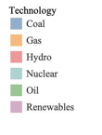
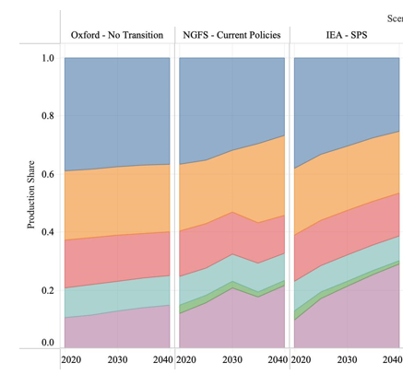
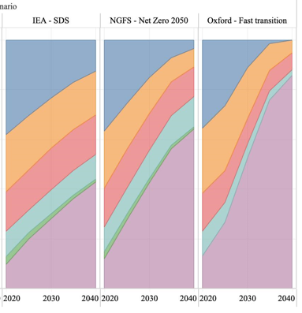

The net zero transition can unfold in many different ways that might have not been considered by climate stress testing
Share of energy production technology
Business as usual
Below 2C
Climate stress testing focuses on a small part of the possible solution space, but there is significant uncertainty around how transition risk might emerge
Current stress test approaches might need to evolve to be used for prudential regulation and capital setting
Significant focus between below 2C and Business as Usual scenarios but little to the within cluster variation which could be significant

Slide 11
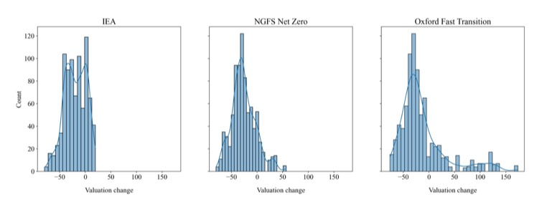
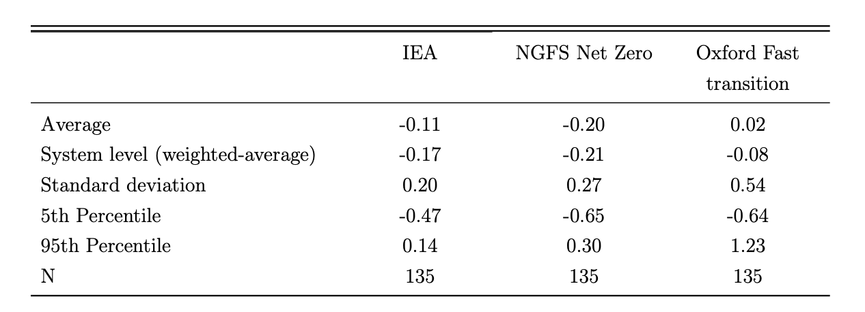
The impact of the net zero transition on the financial system can vary significantly depending on scenario narrative and assumptions
Average impact on power generation firms valuation by scenario
Stress test approaches should account for the sensitivity of different scenarios and assumptions
Faster technological progress could result in a different structure of the energy system without policy intervention
Assumptions around carbon capture and storage are still highly controversial
We should not over-estimate our understanding of climate change and the net zero transition

Slide 12
Climate and Capital Conference
Climate scenario analysis seen as a key tool to manage risk and uncertainty in the trading book
Panayiotis Dionysopoulos, Head of Capital, ISDA
Lionel Stehlin, Partner, Ernst & Young

Slide 13
