Slide 1
July 2026
Monetary Policy Report
Jamie Barber
Huw Pill
Fergal Shortall
Friday 31 July 2026

Slide 2

Plan for the session
Scene setting (Jamie) – 5 minutes
Quick tour of the Report (Fergal) – 20 minutes
MPC perspective and policy (Huw) – 5 minutes
Q&A with Huw and Fergal (please submit your questions via chat box and Jamie will ask them) – 30 minutes

Slide 3
Main points from the MPR
Overview

Slide 4
Backdrop
MPC held Bank Rate yesterday at 3.75%.

Slide 5
Backdrop
MPC held Bank Rate yesterday at 3.75%.
Oil and gas prices continue to be high and volatile.
In the background, services and wage inflation continues to moderate and CPI outturns have been better than expected.

Slide 6
Backdrop
MPC held Bank Rate yesterday at 3.75%.
Oil and gas prices continue to be high and volatile.
In the background, services and wage inflation continues to moderate and CPI outturns have been better than expected.
Two key uncertainties facing the MPC are how the outlook for global energy prices evolves and how that might feed into the strength of any second-round effects.
MPC can’t do anything about what happens to global energy prices, but it’s setting policy to make sure they don’t lead to high inflation becoming embedded and so instead that we get back to the 2% target and stay there.

Slide 7
Backdrop
MPC held Bank Rate yesterday at 3.75%.
Oil and gas prices continue to be high and volatile.
In the background, services and wage inflation continues to moderate and CPI outturns have been better than expected.
Two key uncertainties facing the MPC are how the outlook for global energy prices evolves and how that might feed into the strength of any second-round effects.
MPC can’t do anything about what happens to global energy prices, but it’s setting policy to make sure they don’t lead to high inflation becoming embedded and so instead that we get back to the 2% target and stay there.
The policy stance required to achieve this will depend on the scale and duration of the energy shock and how it propagates through the economy

Slide 8
Current approach to setting policy is based on two key policy judgements
Key policy judgement 1
Weakness in economic activity and demand for labour is likely to help contain the strength of second-round effects from higher energy prices.
But the outlook is uncertain and the risk of strong inflationary pressures continues to be greater than the risk of weak inflationary pressures.
Key policy judgement 2
Monetary policy is weighing on inflation. The MPC is continuing to set policy to balance the costs of leaning too little against potential inflationary pressures and the costs of responding too much.
The amount policy needs to lean, and the level of Bank Rate to achieve that, could change depending on how the outlook evolves.

Slide 9
Main points from the MPR
Key policy judgement 1

Slide 10
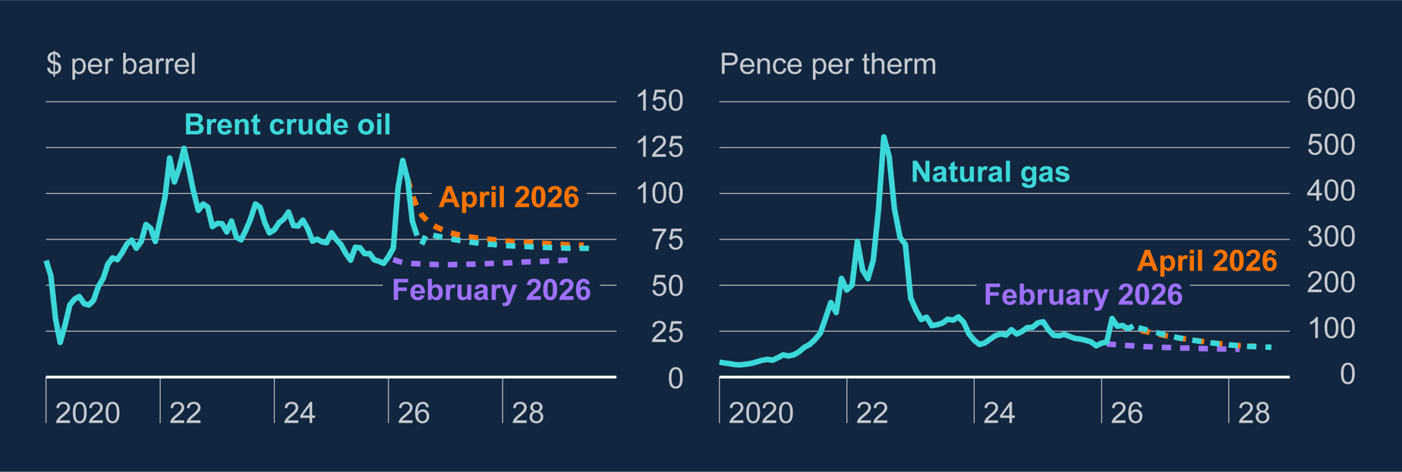
Chart 1.6: Wholesale energy futures prices remain elevated relative to their levels prior to the conflict, but have been volatile
Oil and gas prices have been volatile over the past three months.
Even if crude prices have been a little lower than their peaks, global refining issues mean prices at the pump have fallen by less, and gas prices have not fallen at all.
Notes:
Sources: Bloomberg Finance L.P., LSEG Workspace and Bank calculations.
(a) Oil prices are Brent crude in dollars per barrel and gas prices are Bloomberg UK NBP Natural Gas Forward prices. In the left panel, the solid aqua line shows historical oil prices and the dashed aqua, orange and purple lines show futures curves based on forward prices averaged over the 15 UK working days to 20 July 2026, 22 April 2026 and 26 January 2026, respectively. In the right panel, the solid aqua line shows the historical evolution of the 12-month ahead natural gas futures price. The dashed aqua, orange and purple lines show 12-month ahead average gas futures curves, averaged over the same 15-day periods as the oil curves. The final data points for the July 2026 oil and gas futures curves are September 2029 and September 2028, respectively. The September 2028 gas futures data point is calculated as the average futures price between October 2028 and September 2029.

Slide 11
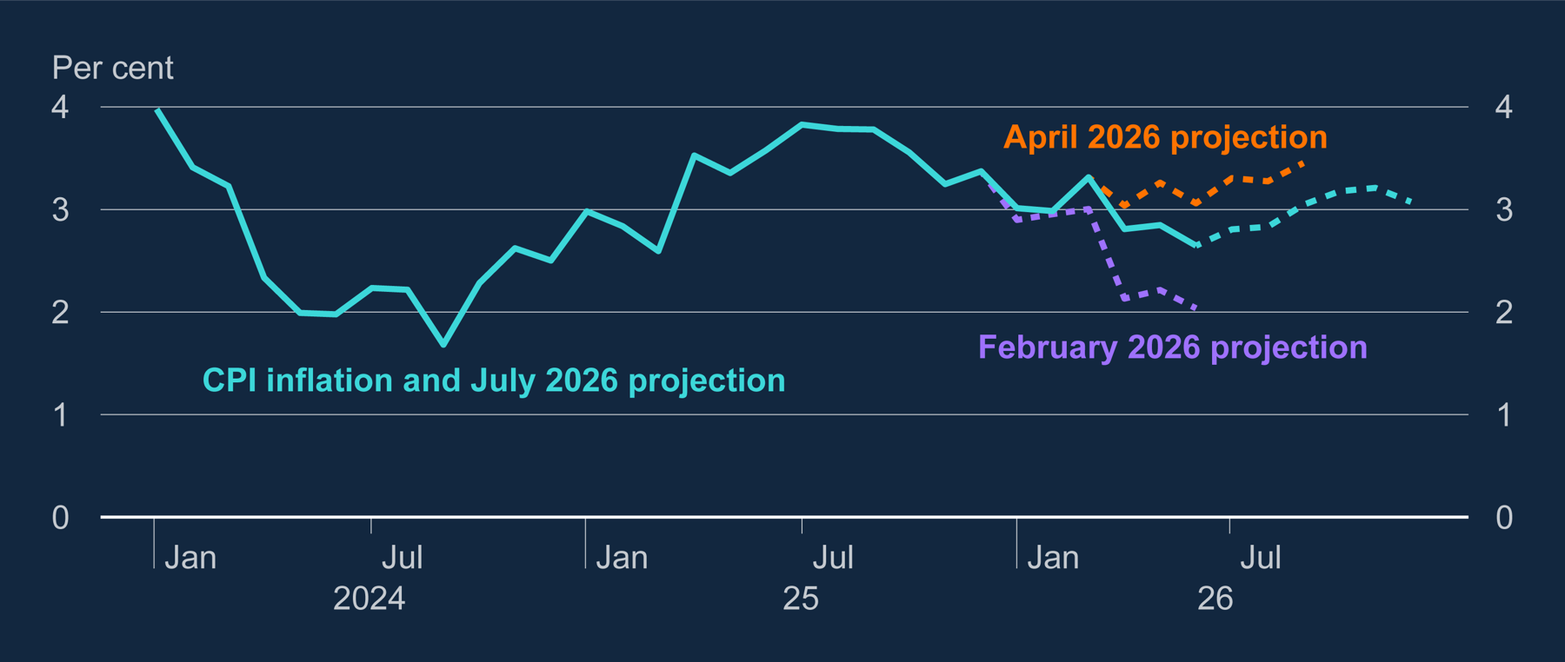
Chart 1.1: The near-term outlook for CPI inflation has shifted in recent months
CPI inflation was 2.6% in June, down ¾pp since March and 0.4pp lower than expected.
But inflation remains above where we were expecting it to run ahead of the conflict and likely to rise from here. Peaks at 3.2% in the central projection
Notes:
Sources: ONS and Bank calculations.
(a) The solid aqua line shows CPI data to June 2026, and the dashed aqua line shows Bank staff projections from July to December 2026. The dashed orange and purple lines show the near-term projections at the time of the April 2026 and February 2026 Reports, respectively.

Slide 12
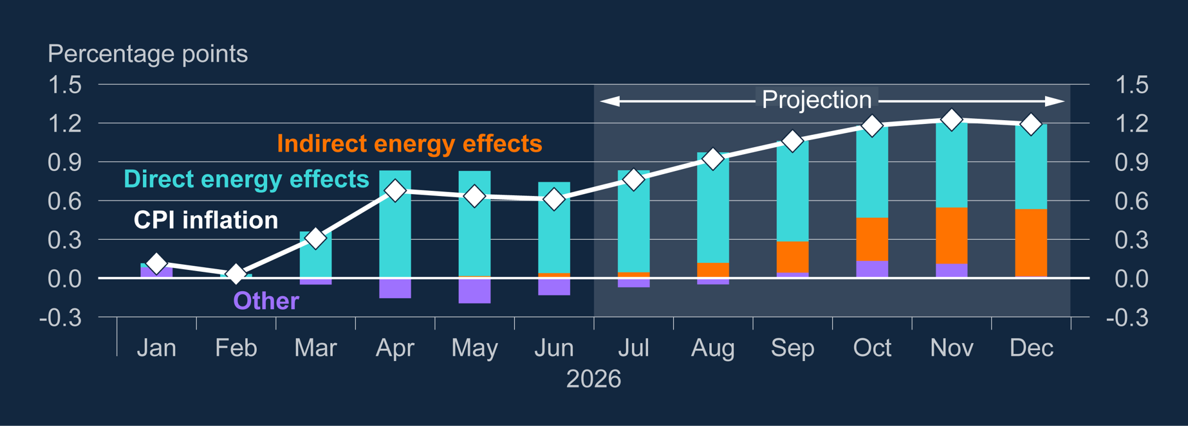
Chart 1.5: The indirect effects of the energy shock are projected to grow over the remainder of 2026
Also expecting some knock-on supply-chain effects in areas like transport and logistics to add around ½pp to inflation over the second half of the year
Notes:
Sources: ONS and Bank calculations.
(a) The bars show contributions to CPI inflation relative to the projection in the February Report. The bars to June 2026 are based on CPI outturns. The bars from July to December 2026 are based on Bank staff projections. As Bank staff’s February 2026 short-term inflation projection covered only six months, the expected direct energy contribution for 2026 H2 at the time of the February Report has been estimated using wholesale energy prices averaged over the 15 UK working days to 26 January 2026, together with the expected impact of the reduction in costs levied on household electricity and gas from April 2026 announced in Budget 2025 (Box D of the February 2026 Monetary Policy Report). The orange bars capture both domestic and imported indirect effects.

Slide 13
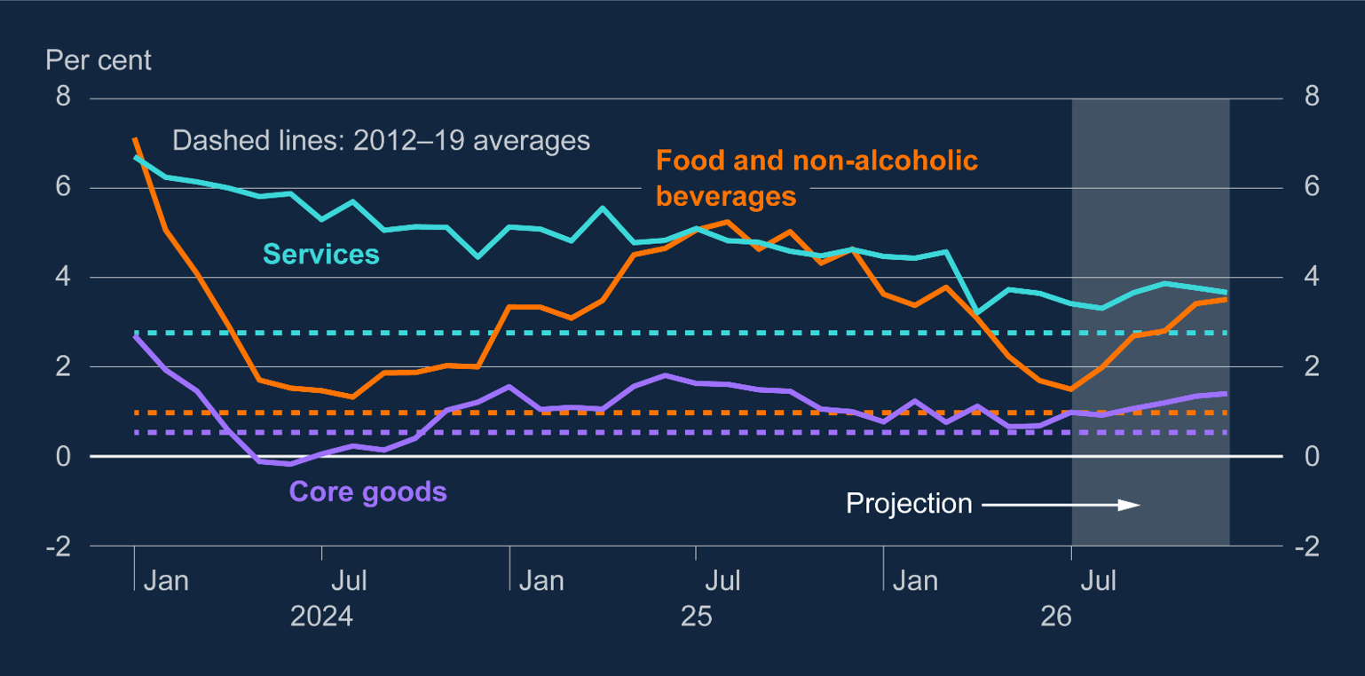
Chart 1.8: Inflation rates are projected to pick up across CPI components, most notably for food
This is likely to show up in food price inflation over the rest of the year and goods prices
Other global influences could also push prices here, such as impact of El Niño…
Notes:
Sources: DMP survey, HMRC, Indeed, ONS and Bank calculations.
(a) Private sector regular pay growth shows the ONS measure of private sector regular AWE growth (three-month average on same three-month average a year ago). The DMP shows three-month average realised pay growth from the DMP survey (three-month average on same three-month average a year ago). HMRC RTI (three-month average on same three-month average a year ago) shows a proxy of growth in median pay in the private sector. Staff construct this measure by taking median pay for each industry (excluding public administration and defence, education, health and social work) and combining them using industry shares in payrolled employment. Annual growth is then calculated using the Laspeyres formula, holding industry weights fixed at their levels a year earlier to reduce the influence of changes in workforce composition. Indeed Wage Tracker shows annual average job title matched pay growth for UK job vacancies. Latest data points are for the three months to February 2026 for private sector regular pay and the Indeed Wage Tracker, March 2026 for the HMRC RTI private sector median, and April 2026 for the DMP survey. Private sector regular pay growth projection diamonds are for 2026 Q1 and 2026 Q2.

Slide 14
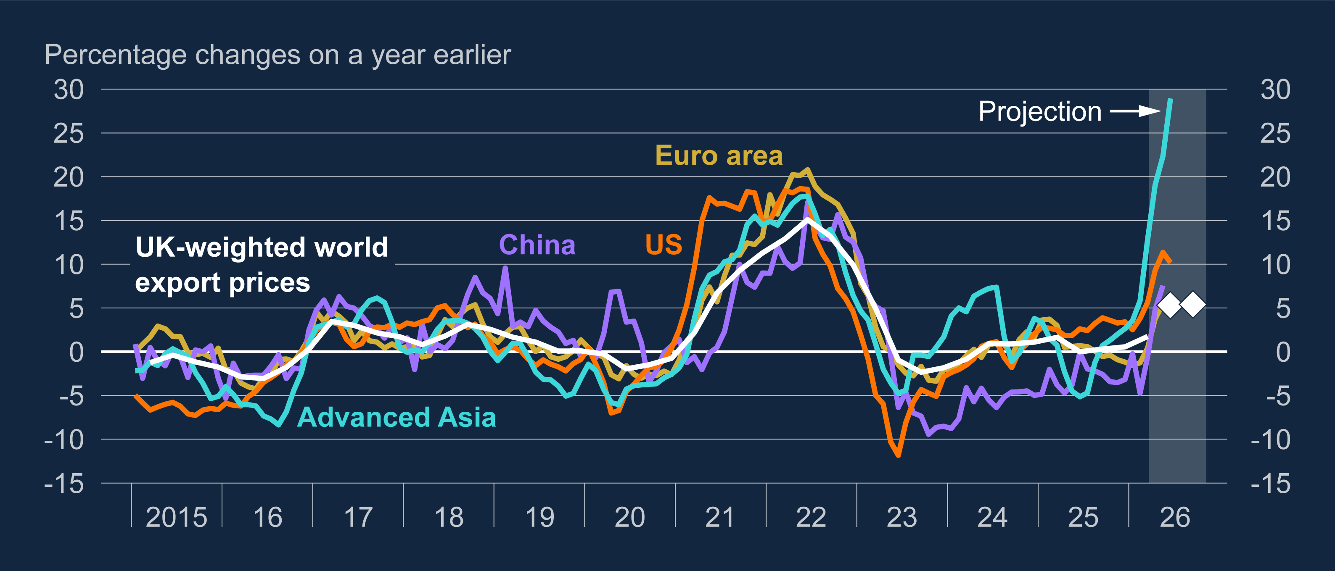
Chart D.3: Global demand for AI-related goods is boosting Advanced-Asia export prices
…and higher memory-chip prices, given strong AI demand, are already showing up in prices of electronics further up the supply chain.
Notes:
Sources: LSEG Workspace and Bank calculations.
a) Advanced Asia refers to Hong Kong, Japan, Korea, Singapore and Taiwan. Euro area monthly series is calculated from Belgium, Estonia, Finland, Germany, Ireland, Italy, Netherlands and Spain series. The final data points for each monthly series are June for Advanced Asia and the US, and May for China and the euro area. The diamonds show staff projections for UK-weighted world export price inflation over the period 2026 Q2–Q3.

Slide 15
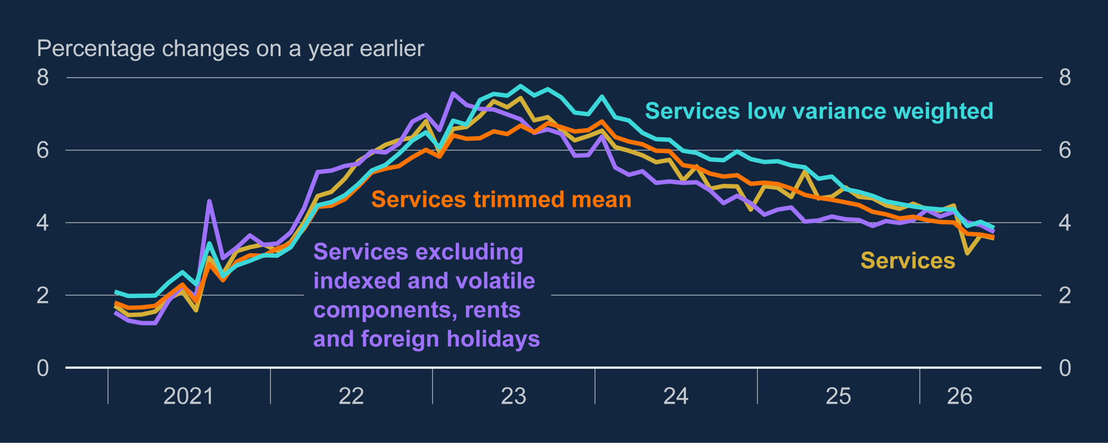
Chart 1.3: Measures of underlying services price inflation eased further in 2026 Q2
Continuing to learn about the path the economy was on before conflict broke out
Measures of more persistent domestic inflation such as services price inflation eased further…
Notes:
Sources: ONS and Bank calculations.
(a) The low-variance measure is calculated by weighting each component of services inflation by the inverse variance of the change in 12-month inflation of that component from 12 months previously. The maximum adjusted weight is capped at twice its original value. Details of the components that have been included/excluded from the services excluding indexed and volatile components, rents and foreign holidays measure are included in the accompanying spreadsheet published online. The trimmed-mean measure excludes the 10% largest and 10% smallest price changes. The latest data points are for June 2026.

Slide 16
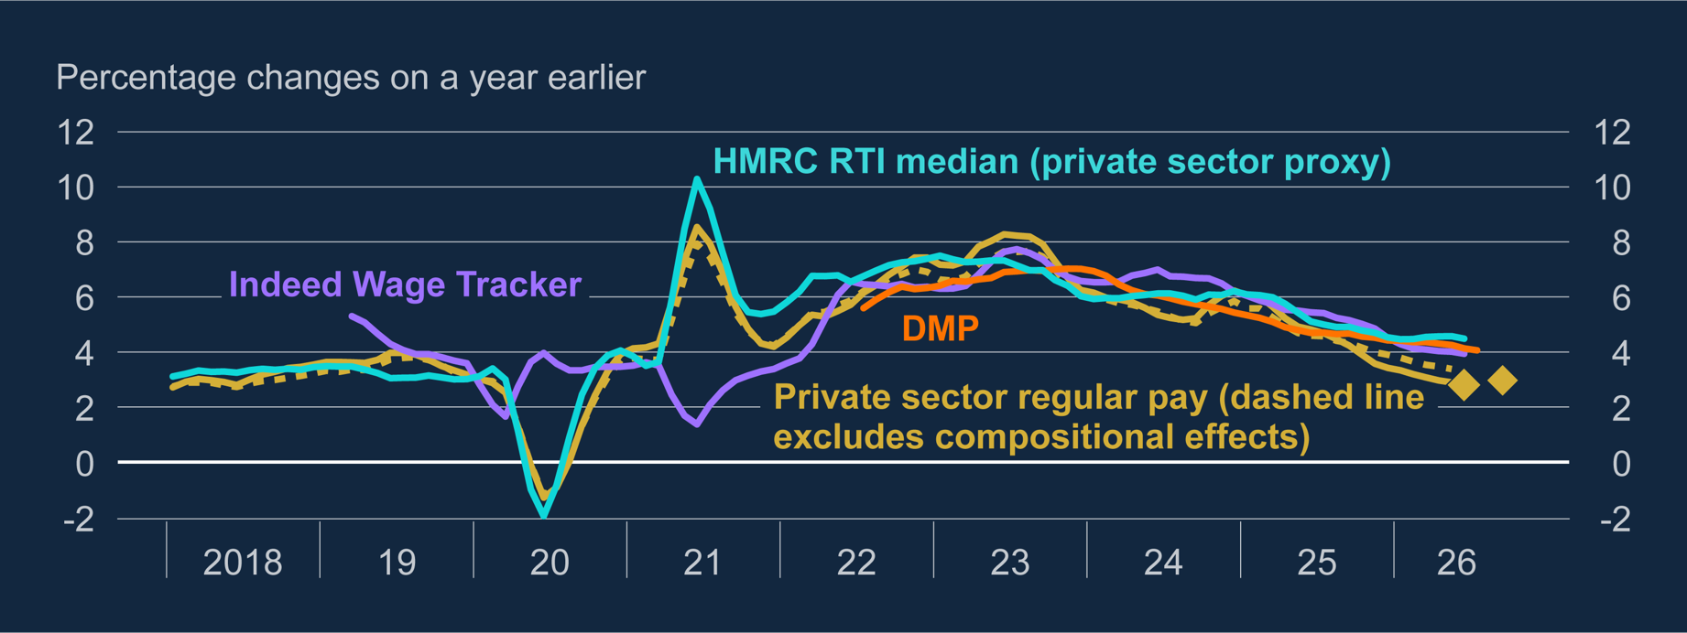
Chart 1.4: Private sector wage growth has continued to slow
…and wage inflation continues to slow towards rates more consistent with the 2% inflation target…
Notes:
Sources: DMP survey, HMRC, Indeed, ONS and Bank calculations. (a) The private sector regular pay growth line shows the ONS measure of private sector regular AWE growth, measured as the three-month average on the same period a year earlier. The DMP line shows average realised pay growth from the DMP survey on the same basis, while the HMRC RTI line shows a proxy of growth in median pay in the private sector, also measured as the three-month average on the same period a year earlier. Bank staff construct the HMRC RTI measure by taking median pay for each industry – excluding public administration and defence, education, health and social work – and weighting them by industry shares in payrolled employment. Annual growth is then calculated using the Laspeyres formula, holding industry weights fixed at their levels a year earlier to reduce the effect of changes in workforce composition. The Indeed Wage Tracker line shows annual average job title matched pay growth for UK job vacancies. The latest data points are for the three months to May 2026 for private sector regular pay, June 2026 for the HMRC RTI private sector median and the Indeed Wage Tracker, and July 2026 for the DMP survey. The private sector regular pay growth projection diamonds are for the three months to June and September 2026.

Slide 17
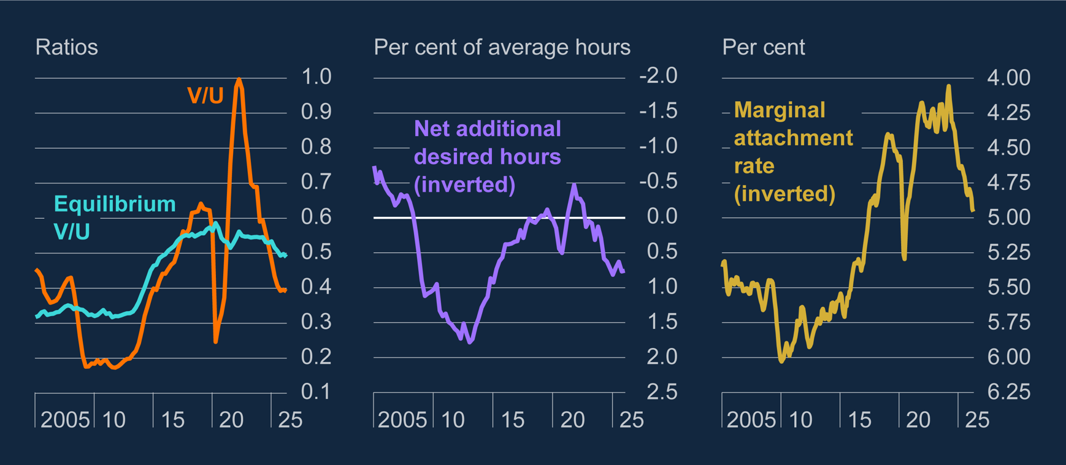
Chart 1.13: The labour market continues to operate with a degree of spare capacity
…reflecting spare capacity in the labour market
Notes:
Sources: Advertising association/World Advertising Research Centre Expenditure Report, ONS and Bank calculations.
(a) The equilibrium V/U ratio in the left panel is estimated using an error-correction model over the period 1982–2025. The real cost of vacancy posting and hourly labour productivity are included as long-run determinants for the level of vacancies. The model also includes controls for short-term movements in these variables (Stelmach et al (2025)). The latest data are for 2026 Q1. The 2026 Q2 data points are projections based on data to the three months to May. The middle panel shows the number of net additional hours that the currently employed report they would like to work, on average, per week, expressed as a share of average weekly hours. The latest data are to 2026 Q1 and the vertical axis is inverted. The data in the right panel are three-month averages of the share of people aged 16–64 who report that they are not in work or not actively looking for work but would like a job. The latest data are for the three months to April 2026 and the vertical axis is inverted.

Slide 18
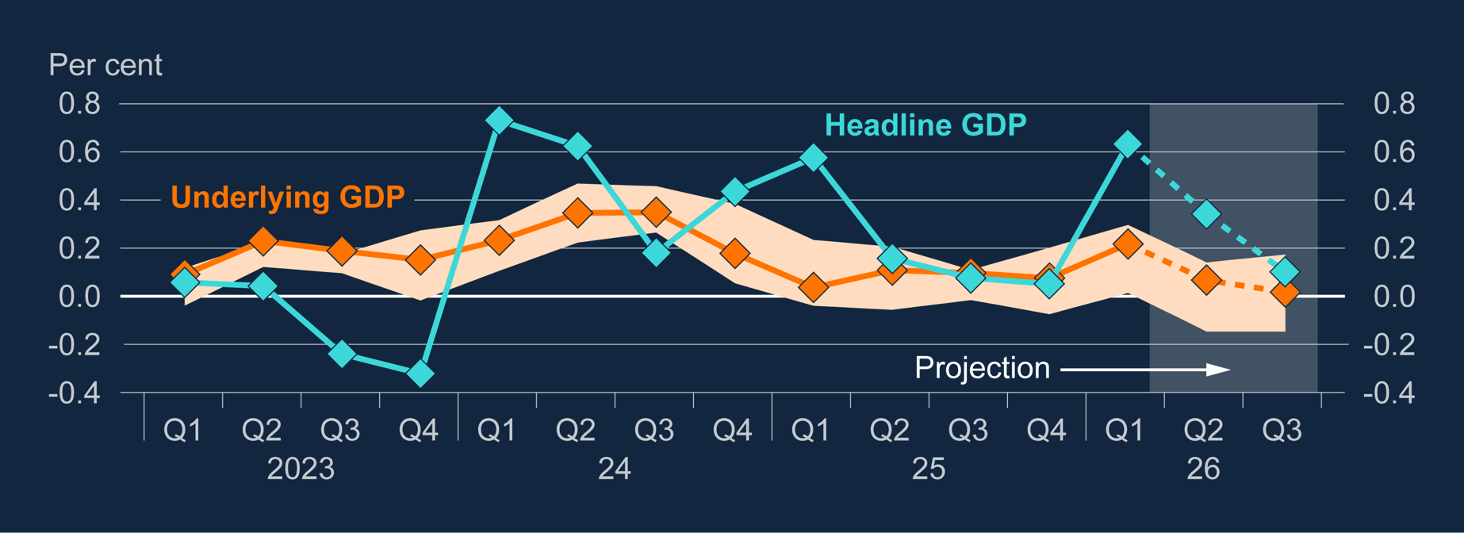
Chart 1.10: Underlying GDP growth is projected to weaken slightly in the near term
Underlying activity growth remains relatively weak and is likely to slow a little further, but no immediate signs of a dramatic impact on confidence or business sentiment.
Notes:
Sources: ONS and Bank calculations.
(a) Diamonds show Bank staff projections for 2026 Q1 and Q2. Bars may not sum to total due to rounding. Income includes non-profit institutions serving households and is defined as total available household resources, deflated by the consumer expenditure deflator. The data are based on ONS codes: RPQK/((ABJQ+HAYE)/(ABJR+HAYO)).

Slide 19
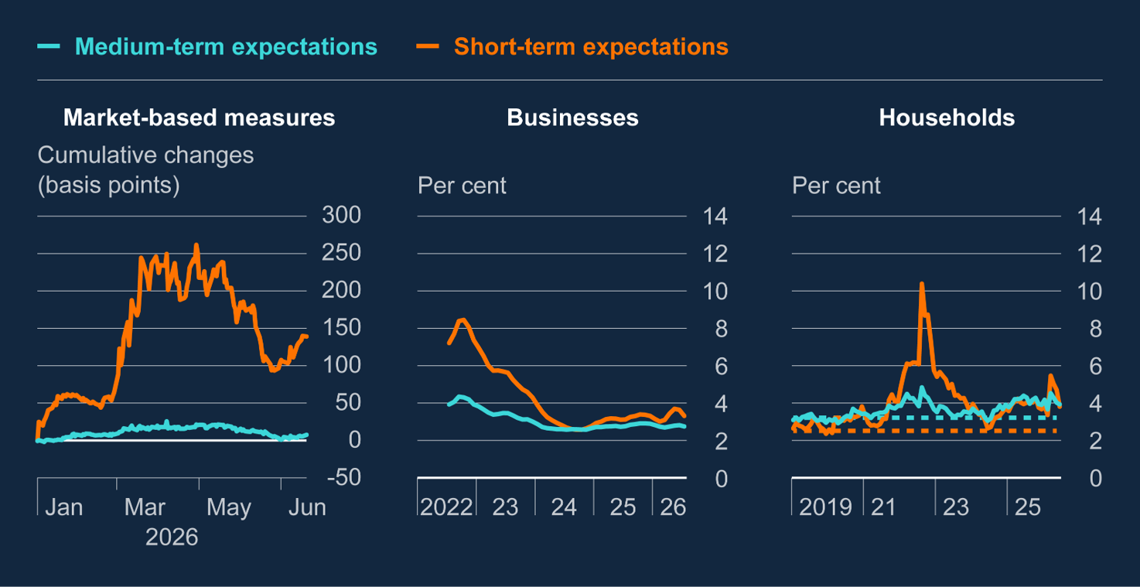
Chart 1.9: Inflation expectations remain elevated, especially at shorter horizons
Subdued growth and spare capacity in the labour market may limit the extent to which higher energy prices become embedded in wage and price setting.
And inflation expectations have fallen back a little from their peaks in the Spring
Notes:
Sources: Bloomberg Finance L.P., Citigroup, DMP survey, YouGov and Bank calculations.
The data show cumulative changes in market-based measures of inflation compensation since 31 December 2025. The orange line shows the one-year inflation swap rate, and the aqua line shows the five-year, five-year forward inflation swap rate. A short back-run is shown because of the impact of RPI reform, which distorted the five-year, five-year forward inflation swap rate between April 2020 and March 2025. From 2030, UK RPI will be aligned with the CPIH measure of consumer prices. The final data points are for 20 July 2026.
The data are from the DMP survey and show three-month averages. The data are in response to the question: ‘What do you think the annual CPI inflation rate will be in the UK, one year from now and three years from now?’. The latest data points are for July 2026, with the survey conducted between 3–17 July. The DMP survey data have a short back-run, so no historical averages are shown.
The data are from the Citi/YouGov survey and are based on responses to the questions: ‘How do you expect consumer prices of goods and services will develop in the next 12 months?’, and ‘And what do you think will happen to the prices of goods and services, on average, over the longer term – say five to ten years?’. The dashed lines represent the series averages over 2010–19. The latest data points are for June 2026, with the survey conducted between 22–23 June. The chart does not show the July 2026 Citi/YouGov data, which was released after the data cut-off for incorporation in the charts.

Slide 20
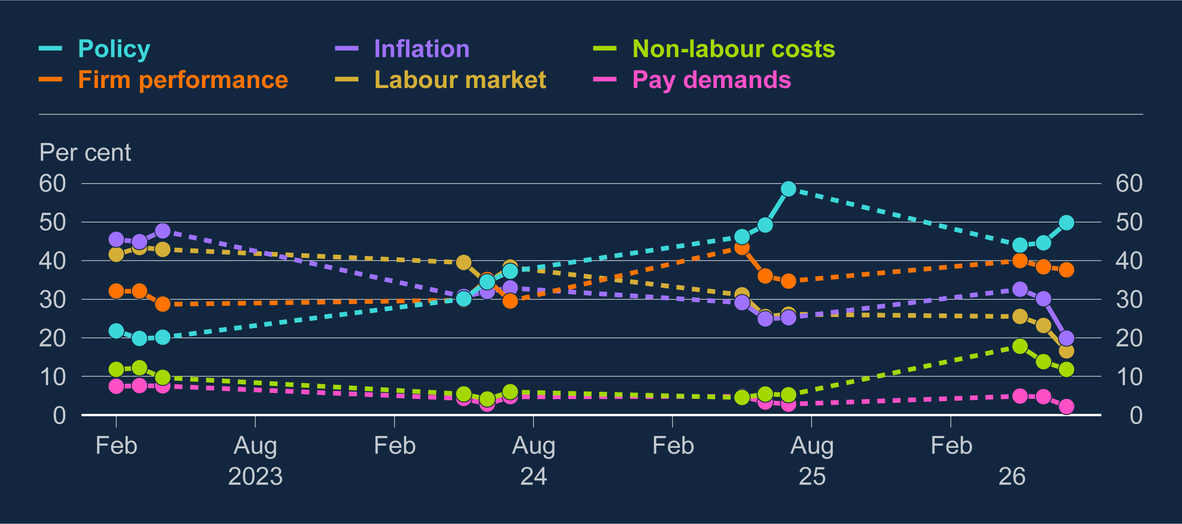
Chart B.3: Firms are less likely to report that inflation is important for wage growth than in the recent past
Over the past couple of months, companies have become less worried about high inflation pushing up on wage growth. Energy prices have since risen again, however
Still very early days – this year’s wage round largely complete before conflict started and we may not observe impact on wage growth until early next year
Notes:
Sources: DMP survey and Bank calculations.
(a) The results are based on application of a LLM to the DMP survey open-text question: ‘In your own words, what are the main factors that will affect average wage growth per employee in your business over the next 12 months?’. The model categorised comments depending on if they mentioned a range of factors, which have been aggregated to the broad groupings shown on the chart. A sample of the responses was validated by a researcher performing the same categorisation – the LLM provided a very high degree of accuracy in the sample. Comparing category shares over time may not be a perfect signal as some firms may have mentioned inflation in the context of falling inflation in 2024 and 2025 leading to slower wage growth while mentioning inflation in the context of rising wage growth in 2023.

Slide 21
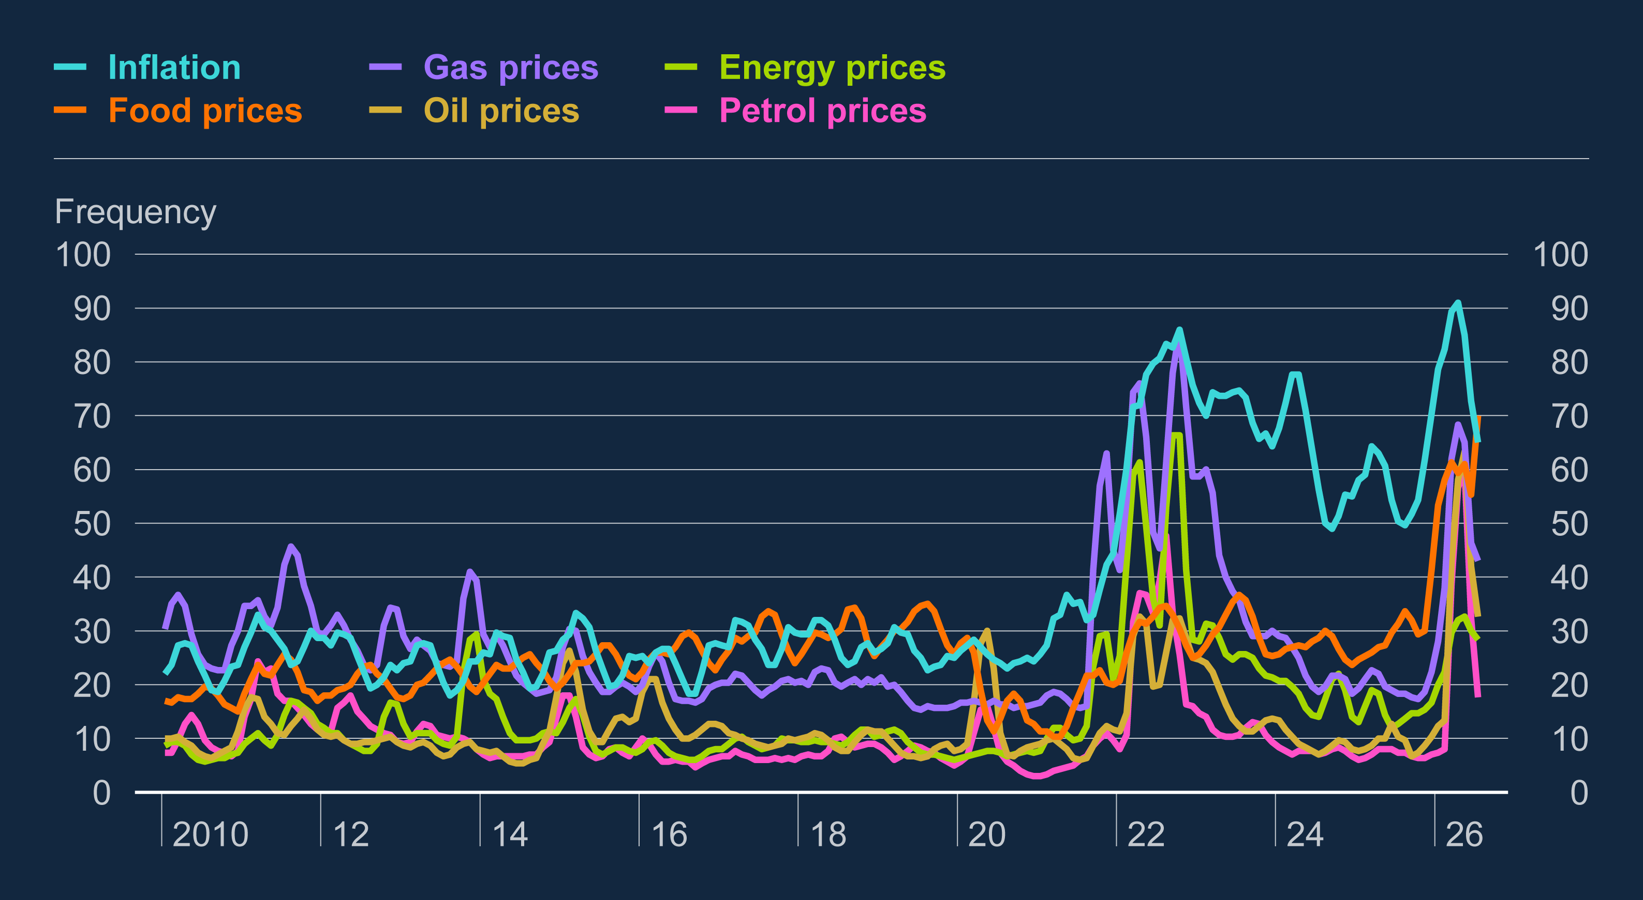
Chart B.1: Household attentiveness to inflation is high
Moreover, recent experience of high inflation may affect behaviour too.
Households are much more attentive to developments in prices than they were before the war in Ukraine, and may try to ensure make up any loss in spending power.
Notes:
Sources: Google and Bank calculations.
(a) The series are three-month rolling averages. The frequency is a relative measure for each individual search term, over 2005–2026, where 100 indicates the highest frequency over that time period. Data are up to July 2026 and are not seasonally adjusted

Slide 22
Key policy judgement 1
Overall, the MPC judges at this time that second-round effects will probably be moderate.
But the outlook is uncertain and the risk of strong inflationary pressures continues to be greater than the risk of weak inflationary pressures.
As in April, the MPC continues to judge that weakness in economic activity and demand for labour is likely to help contain the strength of second-round effects.
But other factors could lead to grater second-round effects and there is not enough evidence yet to rule out this risk.

Slide 23
Main points from the MPR
Key policy judgement 2

Slide 24
Baseline forecast and scenarios
MPC members have to make a judgement call meeting by meeting about how to balance the costs of leaning too little against inflationary pressures against the cost of leaning too much.
In thinking about that this round, they’ve looked at a central forecast and two scenarios which they found useful as they came to their decision
Not all encompassing and don’t cover the full set of risks, and none will be exactly correct.
Not aiming to keep with every single up and down in oil prices – focus instead on potential implications for the medium term.

Slide 25
Table 3.A: Key assumptions and judgements in the central projection and scenarios
 | Central projection | Milder scenario | Adverse scenario
Energy prices | Energy prices for wholesale oil and gas follow the market futures curves over the 15 UK working days to 20 July. | Energy future prices follow the paths as observed on 1 July, capturing the lower prices after the signing of the Memorandum of Understanding (MoU). | Energy prices rise materially above the central projection and remain persistently higher over the forecast period.

Slide 26
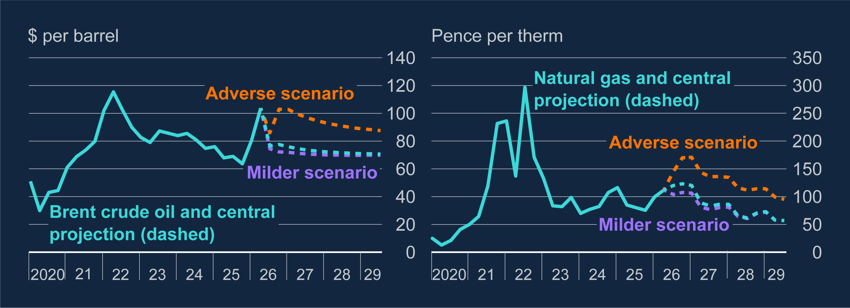
Chart 3.1: Energy price paths are higher in the adverse scenario relative to the central projection and milder scenario
Central projection has oil prices falling back to $70 and gas to 60p per therm.
The milder scenario runs off early July energy prices.
Adverse scenario assumes conflict continues with occasional flare ups and no clear resolution. Oil prices rise above $100 again and fall back much more slowly.
Notes:
Sources: Bloomberg Finance L.P., LSEG Workspace and Bank calculations.
(a) Historical spot prices are quarterly averages of Brent crude oil prices and are in US dollars. The dashed lines refer to the conditioning assumptions for the central projection, and the milder and adverse scenarios, as outlined in Table 3.A. The final data are for 2029 Q3.
(b) Historical spot prices are quarterly averages of Bloomberg UK NBP Natural Gas Forward Day prices and are in sterling. The dashed lines refer to the conditioning assumptions for the central projection, and the milder and adverse scenarios, as outlined in Table 3.A. The final data are for 2029 Q3.

Slide 27
Table 3.A: Key assumptions and judgements in the central projection and scenarios
 | Central projection | Milder scenario | Adverse scenario
Energy prices | Energy prices for wholesale oil and gas follow the market futures curves over the 15 UK working days to 20 July. | Energy future prices follow the paths as observed on 1 July, capturing the lower prices after the signing of the Memorandum of Understanding (MoU). | Energy prices rise materially above the central projection and remain persistently higher over the forecast period.
Second-round effects from recent energy shock | Moderate additional second-round effects, consistent with some effect on short-term inflation expectations and hence wages. In addition, heightened attentiveness to inflation also contributes to second-round effects. | No new second-round effects from the recent energy shock, owing to weaker worker bargaining and firm pricing power. This partly reflects weaker demand, driven by a greater degree of saving than in the central projection. | Stronger and more persistent additional second-round effects relative to the central projection and milder scenario. This stems from a greater effect of the energy shock on long-run inflation expectations and hence wages and prices.

Slide 28
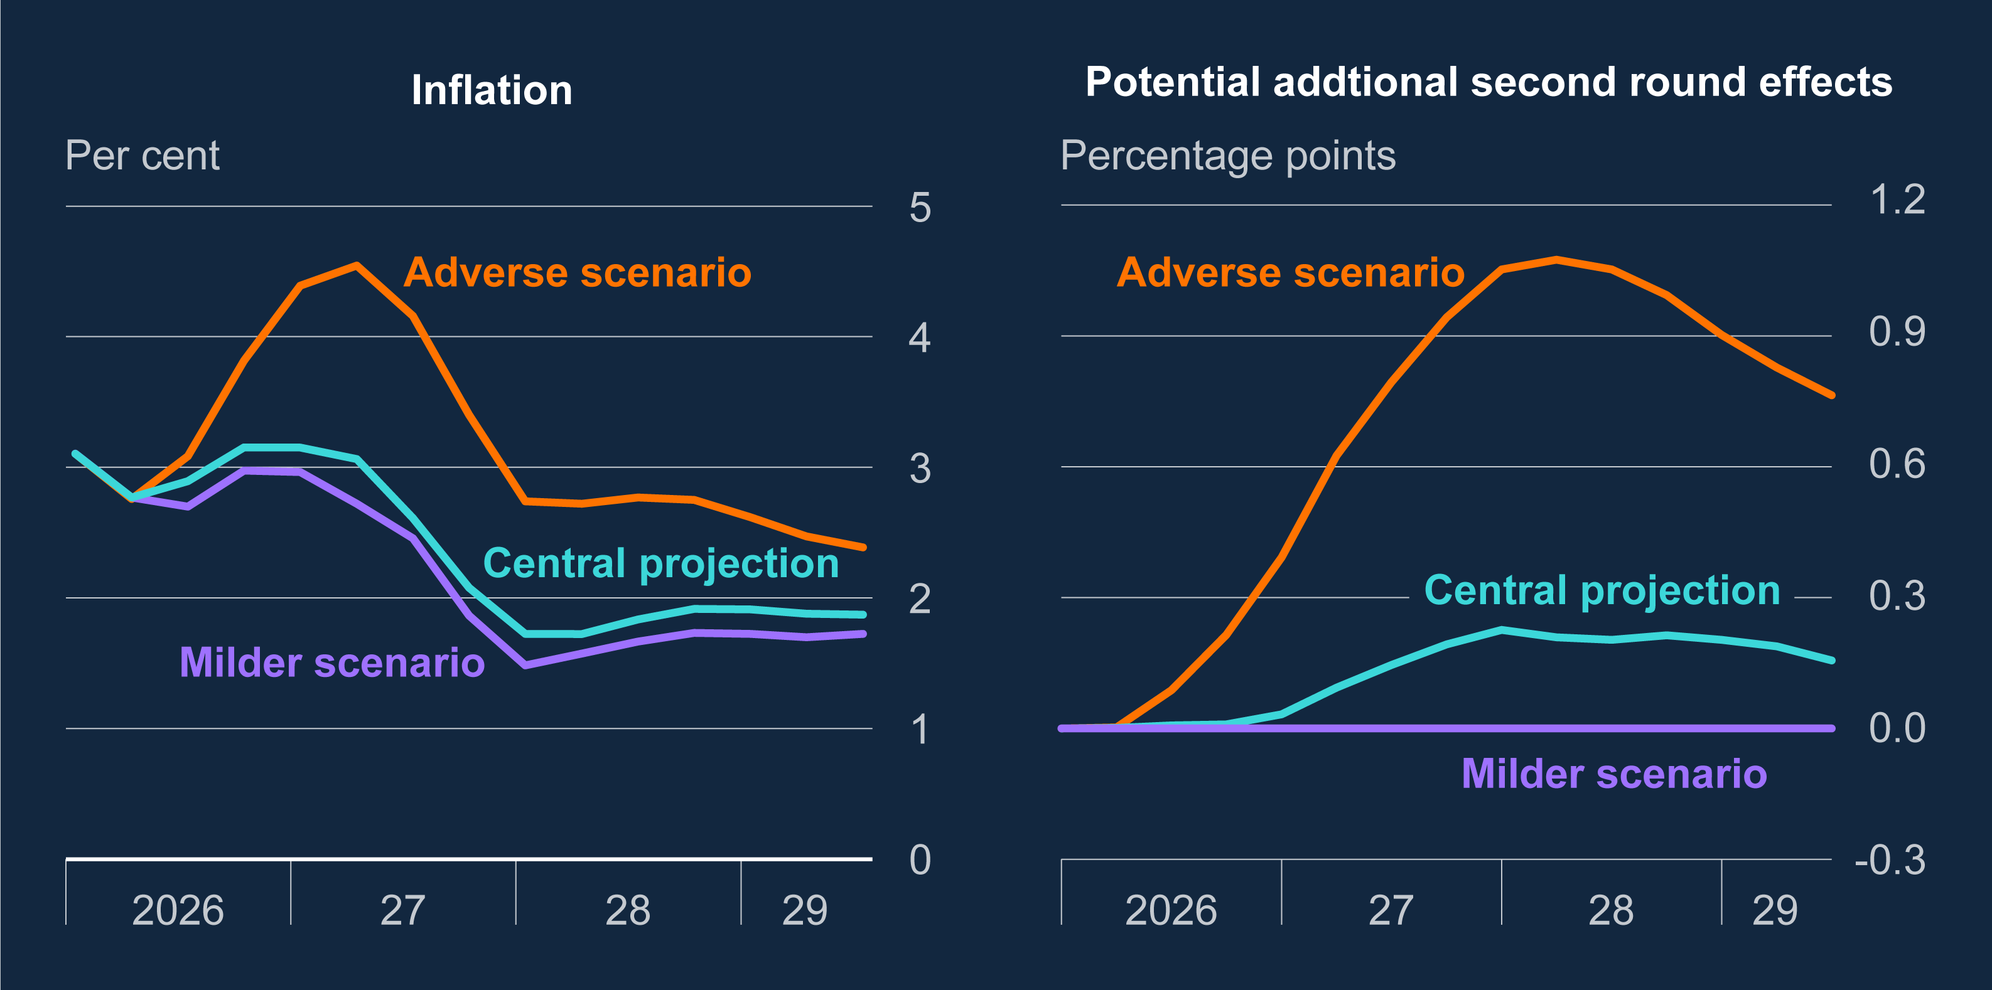
Chart 3.3: Relative to the central projection, inflation is higher in the adverse scenario and lower in milder scenario, in part due to second-round effects
Central forecast has with inflation spending several quarters above 3% before falling back as futures prices fall, and finishing the projection a little below 2%.
Milder scenario sees inflation fall more quickly and end the projection further below 2%
Adverse scenario is associated with nastier second round effects and inflation staying well above 2% under the market curve for interest rates.
Notes:
Sources: ONS and Bank calculations.
(a) All three scenarios shown here are conditioned on the same market-implied path for Bank Rate. Further details on conditioning assumptions can be found in Table 3.A and the Scenario Projections Databank accompanying this Report. The final projections are for 2029 Q2.

Slide 29
Outcomes across central forecast and scenarios (assuming market interest rates)
 | CPI Inflation |  |  | GDP growth |  |  | Unemployment rate
 | Central | Milder | Adverse | Central | Milder | Adverse | Central | Milder | Adverse
2027Q3 | 2.6 | 2.4 | 4.1 | 1.1 | 1.1 | 0.9 | 5.3 | 5.5 | 5.5
2028Q3 | 1.8 | 1.7 | 2.8 | 1.7 | 1.6 | 1.6 | 5.2 | 5.3 | 5.4
2029Q3 | 1.9 | 1.7 | 2.4 | 1.6 | 1.6 | 1.7 | 5.0 | 5.2 | 5.3
Central forecast has with inflation spending several quarters above 3% before falling back as futures prices fall, and finishing the projection a little below 2%.
Milder scenario sees inflation fall more quickly and end the projection further below 2%
Adverse scenario is associated with nastier second round effects and inflation staying well above 2% under the market curve for interest rates.

Slide 30
Implications
If conflict persists or if MPC begins to see visible signs of the sort of second round effects in the adverse scenario, it will act to head them off by raising interest rates, probably by more than markets currently price in.
If there is a quick resolution and clear signs that higher energy price haven’t become embedded, then Bank Rate can stay lower.

Slide 31
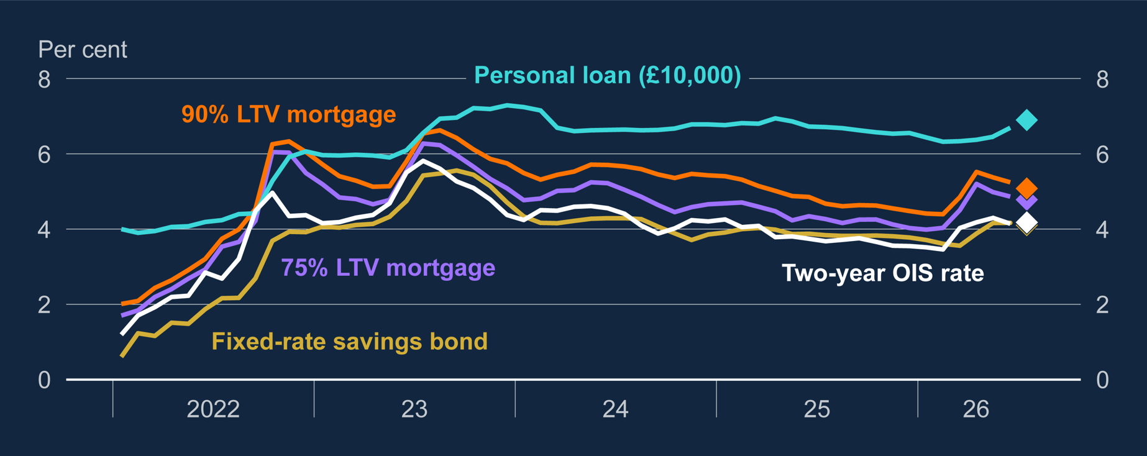
Chart 1.17: Mortgage rates have fallen since the April Report while time deposit rates have risen a little
Interest rates for households and businesses have gone up since February as the cuts that were priced in back then have gone away. That’s leaning against the risk of higher inflation.
At this meeting MPC concluded keeping Bank Rate unchanged struck the right balance between leaning against inflation risks too much or too little.
But ready to act as necessary to ensure that CPI inflation on track to meet the 2% target.
Notes:
Sources: Bank of England, ONS and Bank calculations.
(a) Aggregate broad money captures M4 excluding the deposits of intermediate other financial corporations and is break-adjusted. The dashed line shows the 2012–19 linear trend in the ratio of aggregate broad money to nominal GDP, projected forward. The final data shown are for 2025 Q4. The diamond represents a provisional estimate for 2026 Q1, using the latest Bank staff projection for nominal GDP.

Slide 32
MPC perspective and policy

Slide 33
Main messages from the Monetary Policy Summary
“Monetary policy cannot influence energy prices but is being set to ensure that the economic adjustment to them occurs in a way that achieves the 2% inflation target sustainably. The policy stance required to achieve this will depend on the scale and duration of the shock, and how it propagates through the economy including via financial conditions.
The risk of material second-round effects in price and wage-setting, against which policy needs to lean, is greater the longer higher energy prices persists. There is little evidence so far to suggest such effects, and there have continued to be clear signs of underlying disinflation in recent data.
The Committee judges that the risks to the inflation outlook are tilted to the upside relative to the central projections in the July Monetary Policy Report, but there remains scope for the outlook to change materially as events in the Middle East unfold.
The Committee judges that it is appropriate to maintain Bank Rate at this meeting. The Committee stands ready to act as necessary to ensure that CPI inflation remains on track to meet the 2% target in the medium term.”

Slide 34
Q&A

