Slide 1
April 2026
Monetary Policy Report
Malindi Myers
Huw Pill
Fergal Shortall
Friday 1 May 2026

Slide 2

Plan for the session
Scene setting (Malindi) – 5 minutes
Quick tour of the Report (Fergal) – 20 minutes
MPC perspective and policy (Huw) – 5 minutes
Q&A with Huw and Fergal (please submit your questions via chat box and Malindi will ask them) – 30 minutes

Slide 3
Main points from the MPR
Overview

Slide 4
Backdrop
The disruption the Middle East conflict has caused to energy supplies has led to a sharp rise in global energy prices and changed the outlook for UK inflation.
The immediate effects are already being felt: CPI inflation up to 3.3% in March and is likely to remain around that level in coming months.
  Very different from February, when inflation was expected to fall back close to the 2% target.
Monetary policy cannot undo the increase in global energy prices. And it takes time for monetary policy to work through the economy, so any action the MPC might take now would not prevent higher inflation in coming months.
What the MPC will do is set monetary policy to make sure that the effects of the shock do not become embedded into broad-based inflationary pressures, so that inflation falls back to the 2% target and stays there.

Slide 5
Current approach to setting policy is based on two key policy judgements
Key policy judgement 1
Continued weakness in demand and the labour market is likely to lessen the strength of “second-round effects” from higher global energy prices.
But these effects are likely to be stronger, the larger and more persistent is the rise in global energy prices.
Key policy judgement 2
Monetary policy needs to balance the costs of leaning too little against second-round effects and the costs of responding too much.
The right balance is likely to change depending on how events unfold.
MPC judged that it was appropriate to maintain Bank Rate at 3.75%.

Slide 6
Main points from the MPR
Key policy judgement 1

Slide 7
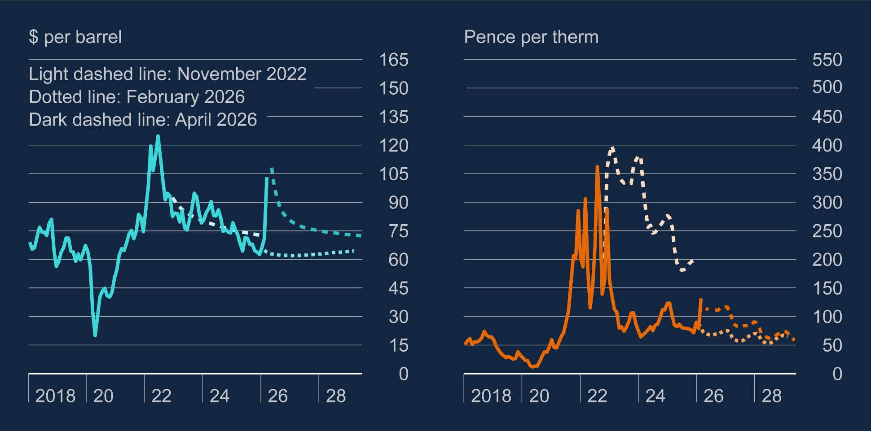
Chart 1.5: Oil and gas prices up sharply but remain below 2022
UK wholesale oil and gas prices
Oil prices up sharply since the outbreak of the conflict and have been volatile (have moved higher since MPR closed on 22 April). Futures curve places weight on a reasonably rapid fall.
Scale of the increase in gas prices is materially less than oil and materially less than in 2022.

Slide 8
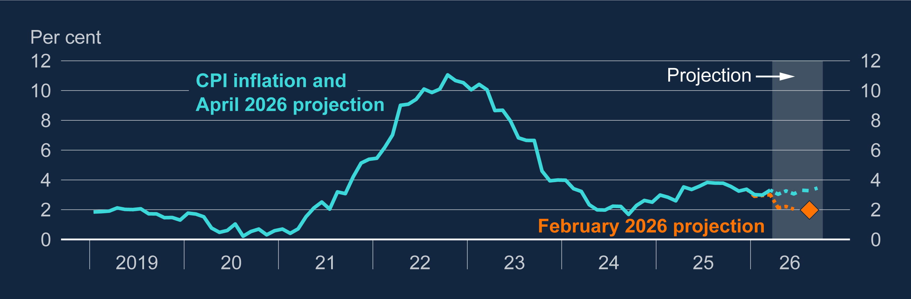
Chart 1.2: Near-term CPI inflation is expected to be much stronger than in the February report
Annual CPI inflation
Higher global energy prices pushed CPI inflation up to 3.3% in March and will keep it close to that rate out to Q3. In February, MPC had expected a return to 2%.

Slide 9
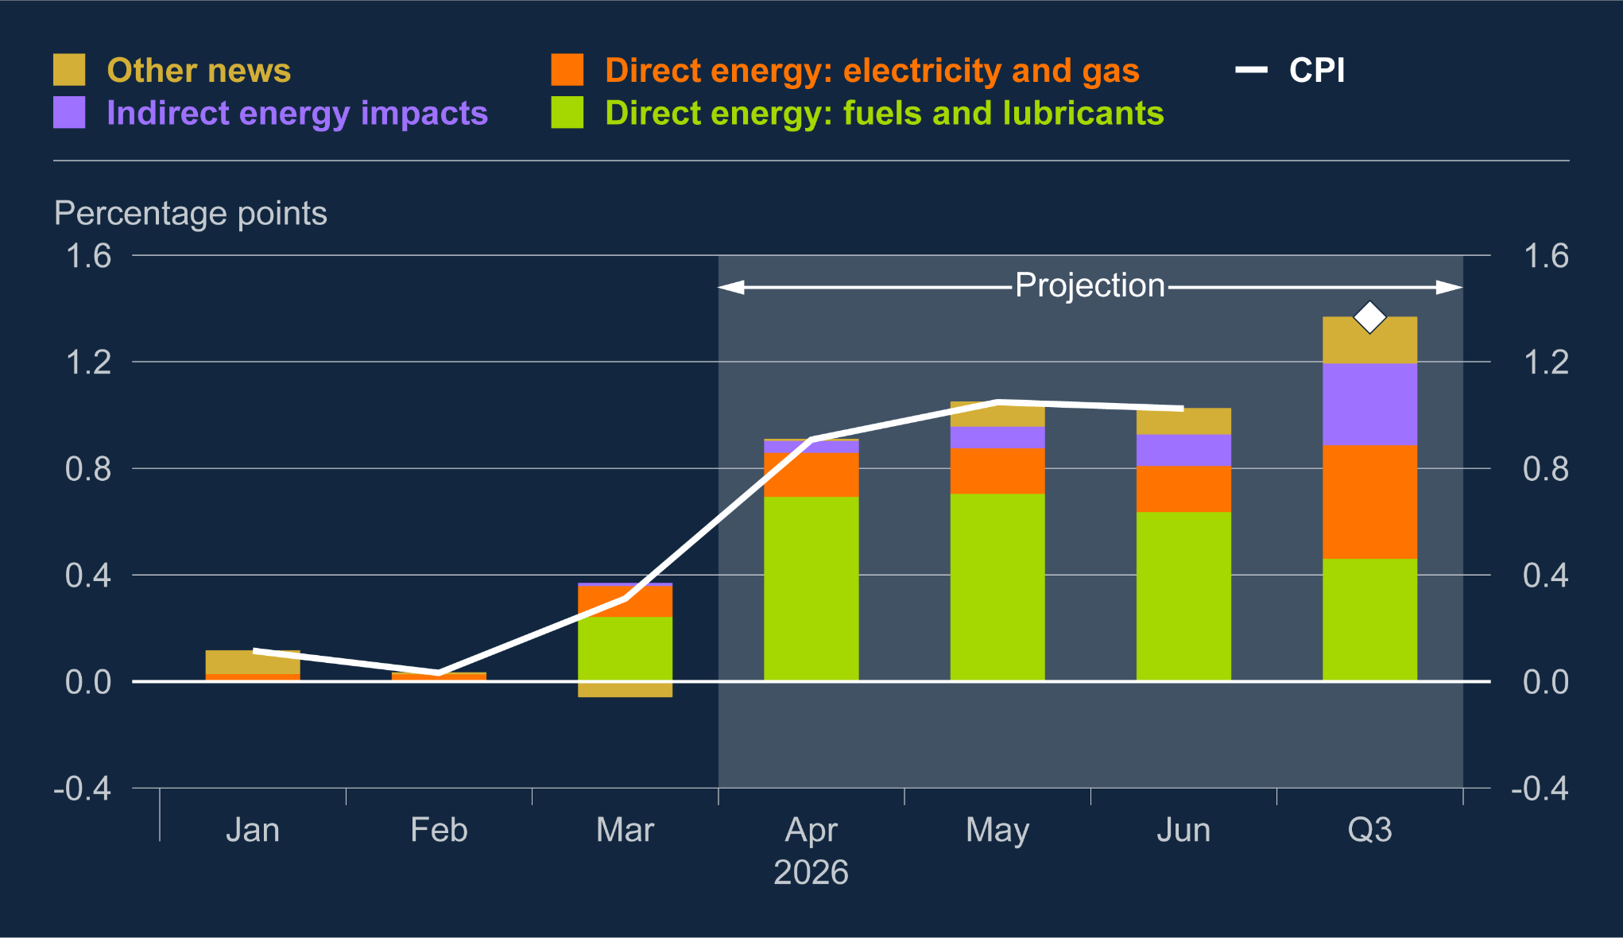
Chart 1.3: Direct energy effects are main driver of higher inflation in the near term
News to CPI inflation relative to the February 2026 projection
Out to Q3, most of the higher path comes from fuel prices. Household utility bills likely to rise from July, with the Ofgem price cap rising to around £1900 from £1640 currently.
More indirect effects through the supply chain build more slowly

Slide 10
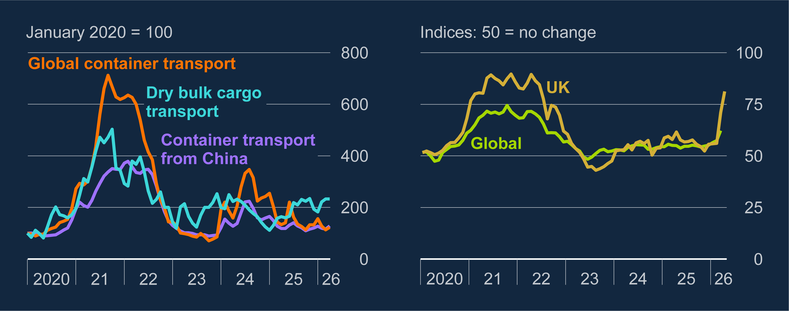
Chart F.2: The conflict in the Middle East has started to affect some global input and transport costs, but by less than in 2022
Shipping cost indices and survey indicators of global and UK manufacturers’ input costs
Some signs of indirect effects already visible in PMI input balances.
Despite Strait of Hormuz blockade, costs on major shipping routes have not increased.

Slide 11
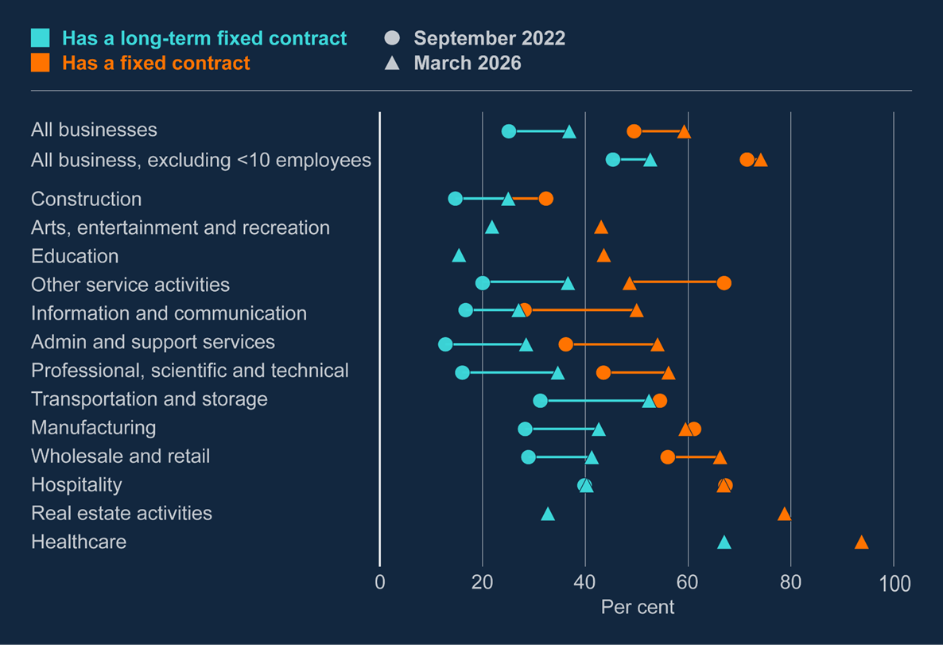
Chart B.1: Energy price rises will affect many firms with a lag due to fixed-price contracts
Share of firms with a fixed-price gas contract
Relative to 2022, more companies are on a fixed-price energy contract and more of those are long-term

Slide 12
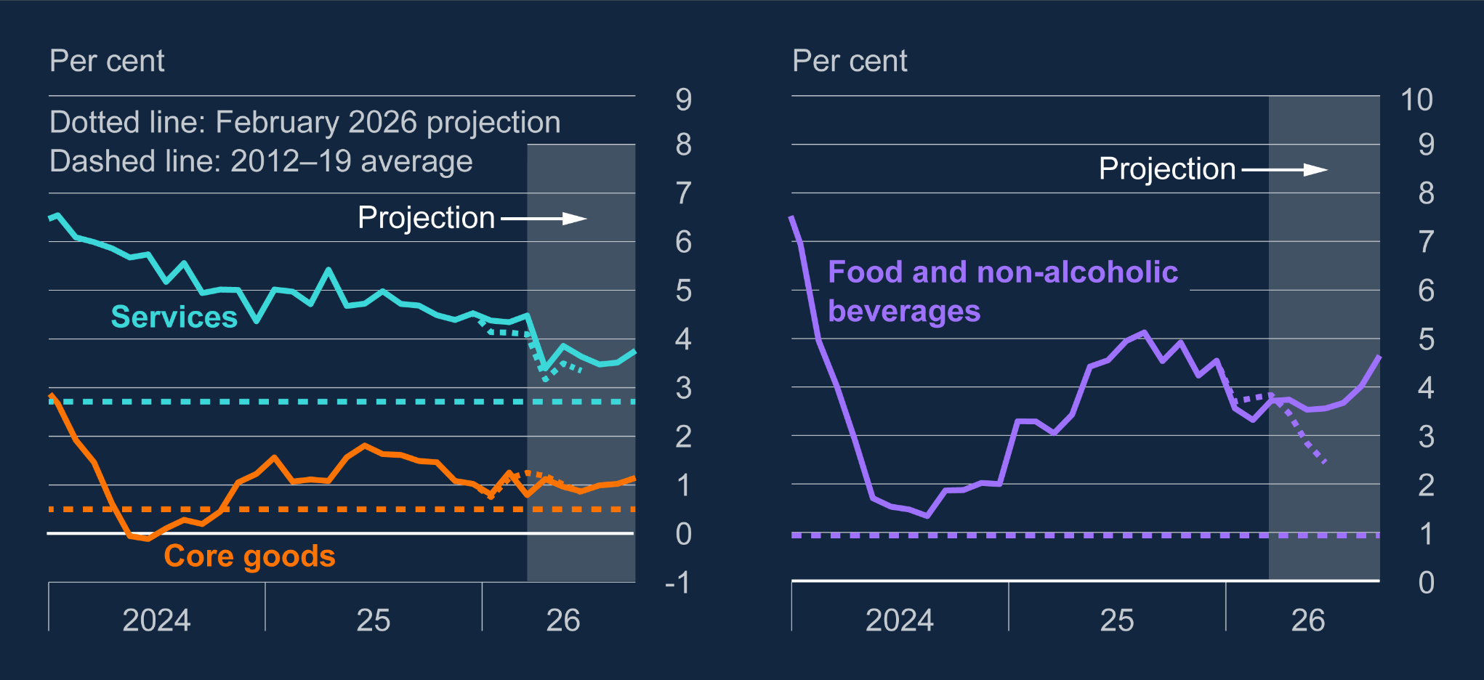
Chart 1.6: Inflation rates are expected to be stronger than at the time of the February Report, especially for food prices
Annual inflation rates for components of CPI
Indirect effects (eg via energy, transport costs, fertiliser) are likely to be strongest in the near term for food prices. Agents’ contacts suggest 6-7% food price inflation by end year.
Less immediate impact on other goods and services prices.

Slide 13
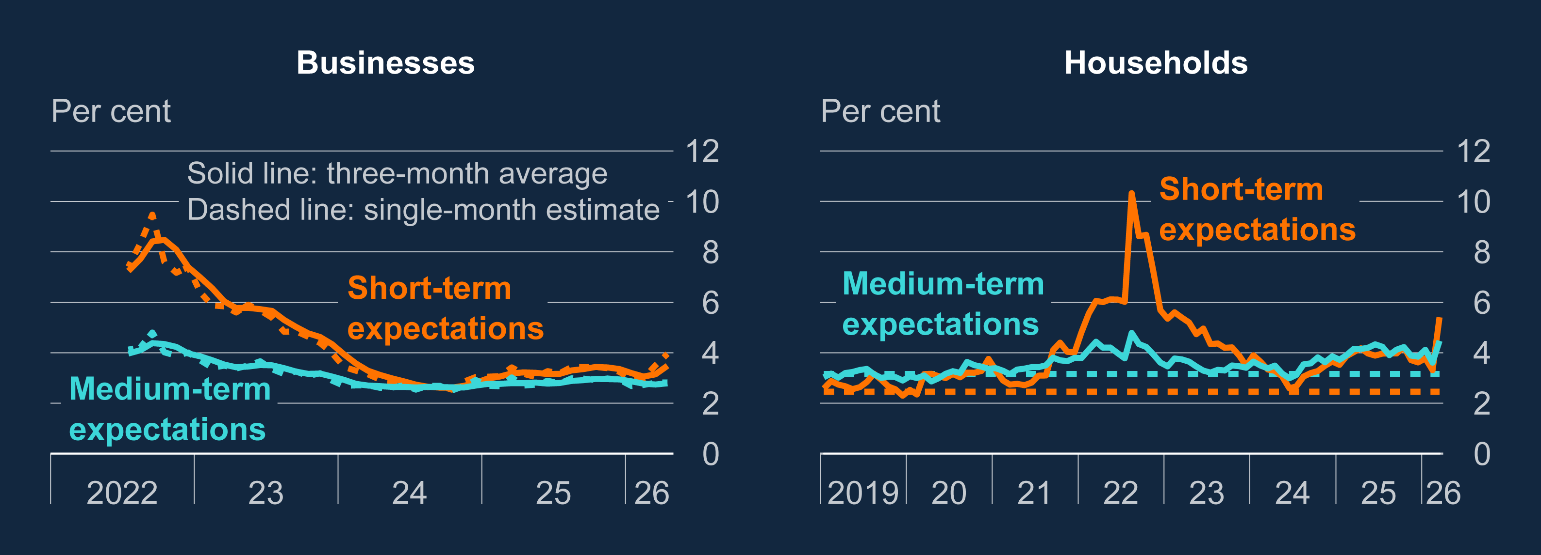
Chart 1.7: Households’ inflation expectations have risen markedly, but business expectations have risen by less
Survey-based measures of household (a) and business inflation expectations
Some factors point to second round effects emerging: large increase in visible and salient price; recent experience of high inflation; wage and price setting hadn’t fully normalised
Notable increase in household inflation expectations

Slide 14
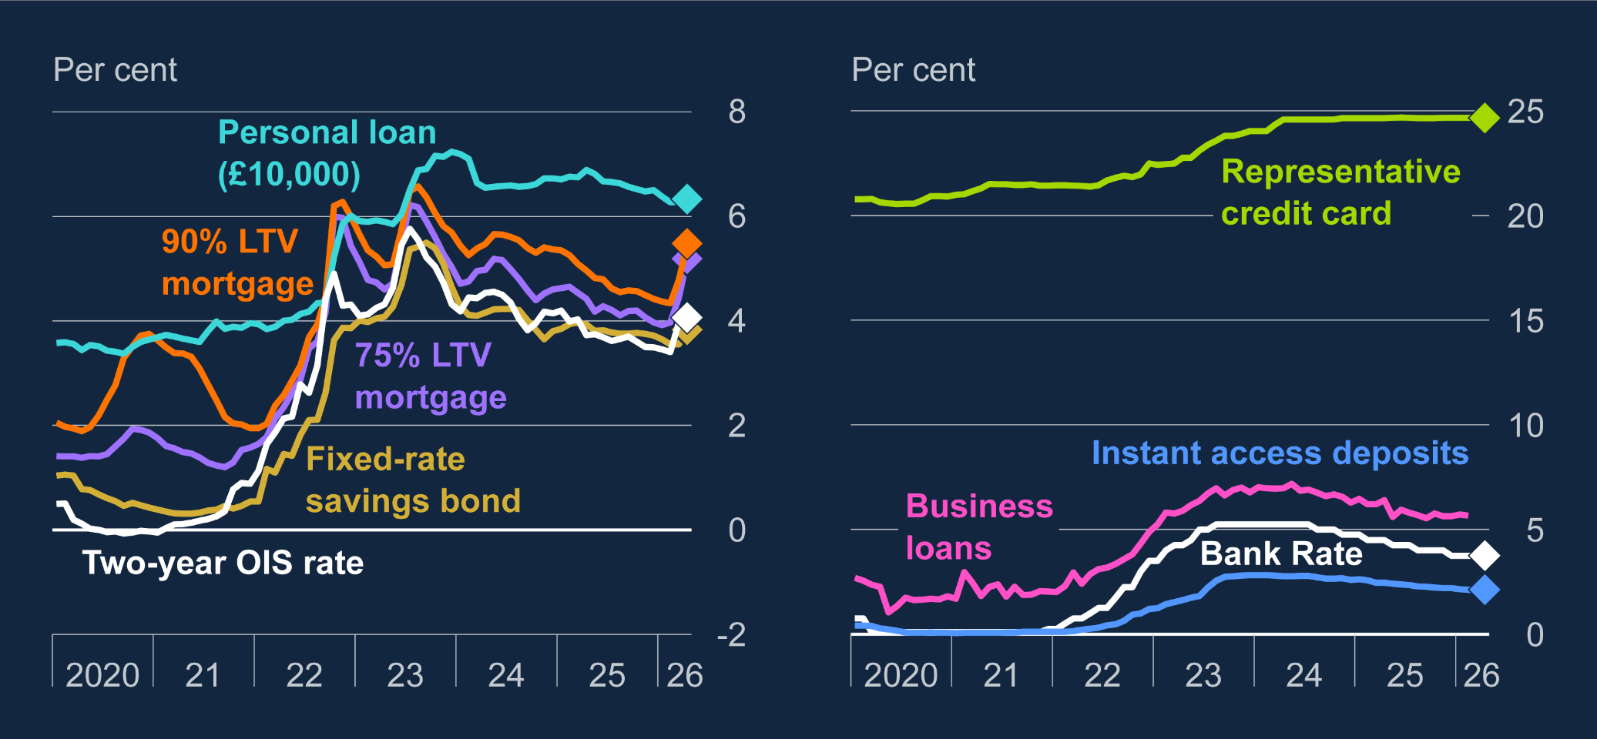
Chart 1.16: Mortgage rates have risen since the February Report, while other rates are little changed
Household and corporate interest rates and their corresponding reference rates
Set against that, monetary policy starts from a restrictive position and financial conditions have tightened…

Slide 15
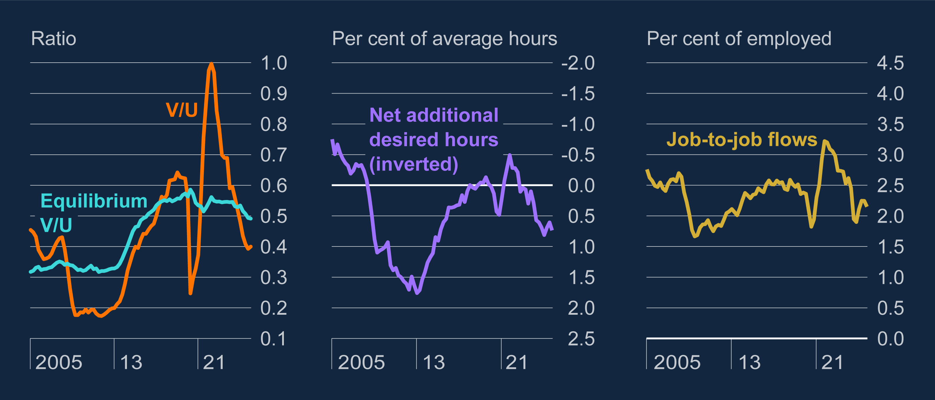
Chart 1.13: Labour market conditions are looser than in 2022.
Indicators of labour market slack
…and the labour market is considerably looser than in 2022. Looser labour market seems to have restrained second-round effects from energy shocks in the past (Box C).

Slide 16
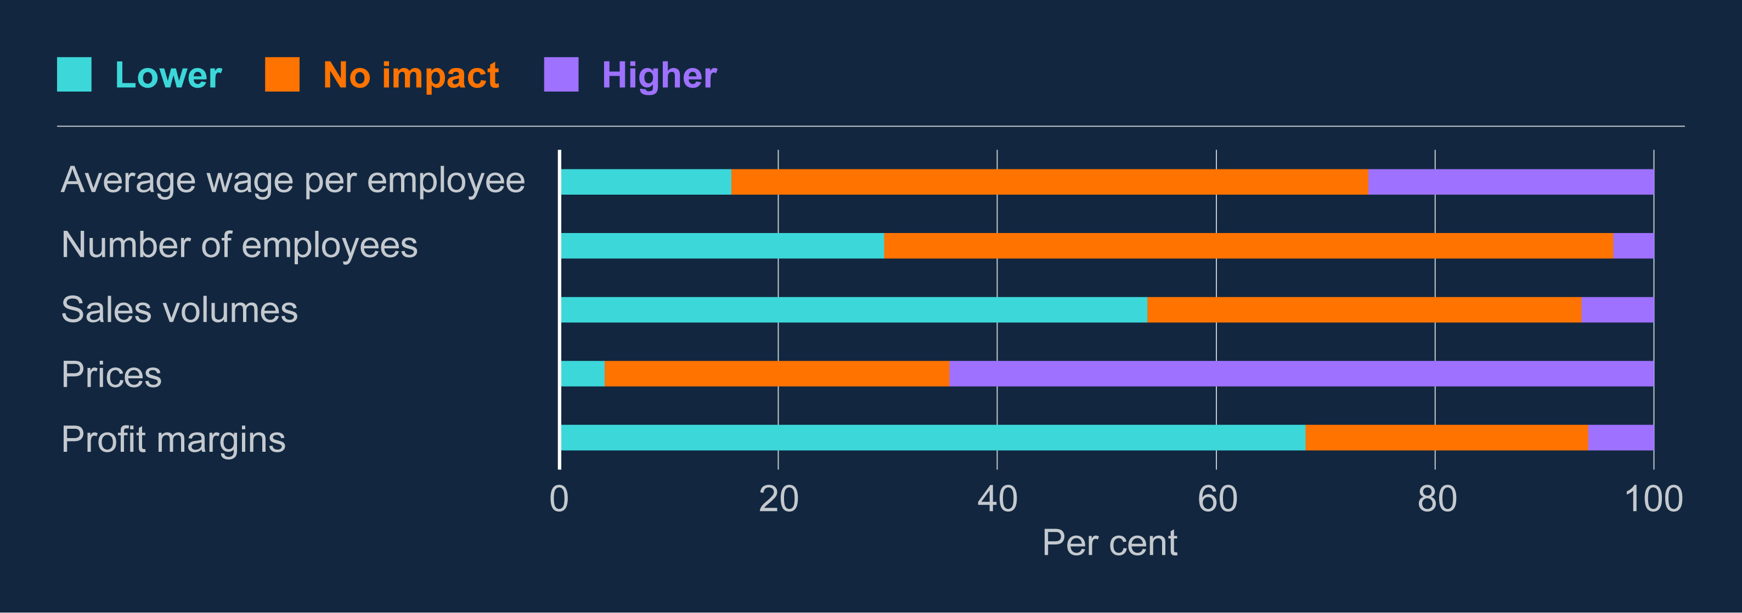
Chart B.2: Higher prices and lower profit margins are the most common responses from firms in response to higher energy costs
Share of firms reporting how they expect the increase in energy prices to affect aspects of their business over the next year
DMP respondents expect material impacts on sales volumes (Box B)
Relatively muted impacts expected on wages and employment. Most wage settlements for 2026 have already been implemented

Slide 17
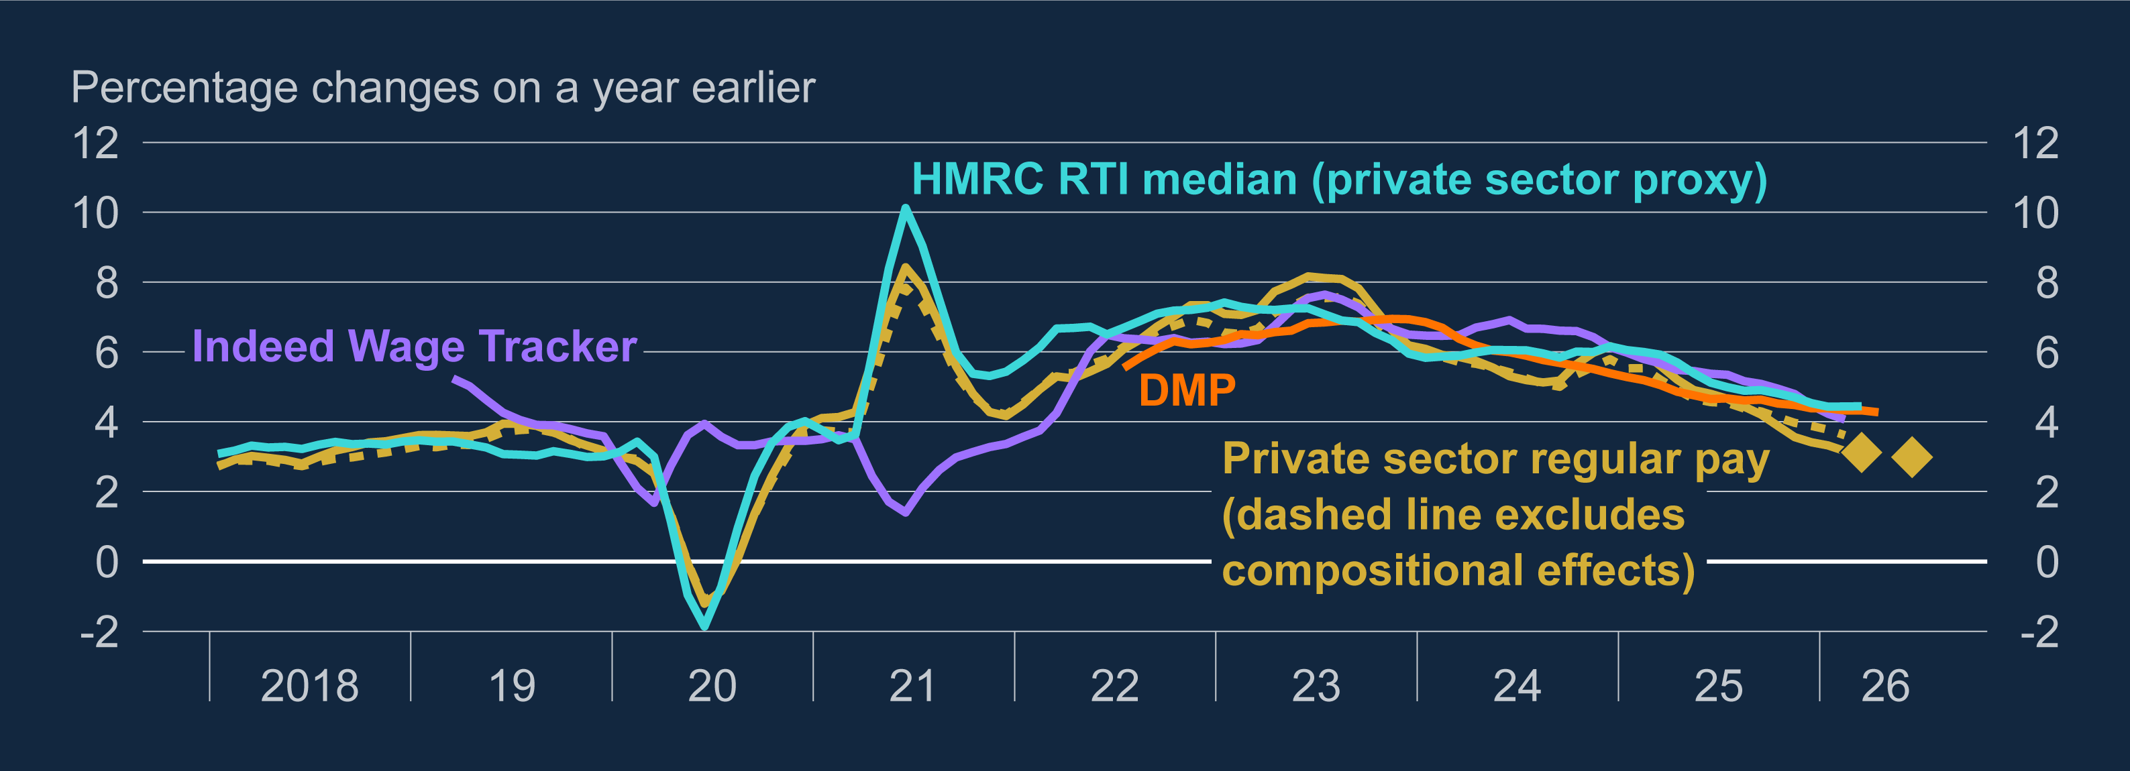
Chart 1.8: Wage growth has continued to slow
Measures of private sector wage growth
Wage growth has been falling towards target consistent rates
Most wage settlements for 2026 have already been implemented

Slide 18
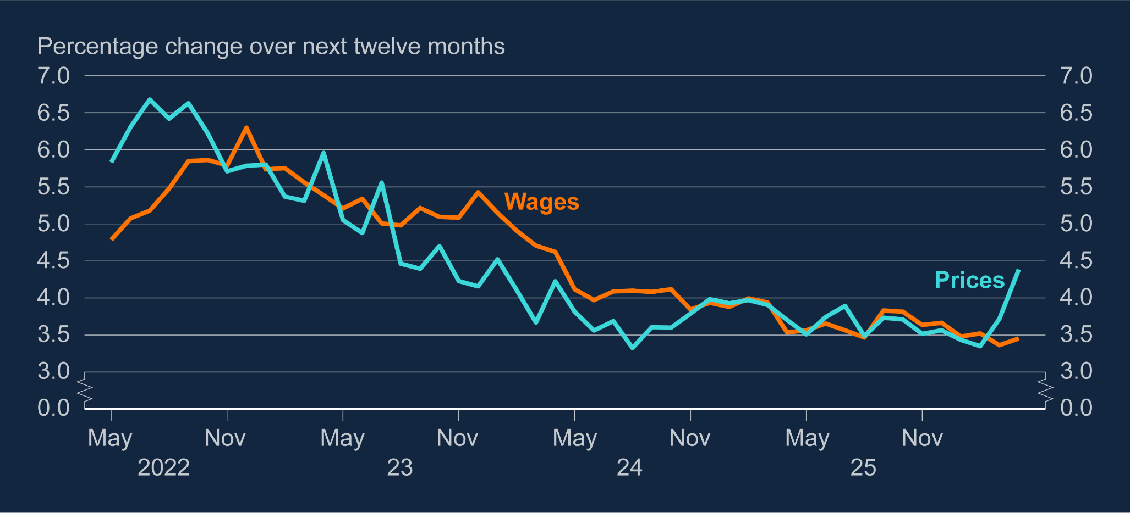
Chart B.3: Firms’ expectations for own prices have increased markedly as energy prices rose; wage expectations little changed
Firms’ reported expectations for their own price and wage growth
While DMP respondents have not changed expectations for wage growth, expectations for their own prices have increased
So if second-round effects occur, may be kick-started by prices rather than wages.

Slide 19
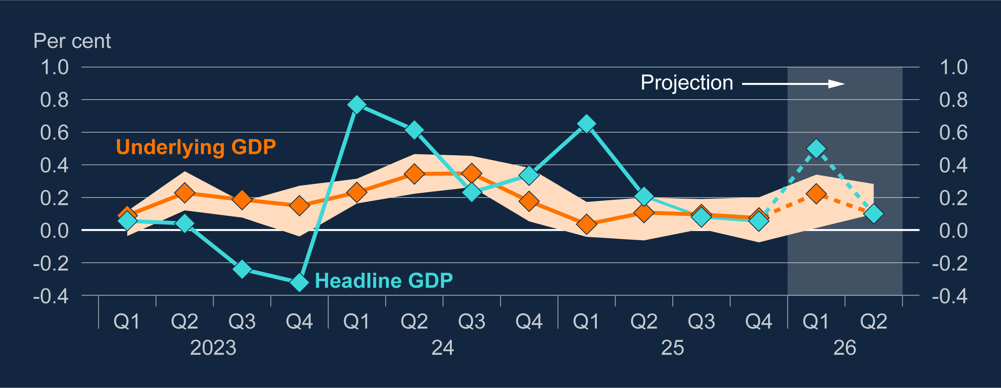
Chart 1.9: Underlying GDP growth is expected to remain subdued
Quarterly growth in headline GDP and underlying growth implied by business surveys
Higher energy prices will also have an impact on demand. Activity growth starts from a relatively muted position, despite stronger headline February outturn for GDP.

Slide 20
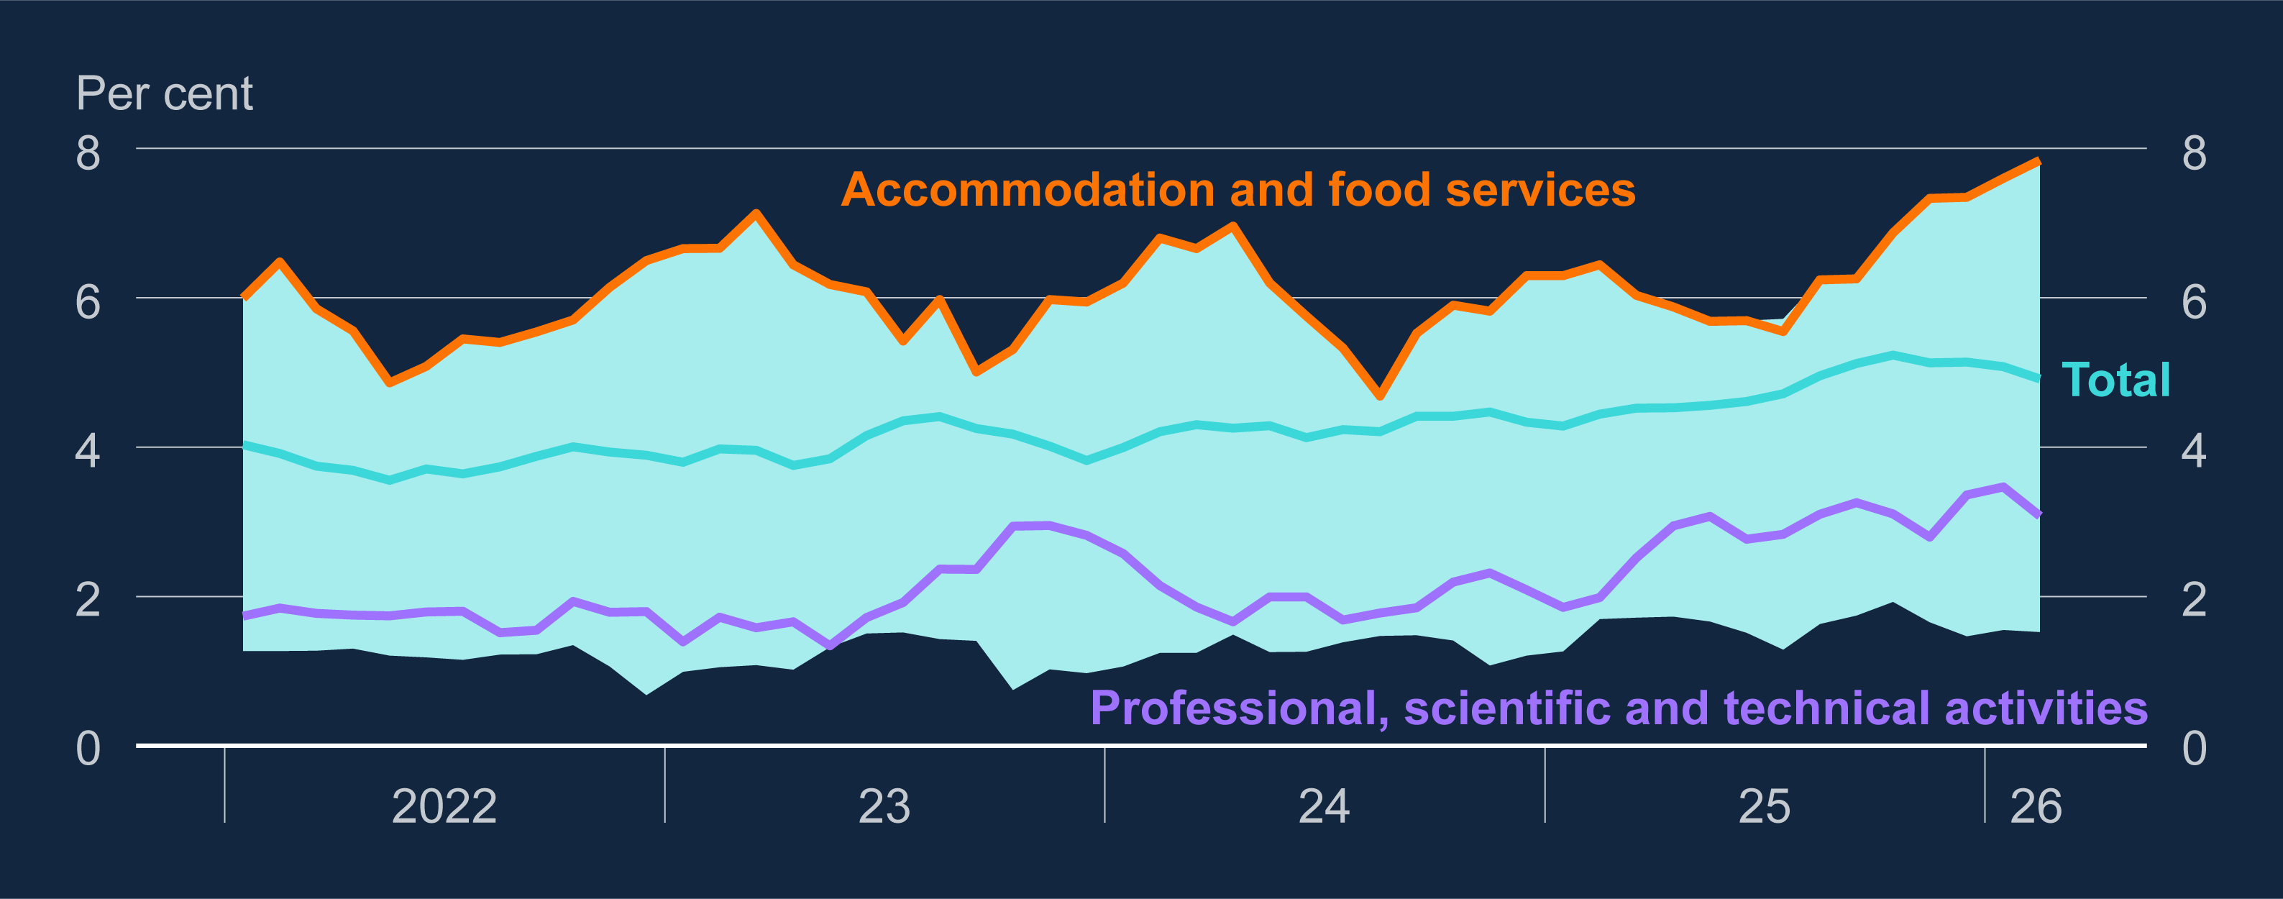
Chart D.1: Dispersion in unemployment rates across industries has been elevated over the past year
Unemployment rates by previous industry
Unemployment has risen, and by more in some sectors than in others.
Some vulnerabilities in accommodation & food, and professional & scientific sectors.

Slide 21
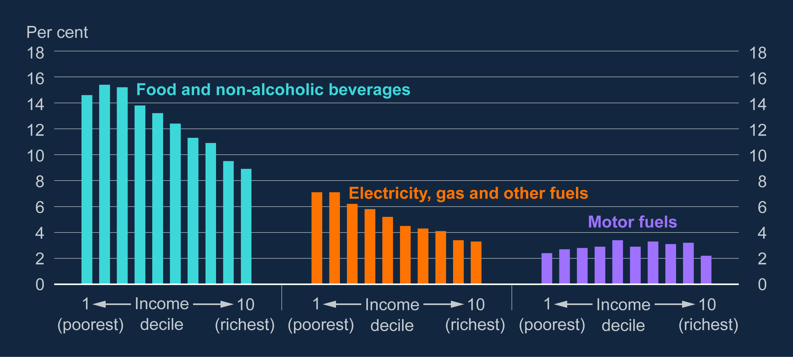
Chart A.1: Low-income households are more exposed to cost increases than high-income households
Share of household spending on categories particularly exposed to energy-driven price rises, by income decile
Low-income households particularly exposed to higher food prices and to home energy prices
Impact of higher motor-fuel prices more evenly spread.

Slide 22
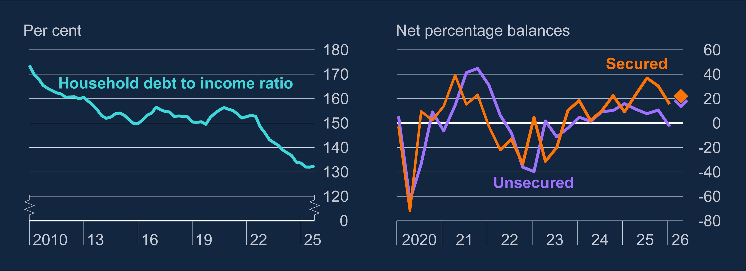
Chart E.2: Household debt has fallen relative to income since 2022, and the availability of credit has improved
Aggregate household debt-to-income ratio; household credit availability
How consumers respond to another squeeze on real incomes is a key uncertainty.
In aggregate, household debt position more favourable than in 2022 and little sign yet of any tightening in credit conditions for borrowers

Slide 23
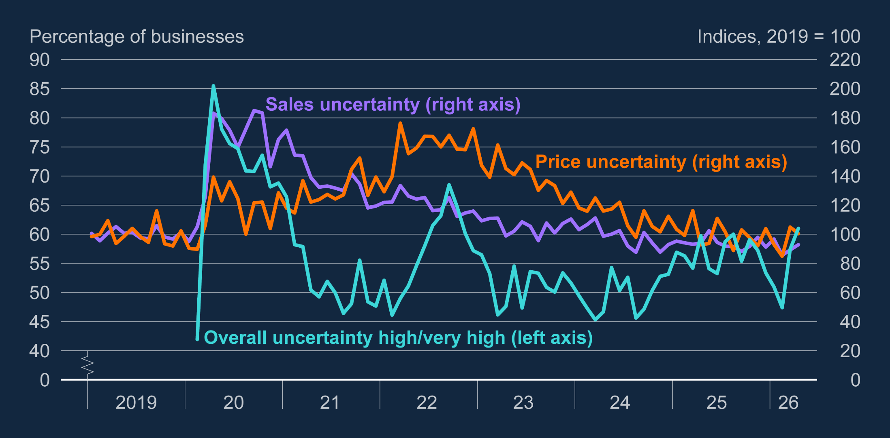
Chart 1.11: Measures of uncertainty among firms have risen slightly
DMP measures of uncertainty
Some bullets

Slide 24
Key policy judgement 1
Overall, the MPC judges that current economic conditions are likely to lessen the strength of “second-round effects” that monetary policy needs to lean against.
…but uncertainty around this judgement and the MPC will monitor the evidence as it emerges.
MPC also judges that second-round effects are likely to be stronger, the larger and more persistent is the rise in global energy prices.

Slide 25
Main points from the MPR
Key policy judgement 2

Slide 26
Key policy judgement 2
Monetary policy needs to balance the costs of leaning too little against second-round effects and the costs of responding too much. The right balance is likely to change depending on how events unfold.
The monetary policy setting will depend on the scale and duration of the shock and how it feeds through the UK economy.
If there are signs that second-round effects are likely to be weaker, then monetary policy can lean against inflation by less.
If there are signs that second-round effects are likely to be stronger, monetary policy will need to lean more strongly against those possible effects.

Slide 27
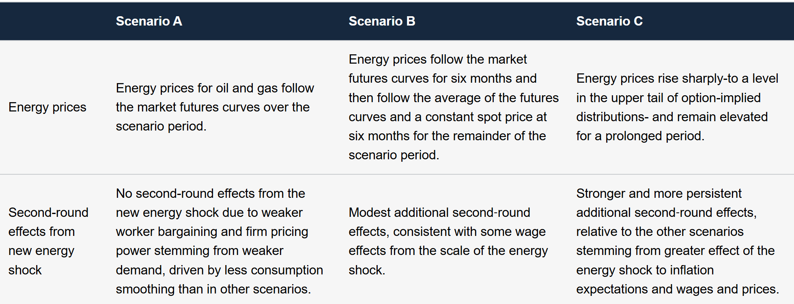
Table 3.A: Key assumptions and judgements in scenarios
Three scenarios – not designed to cover the full spectrum of possibilities, but useful inputs to the decision.
Different members put different weights on each scenario. Some thought C less likely, some thought A less likely

Slide 28
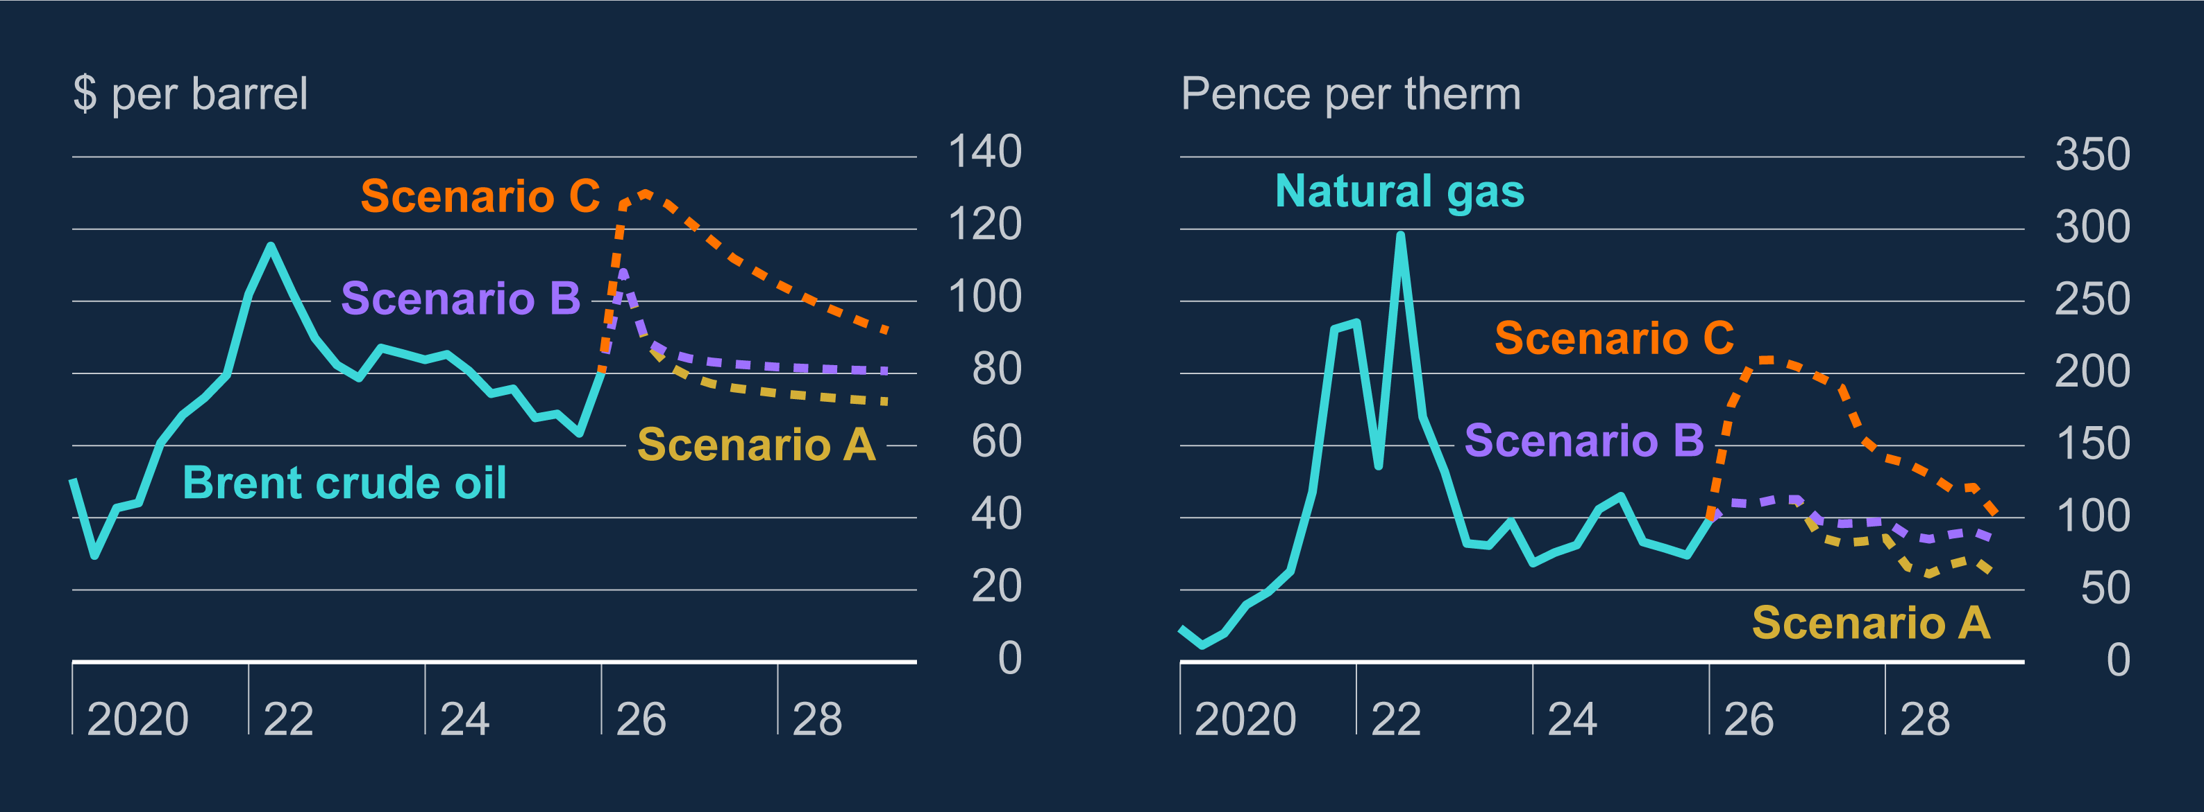
Chart 3.1: Energy price paths are higher in Scenario C relative to A and B
Brent crude oil and natural gas price paths in Scenarios A, B and C
Scenario A has energy prices falling back in line with futures curves in 15 days to 22 April. Slower fall back in B. Further and prolonged increase under C.
Since 22 April oil prices have been volatile and moved higher; smaller increase in gas prices.

Slide 29
Outcomes under market rates across Scenarios
 | CPI Inflation |  |  |  | Output gap |  |  |  | GDP growth |  |  |  | Unemployment rate
 | A | B | C | F26 | A | B | C | F26 | A | B | C | F26 | A | B | C | F26
2026 | 3.3 | 3.3 | 4.5 | 2.2 | -1.3 | -1.2 | -1.3 | -1.0 | 0.8 | 0.8 | 0.7 | 0.9 | 5.1 | 5.1 | 5.1 | 5.3
2027 | 2.6 | 3.0 | 4.8 | 1.9 | -1.4 | -1.3 | -1.6 | -0.8 | 1.0 | 1.0 | 0.8 | 1.5 | 5.5 | 5.5 | 5.6 | 5.2
2028 | 1.5 | 2.0 | 2.9 | 2.0 | -1.0 | -1.0 | -1.3 | -0.4 | 1.7 | 1.7 | 1.7 | 1.9 | 5.4 | 5.4 | 5.6 | 5.1
Output gap opens up and unemployment rises relative to February MPR under all scenarios, particularly C.
Have taken on some lessons from our Jan Forecast Evaluation Report, noting the resilience of activity to the 22-23 energy shock.

Slide 30
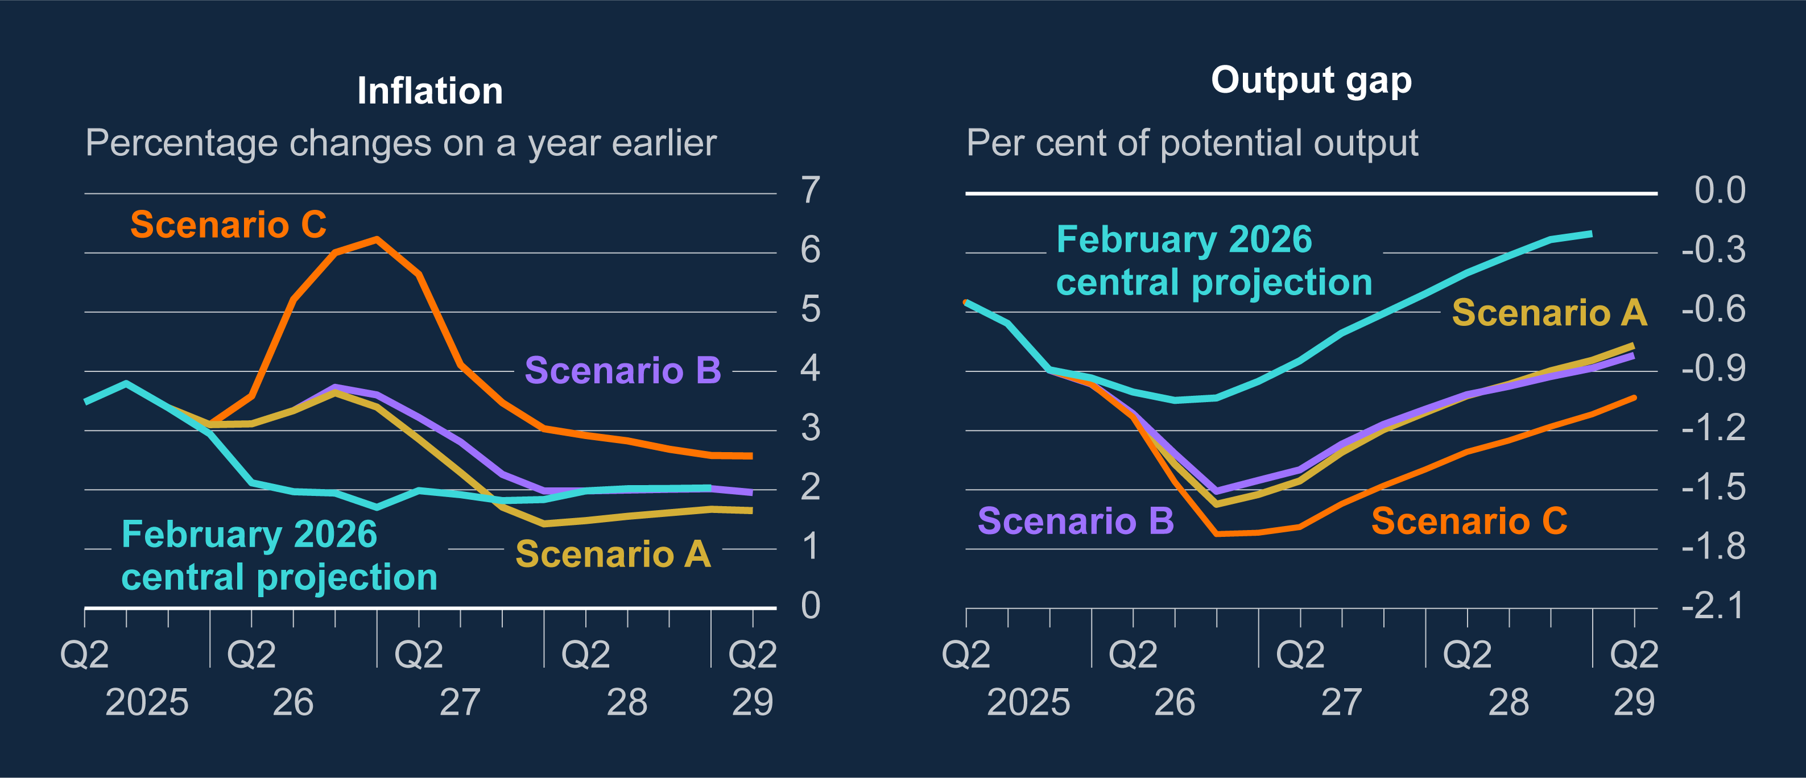
Chart 3.2: Inflation is higher in the near term and the output gap larger in all Scenarios relative to February central projection
Annual CPI inflation and the level of the output gap in Scenarios A, B and C
Assuming Bank Rate follows the market curve, inflation would peak at around 3¾% in A and B. Falls back below target under A, more slowly in B.
Inflation would rise above 6% in C with a more negative output gap.

Slide 31
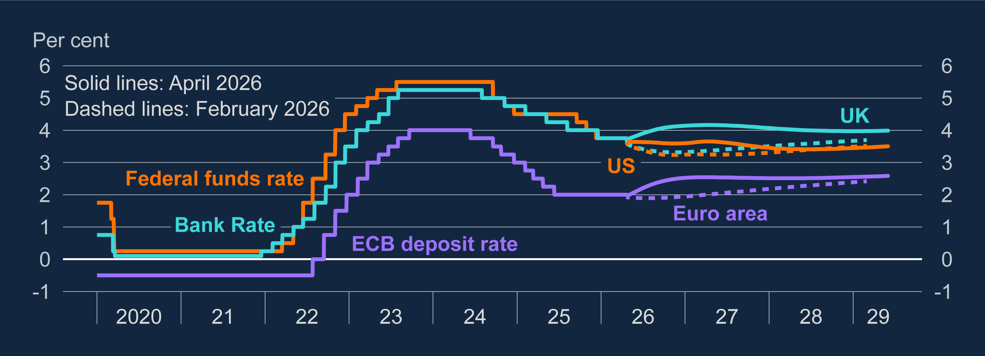
Chart 1.15: The market-implied paths for policy rates were higher relative to the February Report across major economies
Policy rates and instantaneous forward curves for the UK, US and euro area
Scenarios based on market rate path in 15 days to 22 April. On average around 55bp higher than in February.
Given the challenges, delivers reasonable outcomes under Scenario A and B, less so for C

Slide 32
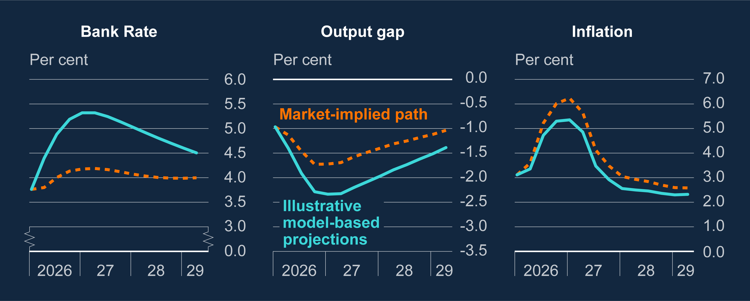
Chart 3.6: Bank Rate may need to rise materially in Scenario C to ensure that inflation returns to the 2% target in the medium term
Scenario C under the market-implied path for Bank Rate and staff’s optimal policy projections
Model-based simulations would suggest Bank Rate would need to be materially tighter than the market curve under Scenario C
Would deliver lower inflation in the medium term and a more negative output gap

Slide 33
Key policy judgement 2
Uncertainty about how events will play out means MPC must form judgement about how much to lean against potential second-round effects.
Leaning more strongly reduces the risk that inflationary pressures become embedded. But at the cost of weakening the economy.
MPC judged that it was appropriate to maintain Bank Rate at 3.75%.
  Conditions are likely to limit the strength of second-round effects that policy needs to lean against. Some tightening in financial conditions already acting against second-round effects.
MPC will continue to monitor Middle East situation and how impact propagates through the economy.
  If second-round likely to be weaker, then policy can lean against inflation by less. If likely to be stronger policy will need to lean more strongly against those possible effects.
However events unfold, the Committee stands ready to act as necessary to ensure that CPI inflation remains on track to meet the 2% target in the medium term.

Slide 34
MPC perspective and policy

Slide 35
Main messages from the Monetary Policy Summary
“Monetary policy cannot influence energy prices but will be set to ensure that the economic adjustment to them occurs in a way that achieves the 2% inflation target sustainably. The policy stance required to achieve this will depend on the scale and duration of the shock, and how it propagates through the economy.
There is a risk of material second-round effects in price and wage-setting, which policy would need to lean against. But the labour market continues to loosen, and a weakening economy could contain inflationary pressures. Financial conditions have tightened since the conflict began, which will help to reduce inflation over time.
Taking all the risks to the economic outlook into account, the Committee judges that it is appropriate to maintain Bank Rate at this meeting.
The Committee will continue to monitor closely the situation in the Middle East and how its impact propagates through the economy. The Committee stands ready to act as necessary to ensure that CPI inflation remains on track to meet the 2% target in the medium term.”

Slide 36
Q&A

