Slide 1


Welcome to the Bank of England Youth Forum’s Presentation and Q&A with Andrew Bailey
The event will begin shortly
Please keep your microphone on mute and introduce yourself in the chat box provided

Slide 2
Bank of England Youth Forum Presentation and Q&A with Governor Andrew Bailey

Slide 3
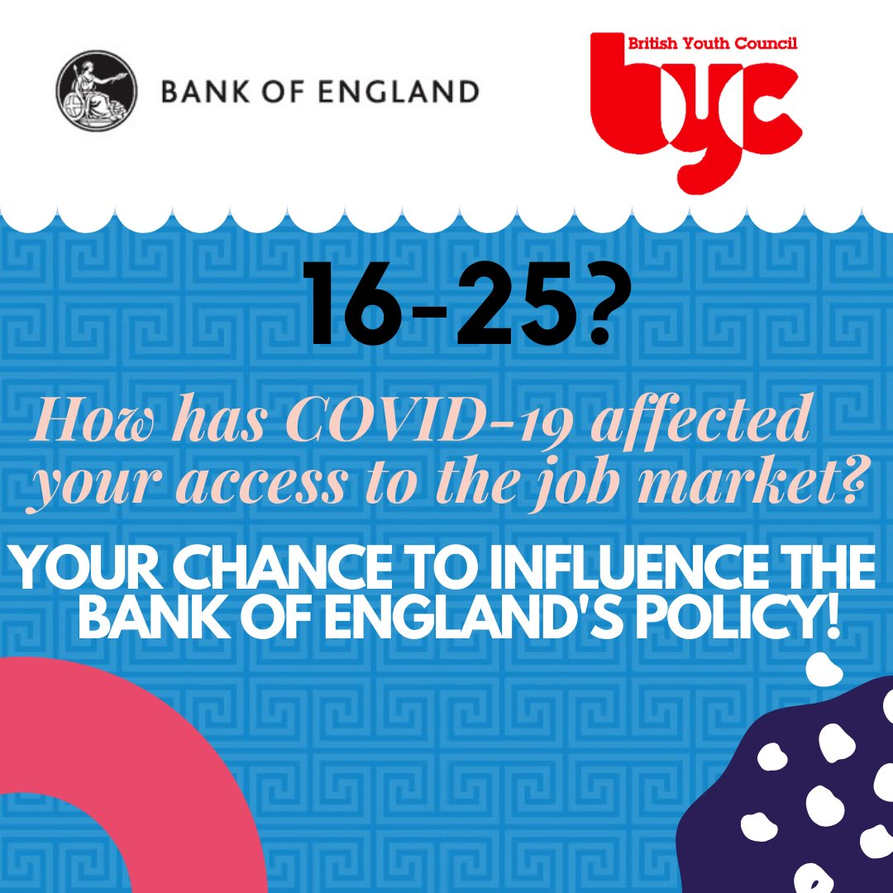
Policy and Labour Market Team
AIMS
To influence and inform the Bank in policy making
To inform the labour market team about potential long-term trends in the labour market
ACTIONS
Created a survey for young people (16-25) on 3 key areas:
  Gig economy
  Perceptions of labour market
  Effects of COVID-19 on young people’s employment, and views on labour market
Created a presentation to summarise the findings
REVIEW
Aspirations for the future

Slide 4
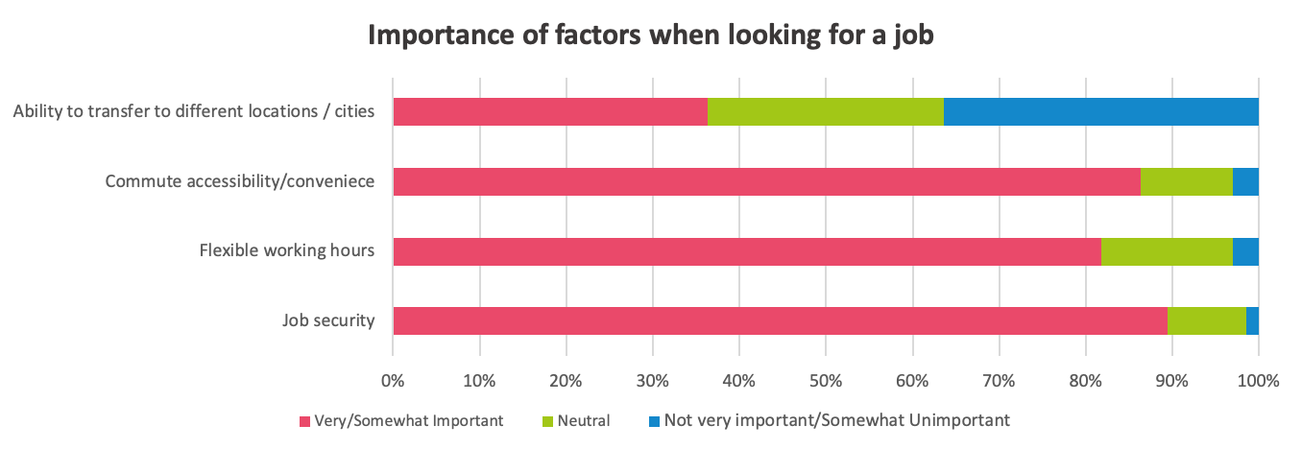
Results of the Labour Market Survey:
3 Key Points for Policy Makers
Young people are likely to be badly affected financially after COVID-19 so policy decisions should focus on young people.
Young people are relatively positive about the accessibility of most sectors but they believe it is getting harder and harder to enter the job market and to gain experience.
Young people value job security and for this reason many would not like to work in the gig economy long-term.

Slide 5


Financial Education Team
THE JOURNEY
We noticed the lack of financial education in the UK - 50% of our group had not heard of or did not have financial education taught in schools
We conducted online research about current financial education and resources for young people
We then put together recommendations for the Bank and next year of the Youth forum

Slide 6
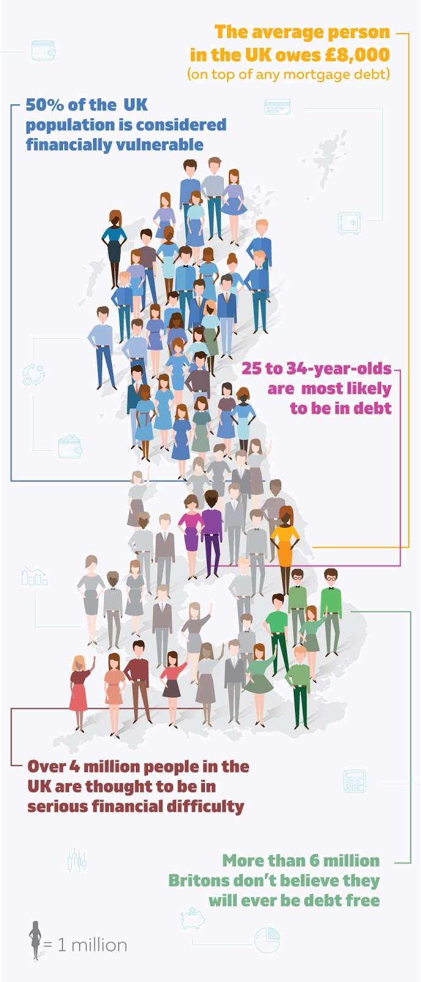
The Findings
9 out 10 consumers in the UK feel that they are undereducated in terms of personal finance.
39% of 16-17-year-olds don’t have a current account,
60% don’t have a savings account.
64% of people who sought advice were aged under 40. Financial problems, which are starting at a younger age for reasons described above, are having a severe knock-on effect later in life.
83% of UK parents believe it is their responsibility to teach their children about money, yet almost 1 in 6 say they don’t feel confident about it.
Over 65% of teachers believe that not enough is being done to secure the financial future of the UK’s young people.
Source: https://www.creditangel.co.uk/blog/is-the-uk-financially-illiterate#:~:text=The%20UK's%20Financial%20Literacy%20Landscape&text=50%25%20of%20the%20UK%20population,be%20in%20serious%20financial%20difficulty. (2018 Post)

Slide 7

Recommendations to the Bank
More promotion of resources.
Create an online toolkit for 14-25 year olds.
Put pressure on the Government for more Financial Education / Literacy in schools.
Look into tuition loans for higher education and young people and the labour market.
Create a guide for educators and guardians.
Recommendations for Next Year’s Youth Forum
Continue survey consultations on young people.
Create a YouTube/Podcast platform for young people.
Create an Instagram account for the Youth Forum to upload content on.
End Goal
We think all young people should be:
  Financially literate.
  Equipped to manage money effectively.
  Confident to make informed decisions and navigate the financial marketplace .
Young people should be provided with money management skills to allow positive financial habits for living independently and tools to research things like loans, credit cards and investment opportunities.

Slide 8
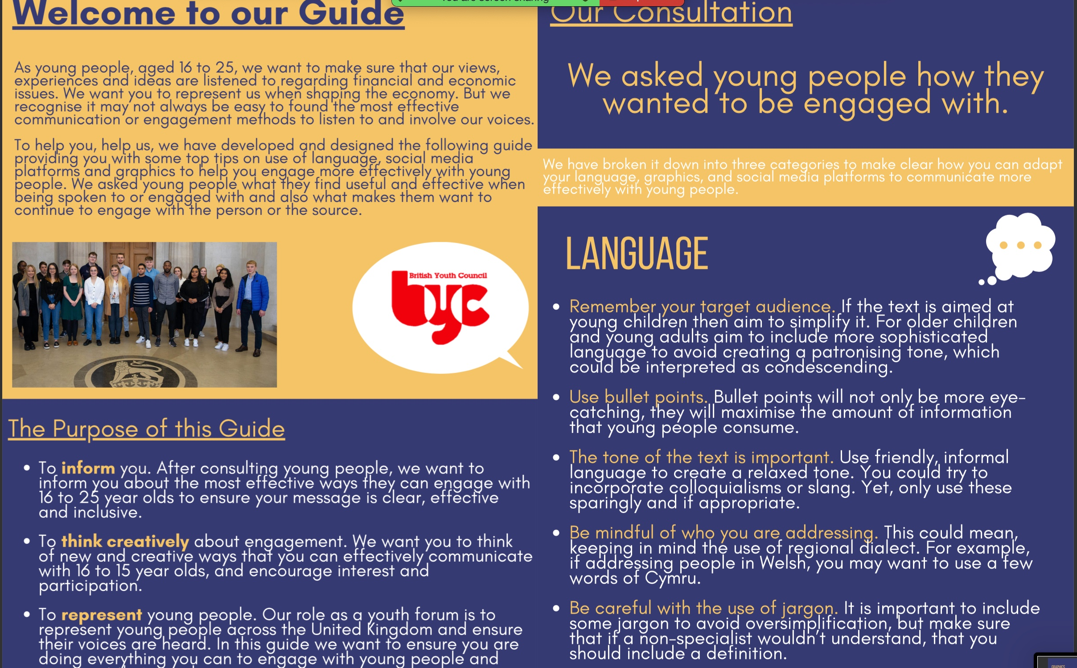
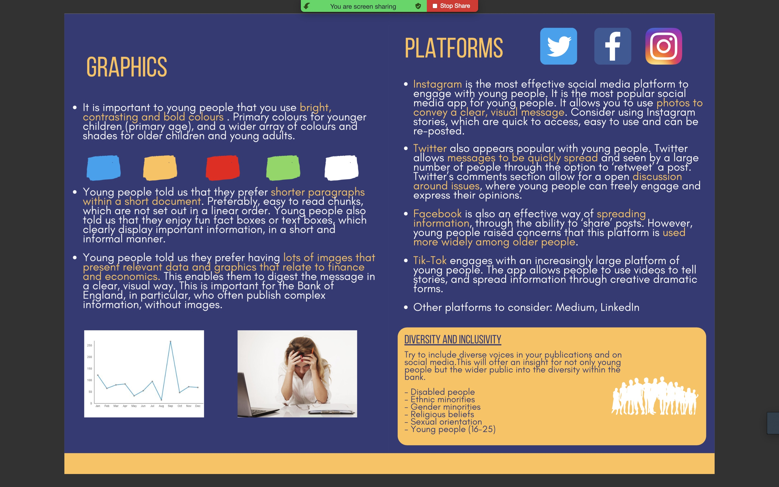
Policy and Communications Team
AIMS
Boost the Bank of England’s engagement with young people.
RESULTS OF SURVEY
Young people want:
  Clarity
  Minimal text
  More graphics
ACTIONS
We have created a guide for the Bank’s communication team on how to engage with young people

Slide 9




VIDEOS
Aims:
To challenge stereotypes within the Bank by connecting with the Discover Economics Programme members to inform young people of the diversity at the Bank.
To encourage more young people into the field of economics by clearly displaying that it can be diverse.
SOCIAL MEDIA
Aims:
To create a brand for the youth forum to boost engagement.
Engage with as many social media platforms as possible so the Bank doesn’t just use platforms directed towards older people.

Slide 10


Youth Voice Team
AIMS
Engage with young people
Raise awareness about the Bank of England
RESULTS
How young people would prefer the Bank to communicate:
Make announcements to young people about the Bank’s aims/projects
Communicate through various charities
Online through:
  Social media (particularly YouTube, Snapchat and Instagram)
  A dedicated website for young people
ACTIONS
Online survey
1-2-1 conversations with peers
Focus group with seldom-heard groups
Focus group with students from schools/Universities

Slide 11
Recommendations
CITIZENS PANELS
Suggestions
Ask each attendee to bring a young person with them
Promote the Citizen Panel via youth organisations
Have a young person on the team to help promote it to young people
We have found that many young people did not know about the impact of the Bank of England in our society.
RECOMMENDATIONS
Promote financial education within schools and youth organisations
Use social media platforms to educate people about the Bank
Engage young people in Policy & decision making
Have an open day for young people to visit the Bank

Slide 12
Immediate Response Team
The Bank of England Youth Forum Immediate Response Team (BoEYF IRT) was made up of 4 members of the Bank of England Youth Forum.
We created a survey to gather views and opinions from young people aged 16-25 across the UK. We focused on how COVID-19 is affecting them financially as a young person to then inform the Bank of England’s decisions going forward.
The survey was launched across Twitter, Facebook, Instagram and other social media sites (we also contacted our own personal networks of people and organisations)
In our promotion we created a video to go alongside our survey to increase our engagement
The survey was launched on Monday 20th April 2020 and closed on Monday 18th May 2020
We then carried out data analysis and created a presentation of our results
Overall 960 responses were gathered
We then presented our findings and held a Q+A with Chief Economist Andy Haldane on Tuesday 26th May 2020

Slide 13
How is COVID-19 affecting you financially as a young person
Universities
Some people are reconsidering going to university or dropping out. This is mainly as a result of not being able to save up money or having had to use any savings now.
Could impact local town/city economies which rely upon university students as main source of business.
Could also impact future labour market/job requirements with less students potentially having a degree
Spending habits
More money is being spent on items that occupy people (e.g books, art supplies, films, media subscriptions, video games).
Less money is being spent on leisure food and drink (restaurants, pubs and takeaways), clothing and travel (public transport and fuel)

Slide 14

How is COVID-19 affecting you financially as a young person – Other themes
Emotions and feelings – Scared, worried, stressed, anxious, confused
Financial situation – Furloughed, unemployed, no support, universal credit, debt, loans, spending savings, struggling to pay rent+bills
Future – Reconsidering university, no opportunity
Link to video of presentation and Q+A - https://www.bankofengland.co.uk/get-involved/youth-forum

Slide 15
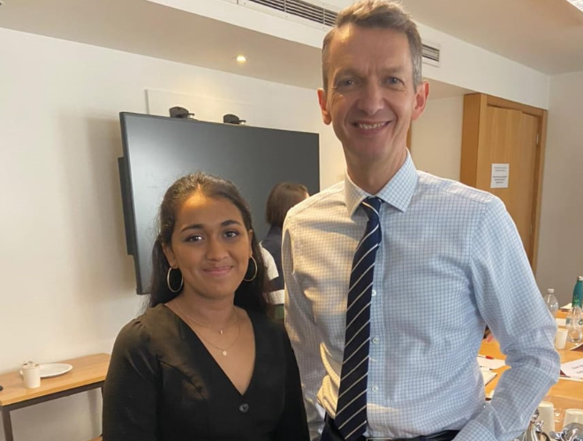
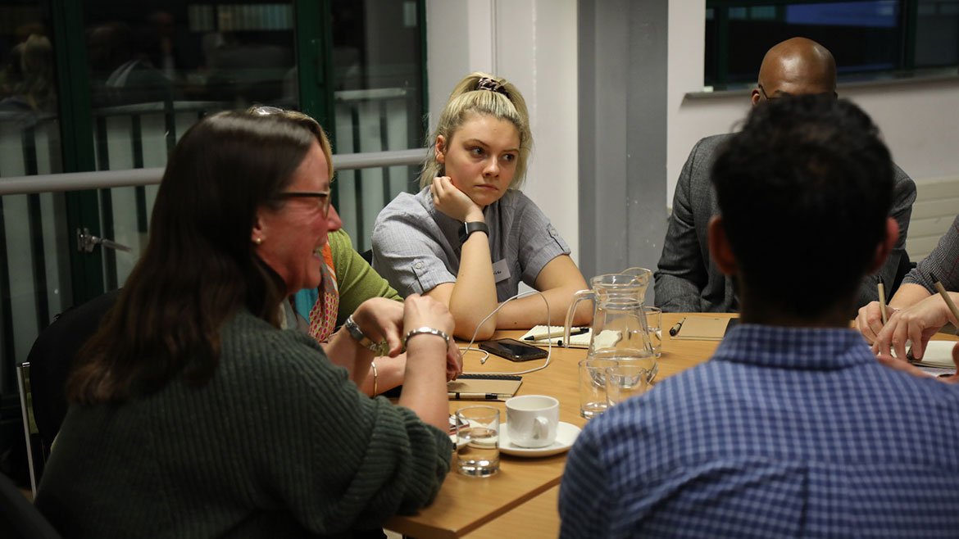
Other Opportunities and Projects
Outside of our work streams, Forum members have participated in a wide variety of projects and events including:​
‘I really enjoyed the experience’
‘All of my opinions were listened to’
‘The open discussions and interactive polls were engaging’
Attending Bank of England Citizens Panels
Pitching a Policy Motion to be added to the British Youth Council’s Manifesto
Applying for ASDAN Youth Voice Awards
Working on blogs for the Financial Times and Bank of England
Economics in Education Roundtable held by the Chief Economist - see blog
‘I could suggest having a young person at each meeting… and [also] assist with travel planning to make it more inclusive’
‘Not many young people around’ so ‘young people may feel intimidated to speak up

