Slide 1
Technical briefing for market participants on QT and APF announcements
17 September 2026

Slide 2
17 September 2026 – QT and APF announcements
The MPC provided clarity over the future of its quantitative tightening (QT) programme by setting a multi-year path for unwind. The remaining stock of bonds held for monetary policy purposes will be unwound at an annual average pace of £46bn by the end of 2034, through annual sales of £20bn alongside maturing gilts.
The Bank Executive will not sell the £222bn of gilts with redemption dates earlier than 2035, and they will be held to maturity within the APF.
The Bank Executive announced that £120bn of the longest-dated gilts in the APF will remain in the APF and be held to maturity for the purposes of indirectly backing current and future banknote issuance.
The Bank Executive is considering adjusting the way it conducts the remaining £146bn of gilt sales and intends to implement the MPC’s multi year plan via sales to the Government rather than to the market. This is subject to final agreement with HMT. Irrespective of the final decision, the Bank will be announcing by April 2027 the operational details through which it will be implementing the MPC’s multi-year plan. Bank APF auctions will pause in the meantime.

Slide 3
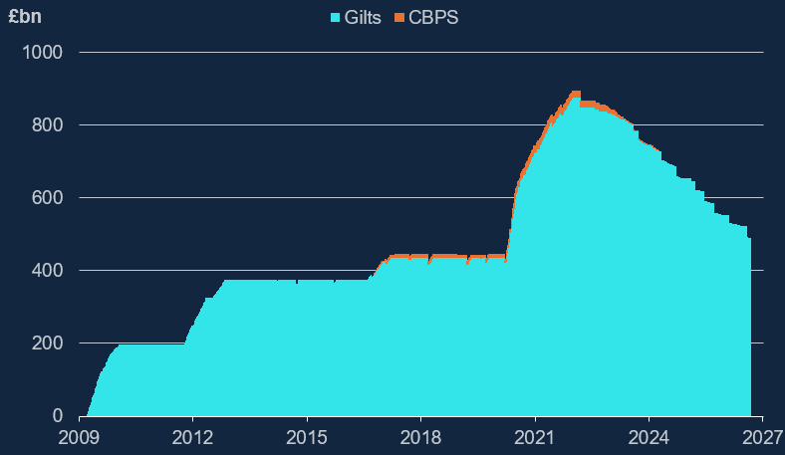
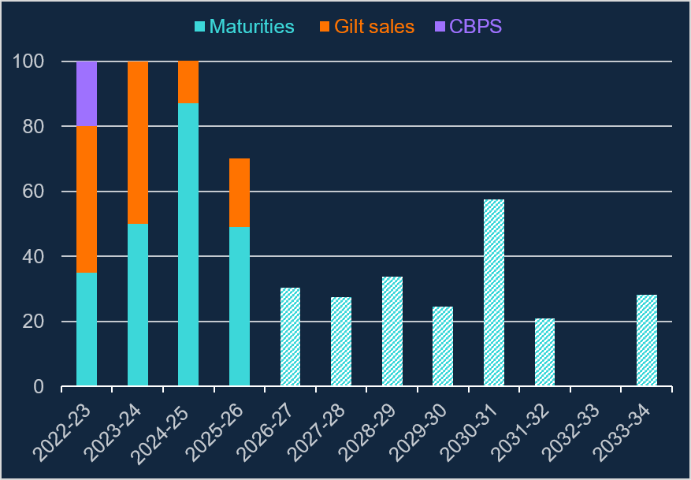
The MPC’s QT strategy so far
Since February 2022, the MPC has unwound the APF's holdings of government bonds (gilts) and corporate bonds (CBPS) through its Quantitative Tightening (QT) programme. Over that period, the size of the APF has fallen from a peak of £895 billion to £488 billion today (Chart 1). This reduction has been delivered through a combination of maturities and sales to the secondary market, with gilt sales commencing in November 2022 (Chart 2).
Chart 1: Stock of gilts and corporate bonds held for monetary policy purposes in the APF
Chart 2: Initial purchase proceeds value of APF maturities and sales, and future maturities:
Source: Bank of England

Slide 4
QT continues to be guided by the MPC’s three key principles
  Bank Rate is the active policy tool when adjusting the stance of monetary policy.
  Sales will be conducted so as not to disrupt the functioning of financial markets, and only in appropriate conditions.
  Sales will be conducted in a gradual and predictable manner over a period of time.

Slide 5
1. The MPC’s multi-year plan provides more certainty and clarity over the future QT path
MPC communicated that it saw the full unwind of the remaining stock of UK government bond purchases held for monetary policy purposes as important, recognising their temporary nature, and increasing the headroom and flexibility to use the balance sheet in the future if needed.
The announced multi-year plan reinforces the MPC’s key principles, in particular QT being gradual and predictable. This would mean the path for QT could be fully embedded into financial conditions, enabling MPC to better take QT into account when setting Bank Rate.
The MPC has voted to unwind the APF at a constant annual sales pace of £20bn in purchase proceeds terms until gilts held for monetary policy purposes are fully unwound. Taking the maturity profile into account, this is equivalent to an annual average stock reduction of £46bn. Under this plan, the MPC’s remaining portfolio of gilts held for monetary policy purposes will be fully unwound by September 2034.
The MPC has confirmed that there will be a high bar for amending the announced reduction in the stock of gilts under its multi-year plan, as had been the case for its annual decisions.

Slide 6
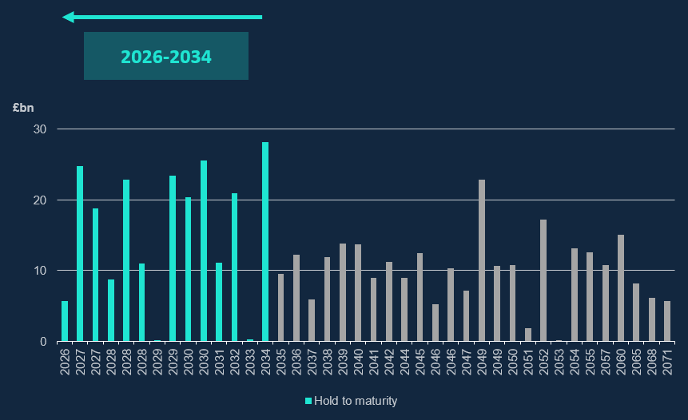
2. Bank Executive implementation: shorter-dated gilts maturing before 2035 will be held to maturity
Chart 3: Initial purchase proceeds value of remaining APF stock
The MPC’s plan specifies a target end year of 2034 for the full unwind of its gilt portfolio.
Given that, in implementing the MPC’s decision, the Bank Executive has decided to hold £222bn of APF gilts maturing before 2035 to maturity.

Slide 7
3. Bank Executive implementation: £120bn APF gilts maturing 2049-2071 to be held for backing banknotes
Today the Bank set out its long-term backing asset plans for banknotes.
Since 2009, banknotes have primarily been backed by a deposit from the Issue Department balance sheet to the Banking Department, which itself is indirectly backed by gilts held in the APF. Throughout QT, this arrangement has remained appropriate, as the stock of gilts remaining in the APF has significantly exceeded the value of banknotes in circulation.
The MPC’s plan to unwind the APF in full gives the Bank Executive greater certainty when assessing the long-term implications of QT on the banknote-backing framework.
The Bank continues to judge that gilts are well suited to backing banknotes - they are a credible, stable and low-risk asset, supporting the key objective of maintaining public confidence in sterling banknotes. This is consistent with pre-GFC plans.

Slide 8
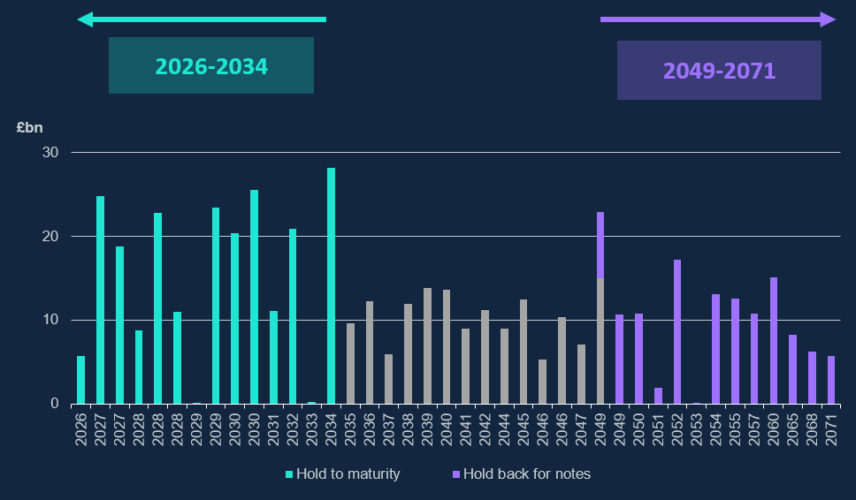
3. Bank Executive implementation: £120bn APF gilts maturing 2049-2071 to be held for backing banknotes
The Bank will retain £120bn of the longest-dated gilts (maturing between 2049 and 2071) in the APF, to indirectly back banknotes. Long dated gilts are an appropriate asset to back a stable liability like banknotes. These gilts will remain indemnified.
Using APF gilts avoids incurring unnecessary transaction costs from the Bank buying gilts for notes backing purposes and selling gilts for QT purposes at the same time.
£120bn has been calibrated to allow for a continuation of previous trends in banknote demand, with an additional buffer included in case of stronger demand.
Chart 4: Initial purchase proceeds value of remaining APF stock
Our Bank Insights article “What Backs Banknotes” provides for more information on the long-term plan.

Slide 9
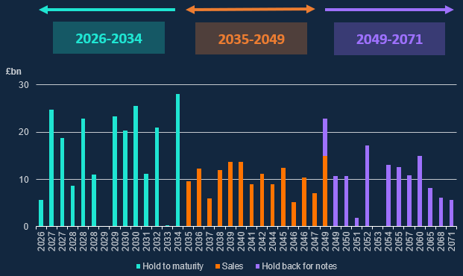
4. Bank Executive implementation: selling the remainder £146bn of APF gilts (maturing 2035-2049)
The Bank has been reviewing its implementation of the MPC’s QT plan, to continue to maximise value for money by minimising cost and risk over the lifetime of the APF.
Over the last year, the Bank and HMT have been exploring a model whereby APF sales are conducted to the Government. HMT would instruct the DMO to purchase APF gilts, which would be retired and financed through the DMO’s aggregate issuance. Sales would be conducted at market prices and in a pre-defined manner, pre-announced by the Bank Executive. This is subject to final agreement with HMT.
Irrespective of the final decision, the Bank will be announcing by April 2027 the operational details through which it will be implementing the MPC’s multi-year plan. Bank APF auctions will pause in the meantime.
Chart 5: Initial purchase proceeds value of remaining APF stock
Our Market Notice provides for more information on the implementation plan.

Slide 10
Questions

