Slide 1
Transforming Data Collection
Town Hall
13 July 2023

Slide 2

Contents
Watch the recording of the Town Hall
Link to place in document
Welcome and opening remarks
The Bank of England and FCA deliver on phase one commitments
The story of transforming data collection
Where we are today
Closing remarks
Showcase

Slide 3
Showcase
On the day we held a Showcase and Networking session for in person attendees.
Attendees had the opportunity to see prototypes the delivery teams are working on.
This part of the event was not recorded however, content that was on the stands is included in this document.
Please use links on the right to navigate to the sections you would like to view
Link to place in document
CRE – Visualisation of concepts
Quarterly derivatives (Form DQ) return
Retail Banking Model Data

Slide 4


Welcome
James Benford Executive Director Data and Analytics Transformation, and Chief Data Officer Bank of England
Jessica Rusu Exco Director and
Chief Data, Information and Intelligence Officer Financial Conduct Authority

Slide 5
Agenda
 | Presenter | Timings
Welcome and Opening remarks | James Benford, (BoE) Jessica Rusu, (FCA) | 15 minutes
Programme Overview & Update | Angus Moir (BoE) Pete Royle (FCA) | 40 minutes
Panel and Audience Q&A | James Benford (to chair) Jessica Rusu Angus Moir Andrew Douglas (DSC) Andrew Turvey (RTC) Julie Ampadu (Board) | 30 minutes
Closing Remarks | James Benford | 10 minutes
Showcase and networking |  | 60 minutes

Slide 6




The Bank of England and FCA deliver on phase one commitments

Slide 7
What we have delivered
More detail to come later in the presentation
Better landing pages & clearer instructions
More intuitive forms for data collection
Prototype for a personalised portal for firms along with a dashboard
Developed a concept for an automated classification answer for UK counterparties
Prototype for a personalised portal for firms along with a dashboard
Reduced the number of questions asked in the Financial Resilience survey

Slide 8
The story of Transforming Data Collection

Slide 9



Setting the Scene
Reporting is one of the most demanding parts of regulation
The quality of data regulators receive is not always to the standard required
Data needs have evolved as technology and business
models have changed

Slide 10
What does data collection look like today?
35k
180
Statistical reporting queries per year
Collections via RegData for regulated firms
1.2
50k
Billion
Data points collected by the PRA
Firms are prudentially regulated by the FCA

Slide 11
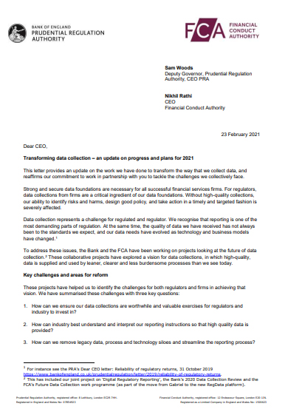
Working together to transform data collection
A joint transformation programme set up between the Bank of England and the FCA with industry to:
identify how data collection could be improved to increase its value
reduce the burden on firms

Slide 12


Our vision of data collection
“Regulators get the data they need to fulfil their mission, at the lowest possible cost to industry“
Integrating reporting to increase consistency in designing and delivering collections for value, reuse, and efficiency
Modernising reporting instructions to improve how data is interpreted and implemented by firms
Defining and adopting common data standards that identify and describe data in a consistent way. These should be open and accessible for use by everyone

Slide 13
A phased approach
Data Collections
Strategic Review of Prudential Data Collection from solo regulated firms
Commercial Real Estate Data
Retail Banking Business Model
Incident, Outsourcing and Third Party Reporting
Financial Resilience Survey
Commercial Real Estate Data discovery
Quarterly Statistical (DQ) Derivatives Return
Phase One
Phase Two

Slide 14


The beginning
The first six months – getting mobilised

Slide 15
The Story of Phase One
Programme set up and getting people on-board
Started to work effectively as a group despite working remotely and technology challenges
Phase One design ran between March and May 2022
July 2021
June 2022
Discovery work for Use Cases
Financial Resilience Survey
Commercial Real Estate Data
Quarterly Statistical (DQ) Derivatives Return
Nominations requested for phase two delivery resource and to refresh committee membership
Began to identify issues, and started to uncover possible approaches to tackle them

Slide 16
The Story of Phase One
As phase one drew to a end…
Recommendations
Response
Presented to our industry committees and then the Bank and FCA.
Presented to internal teams and governance committees within the BoE and FCA to prepare a joint response.
The BoE and FCA accept all the recommendations made by the industry committees.
BoE and FCA published their response to the recommendations.
stakeholders in both organisations were very supportive of the recommendations,
Commitment to deliver benefits to firms by July 2023

Slide 17




What we learnt in Phase One
A programme manager was needed
We didn’t have enough service design experts
Firm engagement important to understanding challenges faced
User research and testing was essential when designing solutions

Slide 18
The Story of Phase Two
Expanded the teams at the BoE and the FCA including service design and user research experts
Use cases move in to design stage with the exception of IOREP which is in the discovery stage
Kick off meeting with BoE, FCA and Industry
Sep 2022
July 2023
3 week mobilisation period
Early prototypes developed
User research and testing taking place with BoE, FCA and industry users

Slide 19
What we discovered
User Pain Points
User Testing Feedback
“Honestly, I don’t understand why we have three systems - I’d like one login instead of three” ​
“The guidance is more user friendly” ​
“In-line validation of the form fields is a major positive improvement”
“I feel like the data I submit goes into a blackhole” ​​
“The fact there’d be linkage between the guidance and that glossary, that would be a huge time saver”
“The links to the help text and guidance is confusing”

Slide 20
Where we are today

Slide 21






What could the firm experience could look like
Data request
One single log for firms
A personalised portal for each firm
Clear guidance readily available
Easy to complete forms
Data Received
The ability to view back data submitted complete with market context
Better quality data
Process more structured
Better firm engagement

Slide 22
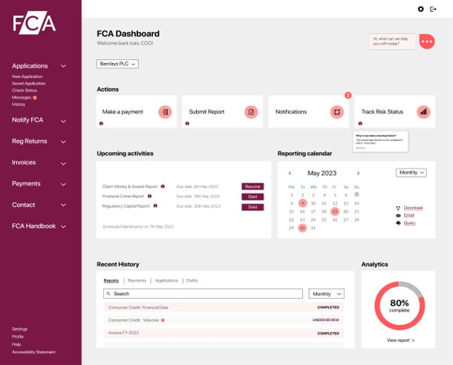
A personalised portal for firms
Firm Portal - one reporting system to improve firms experience
Have one log on to access FCA systems
Be able to submit relevant data collections
*image is for illustrative purposes only and represents what the end-state of the Firm portal may look like

Slide 23
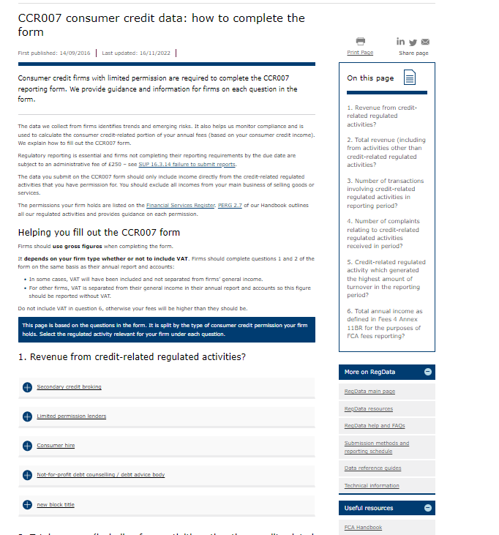
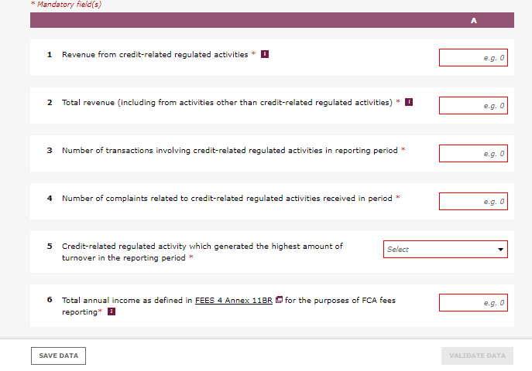
Improved Forms
One page for guidance on how to complete the form (to support the handbook)
Making our forms easier for firms to submit data
Hard and soft validations
Simplified guidance specific to firm permission type
Quick links to specific guidance

Slide 24
Benefits of Intuitive Form Design
“The warnings are good, it prompts me to check what I have entered and make sure its correct” Not for profit limit permission lender
The quality of the data being submitted has improved
There is a reduction in firms submitting late returns
Volume of calls to the FCA from firms is unchanged however, there is anecdotal evidence of ‘higher value calls’ being received. Further investigation and measurement of this is in progress
“The guidance being on one webpage and easy to navigate has really helped me when speaking to firms” Sup Hub first line supervisor

Slide 25
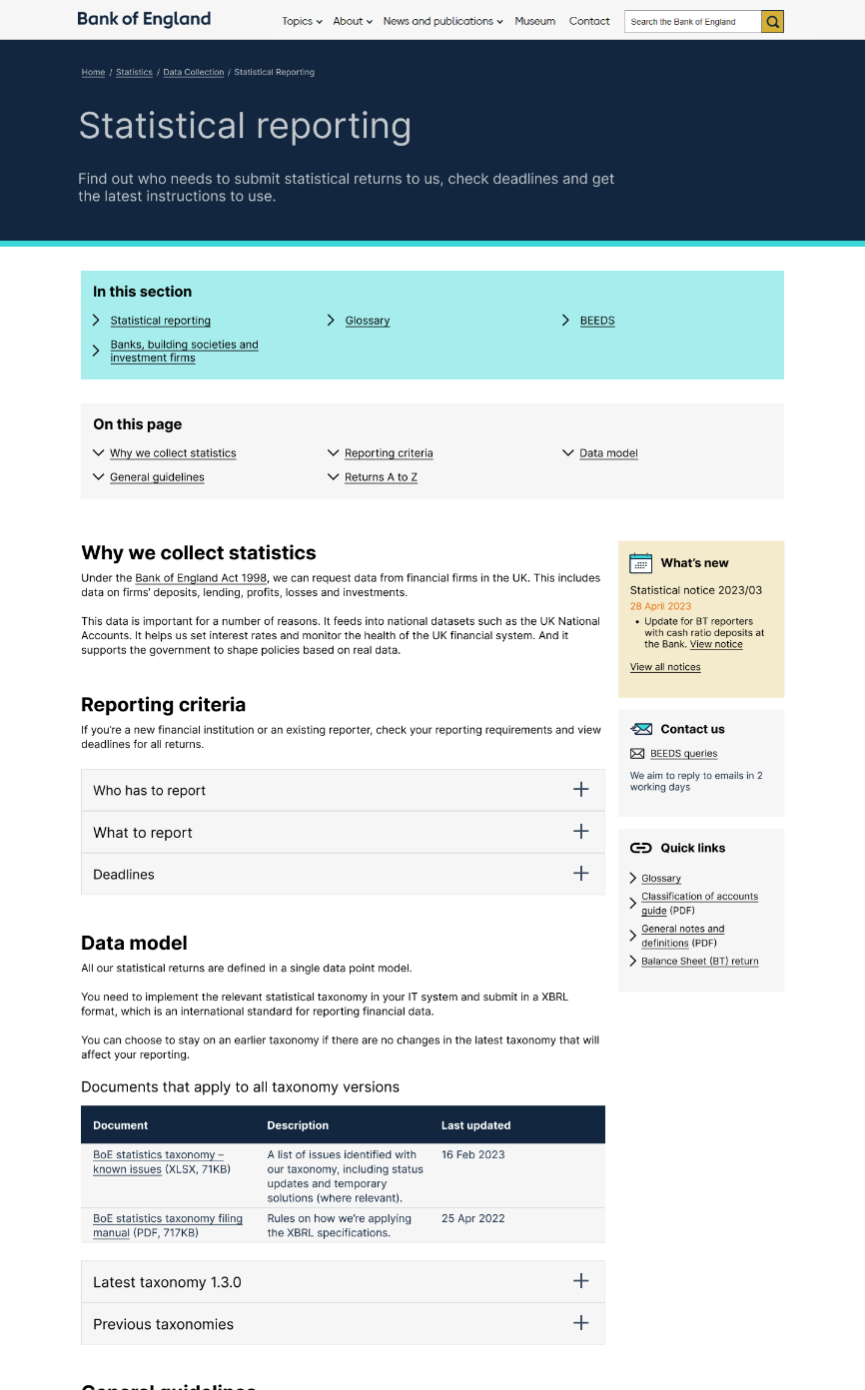
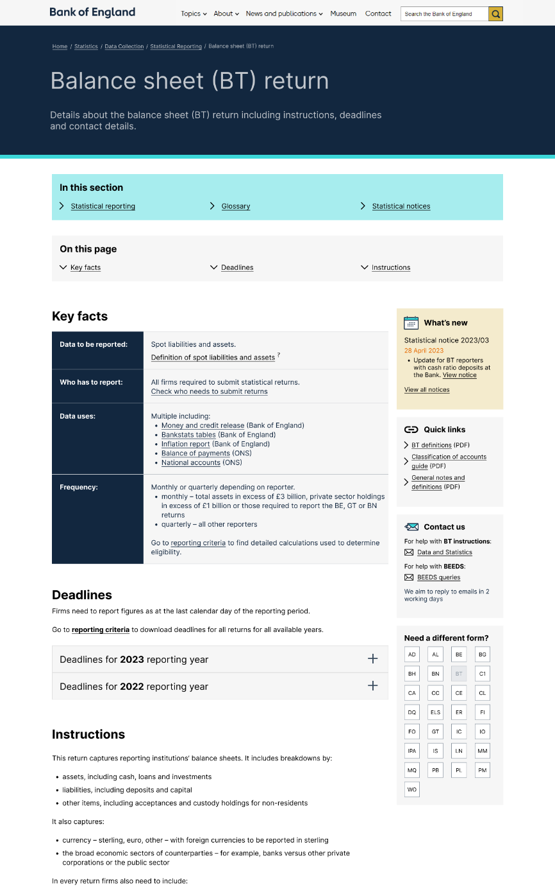
Better Landing Pages
“This [statistical reporting] landing page is hugely clear. We would like this for everything.”
User from Small Bank
Statistical Reporting
Balance Sheet (BT) return
“…it’s very clear to me exactly what needs to be in the form and how the valuation is done. That’s perfect.”
Firm submitter

Slide 26
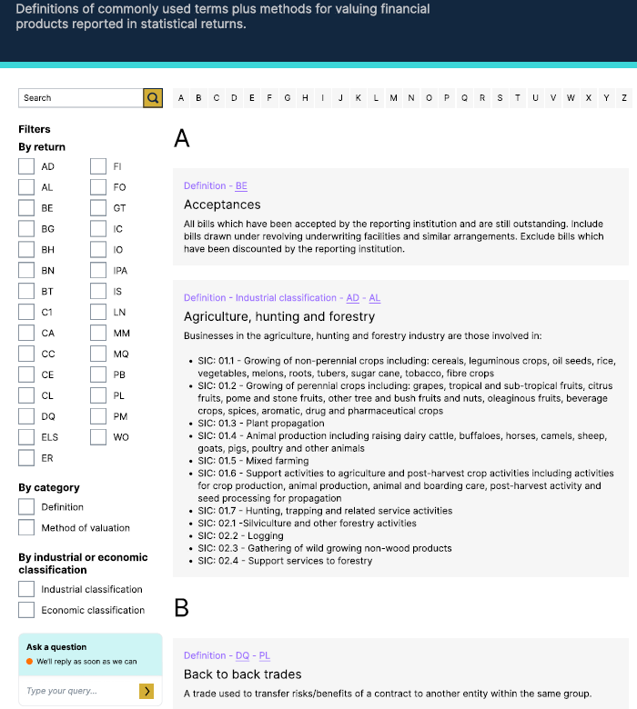
Restructured reporting instructions
Love the fact you can filter on the return
I like it. This is a lot more than I was expecting you to show me.
- Large DQ reporting Bank
1
2
All the forms (definitions) are interlinked, I like this
I think it would probably save people a lot of time wading through guidance
I can immediately see the SIC codes, that’s something we’re looking at all the time
‘Having all that in one place. It’s one landing page and it’s very clear to me exactly what needs to be in the form and how the valuation is done. That’s perfect’
3
4

Slide 27
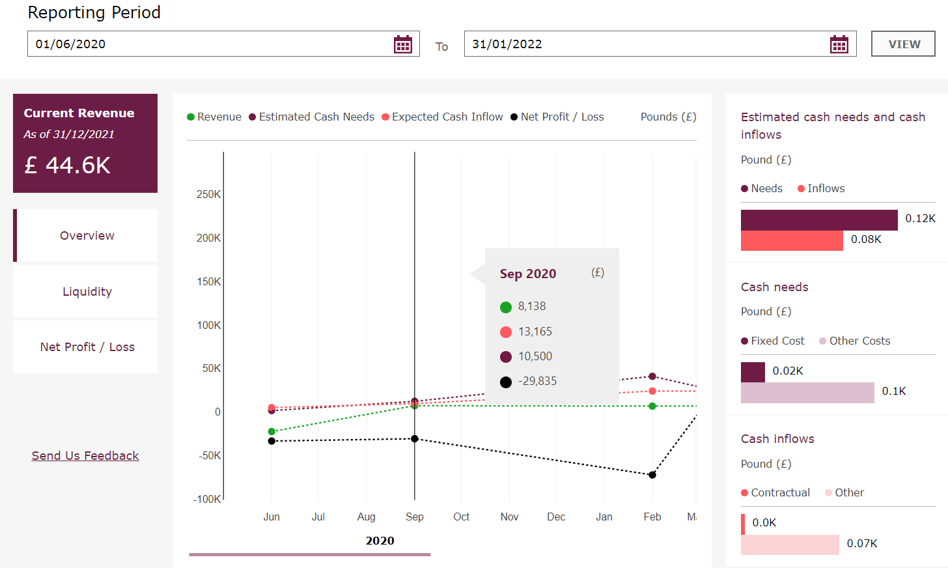
A dashboard so firms can view the data submitted
Firm view mock up with Financial Resilience Survey Data
Data is displayed
in a visual format​
With market context

Slide 28
Where we are
Discovery
Design
Beta
Live
Firm View at a glance
Counterparty classification standardisation
Data Collection Process review
Intuitive Form Design
IOREP
Commercial Real Estate
Financial Resilience Survey ad hoc to regular
New statistical reporting landing page
Data Standards Review
Firm Portal
Retail Banking Business Model Data
Restructured reporting instructions
Form DQ and Form BT new landing pages
Strategic Review of Prudential Data

Slide 29
Q&A

Slide 30
Closing Remarks

Slide 31
Thank you
Thank you for attending today.
If you are here in person, please head out to our showcase area to find out more about the programme and chat to some of the team.
We’d love to hear what you thought about today’s session. Look out for a feedback survey in your inbox shortly.
If you’d like to find out more about Transforming Data Collection, please visit our website at https://www.bankofengland.co.uk/prudential-regulation/transforming-data-collection

Slide 32
Showcase

Slide 33
Commercial Real Estate

Slide 34
Pre-Validation of Data Submission
What it is? A Submission System enables firms to test and rectify their submission prior to submitting to the Bank
Recommendations BoE should build a solution that allows firms to pre-validate their submissions to understand where data quality expectations have not been met:
ability to run multiple validation checks against the submission that are specific to the report being submitted
create an exception report to allow firms to adjust at source which is as automated as possible
provide option to make relevant and appropriate adjustments before re-validating
create an audit trail
Benefits include
Increased clarity about errors/ issues both for preparers and BoE users
Reduction in rejected submission
Increase in quality of submission
Quicker resolution

Slide 35
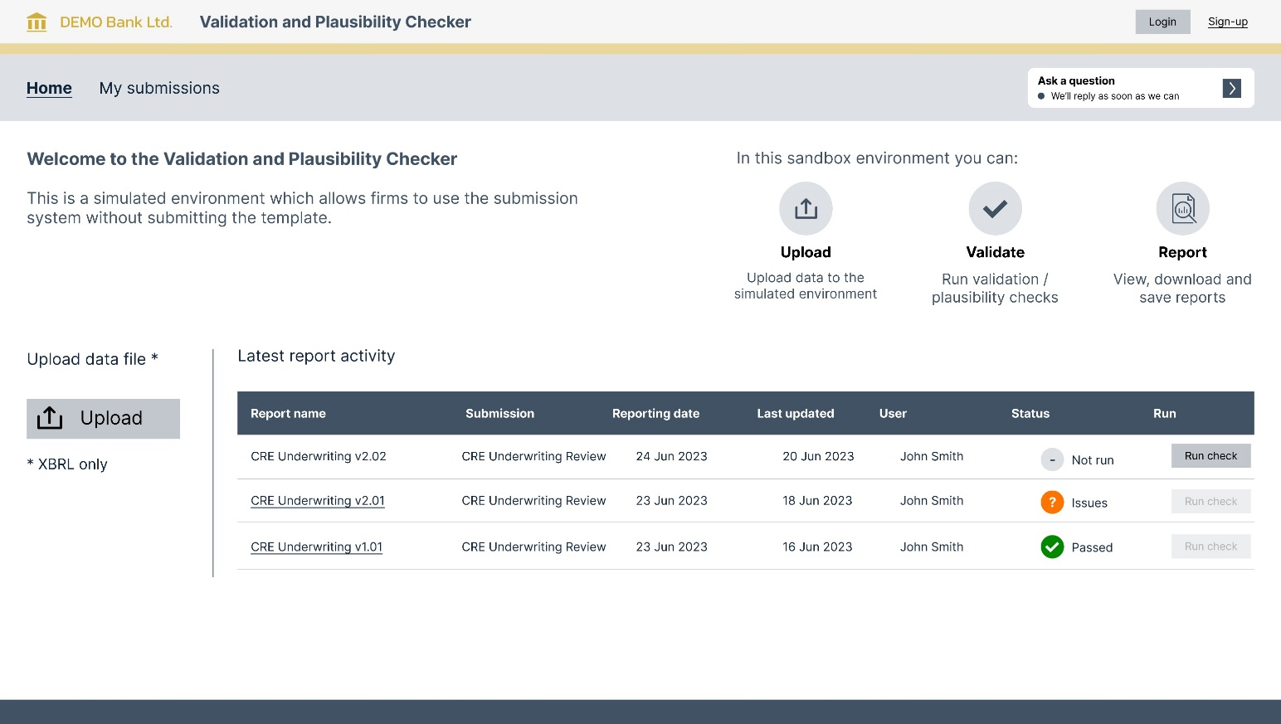
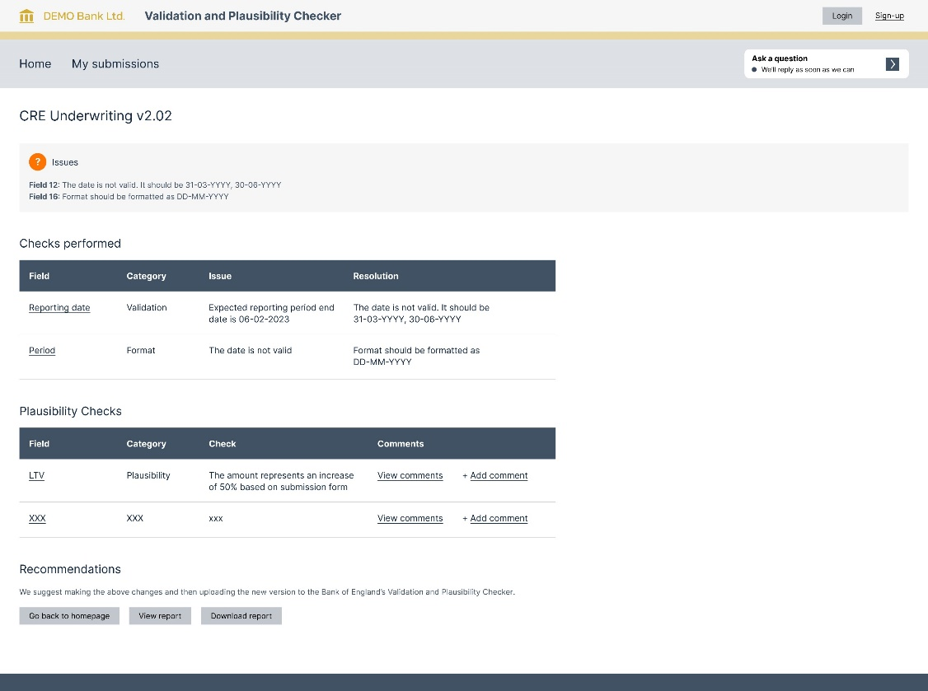
Pre-Validation of Data Submission

Slide 36
Submission System 2.0 with Commentary
What it is? Interactive form, which supports users in better understanding how to complete each field as well as improve quality of their submission. Provides the ability to add comments to fields highlighted by plausibility checks
Recommendations
BoE should build a solution that allows firms to understand the plausibility/ reasonableness checks the Bank is expected to perform and allows firms to input commentary and explanations with their submission:
ability to run multiple plausibility checks against the submission that are specific to the report being submitted
create a commentary report to allow firms to understand where commentary will be required
provide an option to provide explanation (s) and commentary on the submission, both at a field level and at an overall return level
create an audit trail of comments made / received and ability to recall previous comments
Benefits Include
Completion of submission more correctly and more quickly
Reduce ambiguity and contextual learning
Improve transparency across the whole process
Improved communication between submitter and receiver
More effective use of everyone’s time, i.e. reduces BoE queries as explanations and provided with submission

Slide 37
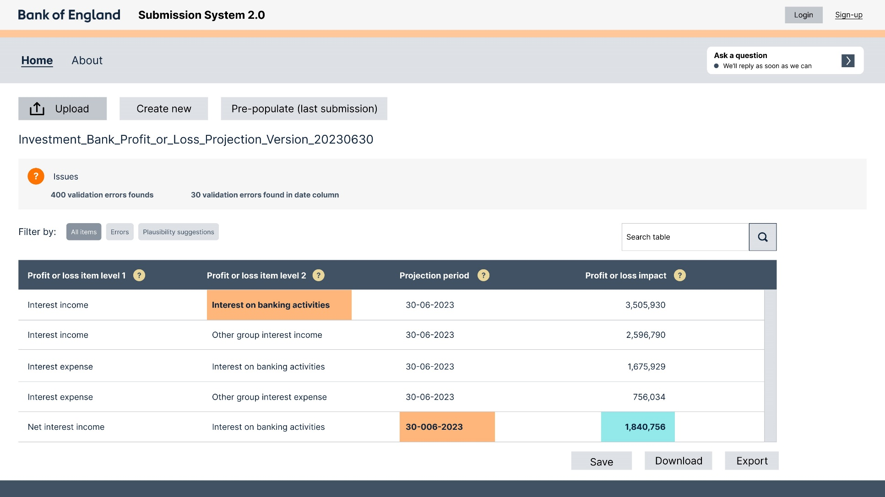
Submission System 2.0 with Commentary
Highlights the plausibility error and offers the option to add commentary
Highlights the validation error and offers the option to edit within the interactive template

Slide 38
FAQS
What it is? A one stop shop for information about submissions
Recommendations BoE should build a solution that allows firms to have their regulatory questions answered. This will enable users to understand and gain clarity on the instructions whilst improve data quality and efficiency of the submission process:
a forum where users can easily search for previous questions and answers in relation to a specific topic
allows users to ask new questions or seek clarity on previous responses
questions will be directed to the relevant SME at the regulator to enable them to post the answer
answers are timestamped and a review period is logged, i.e. the answer needs to be reviewed on a periodic basis to ensure the answer remains valid
answers are logged and publicly displayed for all users in the industry to see
the solution should allow users the option not to display their questions in the public domain, i.e. they may not wish to display their query for valid reasons

Slide 39
FAQS
Benefits include
Find detailed information
Reduction in number of queries from firms
Raise questions and get expert advice
Better understanding of submission, leading to increase quality of submission
Reductions in number of queries received by firms
Reduction in time taken for firms to achieve a clean submission

Slide 40
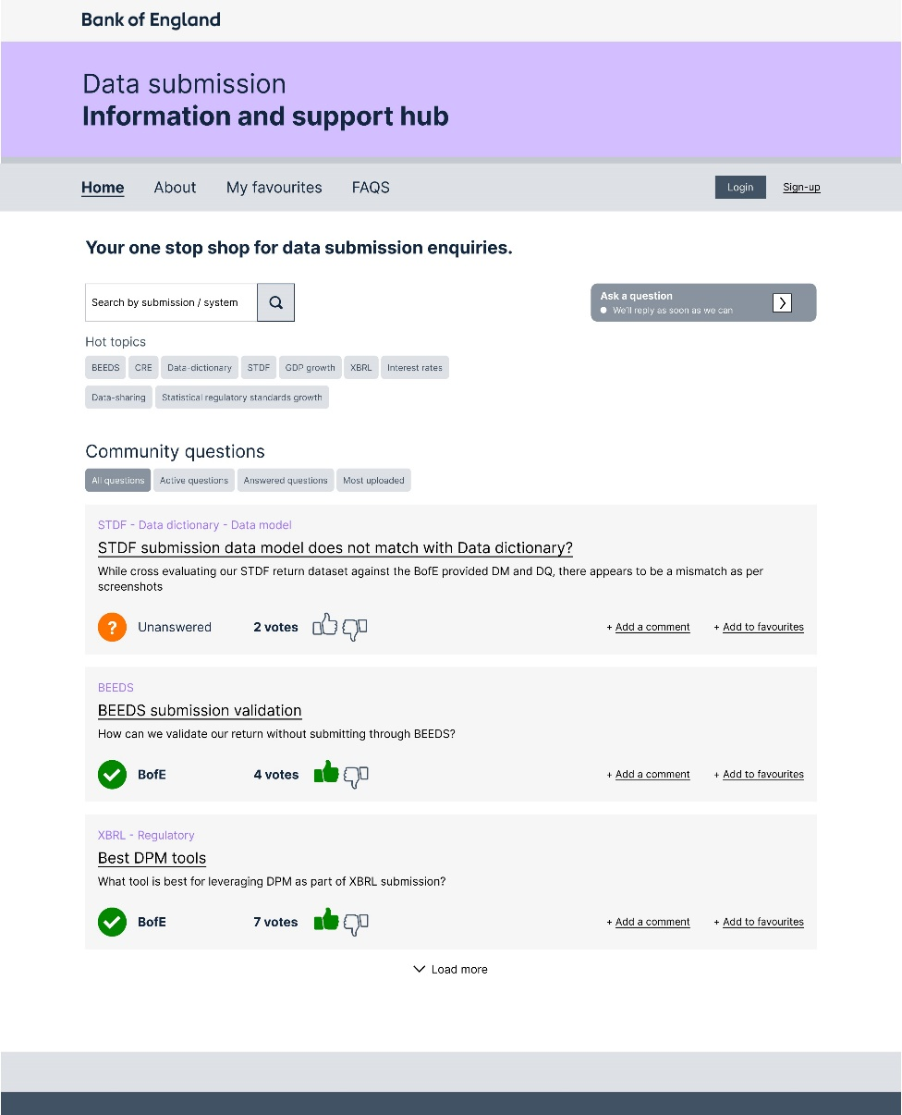
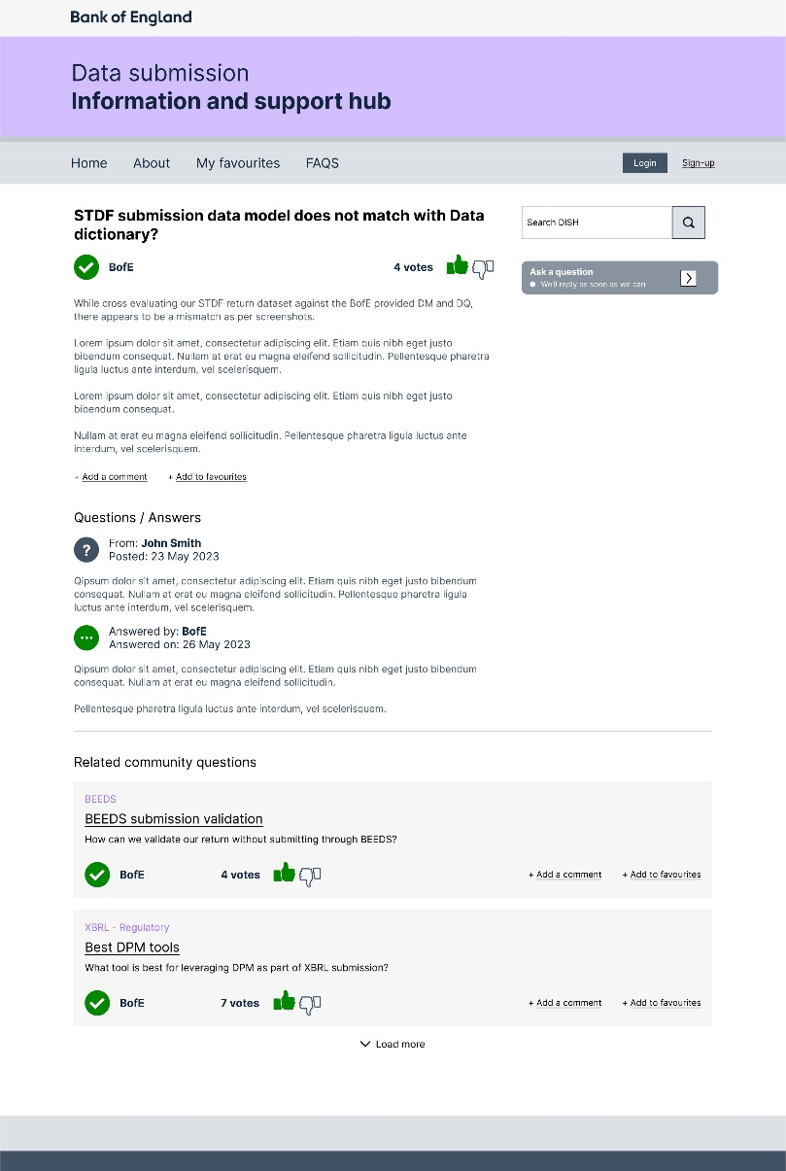
FAQS

Slide 41
Regulatory Academy
What it is? For beginners and advance users, the academy provides tutorials with step by step guide to help preparers get it right from onset
Recommendations
To build a solution that allows users from interested parties (firm and regulatory bodies) to gain training on various regulatory topics. This will enable users to gain better understanding on the reason for the collection, the instructions, and the submission process whilst improve quality of the data submitted to the regulators:
display the various methods of training available to users
allow users to access the training material
allows users to track the courses of interest, courses attended and upcoming courses
the course and training materials are to be reviewed on a regular basis

Slide 42
Regulatory Academy
Benefits Include
Improved understanding of requirements (both instructions and data quality)
Training of new team members for Bank and Firm
Consistency information for new submission
Reduction in number of queries from firms

Slide 43
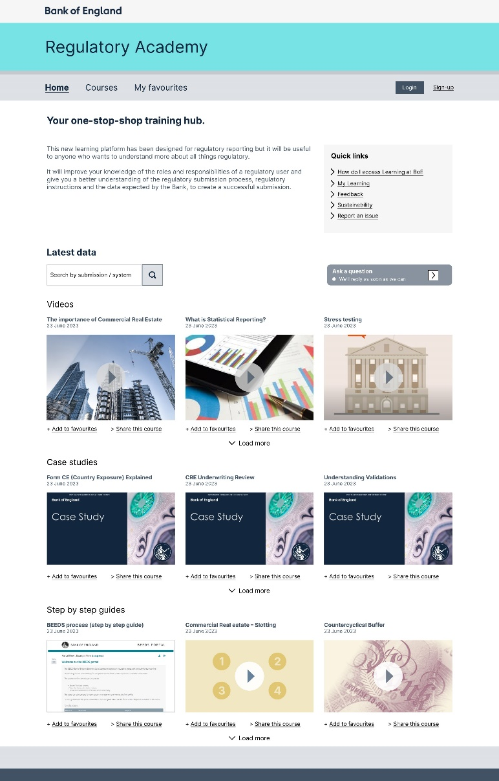
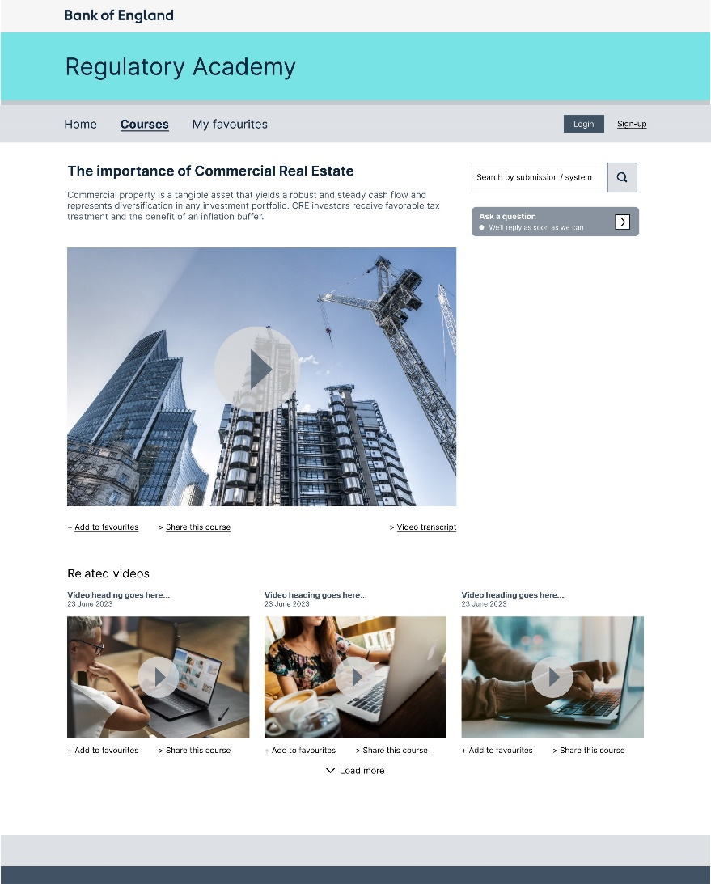
FAQS

Slide 44
Quarterly derivatives (Form DQ) return

Slide 45
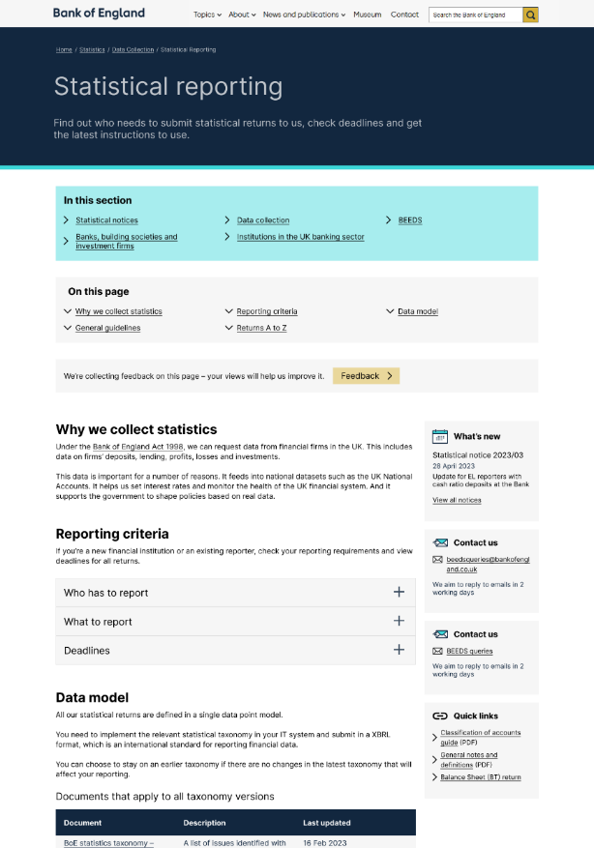
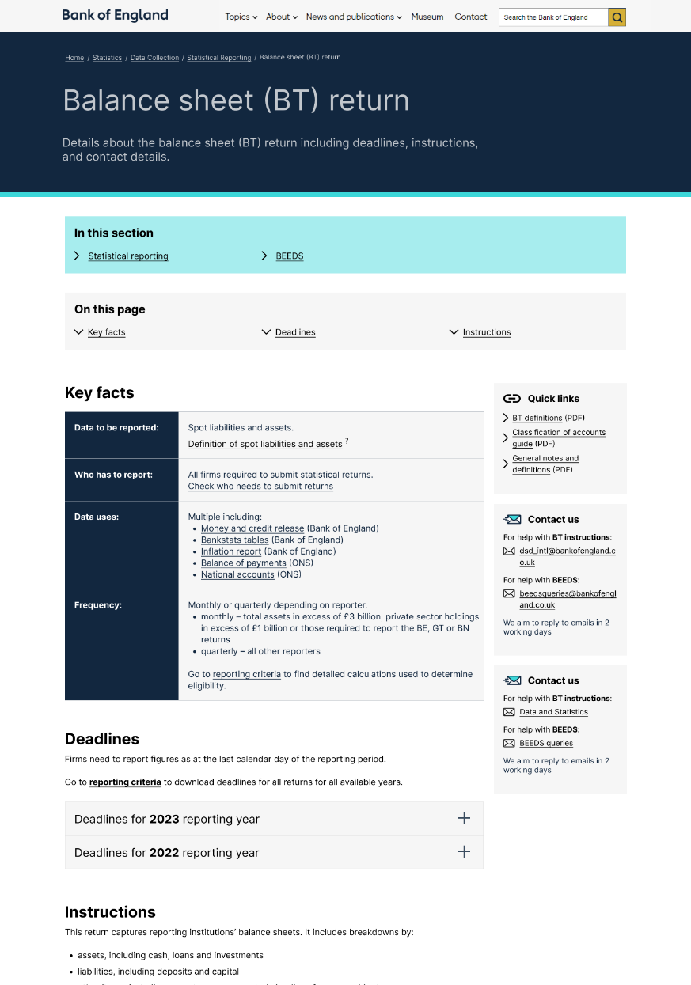
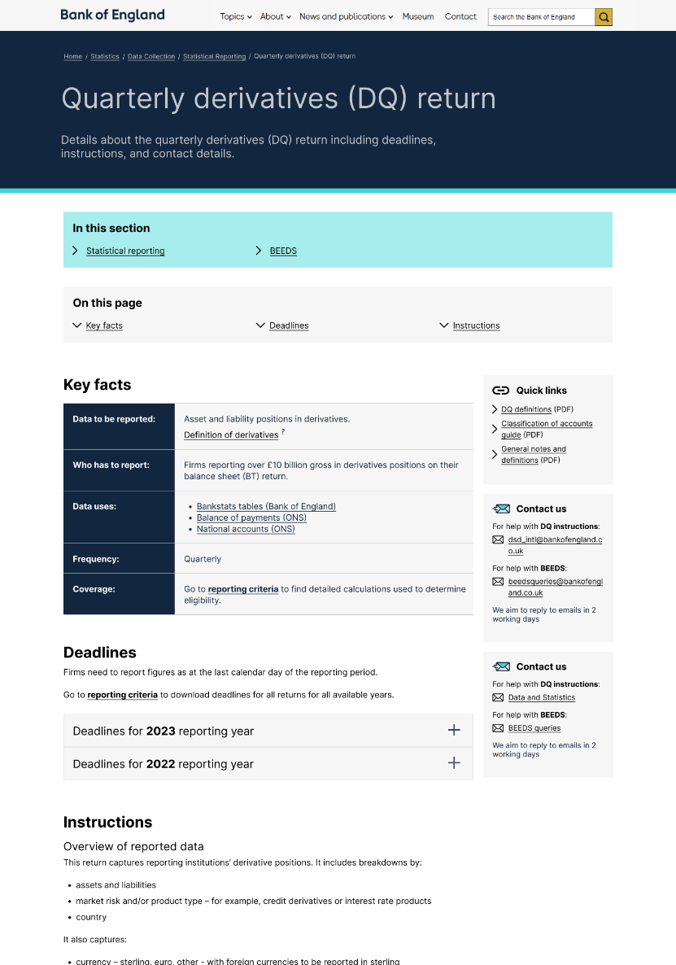
Preview of the web pages launching 31 July 2023
Statistical reporting landing page
Balance sheet (BT) return page
Quarterly derivatives (DQ) return
45

Slide 46
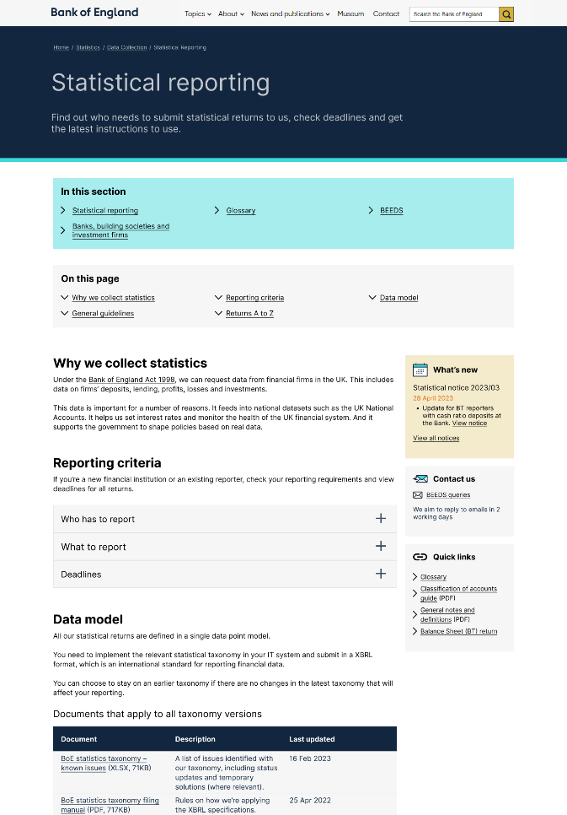
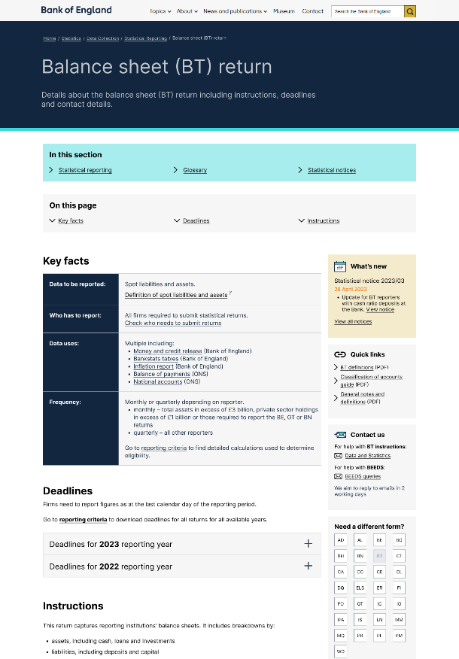
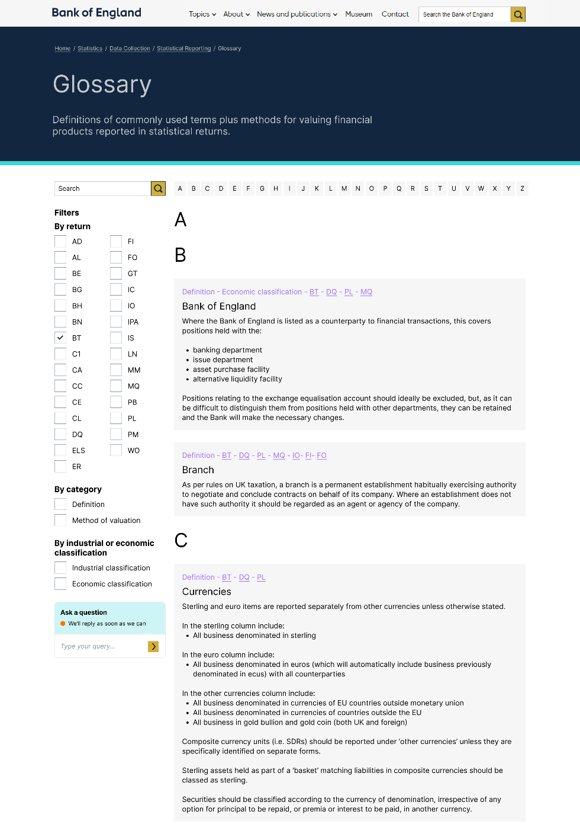
Using insights from our user research, we have been exploring potential future concepts for the statistical reporting web pages
VISION: Statistical reporting landing page
VISION: Balance sheet (BT) return page
VISION: (Statistical Reporting) Glossary
46

Slide 47
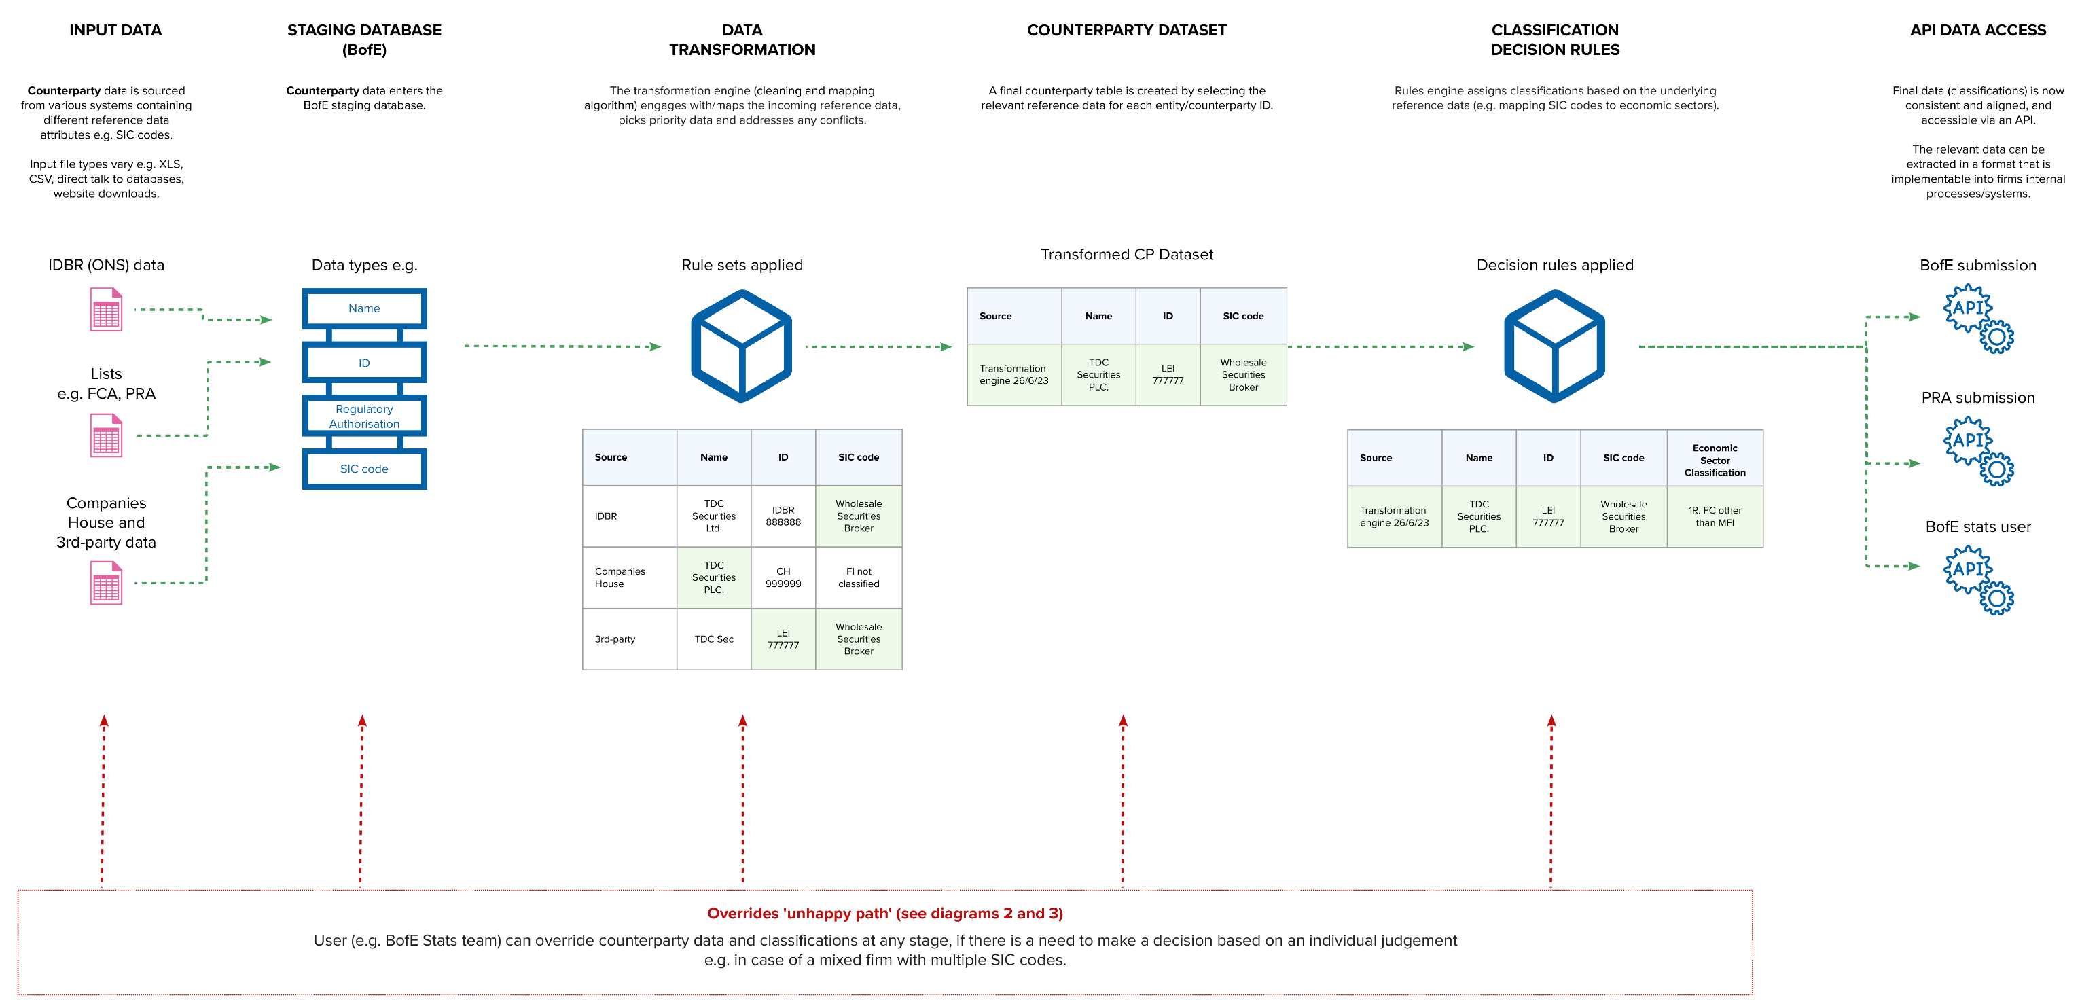
High level technical diagram of the steps to be considered when developing a solution for Counterparty Classification
47

Slide 48
Retail Banking Business Model Data

Slide 49








Who we are – RBBMD alpha team
Meera Amin
User Researcher
Maf’j Alvarez
Service & Interaction Designer
Nadia Huq
Content Designer
Chris Caldwell
Interim Product Owner
Sushma Sehar
Delivery Manager
Jing Jia
Business Analyst
Shaila Vinjili
Excel & Data Specialist
John Stevenson
Technical Architect
49
Not engaged full time in RBBMD Alpha and are available partially or on need basis

Slide 50







Who we are – RBBMD Stakeholders
Ed Smith
FCA Competition HoD
Neil Marshall
FCA Competition Manager
Dharmesh Gadhavi
Retail Banking Sector Manager
Andrew Collings
Retail Banking Sector Lead Associate
Zeynep Smith
FCA Competition Lead Associate
Jack Skingle
Retail Banking Sector Senior Associate
James Harvey
Retail Banking Sector Senior Associate
50

Slide 51
Content
0 – Intro and TDC vision
1 – Recap on the use case
2 – RBBMD service design
3 – Redesigned RBBMD template
4 – RBBMD user testing feedback
5 - What’s next?
6 – How to get in touch with us?
Slide 5 to 7
Slide 8 to 14
Slide 15 to 21
Slide 22 to 23
Slide 24 to 26
Slide 28
Slide 30
51

Slide 52
Intro and TDC vision

Slide 53
What is the objective of Retail Banking Business Data Model (RBBMD) collection for FCA?
Strategic review of retail banking business models market report
Main objective of RBBMD collection is to understand the impact of change on retail banking business models, and the implications for consumers
Understand the impact of changes such as increased use of digital channels and reduced branch usage on business models and consider potential consequences for our consumer protection and competition objectives
Understand retail banking business models and reporting structures from various firms in greater depth by looking at the business models of firms to identify any potential conduct or competition issues
53
For more info: https://www.fca.org.uk/publications/multi-firm-reviews/strategic-review-retail-banking-business-models

Slide 54

Transforming data collection (TDC) programme vision
The FCA and the Bank will get the data they need at the lowest cost to industry
FCA website:
"We recognise that reporting is one of the most demanding parts of regulation, and the quality of data that we receive is not always to the standard that we expect. Our data needs have also evolved as technology and business models have changed.
To address these issues, we have developed a joint transformation programme with the Bank of England. This will identify how data collection should improve to increase the value and reduce the burden to firms. We see many benefits in working closely with firms and industry to make sure that our data collections are worthwhile and valuable for regulators and industry."

Slide 55
Recap on the use case

Slide 56
RBBMD discovery on a page
What is RBBMD collection
What did we do during discovery
Key pain points identified during discovery
Key user needs identified during discovery
Colloquially called R2B2
Collected periodically in an ad-hoc way
3 rounds of data since 2017, Approx. 2499 data points, 30 to 50 firms participate each time
Strategic review of retail banking business models market report.
Valuable data across FCA used by Competition, Supervision, Policy, BoE & HMT
Priority strategic data for competition – Resulted in 3 external publications
Complex adhoc collection to investigate
Conducted User Research with 18 users
7 Internal – 4 Competition, 2 Supervision, 1 Operations – Economist
11 External – 6 Large Bank, 3 Challenger Bank, 1 Building Society, 1 Bank of England Data Analyst
Analysis of Key Themes; Identified User Needs; Understood Pain Points;
Identified Personas
Mapping of the current service
17 unique pain points identified
Insufficient information within Guidance resulting in extra time people and resource
Insufficient information within Definitions resulting in painful process to collate data internally at the firm
Manual Data Validations resulting in Data quality issues
Lack of Measurement (status, audit trail, version control etc.)
Template doesn’t easily align to firms
15 user needs identified
Reduce burden on firms with Clear, comprehensible and accessible definitions and guidance
Mechanism for Automated validation - Receive Accurate data with reduced data quality issues
Ability to Measure (status, audit trail, version control etc.)
Reduce burden on firms with Reduction in duplication of data collected
Ability to access the RBBMD collection across FCA

Slide 57
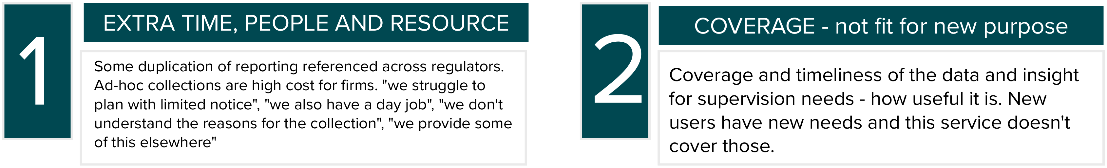
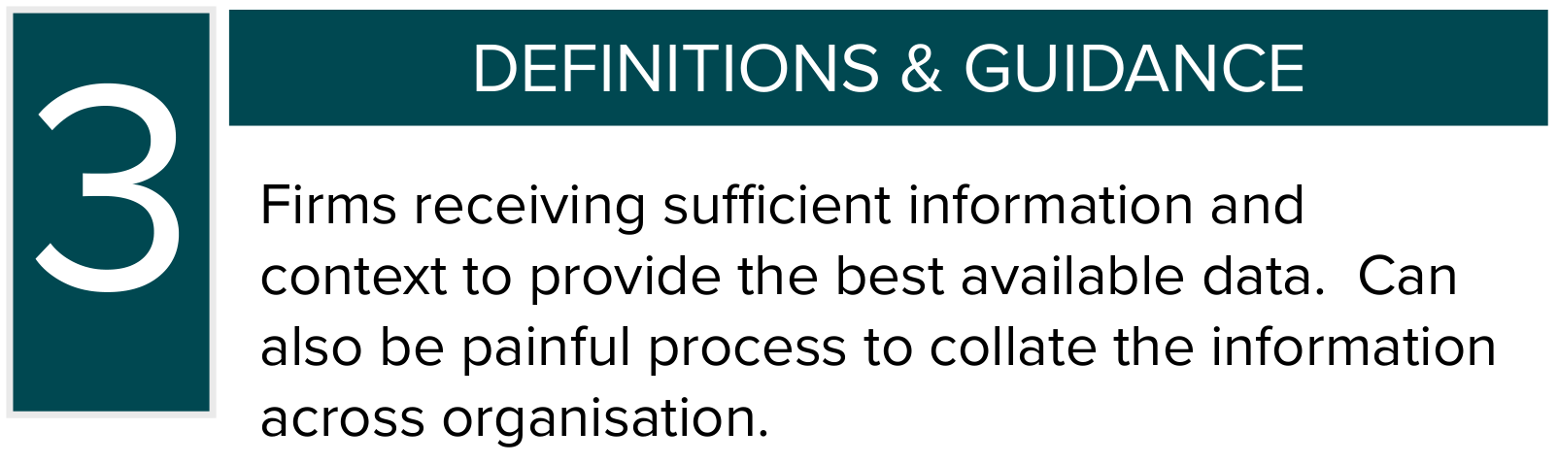
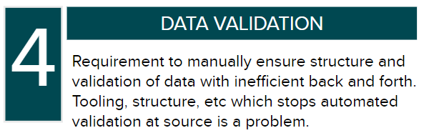
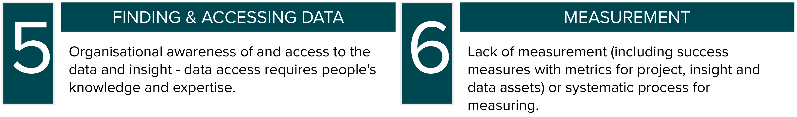
Emerging problem areas
57

Slide 58




Benefits if service is delivered
Reduce burden on firms by reducing frustration and improving efficiency of the collection process
Improve data quality at source decreasing cleaning time and potentially increasing analysis quality/reducing errors
Increase the capacity of FCA colleagues to deliver value-adding work
Increase trust and confidence with firms for ad-hoc collections

Slide 59




Where is RBBMD in the transforming journey
Live
We are here!
Continuous improvement and adding more complex collections
Beta
Prototype and test options with end users (Firms, FCA competition, FCA supervision)
Understand the context and problems with the way RBBMD data is currently collected by Firms and used by the FCA
Build MVP and integrate the service, after significant value is demonstrated in the Alpha phase
Alpha
Discovery
2023
2024 & beyond
59

Slide 60

What are we testing in Alpha?
Experiment to find the effective and efficient way to collect the RBBMD data from firms with increased data quality at source easily & confidently.

Slide 61



Alpha activities
Automated validated excel workflow
Content improvement for definitions and guidance
GDS prototyping user journey front-end
Feasibility of data cataloguing and data lake storage
Feasibility of hybrid collection (ad-hoc/regular etc)
Mini discovery of cross-regulator reporting

Slide 62
RBBMD service design

Slide 63
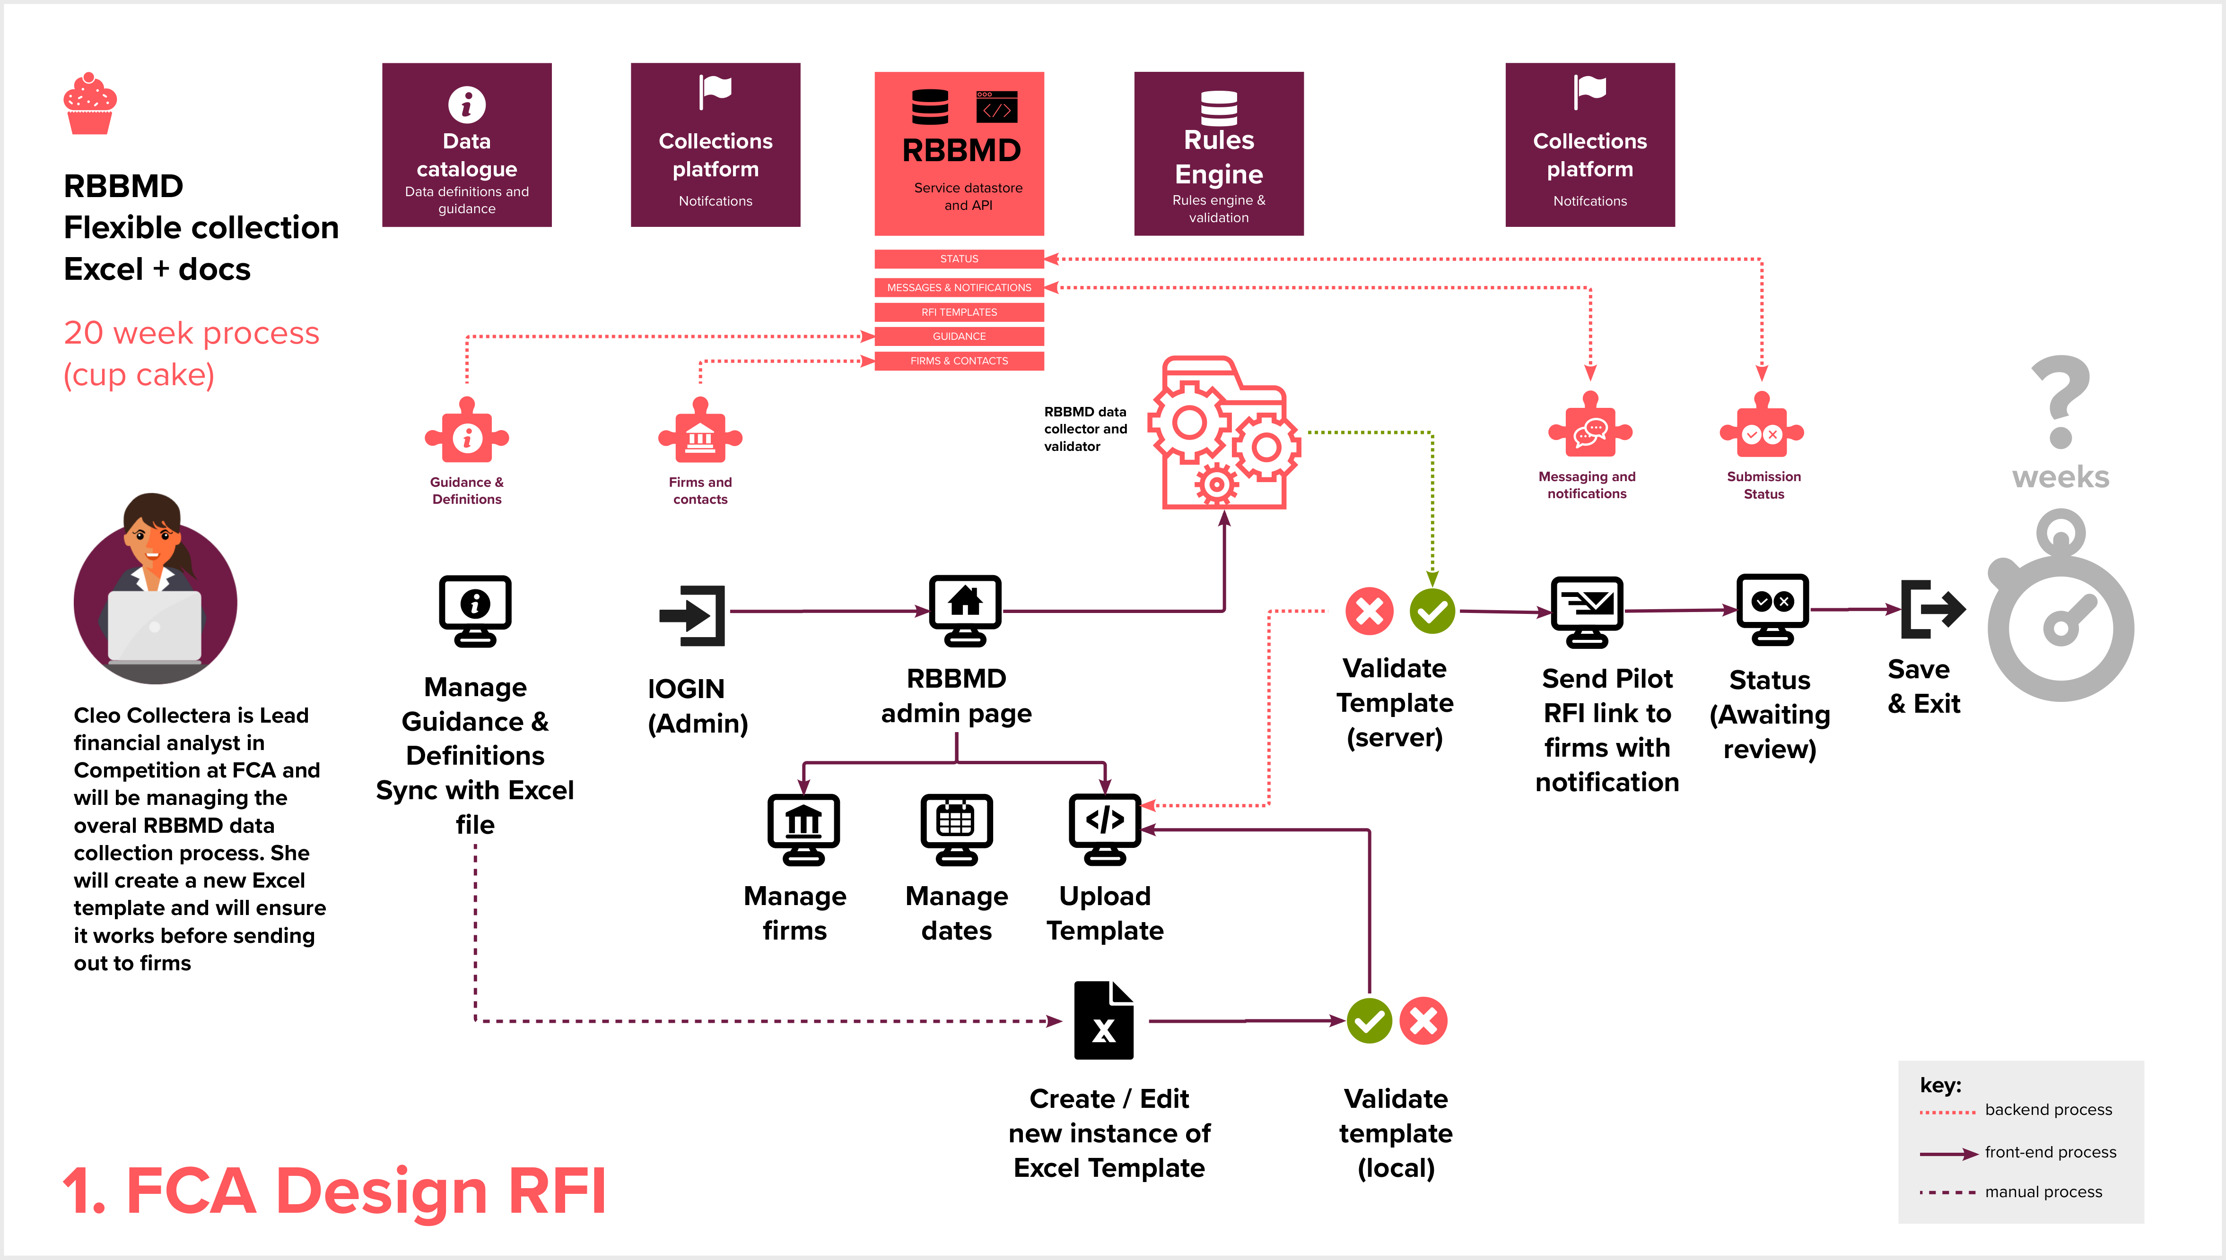

Slide 64
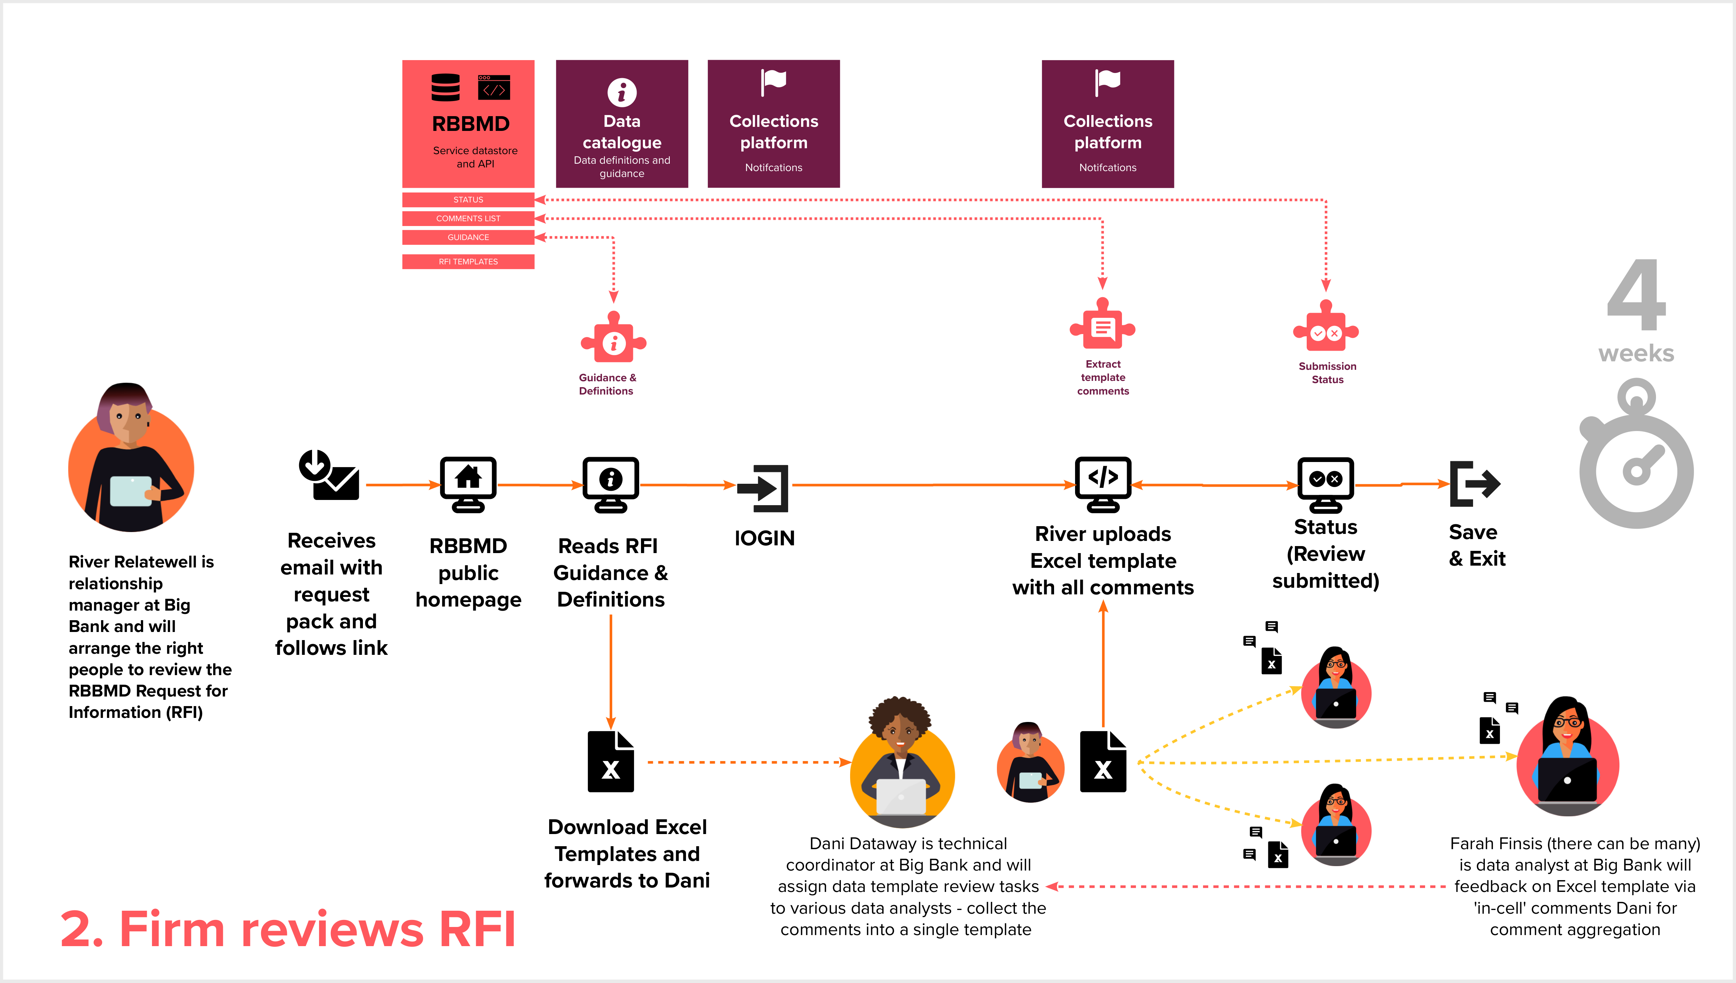

Slide 65
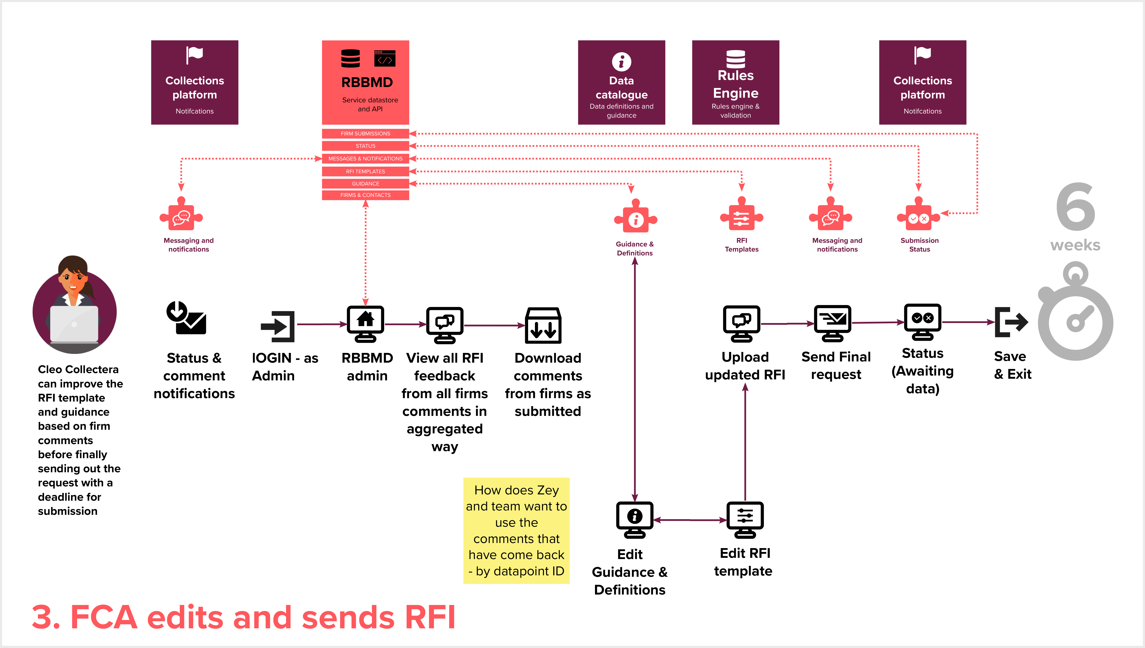

Slide 66
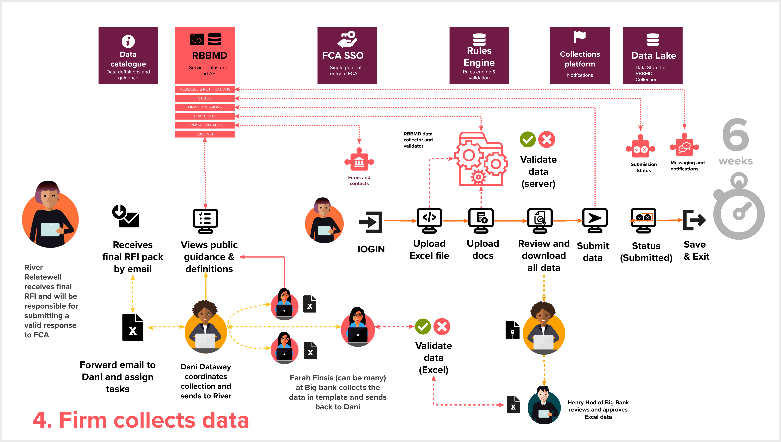

Slide 67
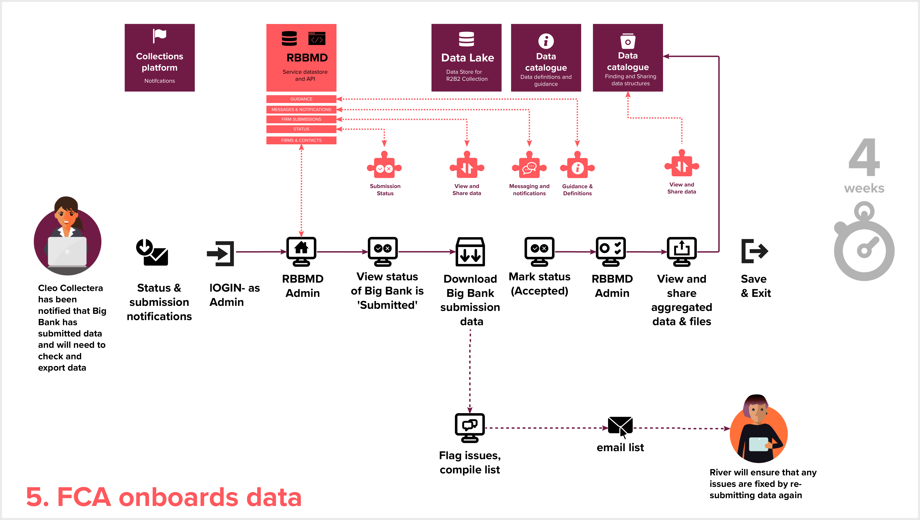

Slide 68
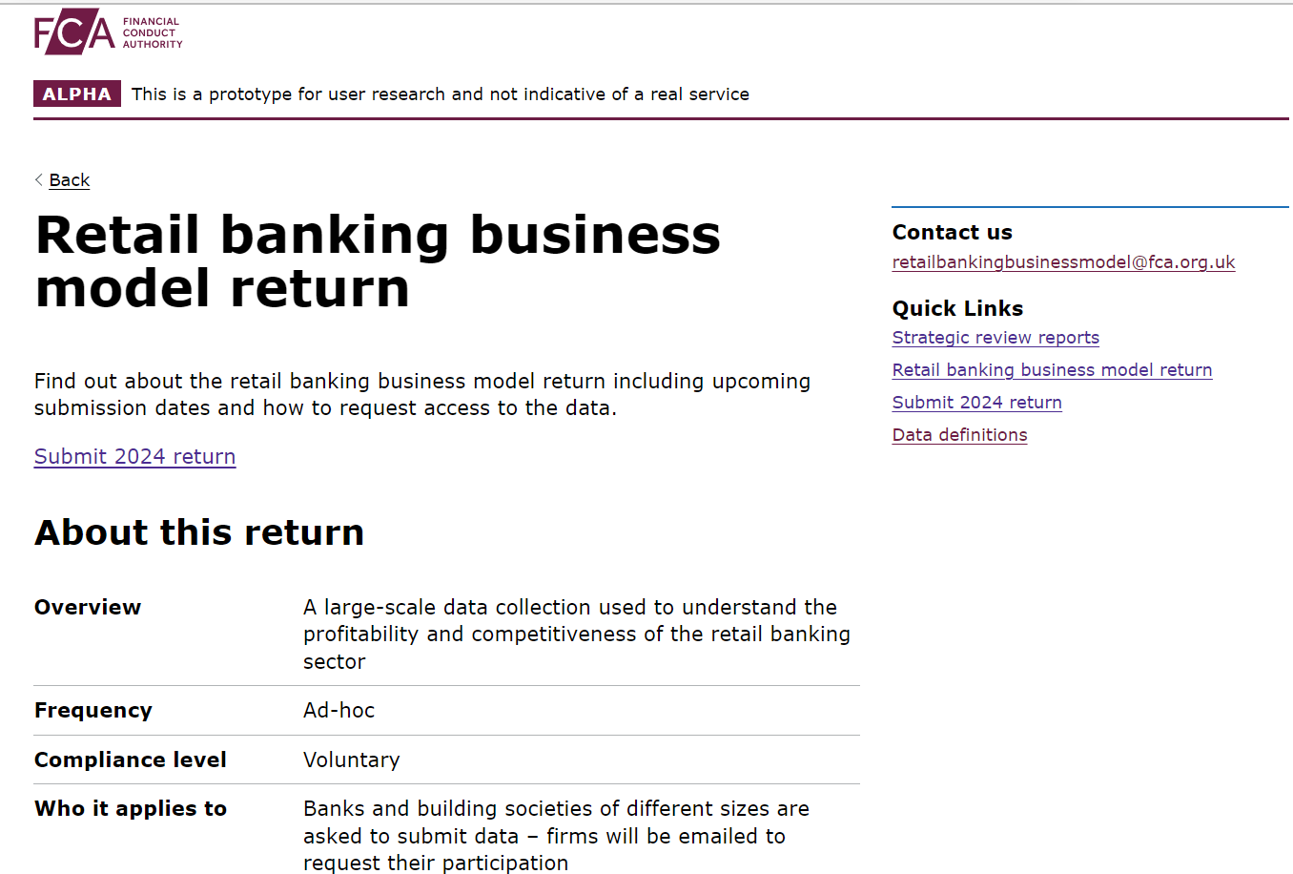
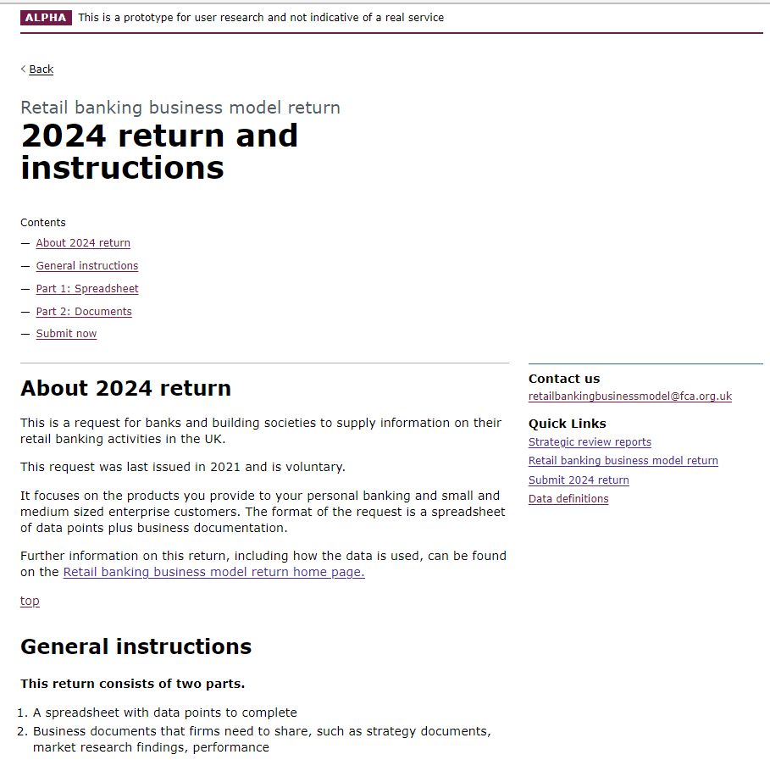
RBBMD Prototype
Prototype Link:
rb.gy/ck6cp

Slide 69
Redesigned RBBMD template

Slide 70

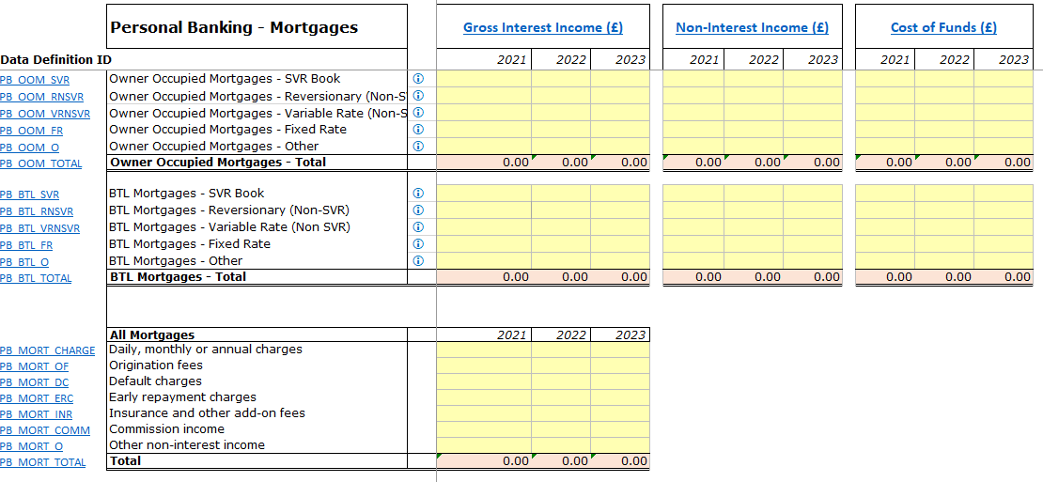
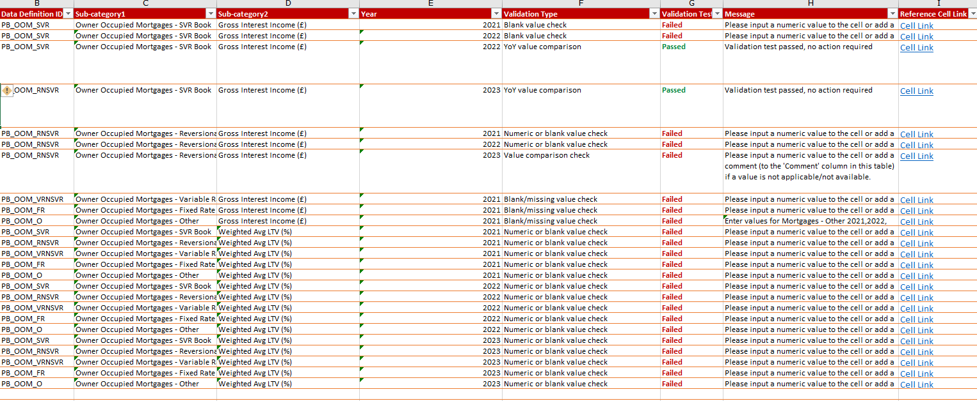




RBBMD template redesigned
Transform the existing data collection template with the goal of reducing firms’ burden as well as improving data quality at source
Redesigned in line with retail banking business model - a new firm product driven approach
Automated and easy-to-use data validations in the template
Clear instructions for firms to follow
Applying flexibility as well as structure in the new template
70

Slide 71
RBBMD user testing feedback

Slide 72






Who have we completed user research sessions with to date?
Bank Finance Manager
2
2
FCA Competition team
13
Bank Finance Analyst
2
Firms
8
FCA Supervision
Bank Regulatory Relationship Manager
8
Bank Head/Director of Data Risk & Analytics
72

Slide 73
User testing feedback
"Well, looking at the excel tab, I mean it's, it's probably just a 30minute job for me or, or less."
"I think it's intuitive, (the way the excel is structured) the team who usually consolidates and provides data to FCA would know who to reach out to. It looks straightforward to me to be very honest. Just by looking at it I know who to go to get the data."
"I do think that's quite clear - the prototype journey. It is quite methodical as well in terms of the step through of the task list. I think that's good"
"It looks like you've done a load on work on it, (the excel) improving the previous template. We won't have this issue we had last time."
"I think this prototype – the new system - seems really user-friendly - it seems easy."
73

Slide 74
What’s next

Slide 75
What’s next?
Draft version of the TDC external committee recommendations to be available in July 2023
External committee members to provide recommendations to FCA in Sep 2023
Iterate prototype and template design, continue to test with users
Internal discussion and decision on feasibility and options Q4 2023

Slide 76
How to get in touch with us?

Slide 77



Would you like to participate in testing?
If you would like to participate in testing or have any queries or feedback to share, please write to:
TDCProgrammeComms@fca.org.uk

Slide 78
Appendix

Slide 79

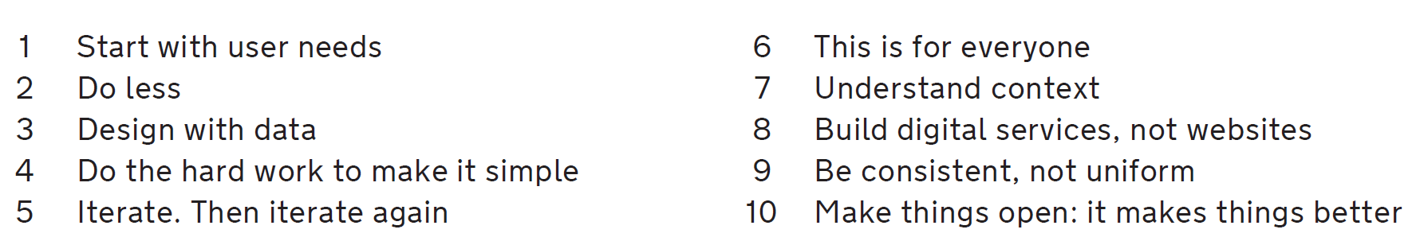
Following GDS principles
If you want to find out more about the Government design principles, you can find out more here: https://www.gov.uk/guidance/government-design-principles

Slide 80

What is a GDS Alpha phase?
Alpha is an experimental stage.
It's an opportunity to use prototypes to work out the right thing to build.
In Alpha stage we test the hypotheses that we reached at the end of Discovery stage.
As we progress through Alpha, we will produce new hypotheses as we discover new things about the users and service.

Slide 81
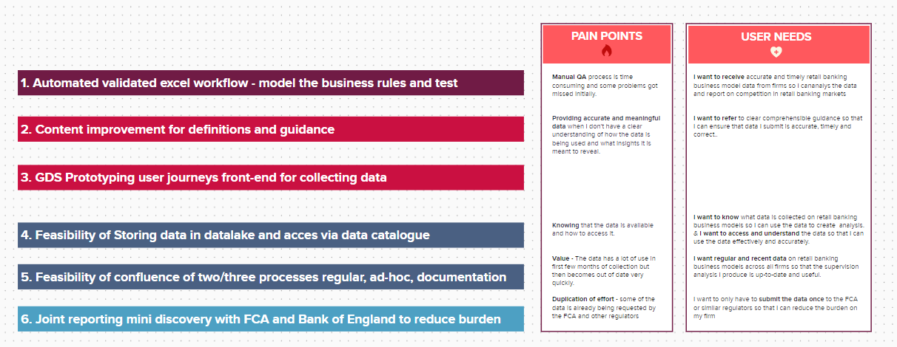
Proposed Activities for Alpha

Slide 82

What to expect at end of Alpha?
Alpha design recommendations
How will we measure success - Measurable KPI
Alpha prototype
Technology feasibility – impact to FCA platforms/products
82

