Slide 1
Monetary Policy in Extraordinary Times
Prof. David Miles
CEPR Lecture, London Business School
Wednesday 23rd February
Notes:
1

Slide 2
Level of Output Relative to Pre-Crisis Trend During Past Recessions ^{(a)}
I use GDP and trend growth estimates from Hills, Thomas and Dimsdale ( Bank of England Quarterly Bulletin 2010) to create this chart. The authors use a Hodrick-Prescott filter to separate the trend and the cyclical components of real GDP growth. I assume that their trend growth estimate at the start of each recession would have prevailed during the following seven years had the recession not occurred. The chart shows deviations of actual GDP from this projected trend growth. The dotted line for the latest recession uses the MPC’s mean projection for output growth over the forecast horizon as reported in the February 2011 Inflation report.
Notes:
2

Slide 3
Commodity Prices (in £, Jan 2007 = 100)
Note: The total commodities series uses the GSCI index.
Notes:
3

Slide 4
Public Sector Stock of Net Debt (% of GDP)
Note: The ONS calculate public sector net debt as financial liabilities less liquid assets and does not include all assets and liabilities of the public sector. The public sector, including the banks classified to the public sector, owns considerable amounts of illiquid assets, but these are not taken into account in the calculation of net debt.
Source: 1855-2007 Hills, Thomas and Dimsdale (Bank of England Quarterly Bulletin 2010), 2007-2009 ONS series code ‘RUTO’.
Notes:
4

Slide 5
Annual Inflation
Source: ONS
Notes:
5

Slide 6
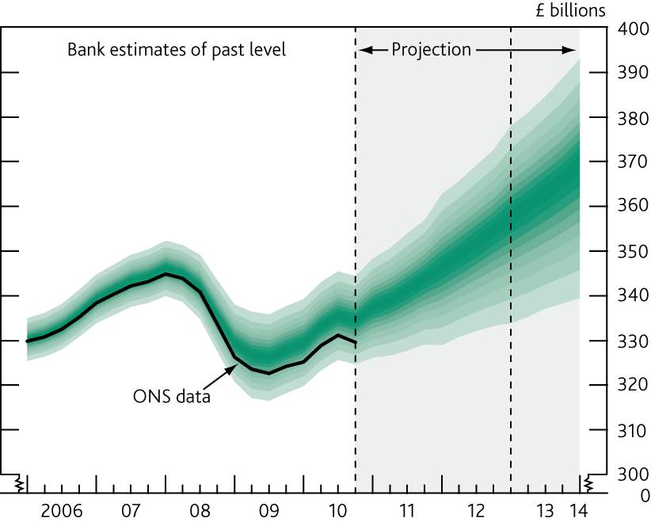
Projected Level of GDP
Note: The width of this fan chart over the past is to take account of likely revisions of the data.
Source: Bank of England Inflation Report, February 2011
Notes:
6

Slide 7
Bank Rate Since 1964
Source: Bank of England
Notes:
7

Slide 8
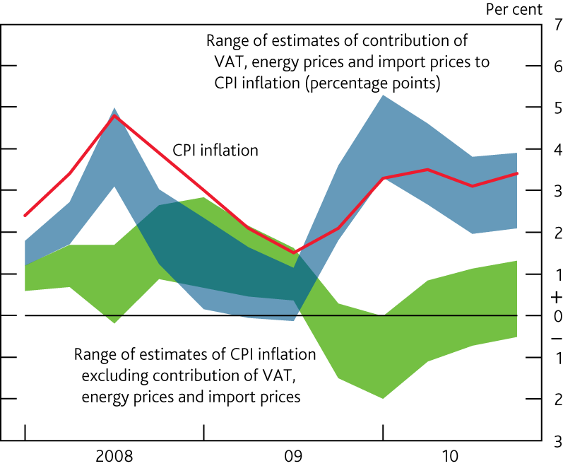
CPI Inflation and the Contribution of VAT, Energy Prices and Import Prices
Note: The blue swathe sums the minimum and maximum of the individual estimated impacts of VAT, energy prices and import prices on CPI inflation.
Source: Bank of England Inflation Report, February 2011
Notes:
8

Slide 9
Interest Rates Faced by Households and Firms
Note:
-the corporate borrowing rate series uses an index of BBB-rated sterling corporate bonds issued by non-financial companies with a current average maturity of 8.5 years.
- the household lending and deposit rate series show data on quoted rates by UK Monetary and Financial Institutions.
Source: Bank of England and Bank of America Merrill Lynch
Notes:
9

Slide 10
Quarter-on-quarter Inflation Rates
Note: Seasonally adjusted. Projections from 2011 onwards are for the mode.
Notes:
10

Slide 11
UK Debt by Sector as % of GDP
Notes:
11

Slide 12
Monetary and Financial Institutions Assets
Notes:
12

Slide 13
Leverage of UK Major Banks
Source: Banks’ published financial accounts.
Notes:
13

Slide 14
UK Banks Leverage Ratio ^{(a)}
(a) UK data on leverage use total assets over equity and reserves on a time-varying sample of banks, representing the majority of the UK banking system, in terms of assets. Prior to 1970 published accounts understated the true level of banks' capital because they did not include hidden reserves. The solid line adjusts for this. 2009 observation is from H1.
(b) Change in UK accounting standards.
(c) International Financial Reporting Standards (IFRS) were adopted for the end-2005 accounts. The end-2004 accounts were also restated on an IFRS basis. The switch from UK GAAP to IFRS reduced the capital ratio of the UK banks in the sample by approximately 1 percentage point in 2004.
Notes:
14

Slide 15
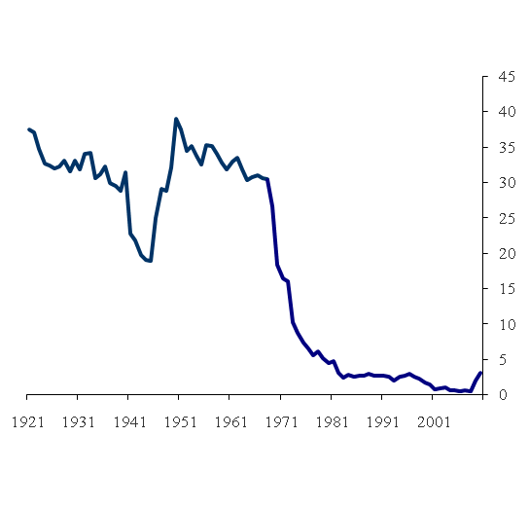
UK Banks Liquidity Ratio ^{(a)}
From 1968 the liquidity ratio is: Cash + Bank of England balances + money at call + eligible bills + UK gilts as a percentage of banks' total asset holdings. Pre-1968 the ratio is calculated as the liquid assets of the London Clearing Banks as a percentage of gross deposits.
Notes:
15

Slide 16
Economic Impact of Reducing Leverage from 30 to 15 (Doubling Tier 1 Capital from 8.4% to 16.8% of risk-weighted assets) – Basis Points
Source: Miles, Yang, Marcheggiano (2011)
Notes:
16

