Slide 1
Low Interest Rates: King Midas’ Golden Touch?
Kristin Forbes
External MPC Member
Bank of England
Institute of Economic Affairs, London
24 February 2015

Slide 2
King Midas’ Golden Touch

Slide 3
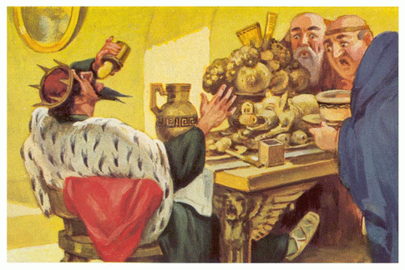
The Costs

Slide 4
The UK Economy Today
UK recovery well in progress and self-sustaining
Still substantial challenges & scars from recession
But economy largely normalizing after severe & protracted crisis
One exception: interest rates
Near-zero rates key part of crisis response & early stages of recovery
Near-zero rates provide a number of benefits
But there are also costs and risks

Slide 5
Potential Costs of Low Rates
inflationary pressures;
(2) asset bubbles and financial vulnerabilities;
(3) limited tools to respond to future challenges;
(4) an inefficient allocation of resources / lower productivity;
(5) vulnerabilities in the structure of demand; and
(6) higher inequality
Key question today: Does the policy of near-zero interest rates risk going the way of Midas’ golden touch?

Slide 6
Risk 1: Inflationary Pressures

Slide 7
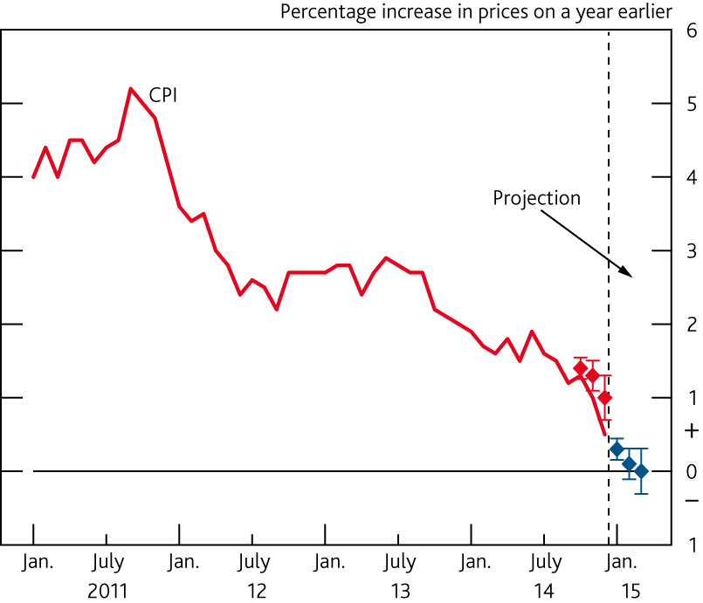
Recent and Forecast CPI Inflation
Source: BOE, February Inflation Report

Slide 8
Domestically-Generated Inflation (DGI) Measures
Source: ONS and Bank calculations.
DGI measures recently stable

Slide 9
Inflation: Looking Forward
Low headline inflation and stable DGI unlikely to persist
Output gap closing
Wage inflation picking up
But pressures should build slowly
Risks that inflation could pick up faster
See Jan. speech, “Risks Around the Forecast
Also risks that inflation picks up more slowly
Bottom line: current policy does not yet appear to be generating incipient inflationary pressures that could not be addressed in a timely fashion as needed

Slide 10
Risk 2: Asset Bubbles & Financial Instability

Slide 11
Risks to Financial Stability
Various risks:
“Search for yield”
Bubbles
Increased risk by banks
Increased debt issuance by companies
Long academic literature on risks (see speech text)
Financial Policy Committee (FPC): 1st line of defence
Will the tools of the FPC be enough in the future?
Risks magnified over time & by lower rates in other economies
May be role for monetary policy to “get in the cracks” in the future, albeit not today

Slide 12
Risk 3: Limited Monetary Policy Tools in the Future

Slide 13
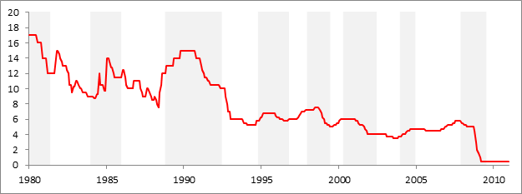
UK: Frequent Use of Bank Rate
UK business cycle slowdowns and Bank Rate:
Source: OECD and Bank of England.

Slide 14
UK: Bank Rate Adjustments During Slowdowns
Business cycle slowdowns: | Dates of easing cycle: | Months of easing: | Fall in Bank rate over easing cycle:
Jan 1980 - April 1981 | Jul 1980 - Mar 1981 | 9 | 5.00pp
Jan 1984 - Nov 1985 | Mar 1985 - May 1986 | 15 | 4.00pp
Nov 1988 - May 1992 | Oct 1990 - Feb 1994 | 41 | 9.75pp
Nov 1994 - Sep 1996 | Dec 1995 - Jun 1996 | 7 | 1.00pp
Jan 1998 - April 1999 | Oct 1998 - Jun 1999 | 9 | 2.50pp
May 2000 - May 2002 | Feb 2001 - Jul 2003 | 30 | 2.50pp
Jan 2004 - Nov 2004 | None | 0 | 0.00pp
Dec 2007 - Jun 2009 | Dec 2007 - Mar 2009 | 16 | 5.25pp
Average: |  | 16 | 3.75pp
Source: OECD and Bank of England.

Slide 15
Risk 4: Inefficient Allocation of Resources / Lower Productivity

Slide 16
Zombies

Slide 17
Liquidations, Interest Payments & Profitability
Company liquidations and interest payments
Company liquidations and loss-making companies
Source: ONS, Department of Business, Innovation and Skills and Bank calculations.
Source: Bureau van Dijk, Department of Business, Innovation and Skills and Bank calculations.

Slide 18
Risk 5: Increased Vulnerabilities in the Structure of Demand

Slide 19
Consumption Growth and Savings Rates
Consumption annual growth
Savings ratio
Source: ONS and Bank calculations.

Slide 20
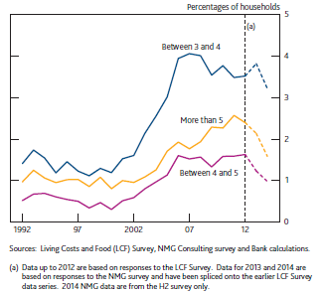
Household Balance Sheets
Household debt to income and deposits to income ratios
Distribution of mortgage debt to income ratios
Source: ONS and Bank calculations.

Slide 21
UK Current Account and Trade Balance
Source: ONS and Bank calculations.

Slide 22
Risk 6: Inequality

Slide 23
Inequality
Distribution of household financial assets by age group
Distribution of household financial assets

Slide 24
Key Distributional Effects of Lower Rates
Boost asset values (equities)
Reduce pension annuities, interest on savings & other fixed income payments
Reduce mortgage, interest and other payments on borrowing
Stimulate job creation
Overall: Net effects on inequality unclear

Slide 25
Conclusions

Slide 26
Tying it All Together
inflationary pressures
asset bubbles and financial vulnerabilities
vulnerabilities in the structure of demand
an inefficient allocation of resources and lower productivity
higher inequality
limited tools to respond to future challenges
Watch closely, could soon factor into decision
Mixed evidence, further from MPC mandate

Slide 27
Final Thoughts
King Midas washing away his touch in the River Pactolus

