Slide 1
[De]Globalisation and inflation
Mark Carney
Governor of the Bank of England
2017 IMF Michel Camdessus Central Banking Lecture

Slide 2
Globalisation and inflation

Slide 3
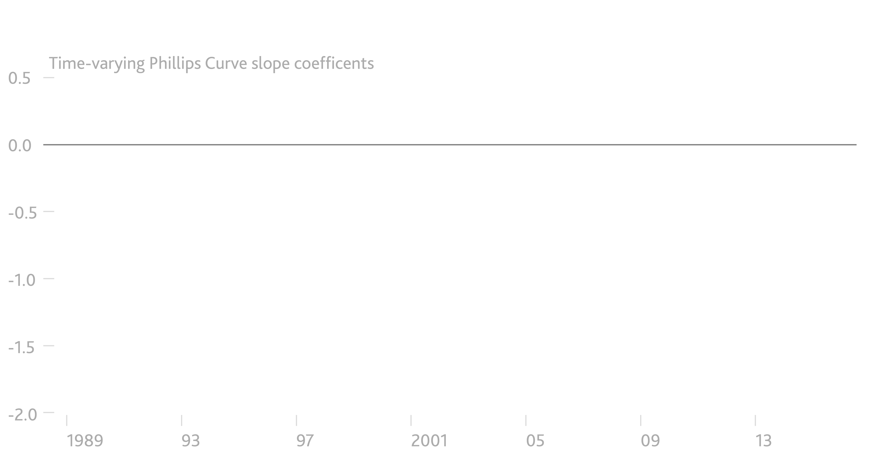
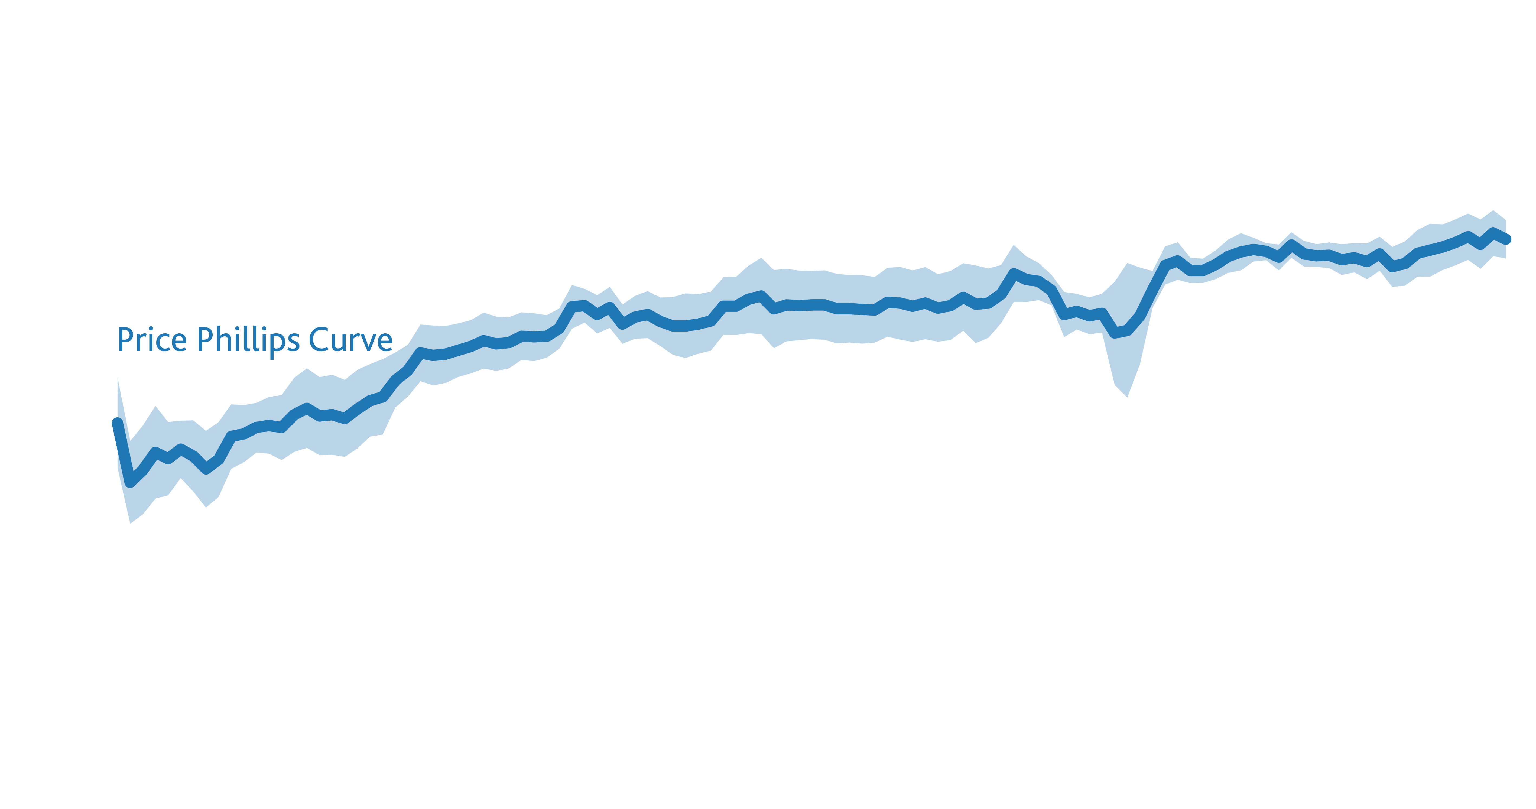
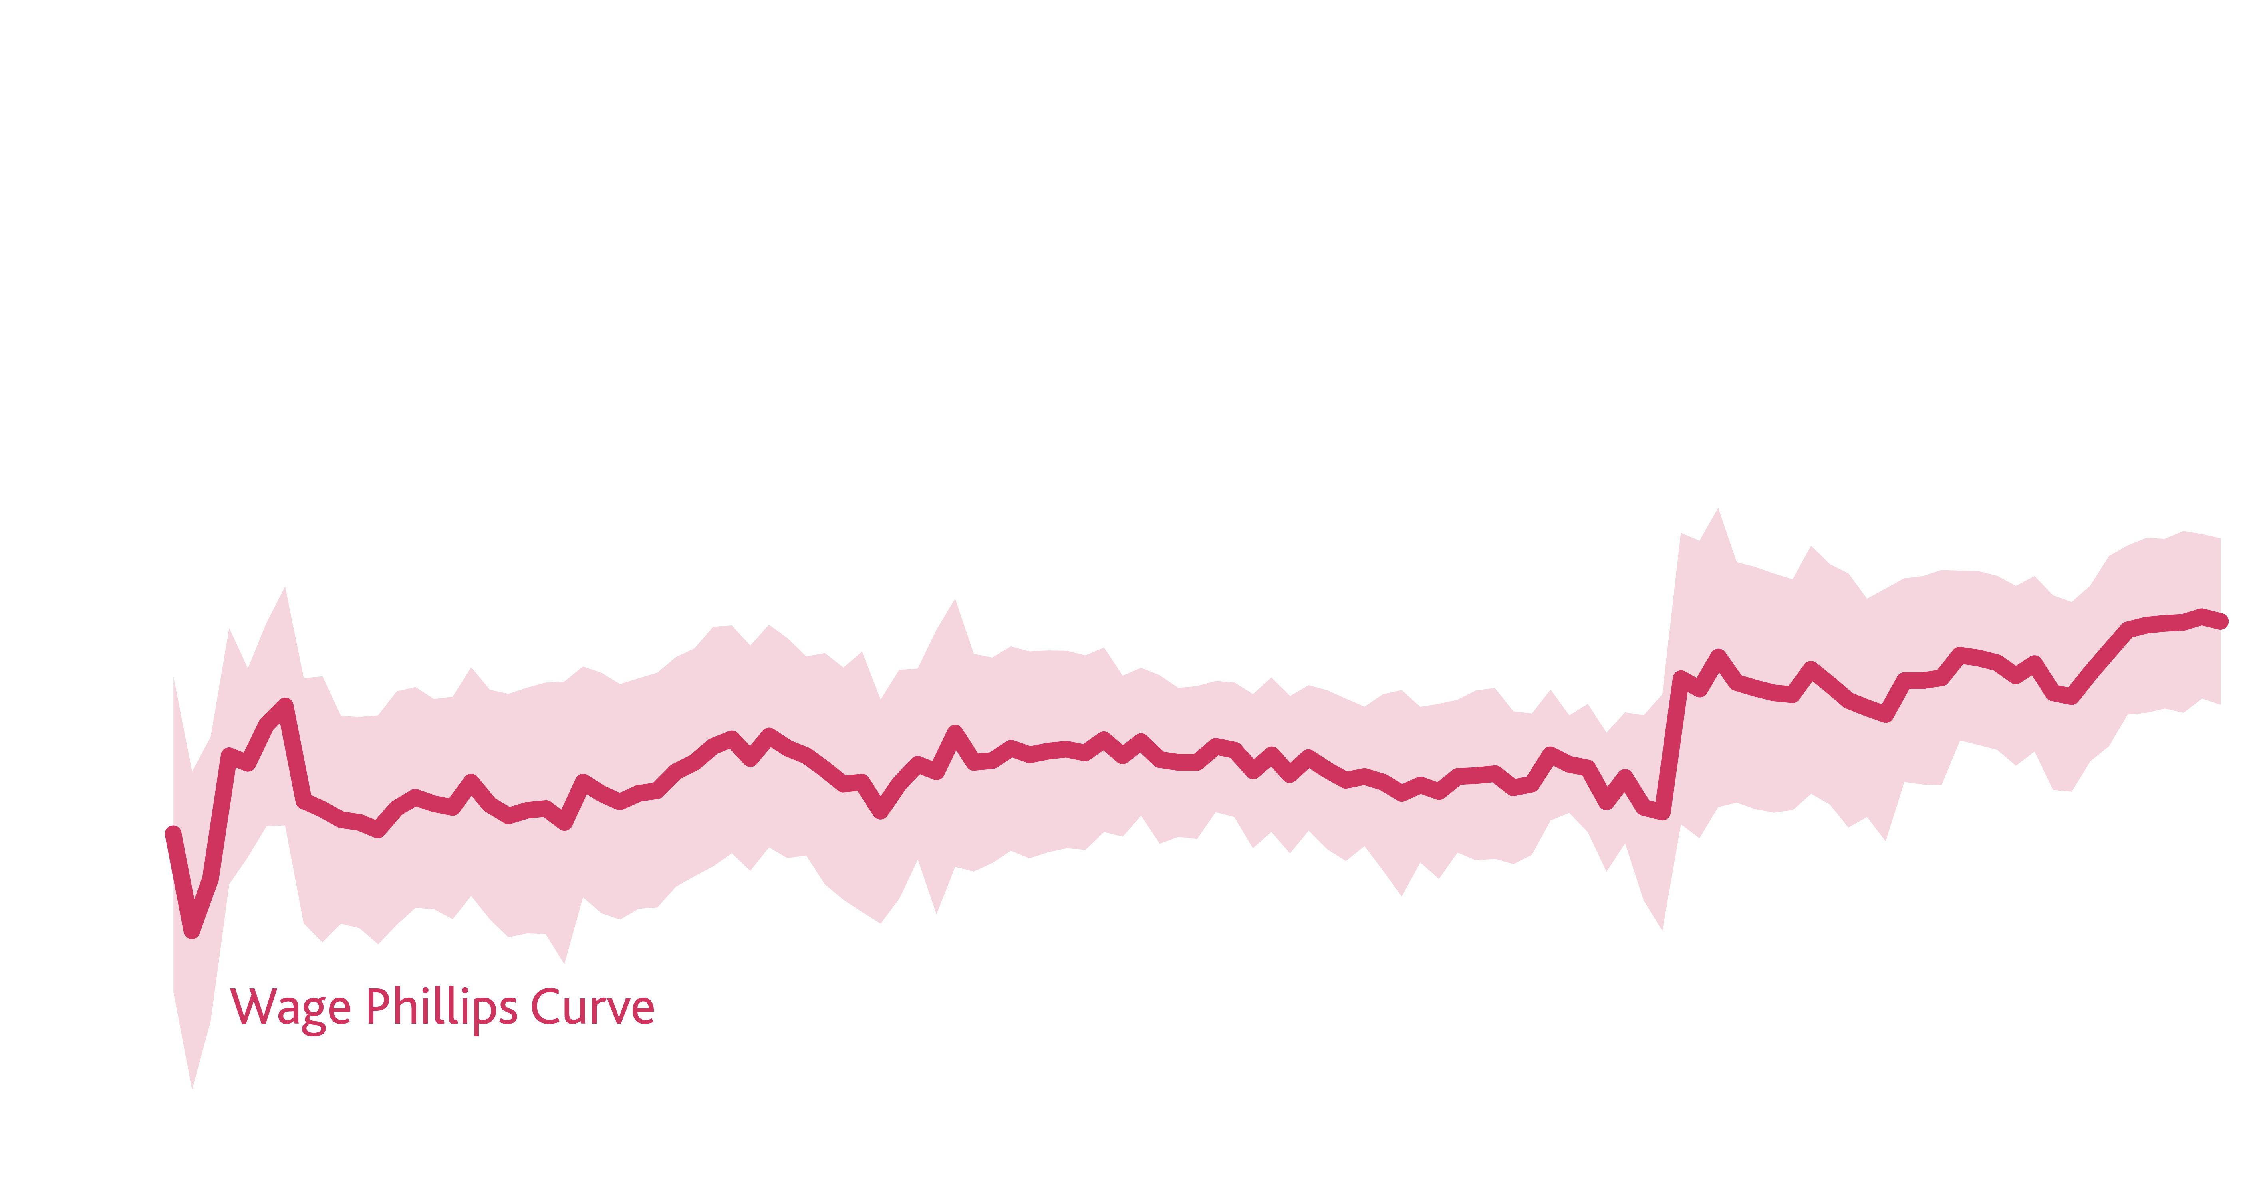
Price and Wage Phillips Curves have flattened throughout globalisation
Phillips Curves flattening

Slide 4
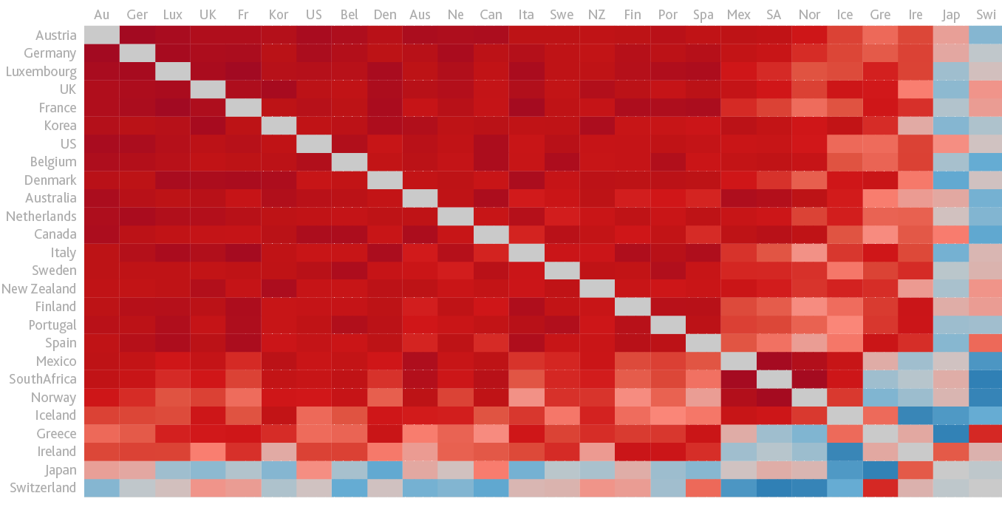
Superficially strong evidence of a global inflation cycle
Correlations of headline inflation rates

Slide 5
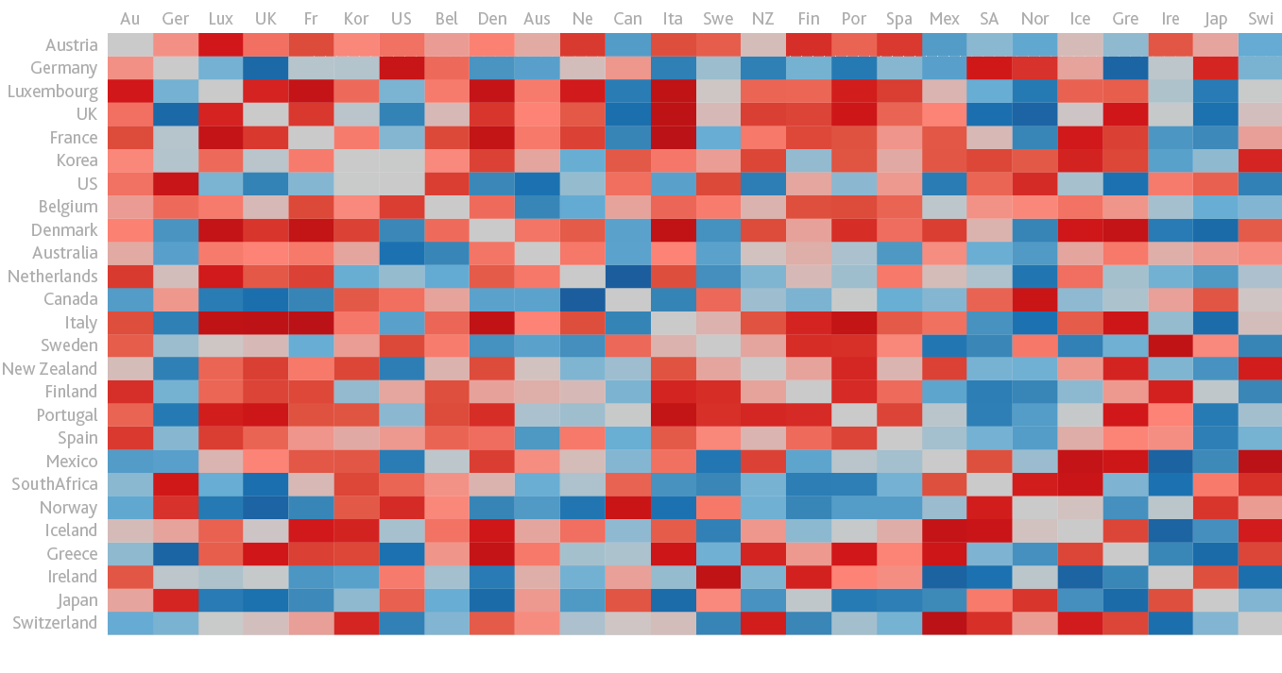
Core inflation rates exhibited little co-movement post-crisis
Correlations of core inflation rates

Slide 6
Global influences on domestic inflation

Slide 7
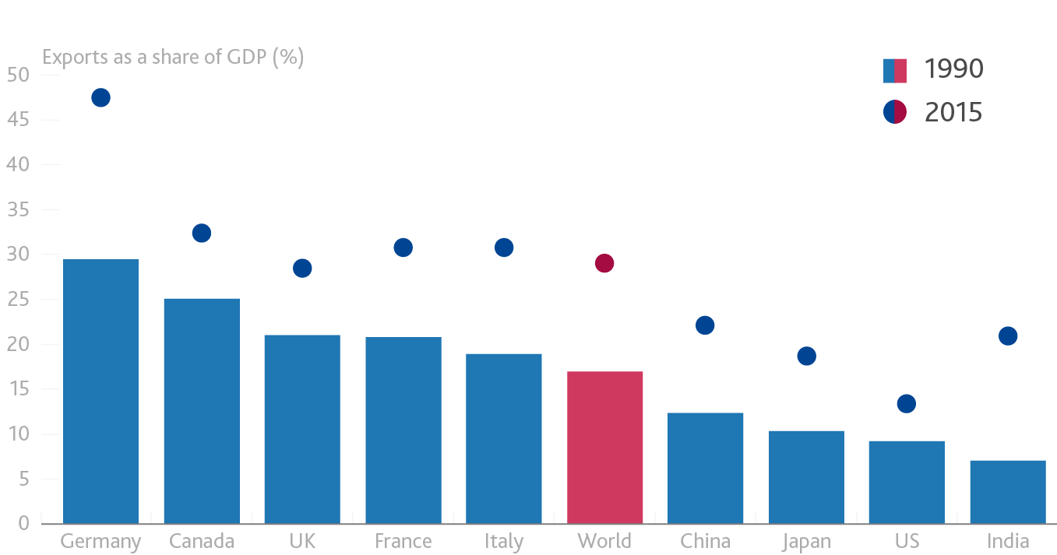
External demand has steadily increased in importance

Slide 8
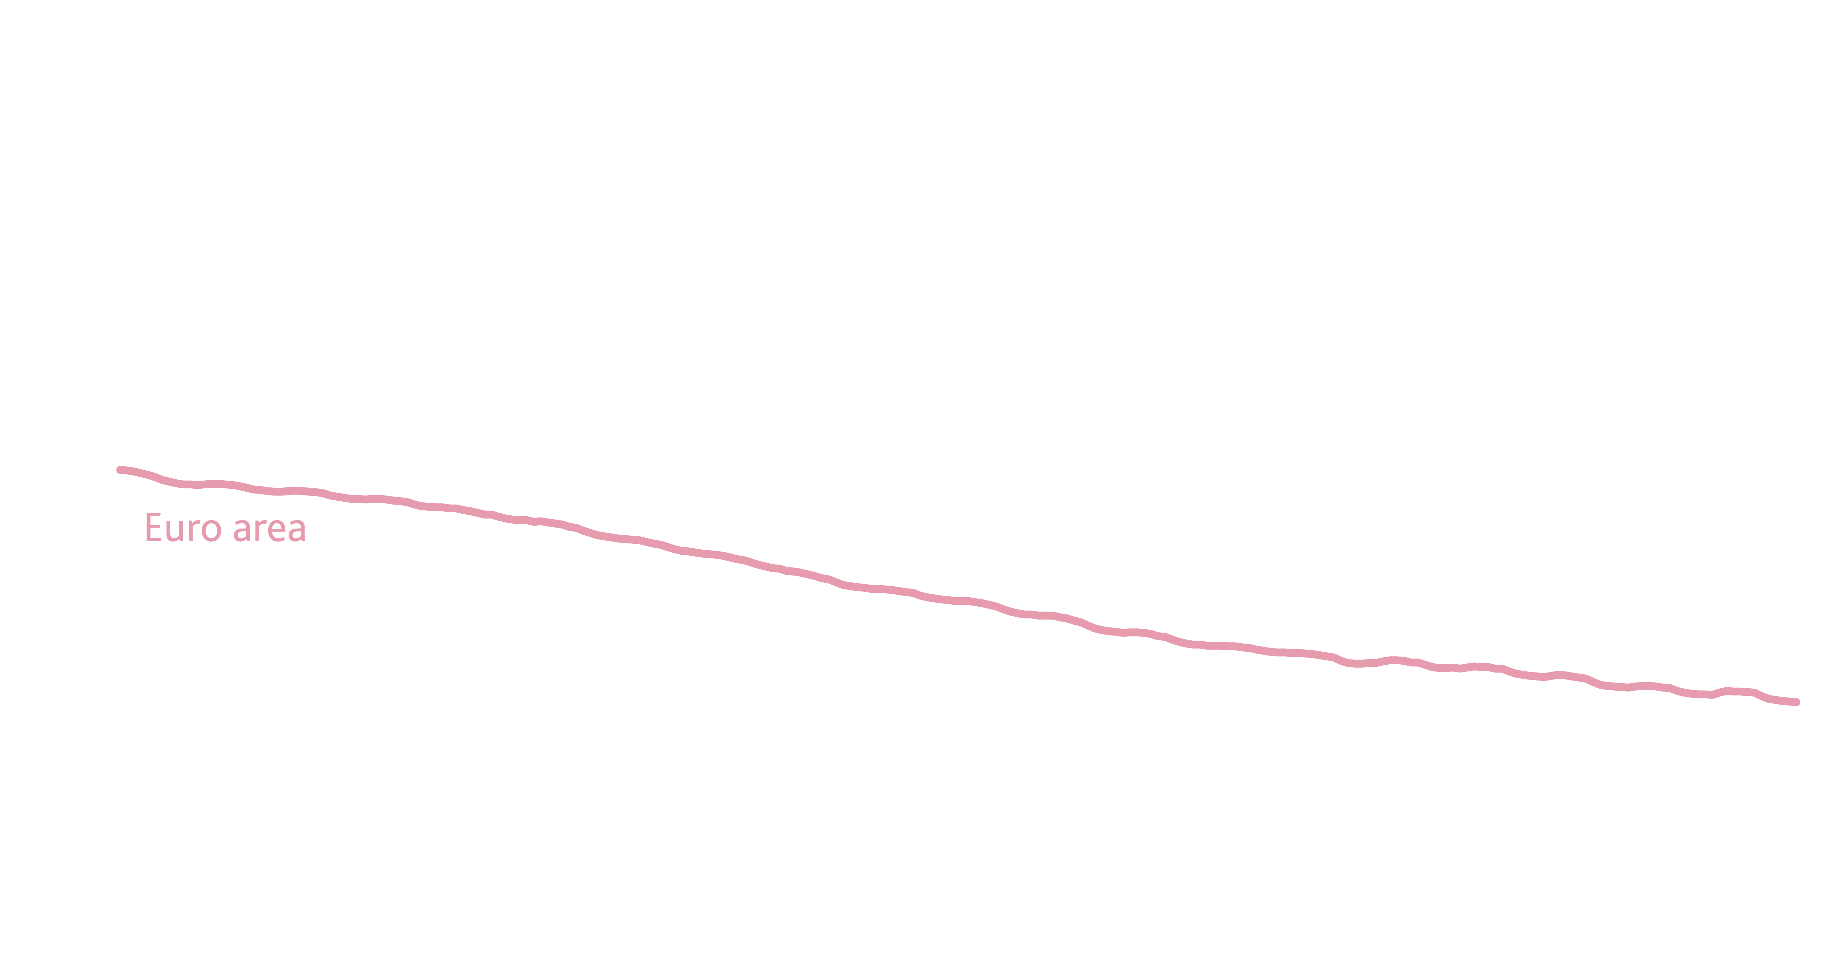
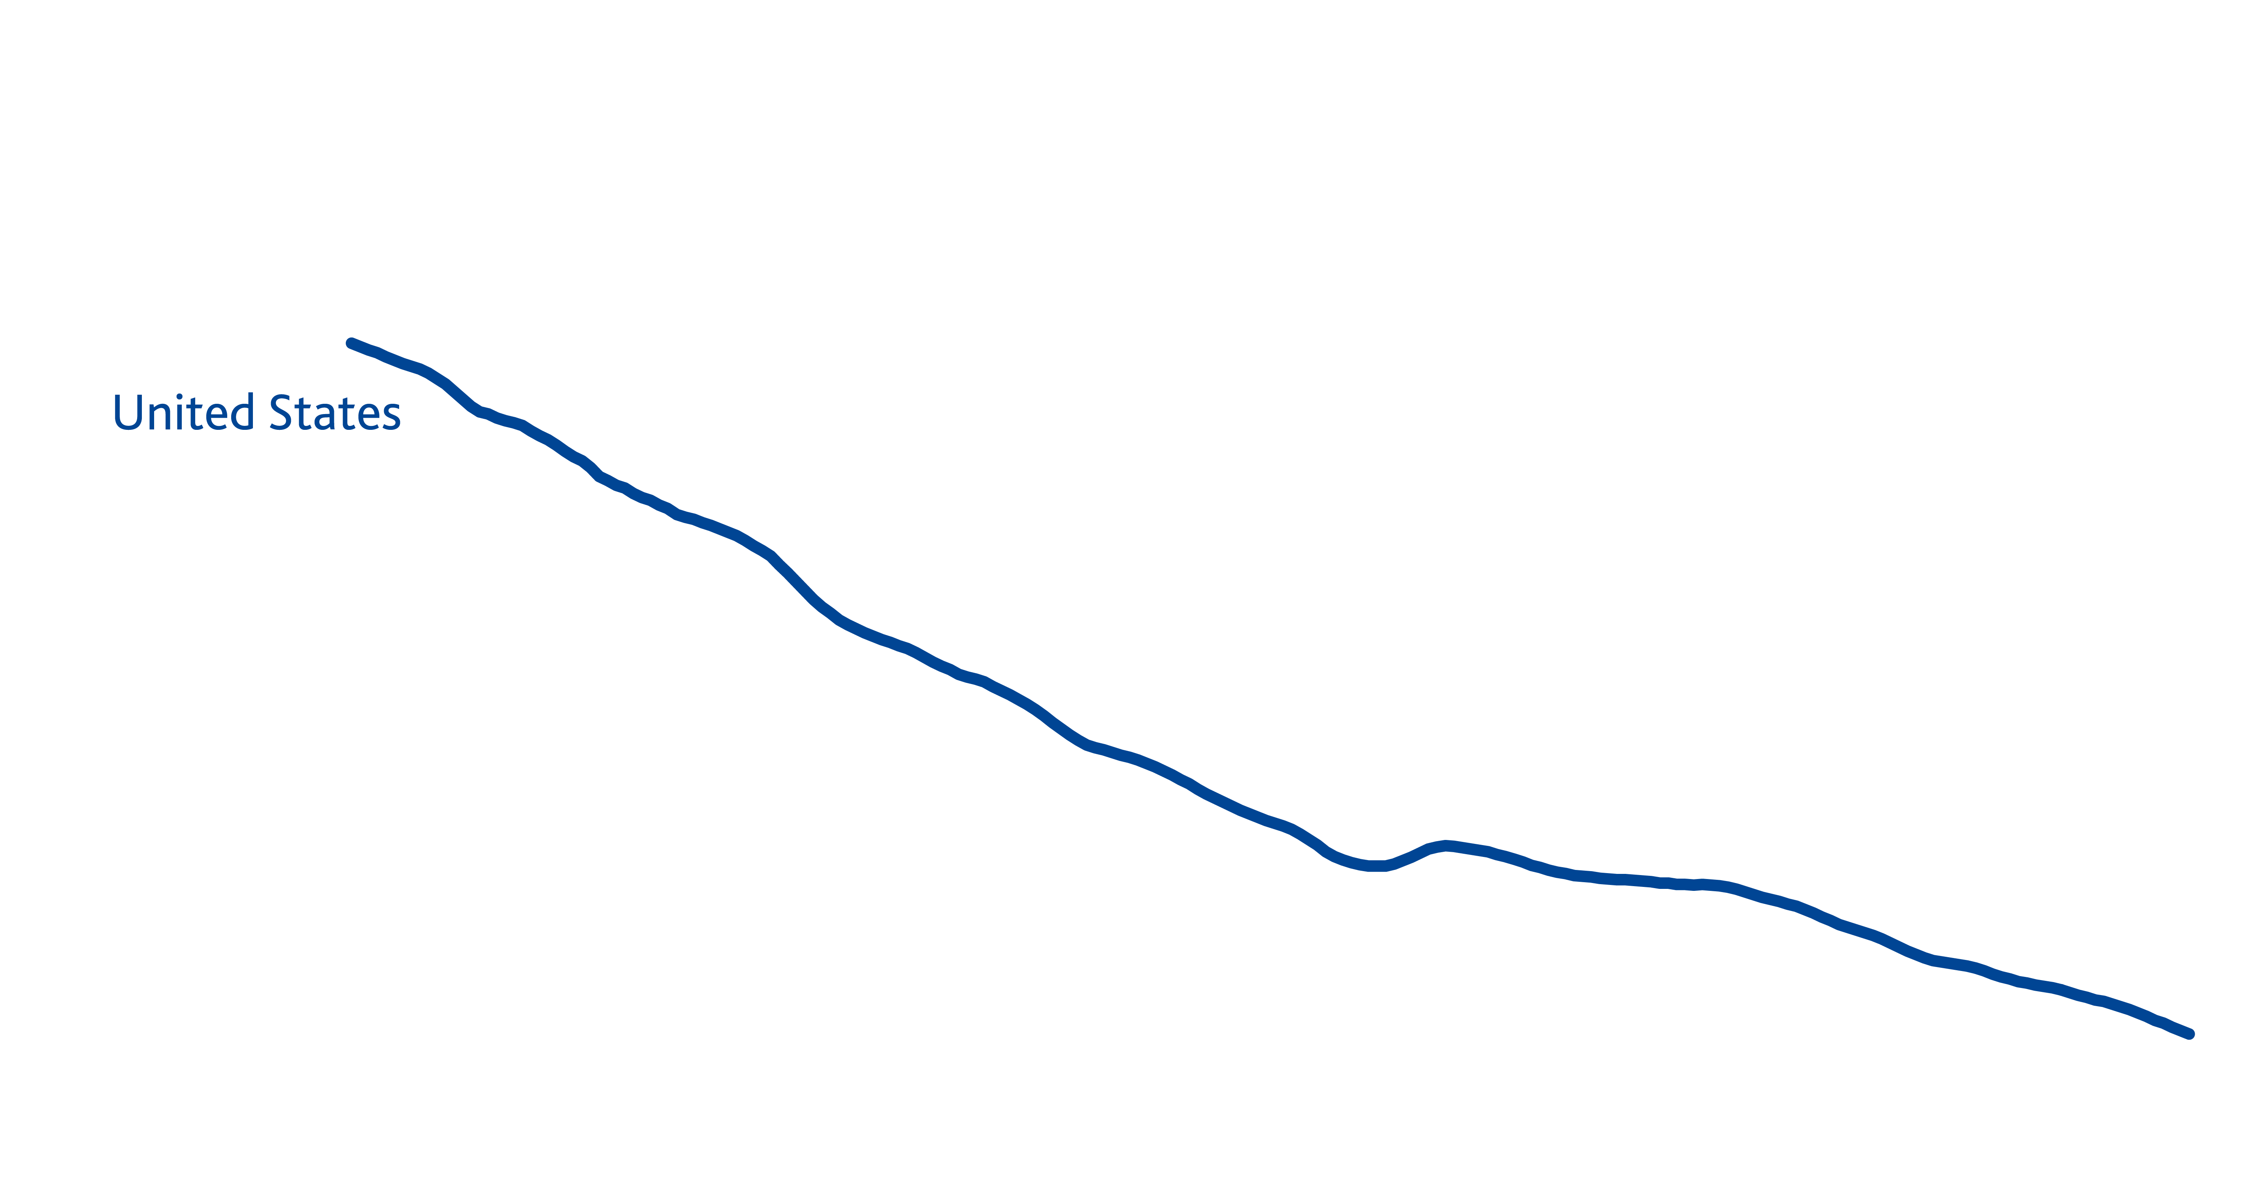
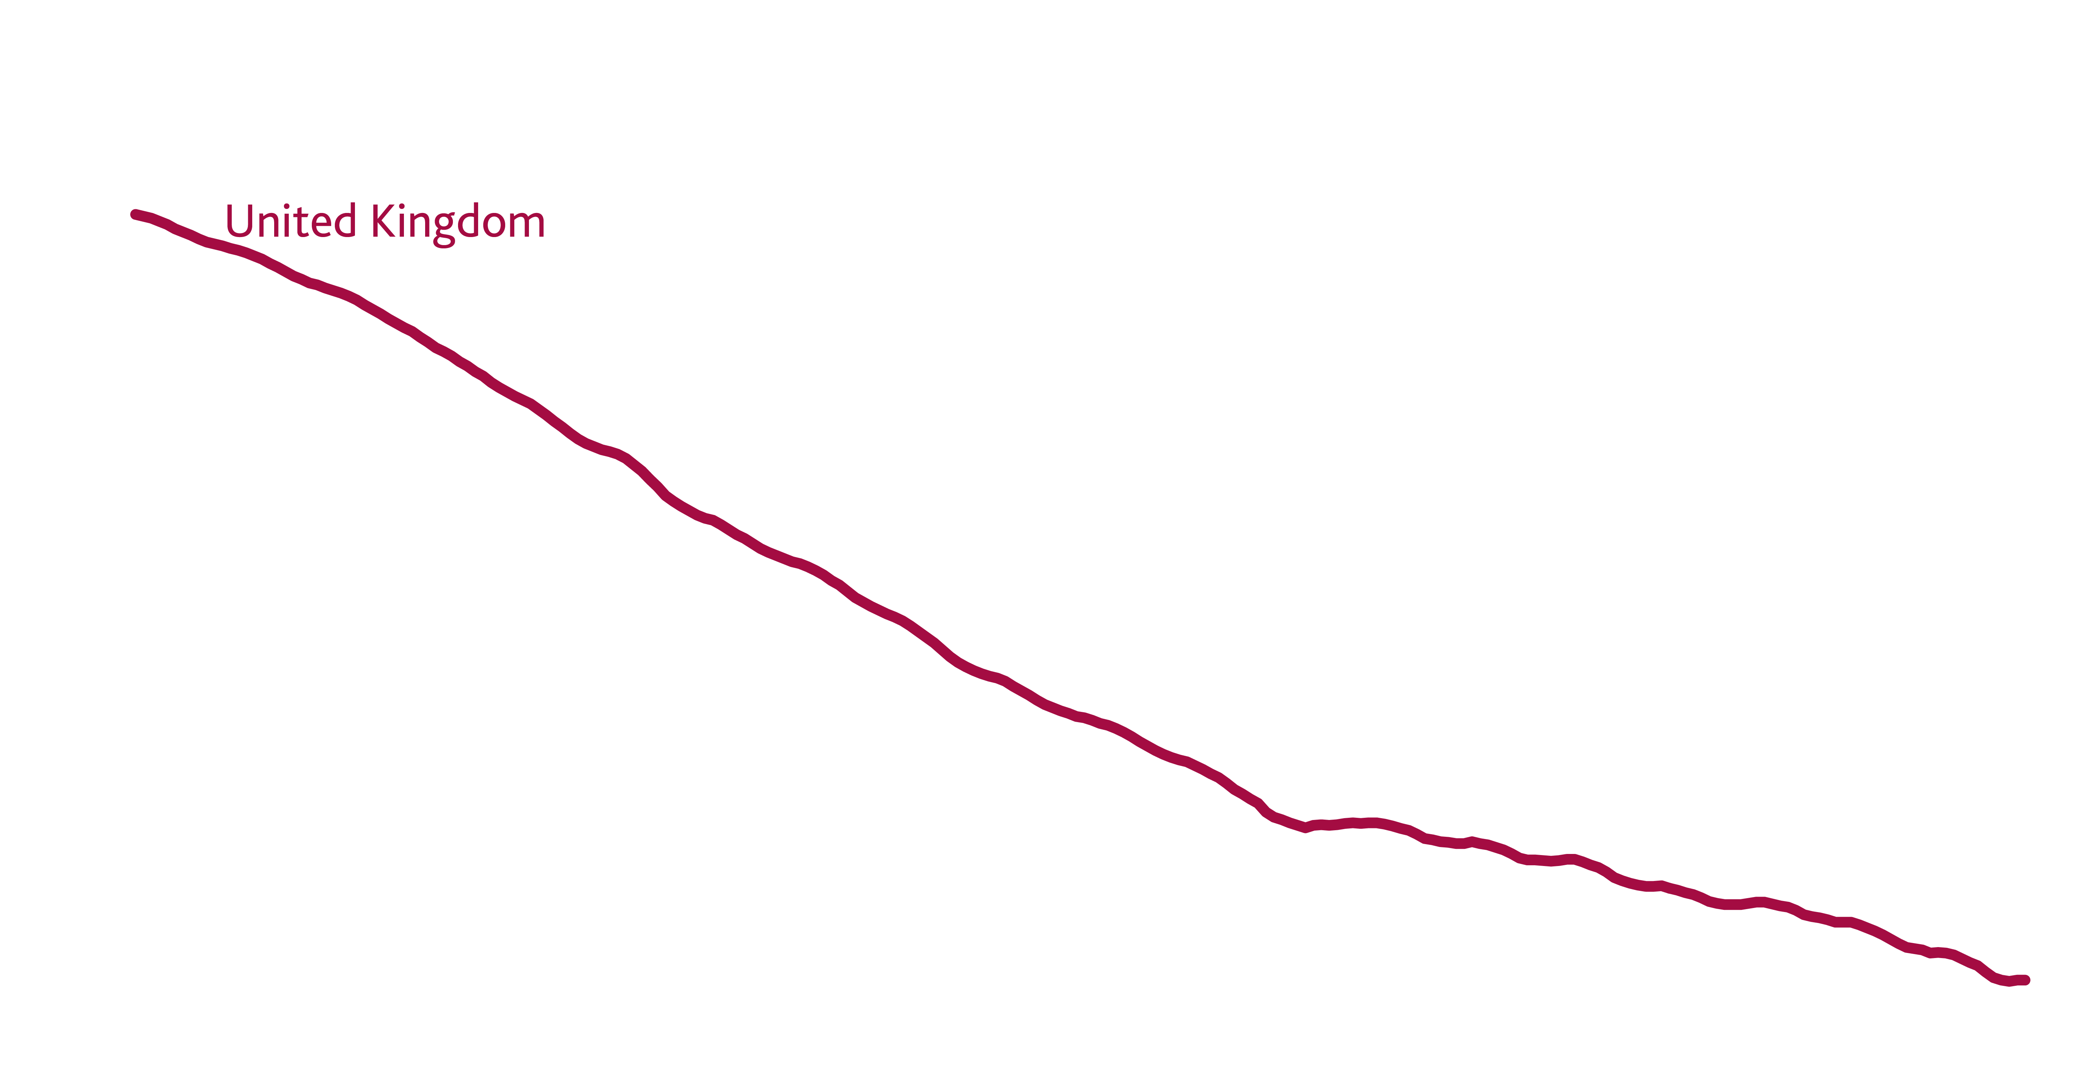
Lower goods prices accommodated through higher services prices
Core goods prices falling
relative to services prices

Slide 9
18
Trade in intermediate goods & services has nearly doubled since the 1990s
2014
%
of world GDP
1989
10
%
of world GDP

Slide 10
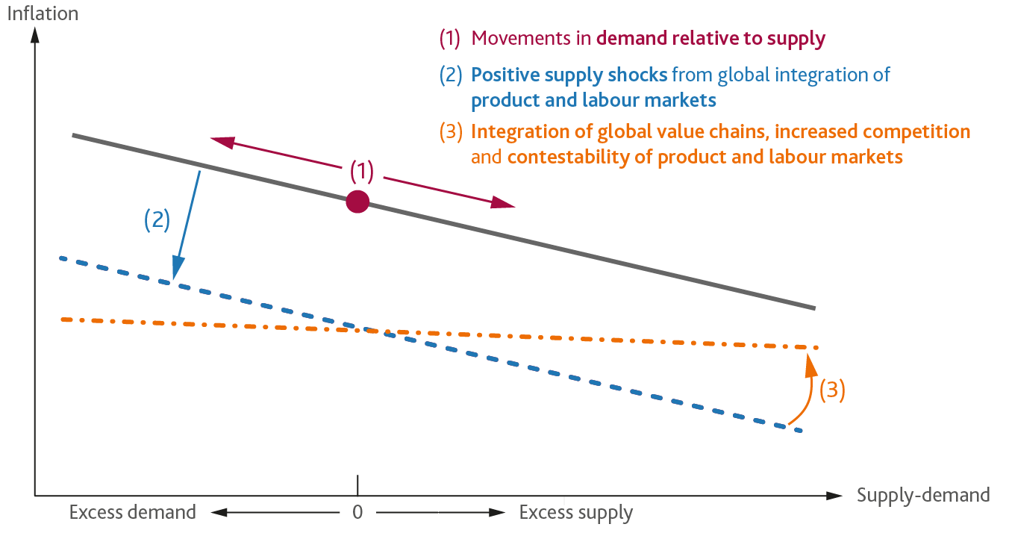
Stylised Phillips Curve

Slide 11
Global influences on the stance of monetary policy

Slide 12
Structural changes push down long-run real interest rates
World real interest rate, R*
Global investment
Global saving
Price of capital, Public investment, Spreads
Demographics,
Inequality,
Savings glut
R*
Global saving and investment

Slide 13
Increased retirement savings contributed to the fall
450bp fall since 1990
Estimated fall from increased retirement savings (140bps)
Further 35bp fall by 2025

Slide 14
75
Global factors drive
%
of the movement in UK rates*
* Bank of England analysis

Slide 15
Should the monetary policy framework be adjusted?

Slide 16
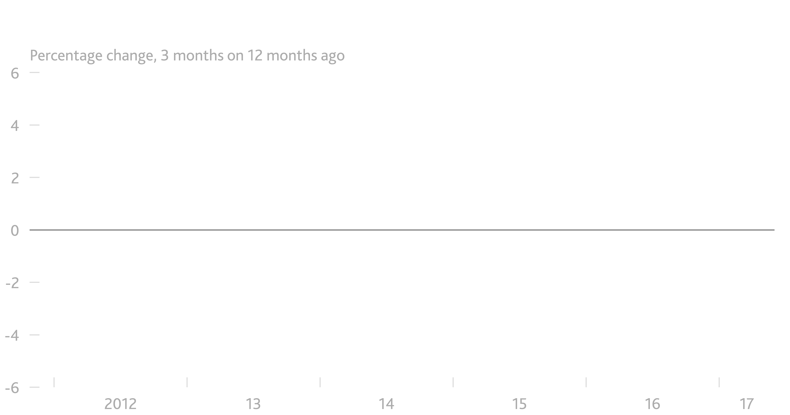
Strong capital goods orders point to demand rotating towards investment

Slide 17
Brexit: De-globalisation and inflation

Slide 18
UK companies may lose their place in some global supply chains

Slide 19
Proportion of UK exports that are intermediate components of EU value chains
1990
20%

Slide 20
Proportion of UK exports that are intermediate components of EU value chains
2014
30%

Slide 21
Inflationary impacts of de-globalisation under Brexit
Inflation
Supply-demand
Excess demand
0
Excess supply

Slide 22
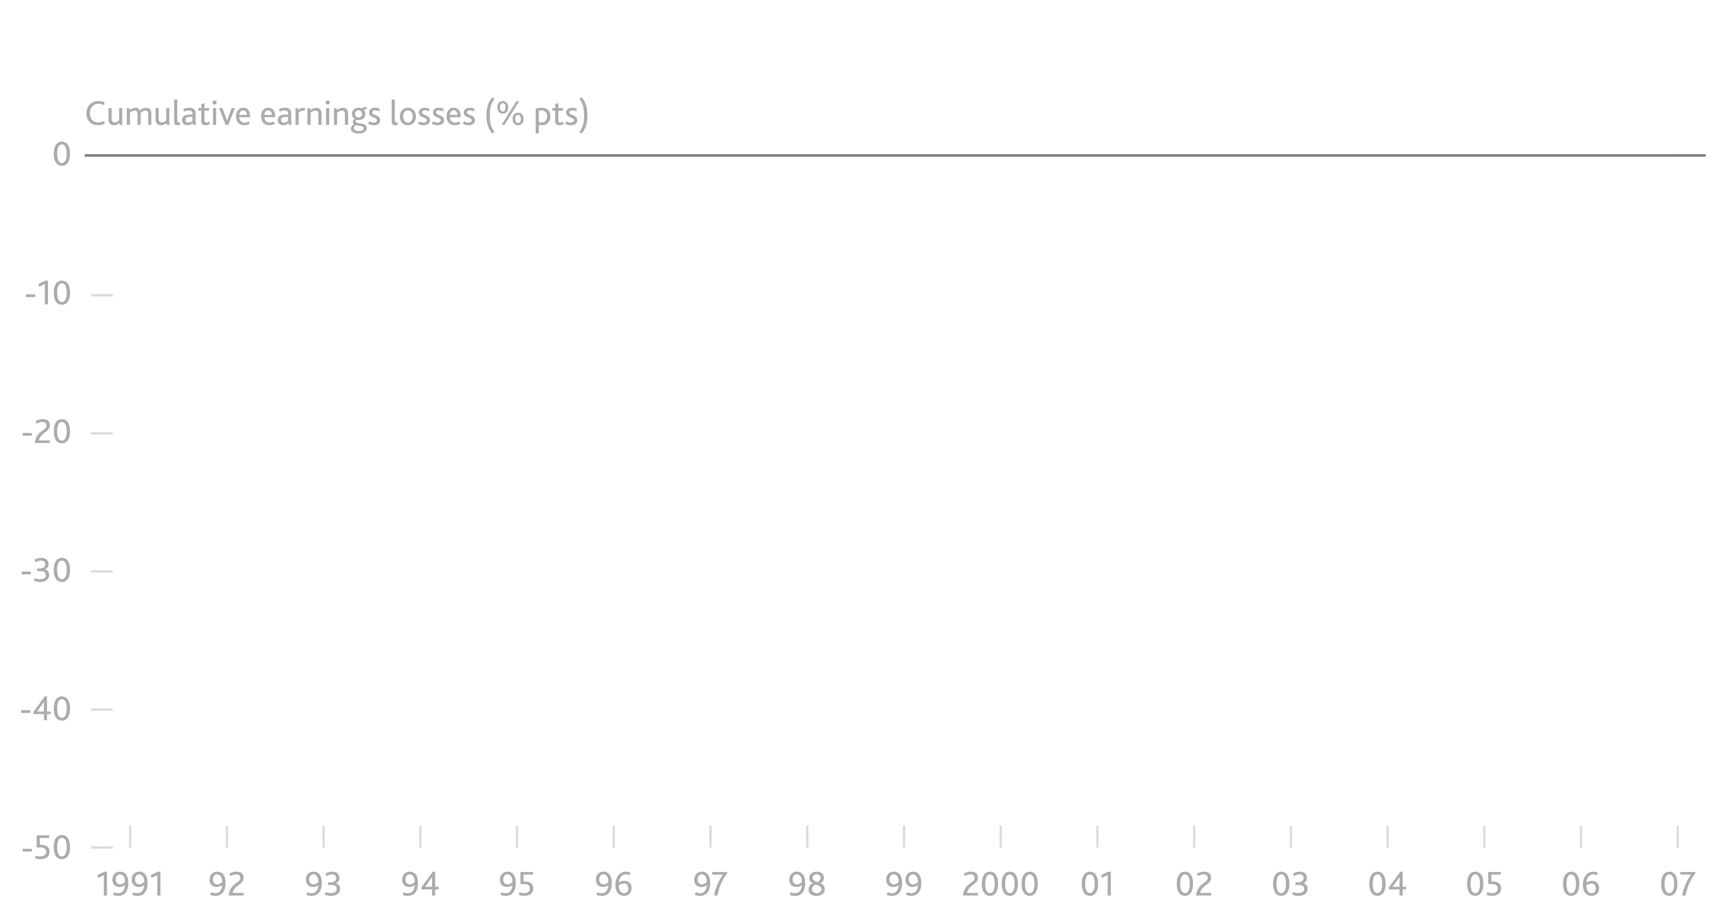
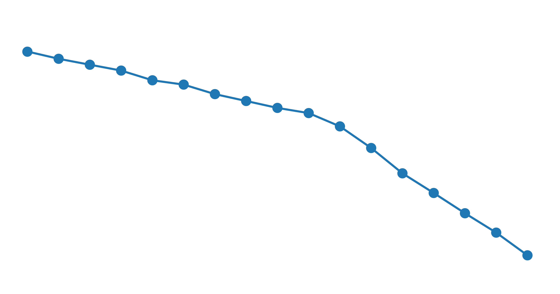
Relative wages of workers exposed to global labour markets squeezed
46pp
loss
‘Trade adjustment: worker-level evidence’ by Autor, Dorn, Hanson and Song

Slide 23
Trade-off that emerged after the referendum diminishing
Inflation
Spare capacity diminishing
3%
November
August (with stimulus)
February 2017
May
August
2%
Target
August 2016 (no stimulus)
Preferred trade-off if λ = 0.1
Preferred trade-off if λ = 1
1%
Supply-demand
-2
-1
0
1
λ = policymaker’s preference for keeping demand close to supply relative to keeping inflation close to target in the face of a trade-off.
Lower λ = more preference for inflation close to target.

Slide 24
[De]Globalisation and inflation
Mark Carney
Governor of the Bank of England
2017 IMF Michel Camdessus Central Banking Lecture

