Slide 1
What a difference a decade makes
Mark Carney, Chair of the Financial Stability Board

Slide 2


Washington 2008: G20 policies to fix the fault lines

Slide 3
Washington 2008: G20 policies to fix the fault lines
Resilient banks
Higher buffers, capital and liquidity
Lower leverage

Slide 4
Washington 2008: G20 policies to fix the fault lines
Ending too big to fail
Higher loss absorbency
Effective resolution regimes
Building resilience

Slide 5
Washington 2008: G20 policies to fix the fault lines
Shadow banking
System-wide monitoring
Strengthen oversight and regulation
Building resilience
Ending too big to fail

Slide 6
Washington 2008: G20 policies to fix the fault lines
Making
derivatives
safer
Central counterparty clearing
Margin requirements
Trade repository reporting of OTC derivatives
Building resilience
Ending too big to fail
Shadow banking

Slide 7
Financial system resilient despite uncertainty

Slide 8
Safer: Banks have substantially more capital…

Slide 9
Safer: Trading and short-term funding slashed
Short-term wholesale funding, % of total

Slide 10

Simpler: shadow banking to market-based finance
Banks
$86 trn
Non-banks
(incl. pension funds, insurers)
$102 trn
of which:
Shadow Banking
$29 trn
Financial system assets, 2007
Real economy

Slide 11
Simpler: shadow banking to market-based finance
$ trillions*
Shadow banking
(limited regulatory oversight)
35
30
Banks
$86 trn
Non-banks
(incl. pension funds, insurers)
$102 trn
25
20
15
of which:
Shadow Banking
$29 trn
10
Financial system assets, 2007
Real economy
5
0
* FSB Global Shadow Banking Monitoring Report 2016

Slide 12
Simpler: shadow banking to market-based finance
$ trillions*
Shadow banking
(limited regulatory oversight)
Resilient market-based finance (comprehensive policies for transparency and resilience)
35
30
25
Shadow banking at
risk of sudden stops
in times of stress
Financial stability risks addressed
- FSB asset management
recommendations ✓
- MMF reforms (notably EU, US) ✓
20
15
10
‘Toxic’ shadow
banking
Financial stability risks addressed
- Securitsation reforms ✓
- Market intermediation reforms ✓
5
0
2007
2015
* FSB Global Shadow Banking Monitoring Report 2016

Slide 13
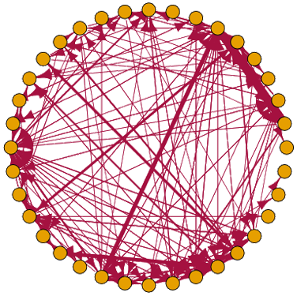
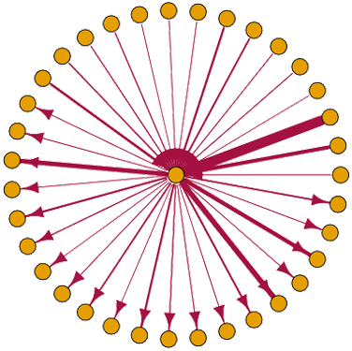
Simpler: benefits of central clearing
GBP 6 Month LIBOR trades, February 2017
Trades without clearing
Cleared trades

Slide 14
FSB roadmap is turning shadow banking into
resilient-market based finance
Mitigate risks in banks’ interactions with
shadow banking entities
Reduce the susceptibility of money market
funds (MMFs) to ‘runs’
Improve transparency and align the incentives
in securitisation
Dampen pro-cyclicality in securities
financing transactions
Assess and mitigate financial stability risks posed
by other shadow banking entities and activities
Building more sustainable sources of non-bank financing for the real economy

Slide 15
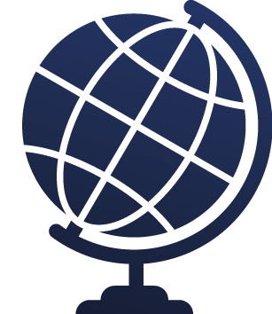



Fairer: Ending too-big-to-fail
Identify most systemic banks
Extra capital to reduce probability of future bailouts
Closer supervision
Resolution regimes, living wills, gone concern loss absorbency

Slide 16
Fairer: Markets no longer banking on bail out….
Too big to fail subsidy reflected in rating
Peak ratings uplift
6
Current ratings uplift
5
4
3
2
1
0
UK
US
Germany
France
Switzerland

Slide 17
Full, timely and consistent implementation
I. Creating resilient banks
III. Shadow banking into market-based finance
Risk-based capital
Valuation rules
Liquidity (LCR)
Liquidity
Leverage ratio
Stable NAV rules
II. Ending too big to fail
IV. Making derivatives markets safer
Resolution powers
Trade repositories
Recovery planning
Central clearing
Exchange trading
Resolution planning
Margin rules
Final rule in force
Final rule or draft regulation published
Draft regulation not published
Not applicable

Slide 18



Working together to take full advantage
Dynamic implementation
Resisting fragmentation
Working together to take full advantage of progress

