Slide 1
Market finance and financial stability: will the stretch cause a strain?
Alex Brazier
Executive Director for Financial Stability Strategy and Risk
1 February 2018
Brevan Howard Centre for Financial Analysis, Imperial College London

Slide 2
2008:
a market correction leads to a global crisis
The crisis cost everyone in the UK
£20,000

Slide 3
2018: a ‘macroprudential’ objective
… to guard against the financial system disrupting growth of the wider economy
Banking system
Standards in place to ensure banks can keep lending through economic shocks
Indebtedness
Limits set on high LTI mortgage lending
Market finance
The next frontier

Slide 4
Companies increasingly rely on market-based finance
Sources: Bank of England and Bank calculations.
(a) Data cover funds raised in both sterling and foreign currency, converted to sterling. Seasonally adjusted. Bonds and commercial paper are not seasonally adjusted.
(b) Owing to the seasonal adjustment methodology, the total series may not equal the sum of its components.

Slide 5
Stretched asset prices can strain the real economy
Stretched market and collateral prices adjust
Corporate debt overhang
Deleveraging
Wider economic impact

Slide 6
Falling commercial property prices lead to lower lending
Sources: MSCI Inc., ONS and Bank calculations.

Slide 7
Stretched asset prices as a danger for the economy, back to our channels:
Stretched market and collateral prices adjust
Fragile markets amplify
Corporate debt overhang
Defaults
Bank losses
Cost of finance rises
Access to finance falls
Credit supply tightens
Deleveraging
Wider economic impact

Slide 8
Four questions:
Have corporate bond and commercial property prices become stretched?
Yes
Do levels of corporate debt rely on these stretched valuations?
Not in the UK, but global picture shows we can’t take that for granted
Is the banking system exposed to an adjustment?
It can withstand severe adjustments
Are markets prone to amplifying adjustments?
Some developments raise questions that need exploring

Slide 9
Globally, combined premium for interest rate and credit risk is at an historic low…
Sources: ICE BofAML, Federal Reserve Bank of New York, and Bank calculations.
(a) The chart shows USD investment-grade corporate bond yield and the expected risk free rate (based on a risk free rate that has a maturity that is similar to the duration of the corporate bond index over the period shown. The difference between the corporate bond yield and the expected risk free rate is the term premia plus the credit spread.

Slide 10
Investors are pricing in downside risks to UK growth…
Sources: Bank of England and Bank calculations.
(a) Calculated from the distributions of external forecasters’ predictions for UK GDP growth two years ahead, sampled by the Bank and as reported in the Inflation Report each quarter.
Sources: Bloomberg Finance LP, Thomson Reuters Datastream and Bank calculations.

Slide 11
Investors are pricing in downside risks to UK growth…
Sources: Bank of England and Bank calculations.
(a) Calculated from the distributions of external forecasters’ predictions for UK GDP growth two years ahead, sampled by the Bank and as reported in the Inflation Report each quarter.
Sources: Bloomberg Finance LP, Thomson Reuters Datastream and Bank calculations.

Slide 12
Corporate bond market has tilted towards companies with lower credit ratings
Sources: ICE BofAML and Bank calculations.
(a) The chart shows the proportion, as measured by market value, of the ICE BofAML sterling investment-grade index that is rated BBB. This index can be used as a representative measure of the sterling investment-grade corporate bond market. However, the index may not capture all sterling investment-grade corporate bonds and alternative indices may contain different proportions of BBB-rated bonds.

Slide 13
Allowing for this, there is zero compensation for risk in sterling corporate bonds
Sources: ICE BofAML, Bloomberg, and Bank calculations.
(a) The chart shows GBP investment-grade corporate bond yield and the expected risk free rate (based on a risk free rate that has a maturity that similar to the duration of the corporate bond index over the period shown. The difference between the corporate bond yield and the expected risk free rate is the term premia plus the credit spread.

Slide 14
Commercial real estate prices appear stretched
Sources: Bloomberg, Investment Property Forum, MSCI Inc. and Bank calculations.
(a) Sustainable valuations are estimated using an investment valuation approach and are based on an assumption that property is held for five years. The sustainable value of a property is the sum of discounted rental and sale proceeds. The rental proceeds are discounted using a 5-year gilt yield plus a long-run average estimated risk premium, and the sale proceeds are discounted using a 20-year, 5-year forward gilt yield plus a long-run average risk premium. The sale price is determined by rental yields equal to a 20-year, 5-year forward gilt yield plus a long run average risk premium minus long-run average rental growth. Expected rental value at the time of sale is based on Investment Property Forum Consensus forecasts. The sustainable valuations are determined by assumptions about the rental yield at the time of sale: either rental yields remain at their current levels (at the upper end), or rental yields revert to their 15-year historic average (at the lower end). For more details, see Crosby, N and Hughes, C (2011), ‘The basis of valuations for secured commercial property lending in the UK’, Journal or European Real Estate Research, Vol. 4, No. 3, pages 225–42.

Slide 15
… especially in London’s West End
Sources: Bloomberg, Investment Property Forum, MSCI Inc. and Bank calculations.
(a) Sustainable valuations are estimated using an investment valuation approach and are based on an assumption that property is held for five years. The sustainable value of a property is the sum of discounted rental and sale proceeds. The rental proceeds are discounted using a 5-year gilt yield plus a long-run average estimated risk premium, and the sale proceeds are discounted using a 20-year, 5-year forward gilt yield plus a long-run average risk premium. The sale price is determined by rental yields equal to a 20-year, 5-year forward gilt yield plus a long run average risk premium minus long-run average rental growth. Expected rental value at the time of sale is based on Investment Property Forum Consensus forecasts. The sustainable valuations are determined by assumptions about the rental yield at the time of sale: either rental yields remain at their current levels (at the upper end), or rental yields revert to their 15-year historic average (at the lower end). For more details, see Crosby, N and Hughes, C (2011), ‘The basis of valuations for secured commercial property lending in the UK’, Journal or European Real Estate Research, Vol. 4, No. 3, pages 225–42.

Slide 16
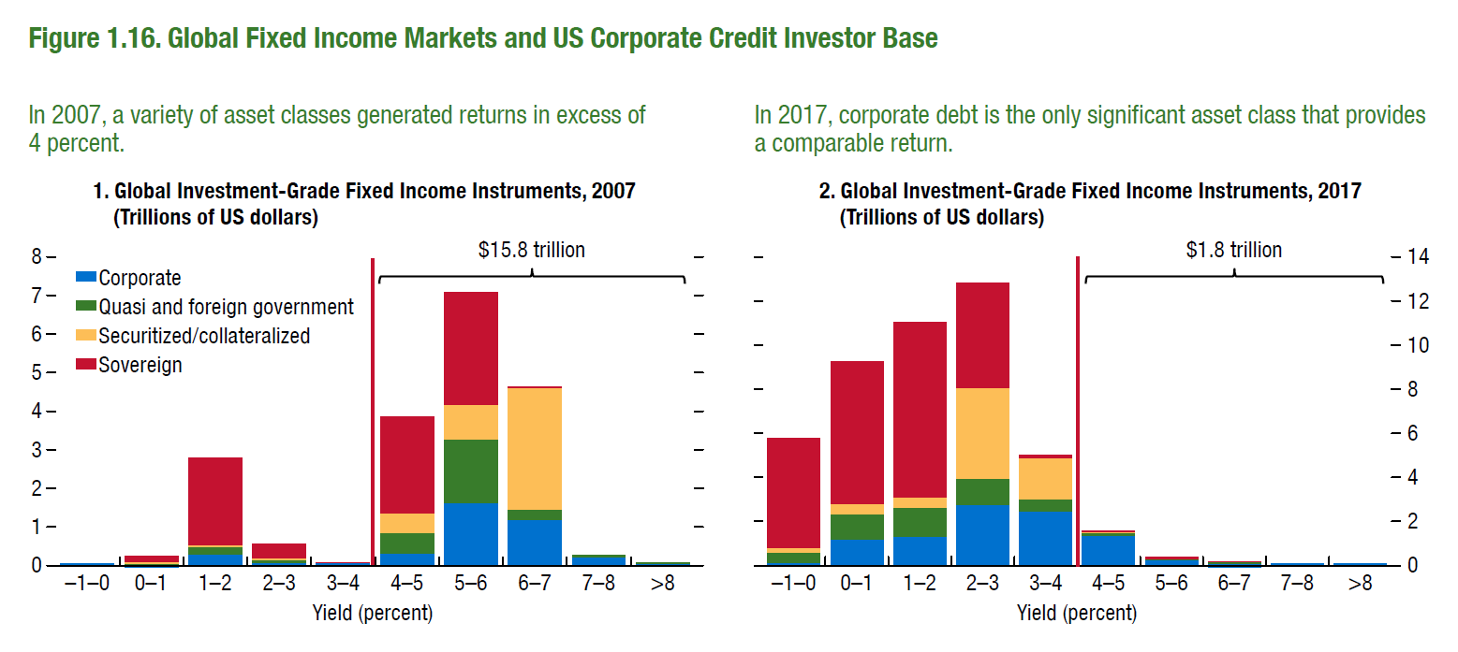
The stock of bonds yielding >4% has all but disappeared
Sources: IMF Global Financial Stability Report October 2017.

Slide 17
The difference between spreads on high-yield and investment-grade corporate bonds have shrunk to pre-crisis levels

Slide 18
Four questions:
Have corporate bond and commercial property prices become stretched?
Yes
Do levels of corporate debt rely on these stretched valuations?
Not in the UK, but global picture shows we can’t take that for granted
Is the banking system exposed to an adjustment?
It can withstand severe adjustments
Are markets prone to amplifying adjustments?
Some developments raise questions that need exploring

Slide 19
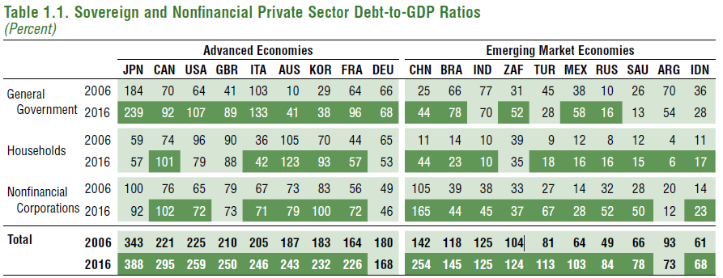
UK corporate debt to GDP has not increased over the decade
Sources: IMF Global Financial Stability Report October 2017. Used Bank for International Settlements; Haver Analytics; IMF, World Economic Outlook database; and IMF staff calculations.
Note: Dark shading denotes a higher debt-to-GDP ratio in 2016 than in 2006. The table shows debt at market values. Advanced economy nonfinancial corporate
debt is shown net of estimated intercompany loans where data are available. Data labels in the table use International Standardization Organization (ISO) codes.

Slide 20
Amongst companies investing in commercial property, debt levels are below pre-crisis
Sources: De Montfort University and MSCI Inc.

Slide 21
Developments in the world economy show we cannot take this for granted…
Sources: IMF Global Financial Stability Report October 2017. Used Bank for International Settlements; Haver Analytics; IMF, World Economic Outlook database; and IMF staff calculations.
Note: Dark shading denotes a higher debt-to-GDP ratio in 2016 than in 2006. The table shows debt at market values. Advanced economy nonfinancial corporate
debt is shown net of estimated intercompany loans where data are available. Data labels in the table use International Standardization Organization (ISO) codes.

Slide 22
In the United States, levels of non-financial corporate sector debt nearing previous peaks
Sources: Institute of International Finance and Bank calculations
Note: Q3 2017 figure is an IIF estimate

Slide 23
Record US leveraged lending issuance has been accompanied by an increase in ‘covenant-lite’ loans
Sources: LCD, an offering of S&P Global Market Intelligence and Bank calculations.
(a) Based on data for public syndication transactions, and excluding private bilateral deals.
(b) Only includes institutional issuance. It does not include leveraged lending issuance that is pro-rata.
(c) Covenant-lite is defined as loans that have bond-like financial incurrence covenants rather than traditional maintenance covenants that are normally part and parcel of a loan agreement.

Slide 24
Four questions:
Have corporate bond and commercial property prices become stretched?
Yes
Do levels of corporate debt rely on these stretched valuations?
Not in the UK, but global picture shows we can’t take that for granted
Is the banking system exposed to an adjustment?
It can withstand severe adjustments
Are markets prone to amplifying adjustments?
Some developments raise questions that need exploring

Slide 25
Bank of England 2017 stress test results

Slide 26
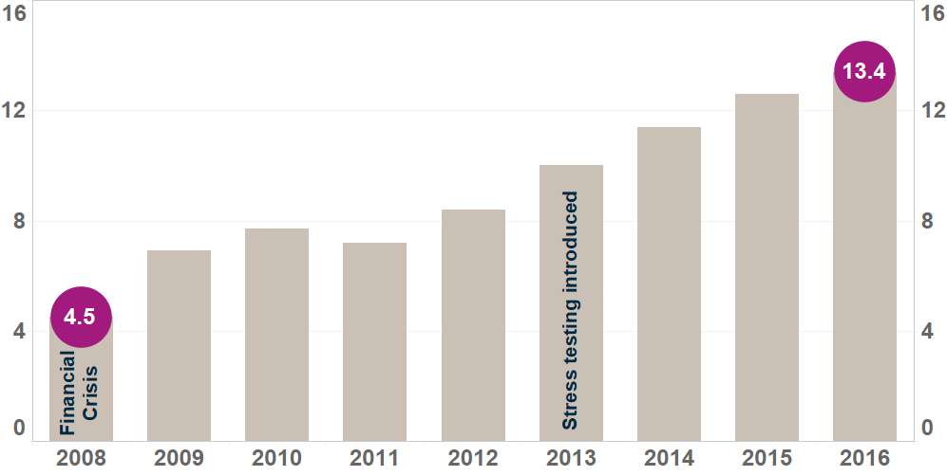
Banks have been increasing their capital ratios
CET1 ratio
CET1 ratio

Slide 27
Capital remains almost double pre-financial crisis levels even after the test
CET1 ratio
CET1 ratio
Capital after stress: 8.3%

Slide 28
Four questions:
Have corporate bond and commercial property prices become stretched?
Yes
Do levels of corporate debt rely on these stretched valuations?
Not in the UK, but global picture shows we can’t take that for granted
Is the banking system exposed to an adjustment?
It can withstand severe adjustments
Are markets prone to amplifying adjustments?
Some developments raise questions that need exploring

Slide 29
Stability has been a defining feature across a range of market prices
Sources: Barclays Live, BBA, Bloomberg, Chicago Mercantile Exchange, NYSE ICE and Bank calculations.
(a) Data starts from January 2000

Slide 30
Low volatility begets low volatility
Low market volatility
Increasing supply of insurance
Low implied volatility

Slide 31
‘Implied volatility’ recently near all-time lows
Sources: Barclays Live, BBA, Bloomberg, Chicago Mercantile Exchange, NYSE ICE and Bank calculations.
(a) Data starts from January 2000

Slide 32
Low volatility begets low volatility
Low market volatility
Dealers’ hedging activities tend to stabilise markets
Increasing supply of insurance
Low implied volatility

Slide 33
Low volatility begets low volatility
Low market volatility
Dealers’ hedging activities tend to stabilise markets
Greater risk taking
Increasing supply of insurance
Low implied volatility

Slide 34
A shock can mean the whole thing goes into reverse
High market volatility
Dealers’ hedging activities could amplify market moves
Decreasing supply or/and increasing demand of insurance
Sharp reduction in risk appetite
High implied volatility

Slide 35
A liquidity imbalance in a bond market adjustment?
Dealers have become less active
Higher proportion of corporate bonds held in redeemable structures

Slide 36
Four questions, and my four answers
Have corporate bond and commercial property prices become stretched?
Yes
Do levels of corporate debt rely on these stretched valuations?
Not in the UK, but global picture shows we can’t take that for granted
Is the banking system exposed to an adjustment?
It can withstand severe adjustments
Are markets prone to amplifying adjustments?
Some developments raise questions that need exploring

