Slide 1

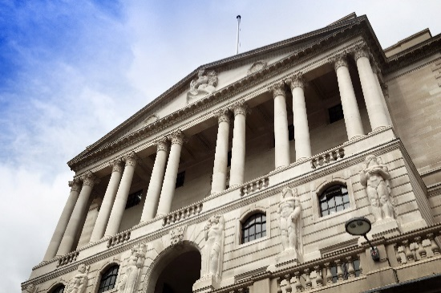

The Dash for Cash and the Liquidity Multiplier: Lessons from March 2020
AQR Asset Management Institute at London Business School
Annual Insights Summit
November 17, 2020
Anil Kashyap
External member of the Financial Policy Committee

Slide 2
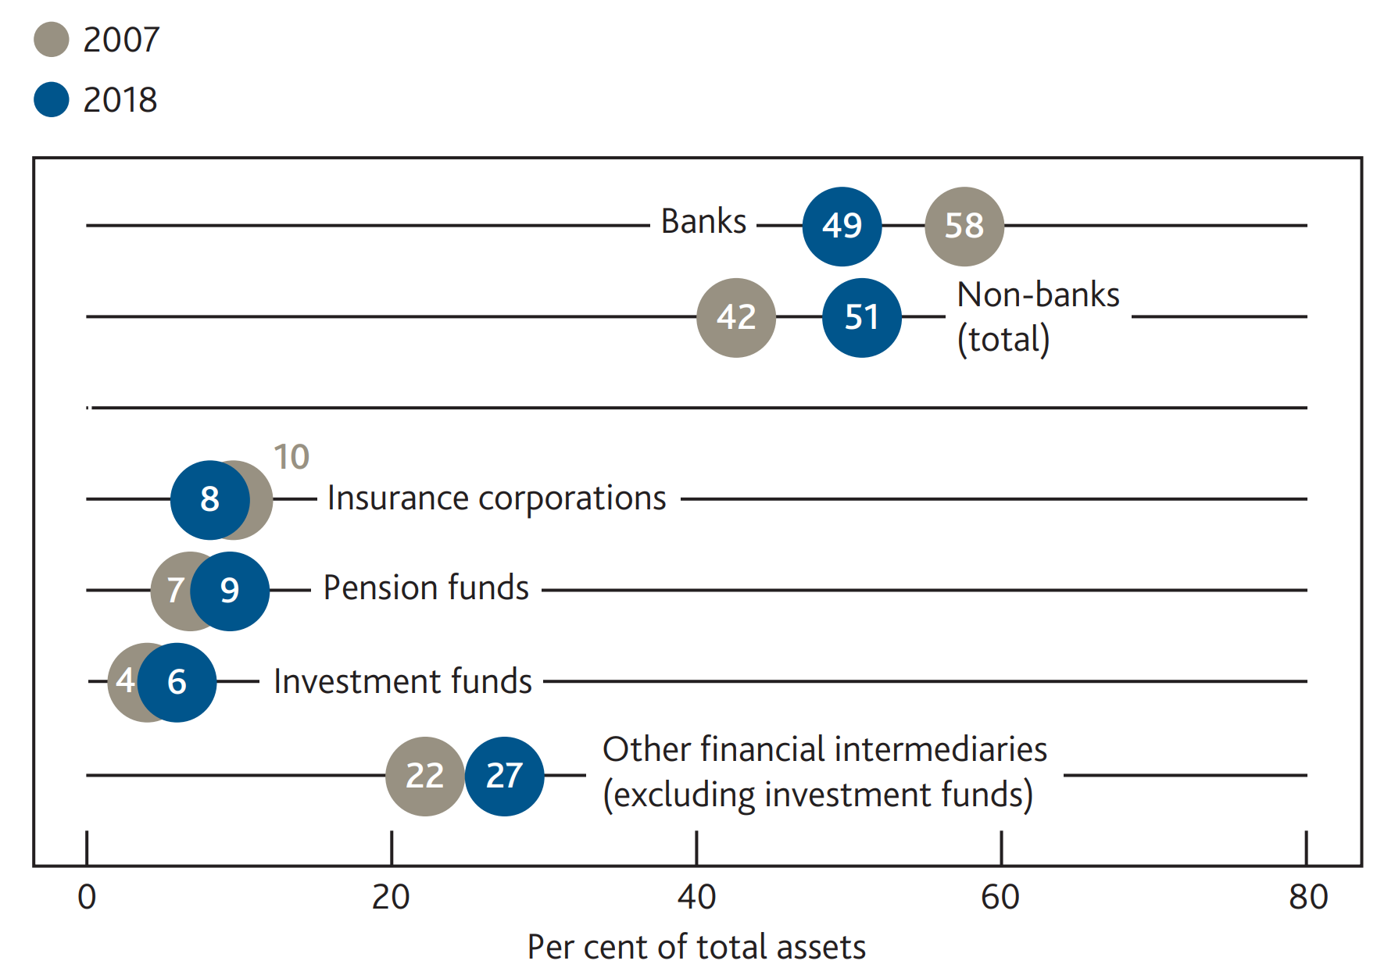
Figure 1: The share of non-bank UK financial sector assets has grown over the past decade
          Sources: The Association for Financial Markets in Europe, Bank of England, Bloomberg Finance L.P, FCA, Morningstar, ONS, published accounts and Bank calculations. Please see the July 2019 Bank of England Financial Stability Report for full details.

Slide 3
Plan for the talk
Funding chains
The dash for cash drains on liquidity
The liquidity multiplier
Some open policy questions

Slide 4





A hypothetical market based finance funding chain
Repo
Repo
Pension fund
Money market fund
Broker-dealer
Hedge fund
?
?
?
Bank deposits

Slide 5
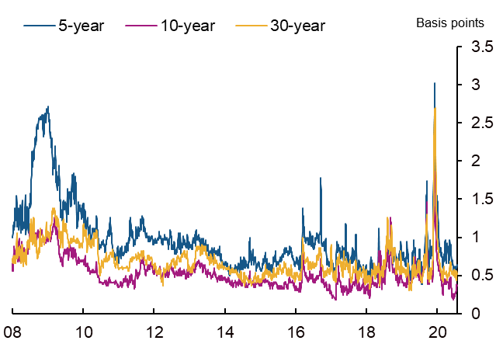
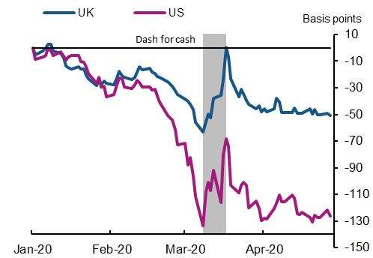
Figure 2: Bid-offer spreads in selected gilts
Figure 3: Changes in 10-year nominal yields
          Source: Eikon from Refinitiv and Bank calculations.
          Source: Bloomberg Finance L.P. and Bank calculations..

Slide 6
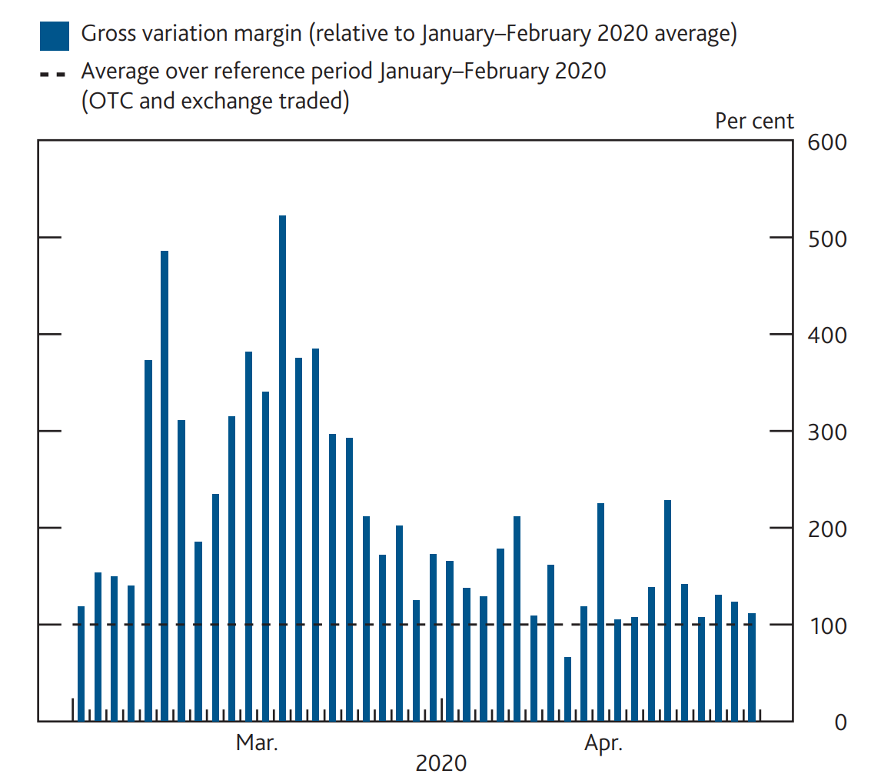
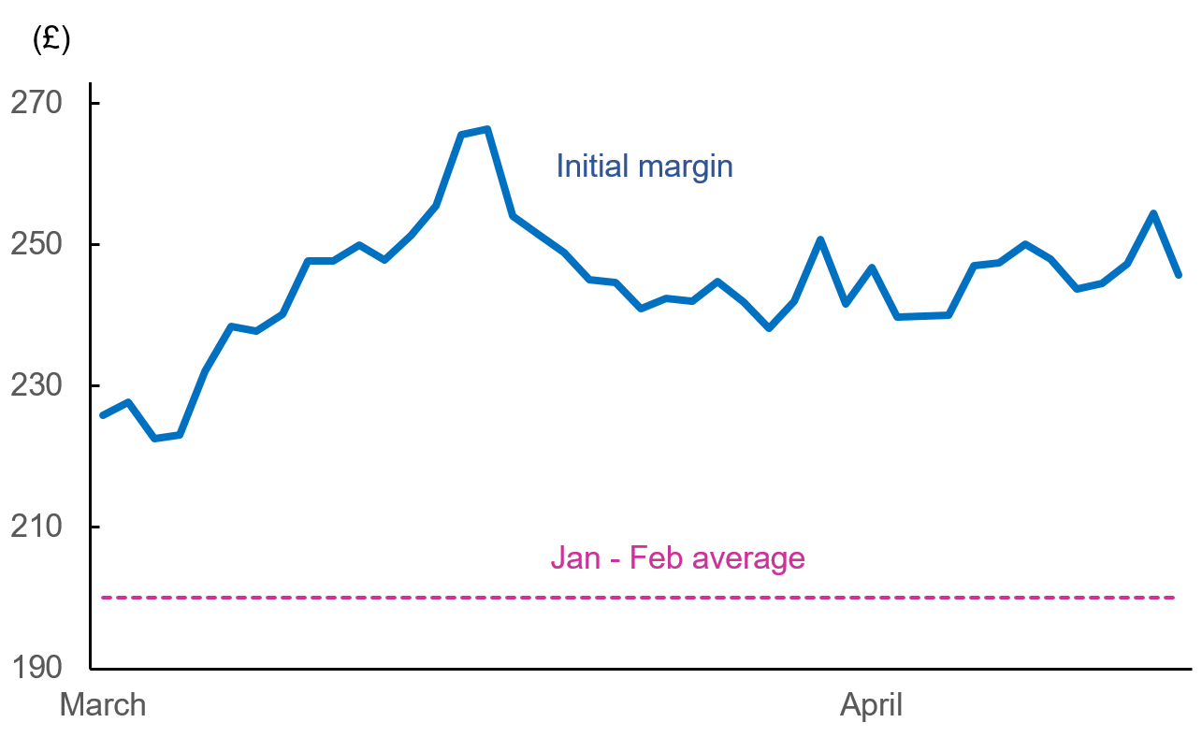
Figure 4: Variation margin on centrally cleared derivatives
Figure 5: Initial margin on centrally cleared derivatives
          Source: Bank of England supervisory returns
          Source: Bank of England supervisory returns

Slide 7
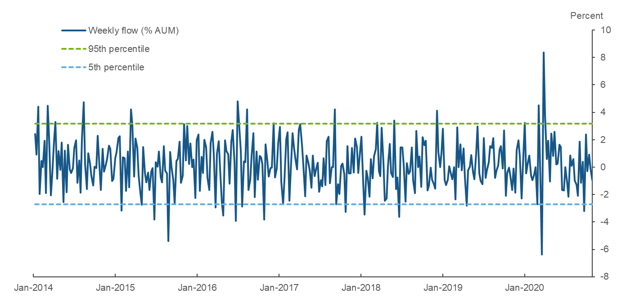
Figure 6: Weekly sterling MMF outflows
          Sources: Crane data and Bank calculations
          Note: Large inflows that occurred as a result of new funds being introduced to the sample have been removed.

Slide 8
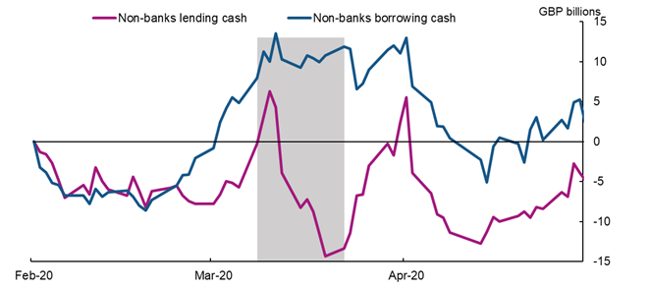
Figure 7: Changes in repo stock from January 2020 average
          Source: Bank of England Sterling Money Market data collection and Bank calculations
          Note: For all gilt repo and reverse gilt repo maturities up to one year. Non-banks include: Hedge Funds, Pension Funds, Liability Driven Investment Asset Managers, and Insurers

Slide 9
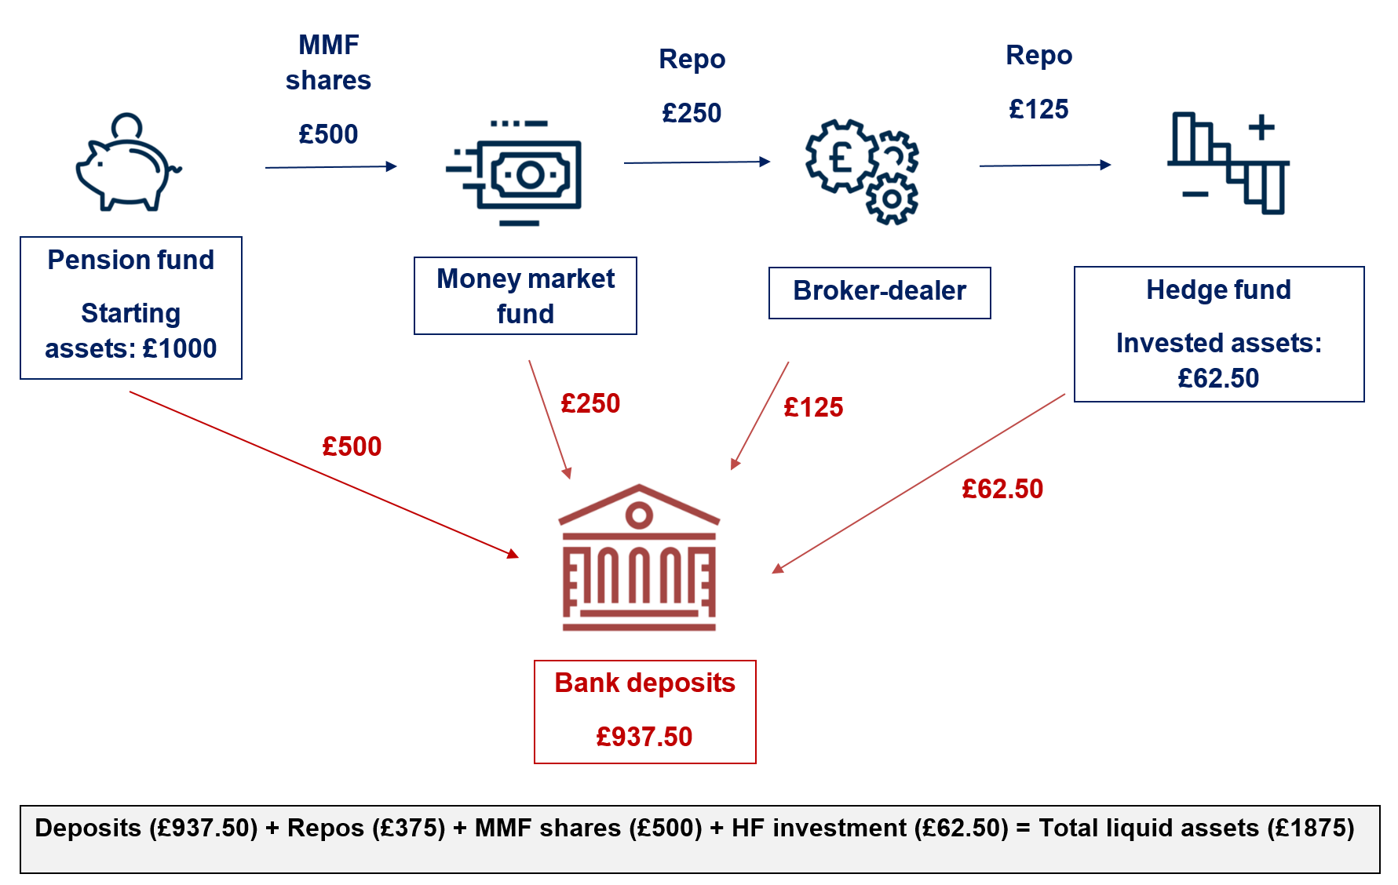
Figure 8: Stylised pension fund chain

Slide 10
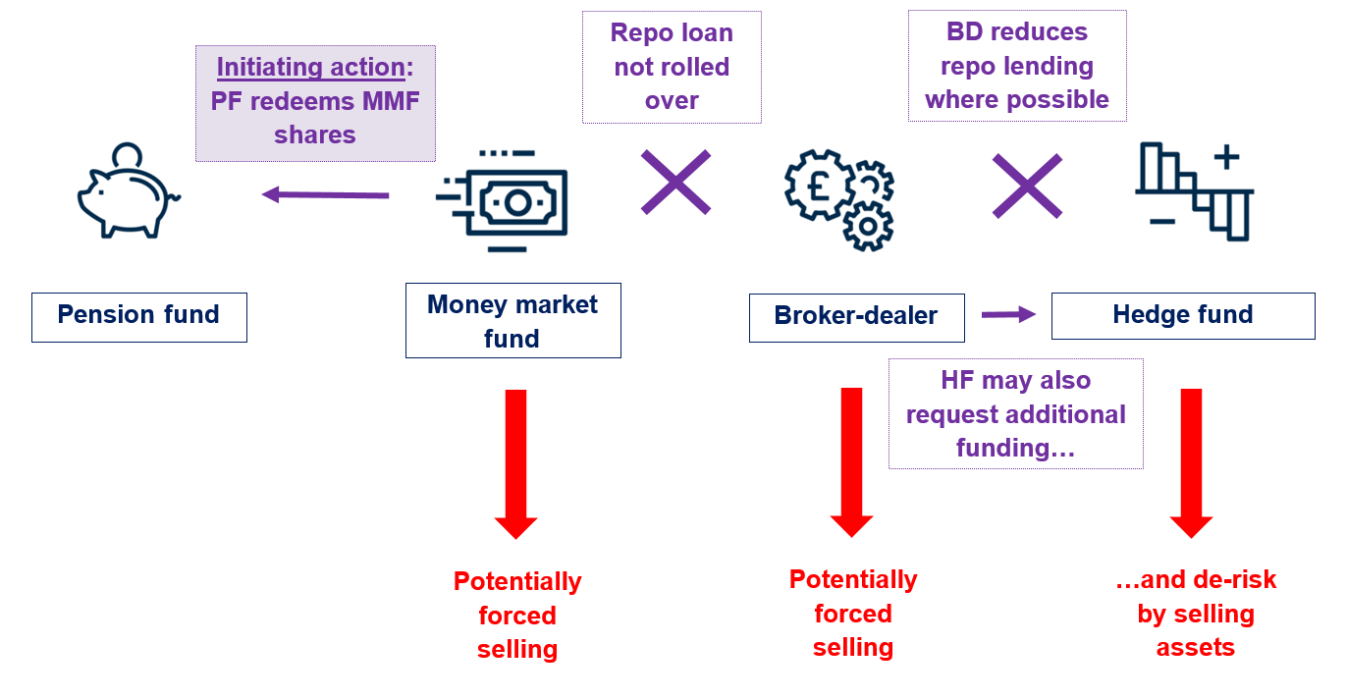
Figure 9: Defensive actions taken by parties in the chain

Slide 11
Some open questions
Does the regulatory system addresses these challenges adequately?
What will be expected of central banks in future stress episodes?
  Is there a way to charge the beneficiaries of the support for the liquidity insurance that central banks are providing ex-post?
Can we make a map of the most important funding chains so that we can monitor them and potentially catch problems before they appear?

Slide 12
Questions?
Anil Kashyap
External member of the Financial Policy Committee

Slide 13
References
On the FPC:
On the Dash for Cash
‘Come with me to the FPC’, Speech by Anil Kashyap given at the Official Monetary and Financial Institutions Forum, 13 June 2018.
‘My Reflections on the FPC’s Strategy” Speech by Anil Kashyap at the “50th Anniversary of the Journal of Money, Credit and Banking, Frankfurt, 28th March 2019.
‘Seven Moments in Spring’, Speech by Andrew Hauser, 4 June 2020
‘Financial System Resilience’ , Speech by Jon Cunliffe, 9 June 2020.
‘The impact of leveraged investors on market liquidity and financial stability’, Speech by Jon Cunliffe, 12 November 2020.

