Slide 1
Will the pandemic “scar” the economy?
Online webinar at the University of Liverpool Management School
19 July 2021
Jonathan Haskel
@haskelecon
Imperial College Business School, and Bank of England
Full text of speech available on Bank of England Website
Views are my own.

Slide 2
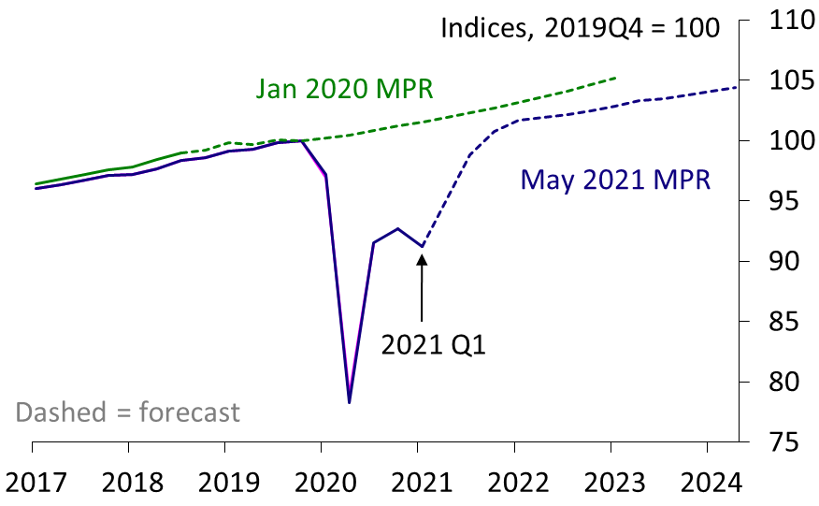
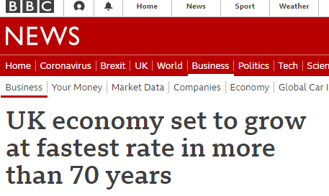
Where we are…
Bank of England GDP forecasts
Sources: ONS and Bank of England

Slide 3
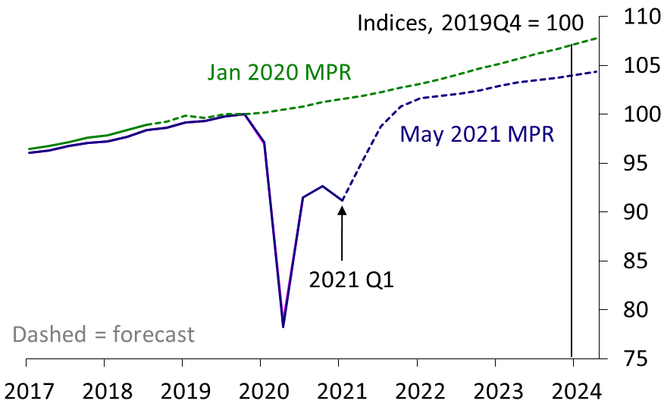
Where are we going?
Bank of England GDP forecasts
The question:
How much level scarring relative to pre-pandemic GDP?
Sources: ONS and Bank of England.
Note: from 2023 onwards, the January 2020 MPR forecast is extrapolated using quarterly growth rates similar to those in the forecast for 2022.

Slide 4
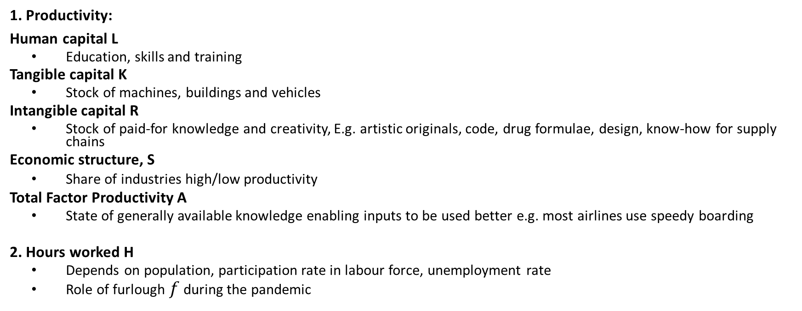
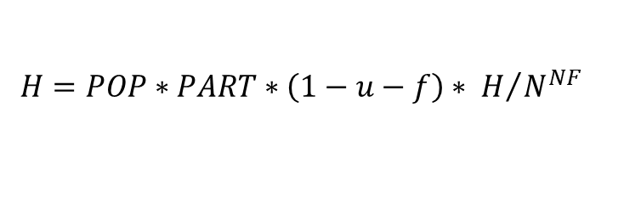

What is economic output?
$$Y^{}=\left(\frac{Y^{}}{H^{}}\right)H^{}=f\left(A^{},\frac{L^{}}{H^{}},\frac{K^{}}{H^{}},\frac{R^{}}{H^{}}, S\right)H^{}$$
1. Productivity:
Human capital L
    Education, skills and training
  Tangible capital K
    Stock of machines, buildings and vehicles
  Intangible capital R
    Stock of paid-for knowledge and creativity, E.g. artistic originals, code, drug formulae, design, know-how for supply chains
  Economic structure, S
    Share of industries high/low productivity
  Total Factor Productivity A
    State of generally available knowledge enabling inputs to be used better e.g. most airlines use speedy boarding
  2. Hours worked H
    Depends on population, participation rate in labour force, unemployment rate
    Role of furlough $f$ during the pandemic
$$H=POP∗PART∗\left(1−u−f\right)∗ H/{N^{NF}}$$

Slide 5
How might the pandemic induce scarring?
$$Y^{}=f\left(A^{},\frac{L^{}}{H^{}},\frac{K^{}}{H^{}},\frac{R^{}}{H^{}}, S\right) ∗ POP∗PART∗\left(1−u−f\right)∗ H/{N^{NF}}$$
1. Lower Productivity:
Human capital L
    Lower L due to loss of years of education, training
  Tangible capital K
    Fewer machines, buildings and vehicles
  Intangible capital R
    Lower investment in “knowledge creation”: science, software, the arts
  Economic structure, S
    Share of industries high/low productivity changes
  2. Fewer hours worked H
    Participation falls
    Unemployment rises e.g. mismatch
R “punches above its weight” : R in an industry helps other sectors (spillovers).
So scarring particularly depends on R

Slide 6
Productivity scarring?

Slide 7
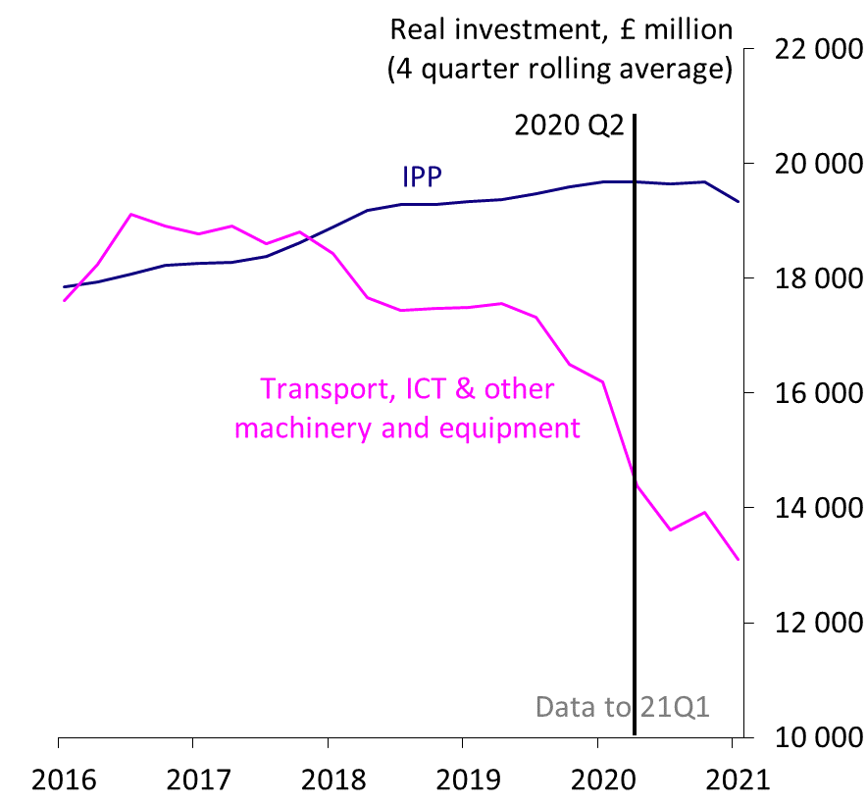
Investment during Covid: intangible investment relatively resilient…
Business investment components
Intellectual Property Products are:
a. R&D,
b. software and databases,
c. literary and artistic originals…
Source: ONS
Business investment fell by 12% in 2020
…concentrated in buildings and tangible capital…
…intangible investment held up
3. Resilience of intangibles limits scarring

Slide 8
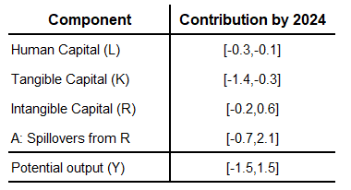
How much scarring in the medium term? Productivity….
Source: author’s calculations
Scarring from L due to loss of experience

Slide 9
How much scarring in the medium term? Productivity….
Source: author’s calculations
Scarring from L due to loss of experience
For capital: use May MPR forecast for total investment, then share out to different capital assets. Try different shares
Tangible capital: always scarring

Slide 10
How much scarring in the medium term? Productivity….
Source: author’s calculations
Scarring from L due to loss of experience
For capital: use May MPR forecast for total investment, then share out to different capital assets. Try different shares
Tangible capital: always scarring
Intangible capital
  high share of R (2020 level), no/negative scarring , and higher output by 2024
  if investment shares back to past levels, scarring

Slide 11
How much scarring in the medium term? Productivity….
Source: author’s calculations
Scarring from L due to loss of experience
For capital: use May MPR forecast for total investment, then share out to different capital assets. Try different shares
Tangible capital: always scarring
Intangible capital
  high share of R (2020 level), no/negative scarring , and higher output by 2024
  if investment shares back to past levels, scarring
Overall scarring estimate in the range of -1.5 to 1.5 percent [Bank of England May MPR forecast: -1.25%]

Slide 12

Might productivity get better not worse?
Working from home
  Shock absorber: used “potential capital” at home
  Concentrated: Dec 2020: 80% Info/comms, 10% accommodation and food
  Productivity evidence? Mixed
    Call centre workers: prod rose
    Patent examiners: prod fell
  Does greater productivity at home mean more WFH?
Digitalisation

Slide 13
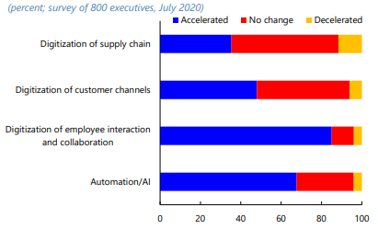
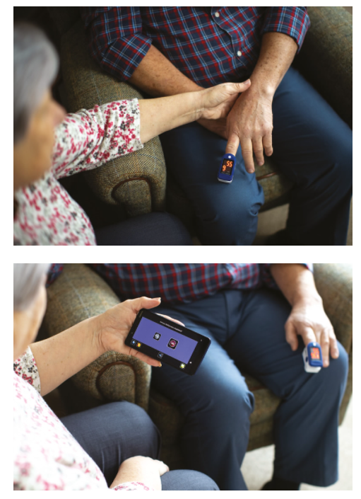
Will digitalisation boost productivity? Back to intangibles….
Digitalisation and automation during Covid-19
Example: a oximeter
Source: McKinsey Global Business Executive Survey, July 2020
Notes:
Pulse oximeter costs 20£.
Detects hypoxia, It allows a nurse, carer or patient to record vital signs such as oxygen levels through an app on a smart phone or by texting in their readings. The system is proving vital in helping identify a form of oxygen deprivation called silent hypoxia, or signs of deterioration in someone’s condition.
Where is it in this picture, mix of tang and intang.

Slide 14
Scarring in the labour market: hours
Depends on the evolution of
  Population
  Participation rates, especially of over 50s (25% of decline in activity, 20% of furl)
  Unemployment and mismatch

Slide 15
Scarring in the labour market: “mismatch”
Mismatch high if:
  Vacancies and unemployed are
    Widely spread by region, industry (= lots of thin labour markets)
    In the wrong industry/region (= wrong skills/location)
If mismatch is high then inflation is high
  labour market not matching
  Workers aren’t available
  Wages rise, prices chase wages, “wage/price spiral”
What measures would indicate mismatch?
    U and V spread widely and/or different industries
    Vacancies took a longer time to fill
    Full time furloughed workers aren’t getting jobs, only partial furloughed are.
What do the data say?

Slide 16
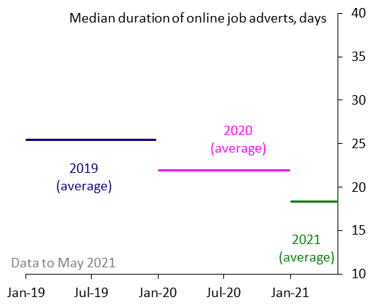
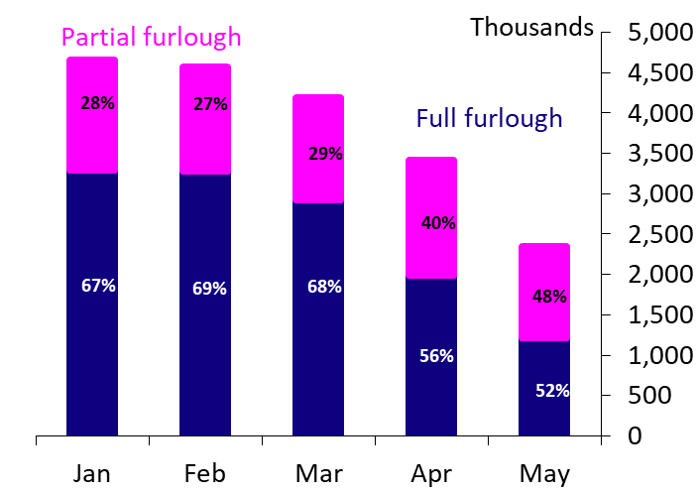
Labour mismatch: vacancy duration, full v partial furlough
Vacancies are being filled quickly
Partially and fully furloughed falling…
Days job advert remains online
Avgs: 25days, 22, 18.
Furlough share
Source: Indeed.
Note: Duration measures the number of days a job posting is visible on the Indeed website.
Source: HMRC CJRS. Note: Monthly figures refer to the end of month. Percentages indicate the share of total furlough for that type. These will not sum to 100 due to unclassified types of furlough in the dataset.
Source: www.indeed.co.uk
Notes:
Duration measures the number of days a job posting is visible on the Indeed website

Slide 17
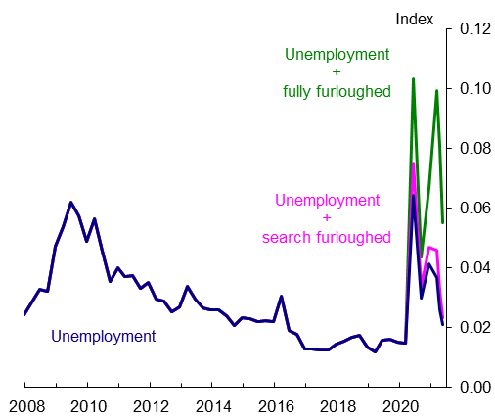
Labour mismatch: unemployment and vacancies
Mismatch is falling…(data to May)
Note: Data to May 2021. Estimates of sectoral mismatch are based on Sahin et al (2014).
The blue line is the standard approach using official unemployment and vacancies.
The green line adds those on furlough by sector to the unemployment series.
The pink line adds those on furlough by sector who are searching for work to the unemployment series. Furlough figures are based on data to May.

Slide 18
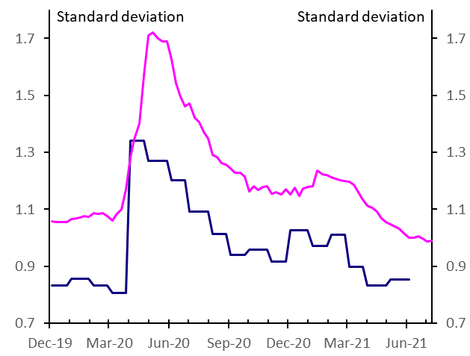
Labour mismatch: vacancy spreads to 9th July 2021
ONS (lower line) and Adzuna vacancy spreads
Source: ONS and Adzuna
Note: ONS June vacancy snapshot was taken on 4 June. Weekly Adzuna online vacancy data to 9 July.

Slide 19
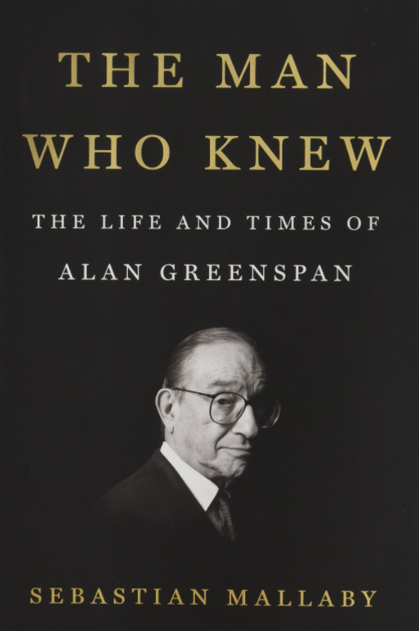
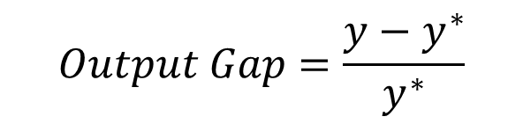
Does more supply mean “run the economy hot”?
The output gap:
2. More y* means
  output gap rises => less inflation => loose policy
  forward-looking firms, consumers spend now in anticipation of better times => more inflation => tight policy
$$Output Gap=\frac{y−y^{∗}}{y^{∗}}$$

Slide 20
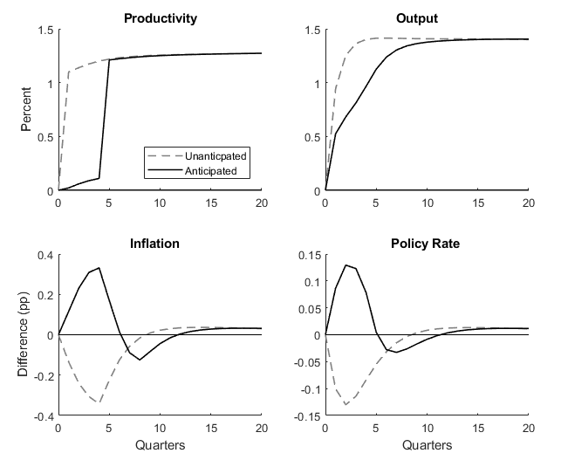
Running the economy hot: model simulations
Anticipated v unanticipated shocks
More supply under 2 scenarios:
  Now, but unanticipated (dashed line)
  In future, but anticipated now (solid line)
Inflation and policy rate ?
  No anticipation: inflation low => looser policy
  Anticipation: inflation high = > tighter policy
Note: Figure plots the simulated responses for selected variables under two scenarios in a medium scale DSGE model based on the Bank of England’s own forecasting model Compass (2013). The unanticipated scenario shows the response to an unanticipated one time one percent increase in TFP. The anticipated scenarios shows the response when the increase in TFP is correctly anticipated by households and businesses four quarters ahead. Inflation is the difference in percentage points from the target. The policy rate is the change in the level of the short-term interest rate set by the Central Bank under a Taylor rule. Output and productivity are percentage differences from a counterfactual of no change in TFP.
Notes:
BPositive TFP shock of 1% under 2 scenarios:
At t=0, unanticipated (dashed line)
At t=4, anticipated at t=0 (solid line)
TFP and output at least 1% higher under both scenarios at t=20
Inflation and policy rate eventually return to starting positions under both scenarios at t=20
But initial responses of inflation and policy rate very different:
If HH anticipate TFP increase, consume more now, so Y runs ahead of Y* => positive OG and inflation call for tighter policy
If HH don’t anticipate TFP shock, Y* runs ahead of Y => negative OG and disinflation call for looser policy

Slide 21
Tight policy is not the right policy
Forward-looking scenario seems relevant:
  Government roadmap
  Inflation at 2.5% in June, input prices rising
But I’m not in favour of tightening policy yet:
  Base effects : mechanical rise of annual inflation from April in 2021 as fuel prices collapsed in March 2020 by 60%. Half of CPI rise to end year likely due to energy prices
  Rising goods prices are because we haven’t been able to consume services
  Labour market signals falling mismatch
  We have not recovered yet:
    Delta variant R=1.5
    Fiscal tightening as Covid measures withdrawn
Risk management: lean against pre-emptive tightening
Notes:
Fuel price fell April 2020 = > inflation fell -0.3
Now the price level is lowerWith no change, inflation would rise April 2021 +0.3.
In addition, fuel price rose April 2021 => inflation rose +0.6.

Slide 22
spares

Slide 23
Prelude: output losses during COVID

Slide 24
Output losses during Covid
Source: ONS, HMRC & author’s calculations
Output loss of 9%

Slide 25
Output losses during Covid
Source: ONS, HMRC & author’s calculations
Output loss of 9%
Within-firm productivity fell by 2% but offset by increased across-sector productivity (“batting average” effects)

Slide 26
Output losses during Covid
Source: ONS, HMRC & author’s calculations
Output loss of 9%
Within-firm productivity fell by 2% but offset by increased across-sector productivity (“batting average” effects)
Fall of 9% in total hours worked almost entirely accounted for by fall in average number of hours worked per worker

Slide 27
Output losses during Covid
Source: ONS, HMRC & author’s calculations
Output loss of 9%
Within-firm productivity fell by 2% but offset by increased across-sector productivity (“batting average” effects)
Fall of 9% in total hours worked almost entirely accounted for by fall in average number of hours worked per worker
Fall in average hours worked
  rise in the furlough rate
  offsetting rise in average hours per employed worker
Key questions: the future of productivity and what will happen to furloughed workers?

Slide 28
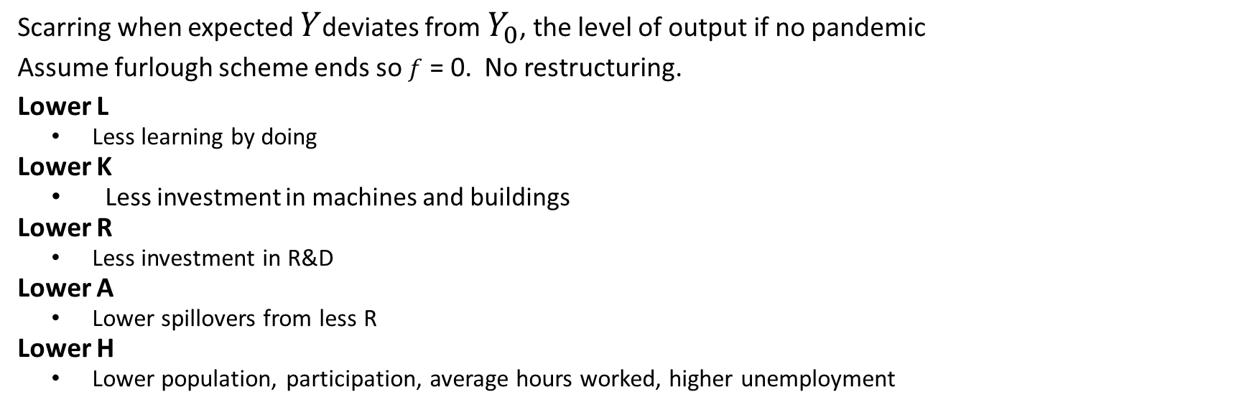

Scarring calculation: output relative to a counterfactual
$$\frac{Y}{Y_{0}}= \frac{\left(\sum_{i}{A_{i} {{\left(\frac{L}{H}\right)}_{i}}^{{S_{L}}_{i}}{{\left(\frac{K}{H}\right)}_{i}}^{{S_{k}}_{i}}{{\left(\frac{R}{H}\right)}_{i}}^{{S_{R}}_{i}}}\right) POP∗PART∗\left(1−u\right)∗ H/{N^{}} }{\left(A_{0} {\left(\frac{L_{0}}{H_{0}}\right)}^{S_{L}}{\left(\frac{K_{0}}{H_{0}}\right)}^{S_{k}}{\left(\frac{R_{0}}{H_{0}}\right)}^{S_{R}}\right)∗{POP}_{0}∗{PART}_{0}∗\left(1−u_{0}\right)∗ {H/N}_{0}}$$
Scarring when expected $Y$deviates from $Y_{0}$, the level of output if no pandemic
Assume furlough scheme ends so $f$ = 0. No restructuring.
Lower L
    Less learning by doing
  Lower K
    Less investment in machines and buildings
  Lower R
    Less investment in R&D
  Lower A
    Lower spillovers from less R
  Lower H
    Lower population, participation, average hours worked, higher unemployment

Slide 29
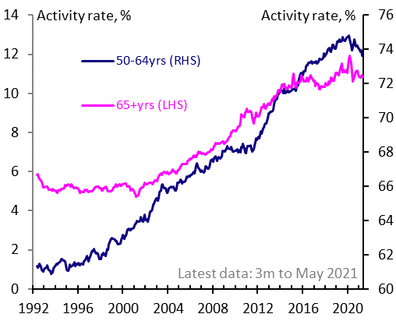
Will older workers participate in the labour force?
Activity rate for the over 50s
Since Feb 2020 peak, over-50s account for:
  A quarter of decline in activity rate
  One fifth of furloughed
Will they return?
A permanent fall in activity would deviate from historical precedent
Source: ONS

Slide 30
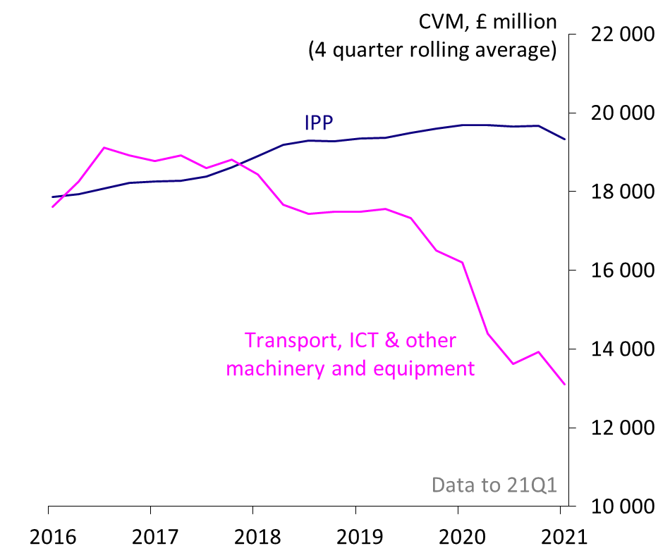
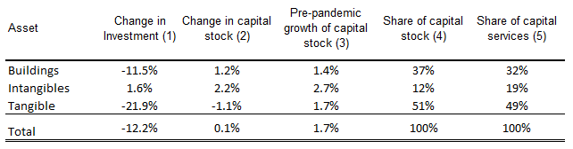

Investment and capital during Covid
Capital $x$ is formed through investment $I_{x}$ net of depreciation at rate $δ_{x}$
Business investment components
$$x_{t}=\left(1−δ_{x}\right)x_{t−1}+{Ix}_{t}$$
Source: ONS experimental productivity estimates
Source: ONS
Business investment fell by 12% in 2020
Business capital stock barely grew in 2020 so lower than relative to pre-pandemic path
Fall in business investment in 2020 concentrated in buildings and tangible capital; intangible investment held up
  IPP investment held up in 2020 while other business investment collapsed [figure]
4. Resilience of intangibles limits scarring through spillovers into A (not shown)

Slide 31
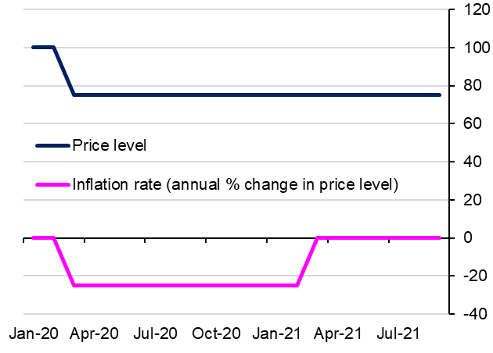
Base effects: inflation is an annual comparison
Stylised base effects
Notes:
Fuel price fell Marcy 2020 by 60%. So April 2020 = > inflation fell -0.3
Now the price level is lower With no change, inflation would rise April 2021 +0.3.
In addition, fuel price rose April 2021 => inflation rose +0.6.

