Slide 1

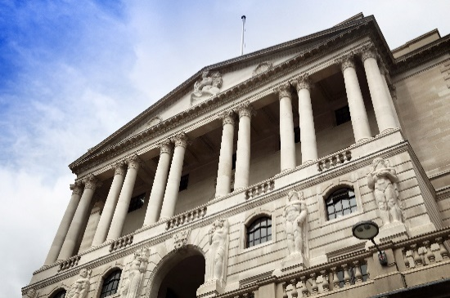

Challenges to the economic outlook
Jonathan Haskel
@haskelecon
External Member of Monetary Policy Committee, Bank of England; and Imperial College Business School, Imperial College London
CEPR / Chicago Booth Webinar: Panel remarks on the economic challenges facing the new U.S. Treasury Secretary Janet Yellen, 5th March 2021
Accompanying text at www.bankofengland.co.uk/publications/speeches

Slide 2
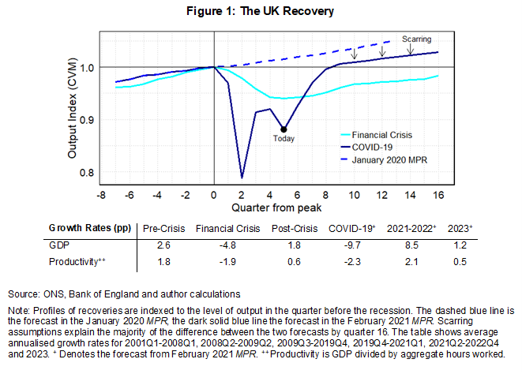
Where we stand (UK Perspective)
Massive contraction (less than 1709)
Currently in lockdown, well below pre-trend y
Forecast recovery stronger than fin crisis
Level scarring effect of 1 ¾ % GDP

Slide 3
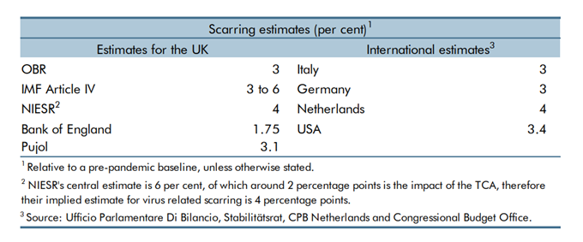


Challenge: Scarring
The recovery of consumption and investment
$$Y^{∗}=\left(\frac{Y^{∗}}{H^{∗}}\right)H^{∗}=f\left(A^{∗}, \frac{K^{∗}}{H^{∗}}\right)H^{∗}$$
Lower $K^{∗}$
    Investment has collapsed.
    Uncertainty and risk aversion to rise
  Lower$A^{∗}$
Less learning by doing
Lower investment intangible capital e.g. lower R&D
  Lower$H^{∗}$
Elevated levels of long term unemployed
Mismatch from structural change
Sources: ONS and Bank of England.

Slide 4
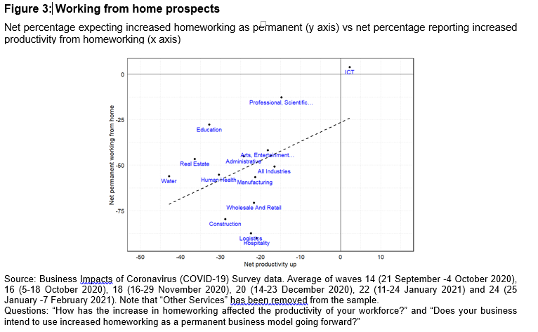
Structural change: is working from home overstated?

Slide 5
Challenge: Fiscal drawdown
Insolvencies and unemployment
UK Targeted government programs have insured against economic contraction.
    E.g. furlough scheme, corporate tax relief, grants and loan guarantees
    about 9% of GDP
    Around 1/3 private labour force furloughed in April 2020 on 80% pay. Around ¼ in February 2021.
    Furlough is about 50% of the rescue spending
    Contrast rise in unemployment with US
  Scheme expires in line with removal of restrictions. Economic adjustment?

Slide 6
Challenges and policy conclusions
Vaccine efficacy versus effectiveness
    >20m (~ 1/3 population) have a first dose. Almost all vulnerable groups. Vaccine seems effective in the field
    O ring production and distribution
    Escape mutants
Pent up demand?
    Households savings risen to approx. 15% of GDP. Savings concentrated among wealthier/older.
    70% of savers say they will keep in bank.
Policy
Exposure to virus or mutations remains
Risk of scarring on the level. But small beer relative to persistent financial crisis scarring to growth.
Relatively little risk of sustained above-target inflation
Risk management: lean against downside risks
Support PRA request for banks to prepare operationally for negative rates

Slide 7
Other charts

Slide 8
Other charts

Slide 9
Other charts

Slide 10
US versus UK
UK

