Slide 1
Why macroprudential policy needs to tackle financial stability risks from climate change
Elisabeth Stheeman
External member of the Financial Policy Committee
Queen’s University Belfast, 3 May 2022

Slide 2
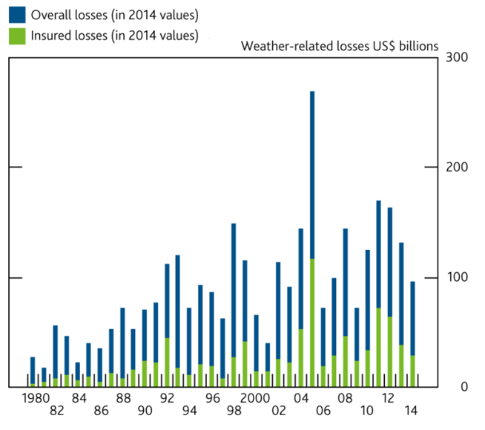
Weather-related loss events worldwide
Sources: Bank of England,
Munich Re NatCatSERVICE (2015)

Slide 3
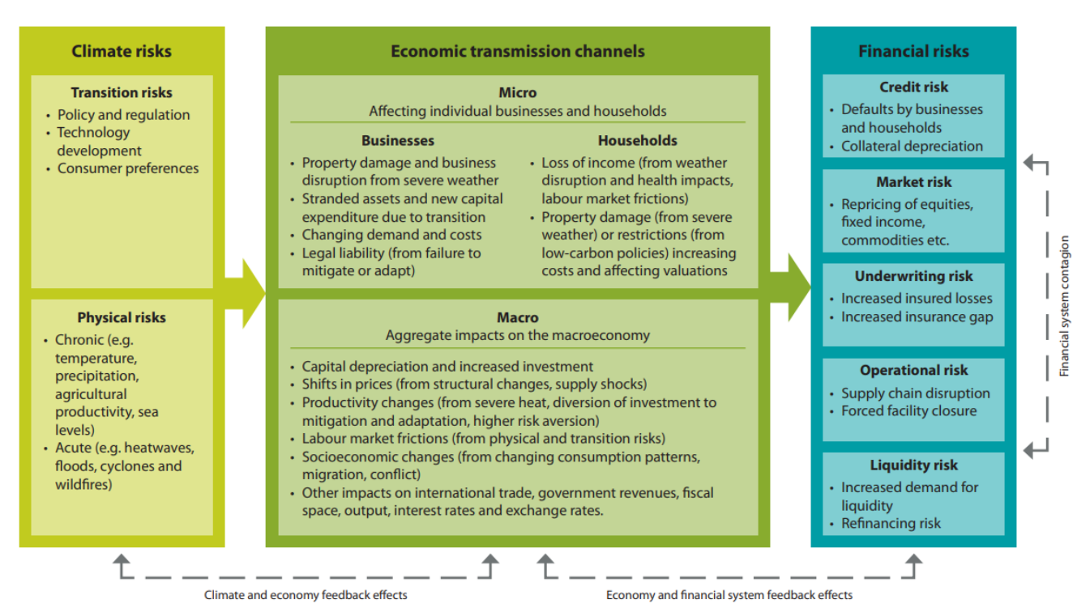
Key climate change transmission channels
Sources: Network for Greening the Financial system (NGFS), Bank of England

Slide 4
Network for Greening the Financial System (NGFS)
Progress report, 2018:
“NGFS Members acknowledge that climate-related risks are a source of financial risk. It is therefore within the mandates of Central Banks and Supervisors to ensure the financial system is resilient to these risks”
Source: First NGFS progress report (2018)

Slide 5
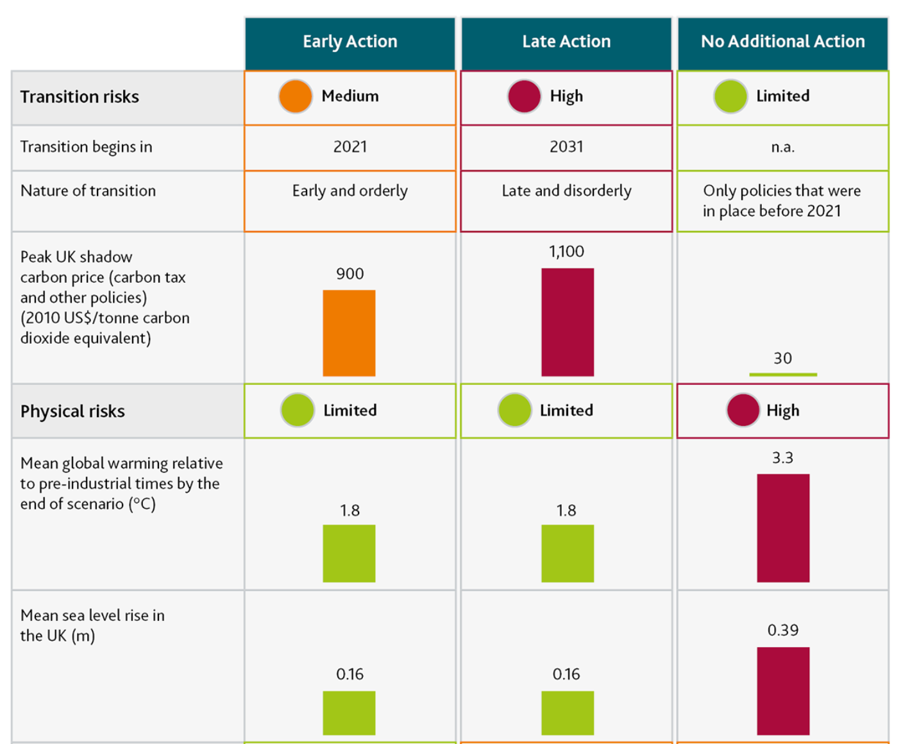
Climate biennial exploratory scenario (CBES) & summary impacts
Source: Bank of England. Data: Met Office, NGFS and Bank calculations

