Slide 1
UK inflation since the pandemic: How did we get here and where are we going?
Jonathan Haskel
November 2023 at Warwick University
External member, MPC, Bank of England and Imperial College Business School
Full text of speech and supporting research paper on Bank of England website

Slide 2
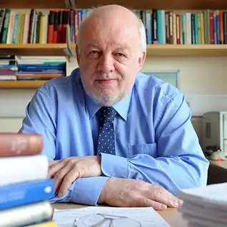
Professor Nick Crafts, 1949-2023
The Times “the most distinguished British economic historian of his generation.”

Slide 3
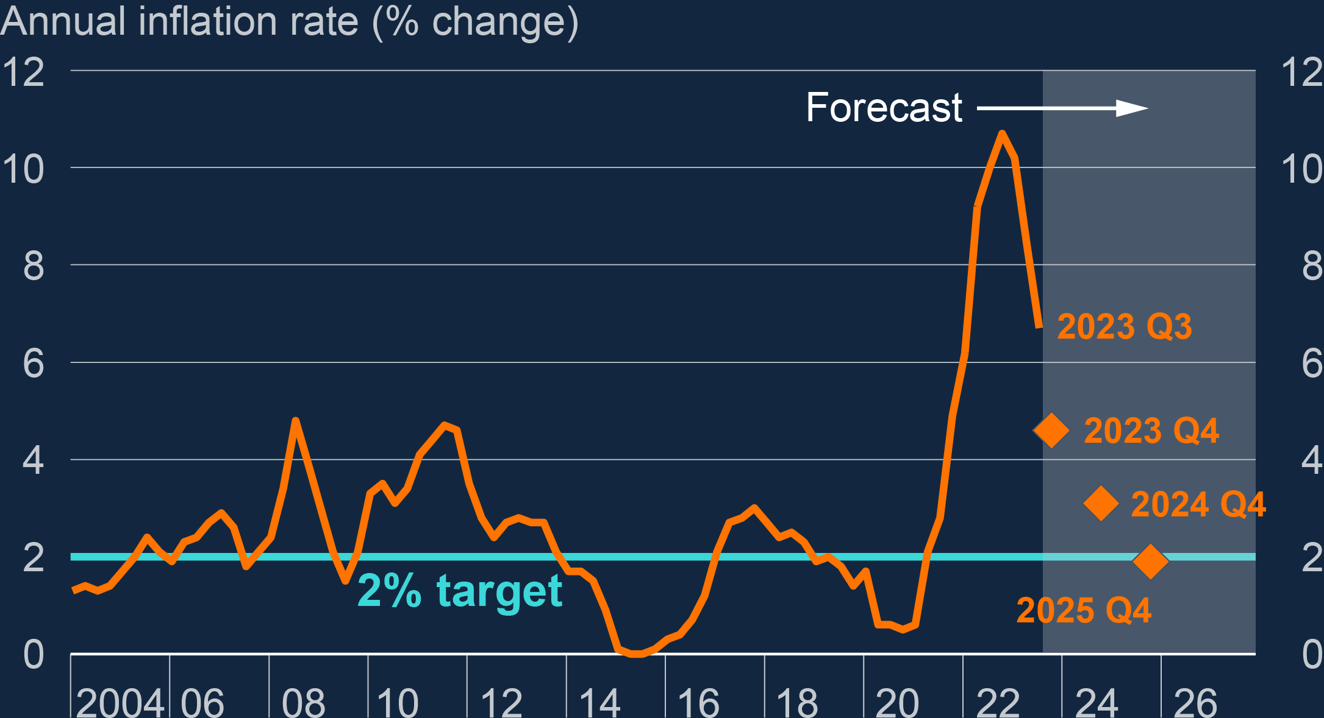
What caused recent UK inflation? What will happen?
Notes:
Source: https://www.bankofengland.co.uk/monetary-policy-report/2023/november-2023

Slide 4
1. Some questions about inflation 2. A model 3. Some facts 4. Accounting for past inflation using the model 5. Inflation prospects

Slide 5
1. Some questions about inflation 2. A model 3. Some facts 4. Accounting for past inflation using the model 5. Inflation prospects

Slide 6
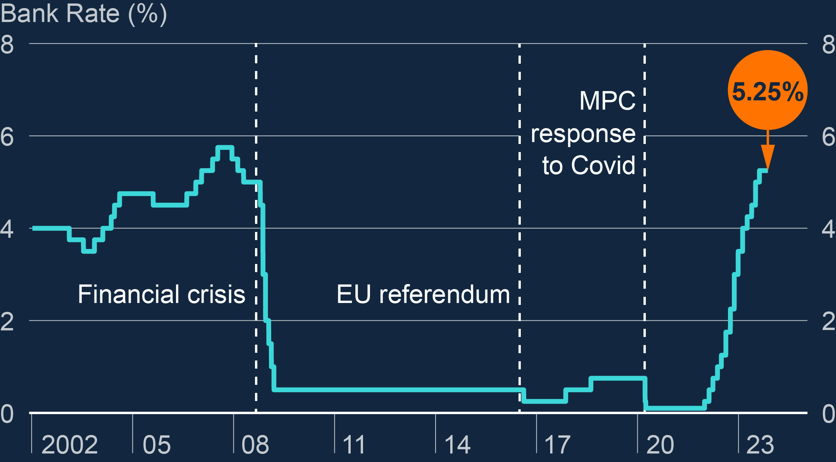
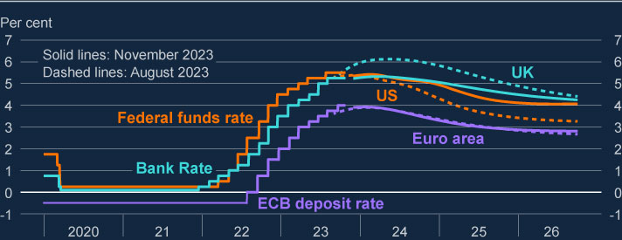
Questions
Q1. How did we get here?
2021 price shocks: energy, food, shortages
Tight labour market, policy too loose
Narrative 1: the BofE was wrong to treat rising inflation in 2021 as transitory.
Q2. Where are we going?
Inflation is falling. Other Banks are cutting. BoE will cut soon.
Inflation will be stuck above target. Interest rate cuts are far off
Narrative 2: with inflation falling, rates can be cut sooner rather than later.
Notes:
Source: https://www.bankofengland.co.uk/monetary-policy-report/2023/november-2023

Slide 7
1. Some questions about inflation 2. A model 3. Some facts 4. Accounting for past inflation using the model 5. Inflation prospects

Slide 8
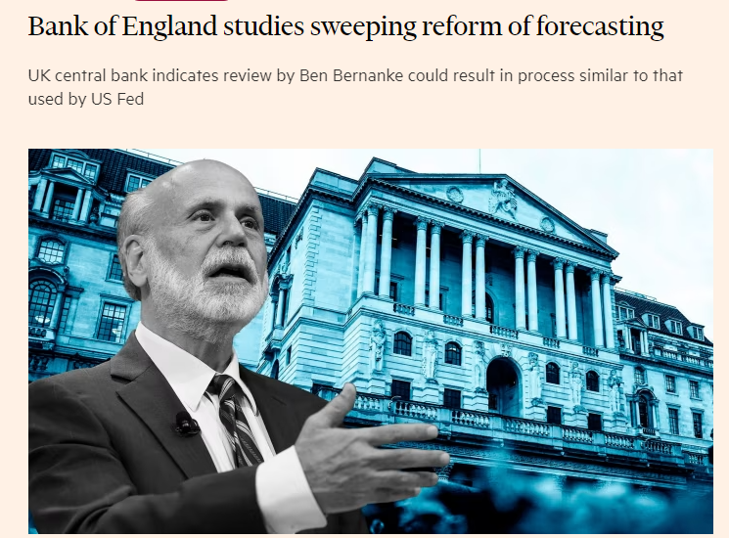
Gathering some evidence on these questions
Estimate Bernanke/Blanchard model originally applied to US
What’s the point of a model?

Slide 9
The model, 1/3
Workers/firms: wage bargaining
Expected inflation
Past inflation
Labour market “tightness”
Productivity
Wage inflation

Slide 10
The model, 2/3
Workers/firms: wage bargaining
Expected inflation
Past inflation
Labour market “tightness”
Productivity
Wage inflation
Firms: price setting
Wages
Other costs: energy, food, shortages
Capital/profits
Productivity
Price inflation

Slide 11
The model, 3/3
Workers/firms: wage bargaining
Expected inflation
Past inflation
Labour market “tightness”
Productivity
Wage inflation
Firms: price setting
Wages
Other costs: energy, food, shortages
Capital/profits
Productivity
Price inflation

Slide 12
The model in action. Energy price shocks
Workers/firms: wage bargaining
Expected inflation
Past inflation
Labour market “tightness”
Productivity
Wage inflation
Firms: price setting
Wages
Other costs: energy, food, shortages
Capital/profits
Productivity
Price inflation

Slide 13
The model in action. 1/3 Energy price shocks
Workers/firms: wage bargaining
Expected inflation
Past inflation
Labour market “tightness”
Productivity
Wage inflation
Firms: price setting
Wages
Other costs: energy, food, shortages
Capital/profits
Productivity
Price inflation
First round effects
Second round effects

Slide 14
The model in action. 2/3 Labour market tightness
Workers/firms: wage bargaining
Expected inflation
Past inflation
Labour market “tightness”
Productivity
Wage inflation
Firms: price setting
Wages
Other costs: energy, food, shortages
Capital/profits
Productivity
Price inflation
First round effects
Second round effects

Slide 15
The model in action. 3/3 Expectations
Workers/firms: wage bargaining
Expected inflation
Past inflation
Labour market “tightness”
Productivity
Wage inflation
Firms: price setting
Wages
Other costs: energy, food, shortages
Capital/profits
Productivity
Price inflation
First round effects
Second round effects

Slide 16
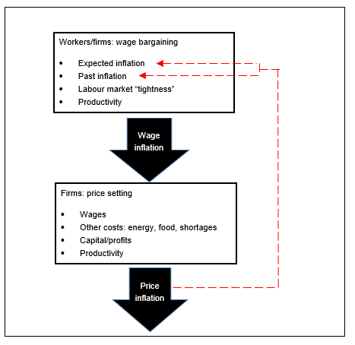
What do we want to know?
1st round effects?
How big are the shocks?
How big is the transmission to inflation?
How long does it last?
2nd round effects?
Size
If we know these we can answer some questions
Are cost shocks transitory?
Is the labour market too tight?
Are expectations out of control?

Slide 17
1. Some questions about inflation 2. A model 3. Some facts 4. Accounting for past inflation using the model 5. Inflation prospects

Slide 18
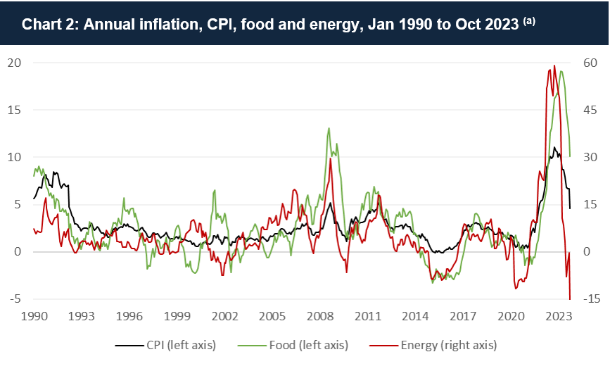
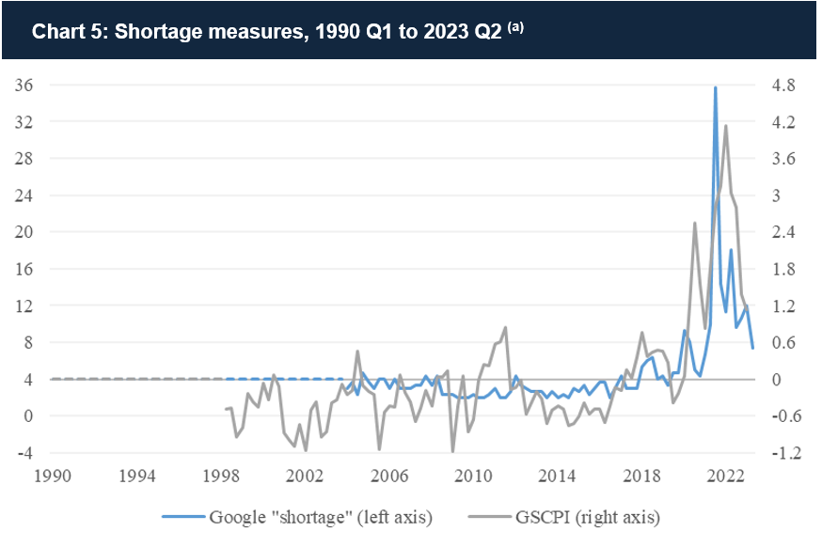
Fact 1: energy, food, shortages shocks were gigantic

Slide 19
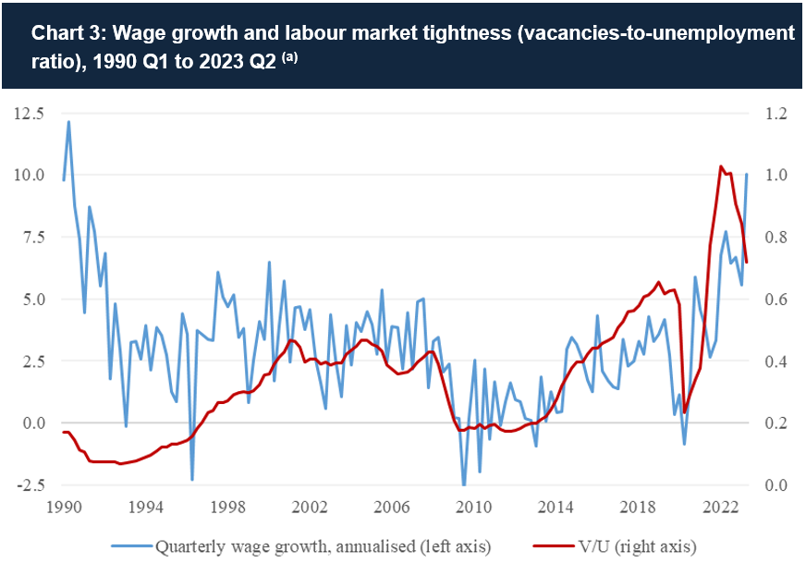
Fact 2: the labour got much tighter, along with rising wage inflation

Slide 20
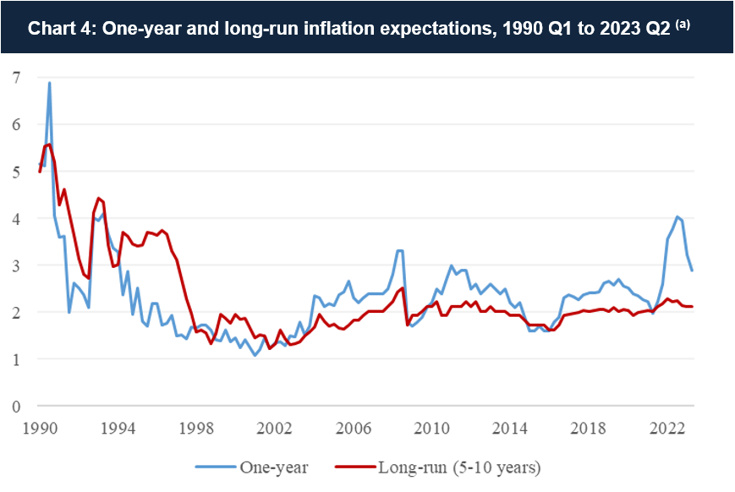
Fact 3: expectations have remained anchored

Slide 21
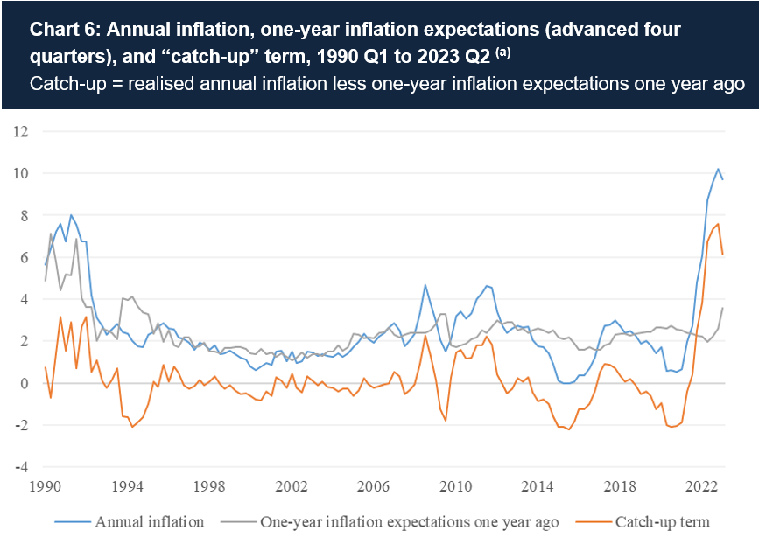
Fact 4: inflation has been unexpected: scope for catch up?

Slide 22
1. Some questions about inflation 2. A model 3. Some facts 4. Accounting for past inflation using the model 5. Inflation prospects

Slide 23
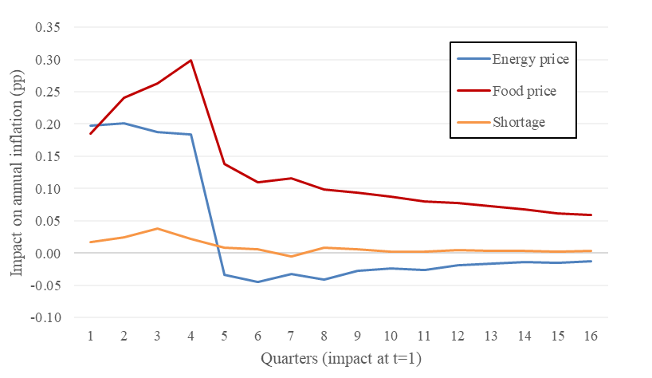
Finding 1: the inflation consequence of typical food, energy, shortage shocks are transitory
Inflation response to typical one-off energy, food and shortage “shock”

Slide 24
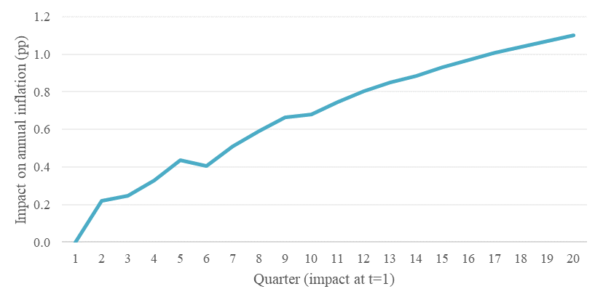
Finding 2: inflation consequence of a sustained rise in labour market tightness is long-lived
Inflation response to permanent rise in V/U

Slide 25
Q1. how did we get here? What caused inflation?

Slide 26
Underlying inflation – pre-pandemic shocks and the pre-pandemic labour market

Slide 27
Shock 1: Shortages raised inflation in 2021 as the economy re-opened

Slide 28
Shock 2: Energy prices raised inflation in 2021 and 2022. Now lowering…

Slide 29
Shock 3: Food prices raised inflation in 2022 and 2023

Slide 30
Shock 4: Historically tight labour market (high V/U) raised inflation since end-2021

Slide 31
Summary: how did we get here?
Hypothesis 1: rising inflation in 2021 was mostly due to shocks that could have been expected to have had transitory effects on inflation.
Hypothesis 2: rising inflation in 2021 was mostly due to the inflationary effects of low interest rates/QE.

Slide 32
1. Some questions about inflation 2. A model 3. Some facts 4. Accounting for past inflation using the model 5. Inflation prospects

Slide 33
Where are we going?
To make predictions we need predicted paths for:
Energy: use futures curve (further fall, settles above historic average)
Food: relative inflation reverts to historic average
Shortages: revert to historic average
V/U:
Stays at 2023 Q2 level 0.72 (above historic average)
Falls at current pace to 0.43 (2012/19 average) in 4 quarters
Falls at current pace to 0.20 (post-GFC level) in 8 quarters

Slide 34
Predicted inflation with different V/U ratios
Lesson: unless labour market weakens, inflation will stay high

Slide 35
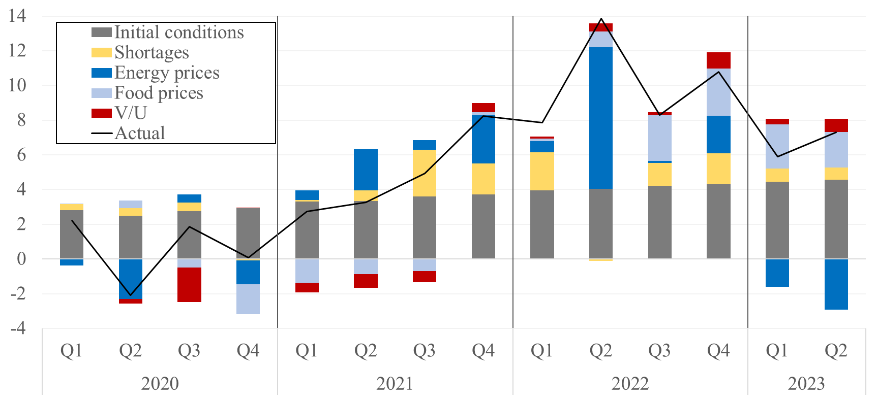
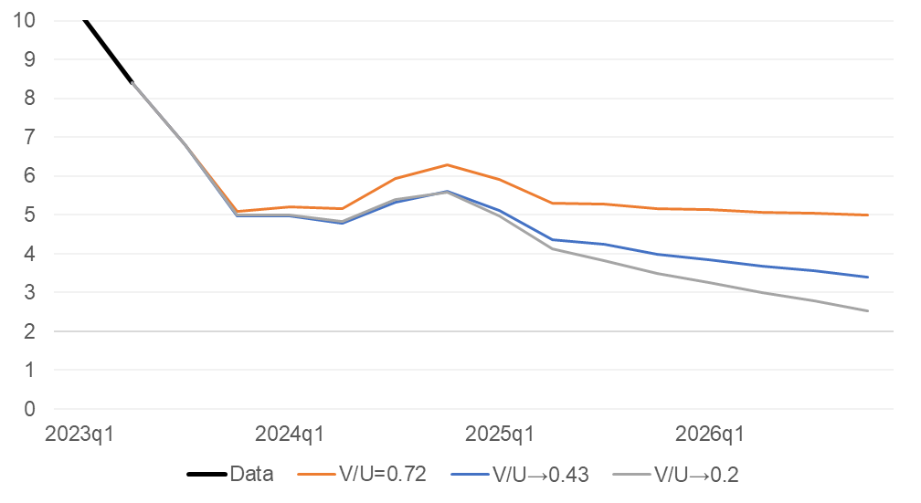
Back to the questions
Q1. How did we get here?
2021 price shocks: energy, food, shortages
Tight labour market, policy too loose
Q2. Where are we going?
Inflation is falling. Other Banks are cutting. BoE will cut soon.
Inflation still risks being stuck above target. Interest rate cuts are far off
Broader messages
Economic models are used and useful
Model tells policy-makers what to look for
Shocks, labour market tightness, productivity, expectations
✓
✗
✗
✓

Slide 36
spares

Slide 37
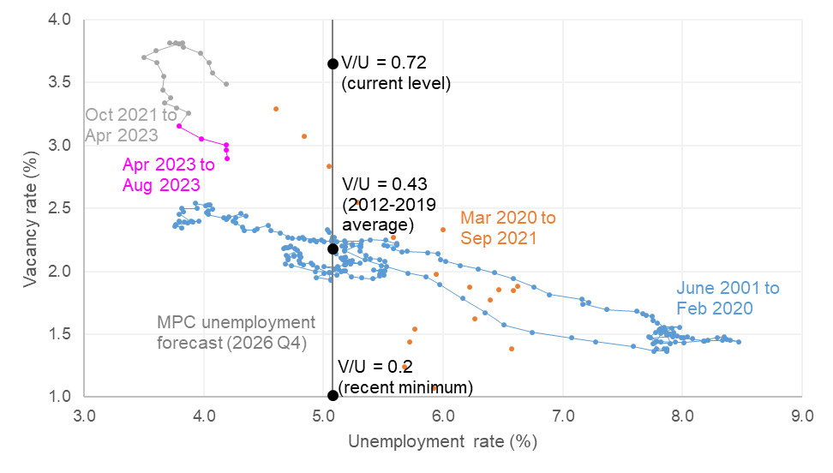
The V/U ratio

Slide 38
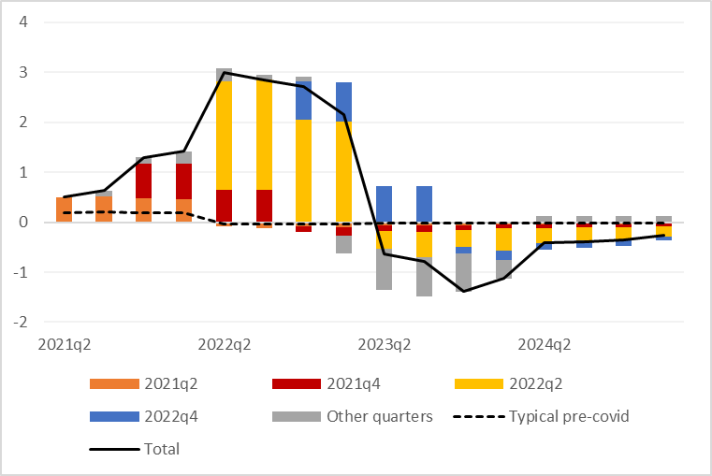
The model in action: energy prices shocks

