Slide 1
Data as a Dialogue
  12 March 2026
Vicky White
Director of Insurance and Cross-Sectoral Policy

Slide 2
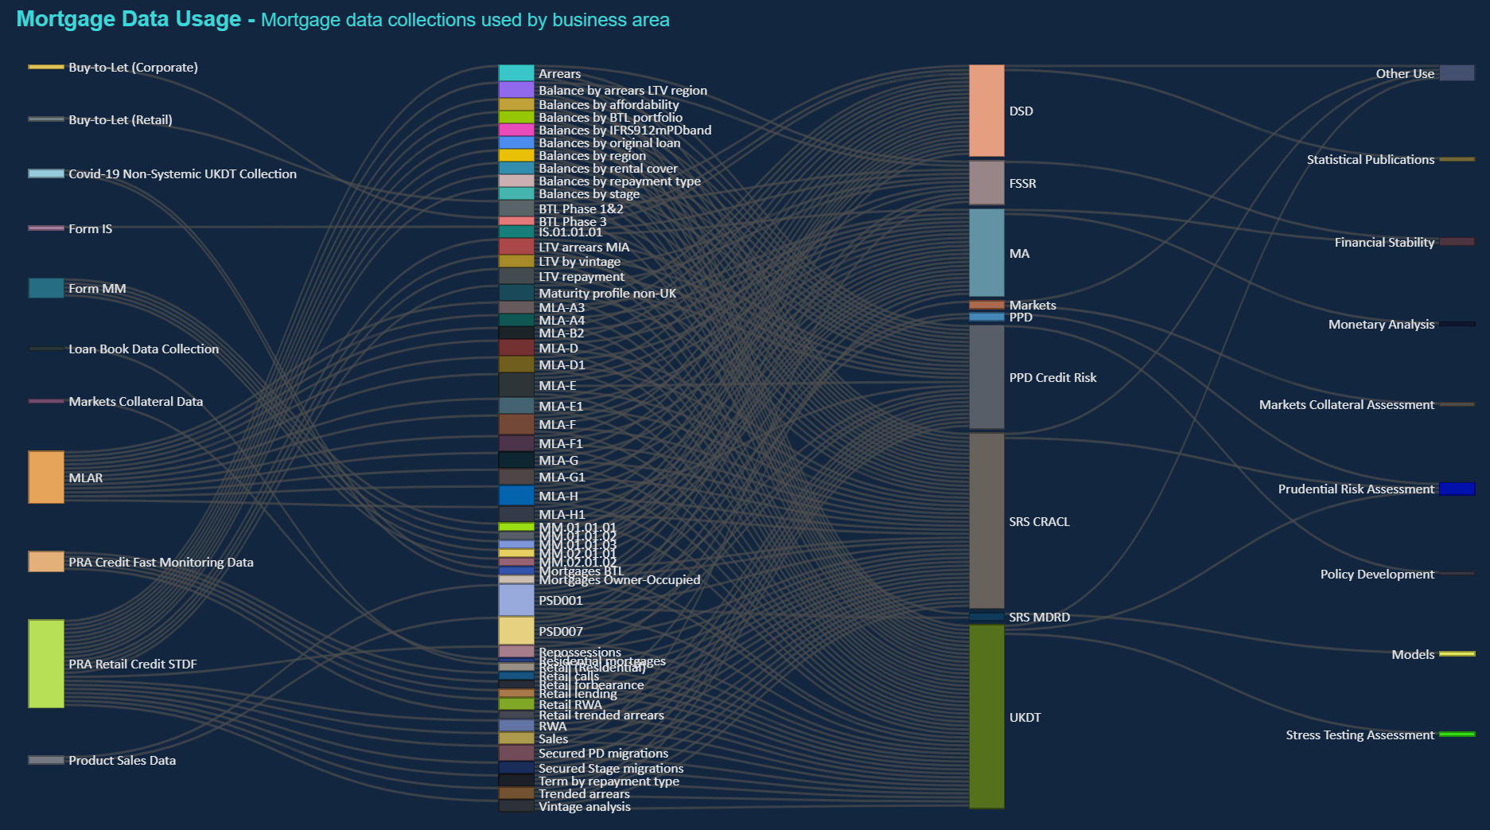

Slide 3
Notes
UKDT – UK Deposit Takers
MLAR – Mortgage Lenders and Administrators Return
STDF – Stress Test Data Framework
DSD – Data Strategy Division
FSSR – Financial Stability Strategy and Risk
MA – Monetary Analysis
PPD – Prudential Policy Directorate
SRS – Supervisory Risk Specialists
CRACL – Credit, Risk Analytics, Capital and Liquidity Division
MDRD – Model Development and Review Division

