Slide 1
Fireside chat at NatWest
April 2026 Monetary Policy Report
14 May 2026
Huw Pill
Chief Economist
Bank of England

Slide 2
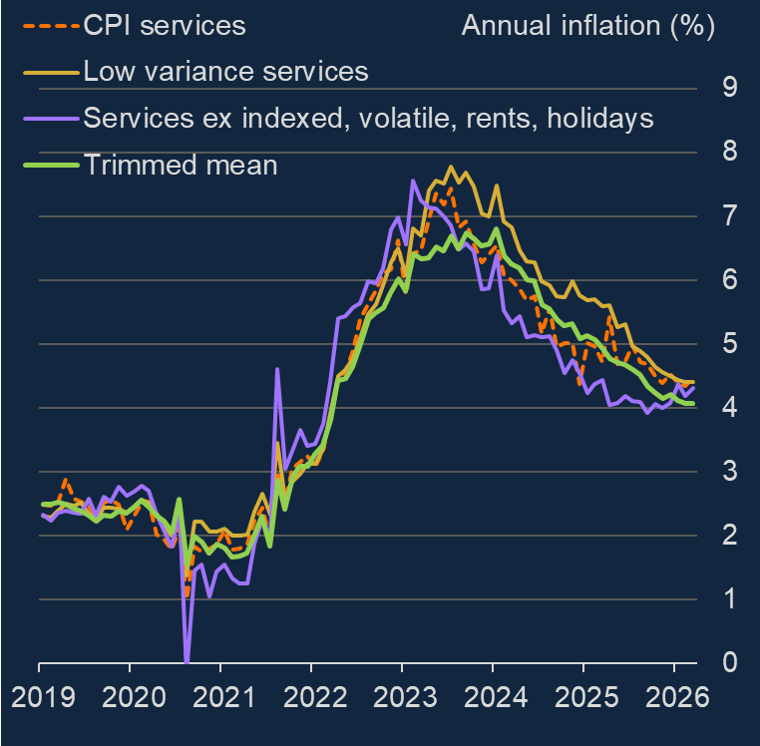
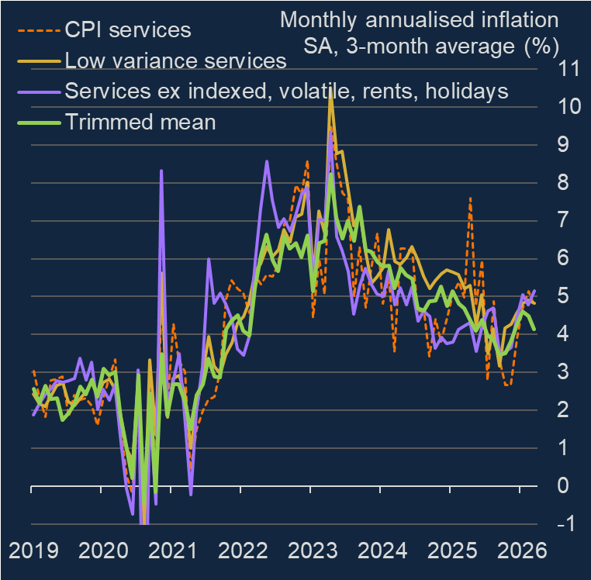
The process of disinflation was stalling before energy shock
Source: Bank of England, ONS

Slide 3
Scenarios and risks
 |  | Second-round effects
 |  | None | Some | Lots
Energy market situation | Futures curve | Scenario A
 | Adverse |  | Scenario B
 | Severe |  |  | Scenario C

Slide 4
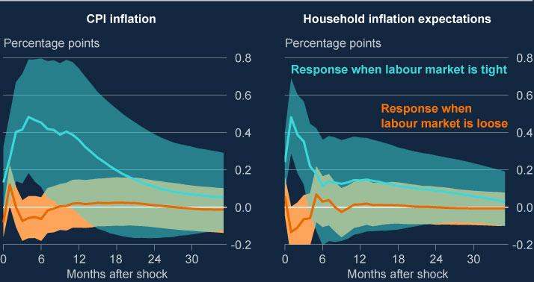
Looser labour market may dampen second-round effects …
Source: Bank of England Monetary Policy Report April 2026, Chart C.1

Slide 5
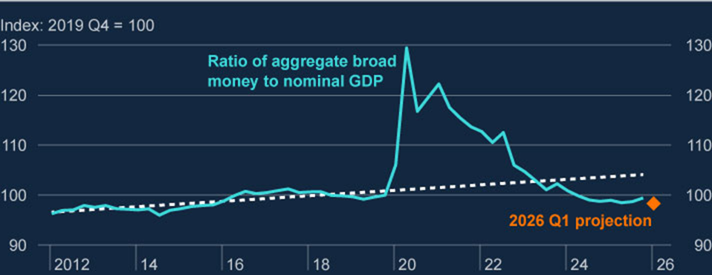
Broad money gap
Source: Bank of England Monetary Policy Report April 2026, Chart 1.17

Slide 6
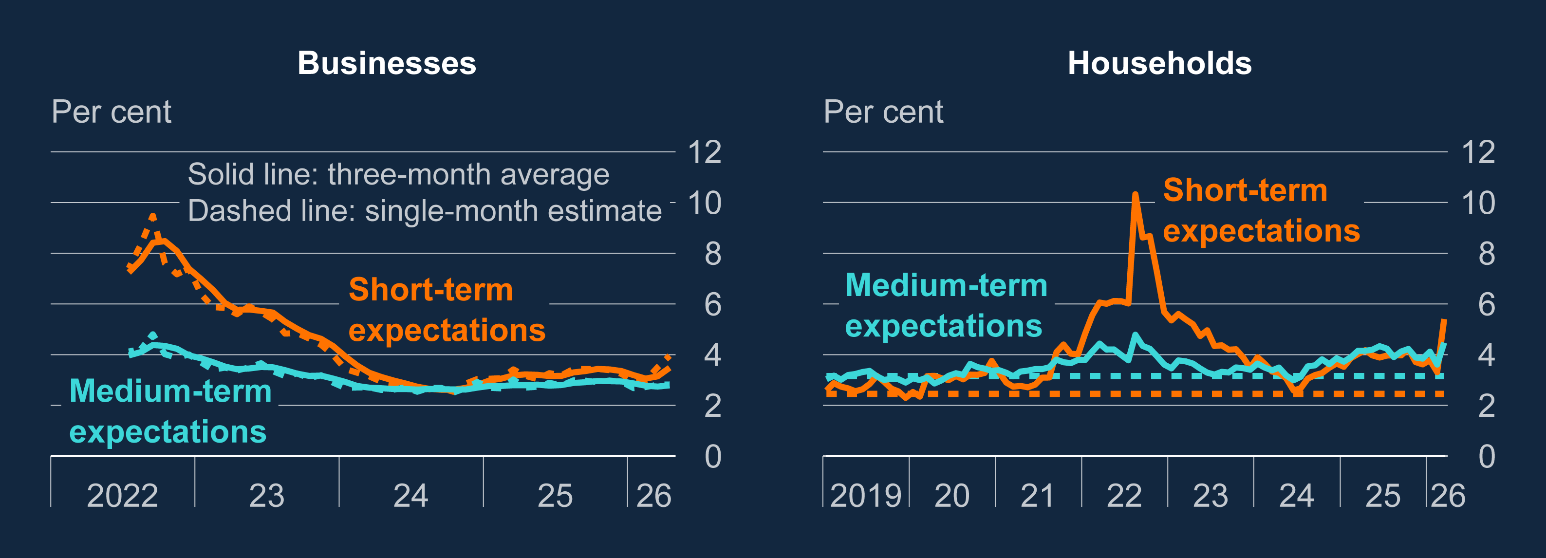
Greater attentiveness to and salience of recent price dynamics
Decision Maker Panel own price
and wage expectations
Households
Source: Bank of England Monetary Policy Report April 2026, Chart B.3 and Chart 1.7

Slide 7
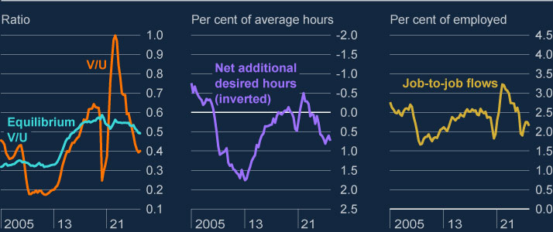
Labour market slack
Source: Bank of England Monetary Policy Report April 2026, Chart 1.13

