Slide 1

              Form BE
  This guide captures…
  Form BE – which collects information for all UK Monetary Financial Institutions (MFIs) with a deposit taking license
  It captures additional breakdowns of liabilities to and claims on UK residents other than MFIs disaggregated by sector and financial instruments.
                Additional Sectoral Detail
BE
Look out for this icon throughout the
presentation for extra information
Navigate through the presentation using
the icons in the bottom-right corner
Click on to take you back to the contents
                Part of Balance sheet and breakdowns from Bank of England’s Core Statistical Returns

Slide 2

    Contents
      Overview
      Family of Statistical Returns
      Form content
      How are the data used?
      Common Reporting Issues
      Form Reconciliations
      Timetable
      Resources
      Contact details

Slide 3
    BE overview
Monthly: Private sector business > £1bn, also any reporter required to submit IC, IO or IS
11 working days after month end for reporters, 12 working days after month-end for concessions reporters
16 working days after month end
Monetary aggregates published in Bankstats,
More detailed analysis for monetary policy and financial stability
      Reporting panel
      Reporting deadline
      Data finalised for publication
      Main uses

Slide 4
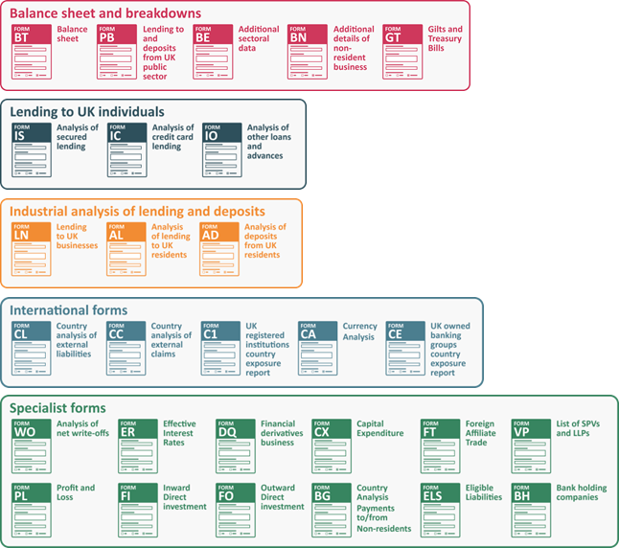

    Family of Bank of England Core Statistical Returns

Slide 5
Other Financial Corporations
Private Non-Financial Corporations
Households including:
Individuals and Individual Trusts
Unincorporated Businesses
Non-Profit Institutions Serving Households
Form content:
Sectors
UK Residents other than MFIs on the balance sheet is split by sector:

Slide 6
Monetary policy e.g. creating the Bank’s preferred M4ex & M4Lex measure
Removes intermediate other financial corporations (OFCs) from the overall M4 & M4L measure
Financial stability e.g. studying the effects of lending on the economy
Link to explanatory notes:
Further details about M4 excluding intermediate other financial corporations (OFCs) data | Bank of England
Further details about M4 lending excluding lending to intermediate other financial corporations data | Bank of England
How are the data used
Monetary Policy Committee

Slide 7
How are the data used
Money and Credit Statistical Release
Inflation Report
Financial Stability Report
Credit Conditions Review
Quarterly Bulletin
Bankstats
ONS – National Accounts
ECB
IMF
BoE publications
External publications

Slide 8
Common Reporting Issues
Loans should be reported at nominal value,
Investments should generally be reported at market value (long positions net of short positions),
If you are aware of any one-off revaluations of investments which are not reported at market value, please inform us.
Loans and investments

Slide 9
Common Reporting Issues
Securitisations
Securitised loans should remain on balance sheet for MFI reporting
There are several BE boxes for positions relating to securitisation:
Loans securitised to SPVs (BE29DB1/2/3A2/3A3/3A4 W or X, BE29D2AW/X)
As securitised loans remain on balance sheet for reporting purposes, there needs to be an offsetting liability created so that the balance sheet balances – and this should be reported in deposits from other UK residents (BE2H/BE3H).
Worked examples are available from the website see:
SPV worked examples

Slide 10
Common Reporting Issues
Classification / reporting issues
Public sector business should not be reported in form BE
e.g. Transport for London should not be reported in BE
Financial Subsidiaries
If a financial subsidiary’s sole function is to raise money for a parent company, it should be classified under the same activity as its owner
e.g. Shell Finance should be reported in PNFC not OFC
Property
If the loan is to an individual this should be recorded in Households
Only loans to businesses are recorded in PNFCs. Real estate companies will be recorded in PNFCs

Slide 11
Form Reconciliations
AD/AL, BE and BT form reconciliations
AD/AL categories | NFCs (1-14) | OFCs (15-17) | Individuals (18)
OFCs (1) |  | X
PNFCs (2) | X
Individuals (3a) |  |  | X
UBs (3b) | X | X
NPISH (4) | X | X
Public Sector | X | X
BE categories
BT

Slide 12
    Reporting deadlines for monthly forms
PB
BT
Bankstats, Money and Credit release
Public
Sector
embargo
BN
GT
Embargo
(For reporters submitting a BT later than +9)
(For PB
reporters)
Working days in the month
6
7
8
9
10
11
12
13
14
15
16
17
18
19
20
21
BT
BE
AD
AL
IS
IC
IO
ER
LN
VP
WO

Slide 13
BE definitions
General notes and definitions
Classification of Accounts guide (residency guidance)
SPV worked examples
Resources

Slide 14
Contacts
Monetary Statistics queries
dsd_ms@bankofengland.co.uk
DSD MCG Industrial –
DSD-MCG-Industrial@bankofengland.co.uk

