Slide 1

              Form WO
  This guide captures…
  Form WO – which collects information for all UK Monetary Financial Institutions (MFIs) with a deposit taking license
  It captures additional breakdowns write offs by UK residents, non-resident deposit taking corporations and other non-residents
                Analysis of Net Write Offs
WO
Look out for this icon throughout the
presentation for extra information
Navigate through the presentation using
the icons in the bottom-right corner
Click on to take you back to the contents
                Part of Balance sheet and breakdowns from Bank of England’s Core Statistical Returns

Slide 2

    Contents
      Overview
      Family of Statistical Returns
      Form content
      How are the data used?
      Common Reporting Issues
      Timetable
      Resources
      Contact details

Slide 3
Quarterly: Discretionary, but generally write-offs over the previous year exceeding £10mn
20 working days after month end on the quarter for reporters
16 working days two months after month end on the quarter (Sep data will be finalised during Oct data collection period)
Monetary aggregates published in Bankstats,
More detailed analysis for monetary policy and financial stability
    WO overview
      Reporting panel
      Reporting deadline
      Data finalised for publication
      Main uses

Slide 4

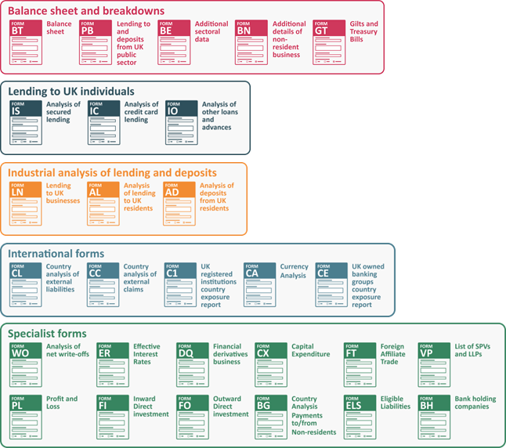

    Family of Bank of England Core Statistical Returns
WO

Slide 5
UK Residents
Banks and Building Societies
MFIs other than Banks and Building Societies
Central Government
Local Authorities
Public Corporations
Financial Corporations
Individuals and Individual Trusts
Unincorporated Businesses
Non-Profit Institutions Serving Households
Non-Resident Deposit Taking Corporations
Other Non-Residents
Form content:
Sectors
UK Residents on the balance sheet is split by sector and some industry. It also captures
non-resident deposit taking corporations and other non-residents:

Slide 6
Included within the aggregates that are used when looking at monetary policy e.g. creating the Bank’s preferred M4ex & M4Lex measure
Financial stability e.g. studying the effects of lending on the economy
Link to explanatory notes:
Further details about write-offs and other revaluations of loans by monetary financial institutions data
How are the data used
Monetary Policy Committee

Slide 7
How are the data used
Included within the data as part of:
Money and Credit Statistical Release
Inflation Report
Financial Stability Report
Credit Conditions Review
Quarterly Bulletin
Bankstats
ONS – National Accounts
ECB
IMF
BoE publications
External publications

Slide 8
Common Reporting Issues
Write-offs should be reported on a net basis i.e. write offs plus write ons (write offs net of recoveries).
Write-offs should be reported as a positive, whereas write-ons should be reported as negative.
Write-offs should not include provisions against bad debts, or impairment charges, although it is likely that most loans written off will have been provided for previously.
Loans and investments

Slide 9
    Reporting deadlines for monthly forms
PB
BT
Bankstats, Money and Credit release
Public
Sector
embargo
BN
GT
Embargo
(For reporters submitting a BT later than +9)
(For PB
reporters)
Working days in the month
6
7
8
9
10
11
12
13
14
15
16
17
18
19
20
21
BT
BE
AD
AL
IS
IC
IO
ER
LN
VP
WO

Slide 10
WO definitions
General notes and definitions
Classification of Accounts guide (residency guidance)
Resources

Slide 11
Contacts
Monetary Statistics queries
dsd_ms@bankofengland.co.uk
DSD MCG Industrial –
DSD-MCG-Industrial@bankofengland.co.uk

